Slide 1
INDIGENOUS SERVICES CANADA
REGIONAL DELIVERY SECTOR - ALBERTA
WATER AND WASTEWATER PROGRAM
May 26, 2026

Slide 2
Overview
Organizational Structure
Who We Are
What We Do
Infrastructure Project Planning and Delivery
Annual Performance Inspections (API’s)
Water Legislation and Litigation Files
Policy, Protocol and Guidelines Review
Provincial Working Groups
Operations and Maintenance
Drinking Water Advisory Group
Capacity Building Initiatives
Contact Information
Questions?

Slide 3
Organizational Structure
Jocelyn Andrews Director General
Alberta
Andrew Wujcik Director
Infrastructure, Lands, and Environment
Adam Kuehnbaum Engineering Manager
Water and Wastewater Infrastructure
Naman Boodram Capital Manager
(Capital Planning, O&M, Housing)
Madison VanTassel Administration
Wei Ming Chew Senior Engineer
Felix Chan Senior Engineer
Carlyle Goetzie Project Officer
Christa Bergeron Project Officer
Diane Gramlich Project Officer

Slide 4
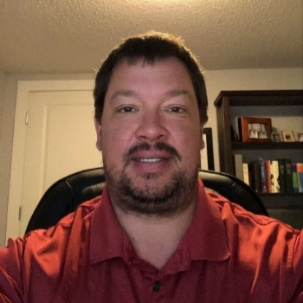
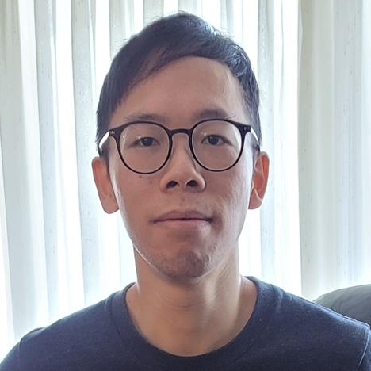

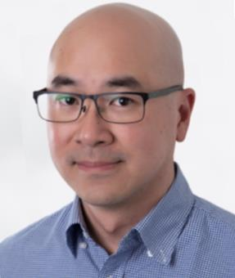
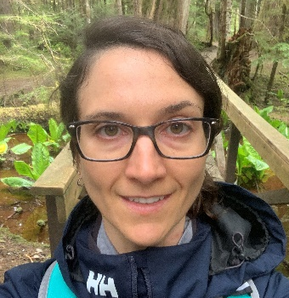
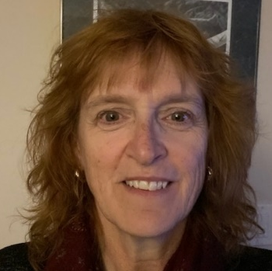
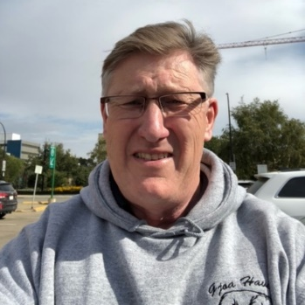
Who We Are
The water strategy team works in partnership with First Nations in Alberta to deliver water and wastewater projects funded through the First Nations Water and Wastewater Enhanced Program (FNWWEP).
Adam Kuehnbaum Engineering Manager
Felix Chan Senior Engineer
Madison VanTassell Capital Planning Officer
Wei Ming Chew Senior Engineer
Christa Bergeron Project Officer
Diane Gramlich Project Officer
Carlyle Goetzie Project Officer
Notes:
Photos of the team.

Slide 5
What We Do
Infrastructure Project Planning and Delivery
First Nation Infrastructure Investment Plan (FNIIP)
What is it?
It helps to identify the infrastructure needs and priorities and to strategically plan infrastructure investments in First Nation communities.
The National FNIIP is developed each year.
It is based on infrastructure investment plans at the community and regional level.
A First Nation will submit a community-level plan to a regional office in order to be considered in the National FNIIP.
Submission for the community-level plan is due October 15 but it can be updated throughout the year.
Capital projects are identified on FNIIP. They are divided into two categories:
Major Capital Projects
Minor Capital Projects
Our team is available to discuss FNIIP with Nations and assist them with infrastructure planning.

Slide 6
What We Do
Infrastructure Project Planning and Delivery
Major Capital Projects (Total Estimated Cost >$1.5M)
Feasibility Study
Look at current conditions of water infrastructure and develop options to meet objectives.
Options analysis must include a life cycle cost estimate (LCC) for each option.
LCC estimate must consider both the capital cost and the long-term operations and maintenance costs.
Project Approval Request (PAR) Development.
Projects <$30M require review and approval within the AB Region.
Projects >$30M require review and approval at headquarters.
Design
Once the PAR has been approved and funding secured, an engineering consultant is typically procured to design the recommended solution.
ISC Environment (RO) and Public Health (FNIHB) reviews.
TSAG involvement to provide operational recommendations
Process typically takes one year.
Construction
A project can go out to tender to procure a contractor for construction.
Involvement of TSAG and FNIHB critical at commissioning step.
Construction of new water and wastewater system typically takes two years.

Slide 7
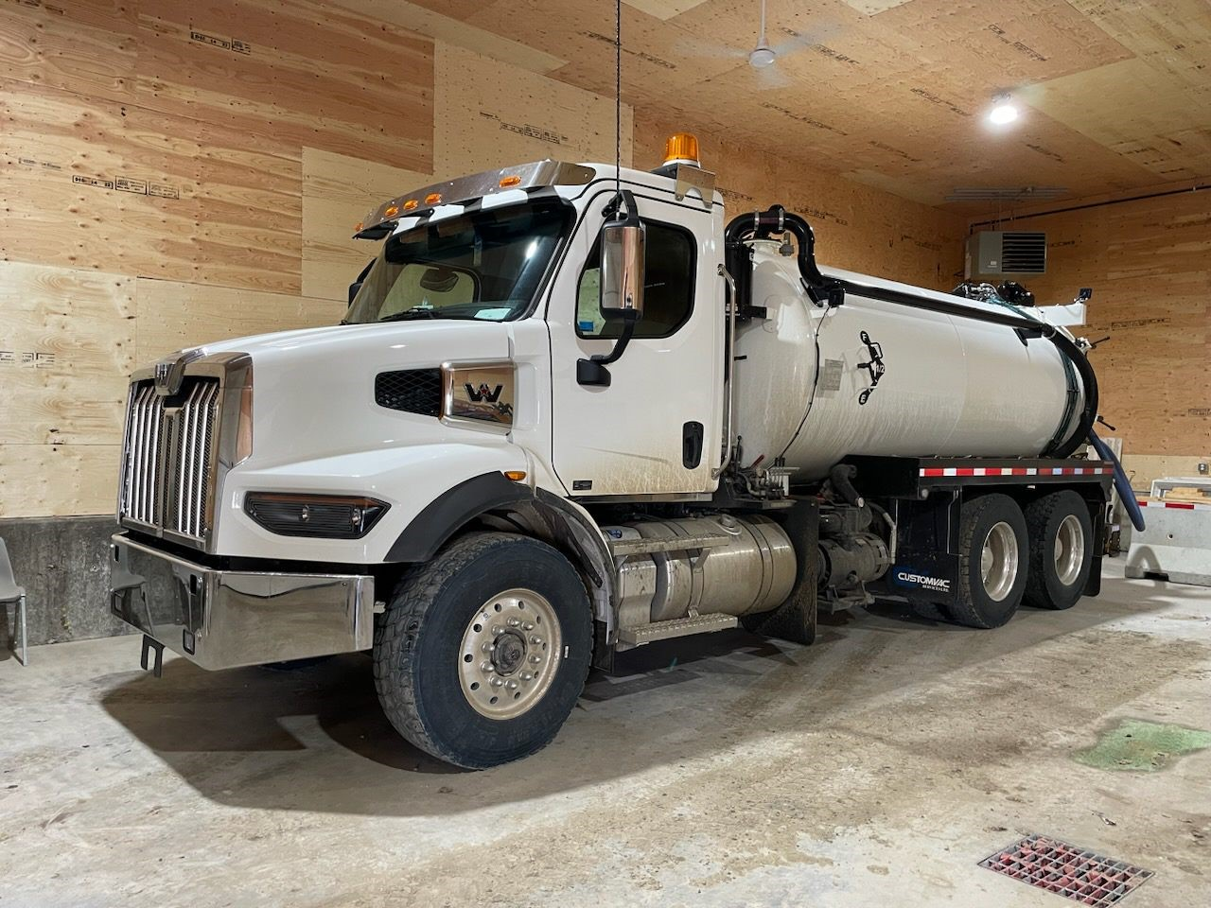
What We Do
Infrastructure Project Planning and Delivery
Minor Capital Projects (Total Estimate Cost <$1.5M)
Nations work with our Senior Engineer or Project Officer on options to secure funding.

Slide 8
What We Do
Infrastructure Project Planning and Delivery
First Nation Water and Wastewater Enhanced Program (FNWWEP)
FNIIP projects are funded under the FNWWEP program
Fiscal Year 2025/26 budget
$137M
Fiscal Year 2026/27 budget
$91M (team is supporting 176 active projects so far this year).
FNWWEP program must be delivered according to the Capital Facilities and Management Program (CFMP)
CFMP is the ‘rule book’ for the use of program funds
Outlines requirements for Feasibility Study, Design, Construction phases, PAR requirements and procurement policies
Tendering Policy
Professional Services
<$150K – sole source with demonstration of value for money
$150K to $650K – invited tender
>$650K – open public tender
Construction Services, varies and is based on remoteness index.
In general:
<$250K – sole source with demonstration of value for money
$250K to $1M – invited tender
>$1M – open public tender
Various other thresholds depending on procurement strategy (CM, own forces)

Slide 9
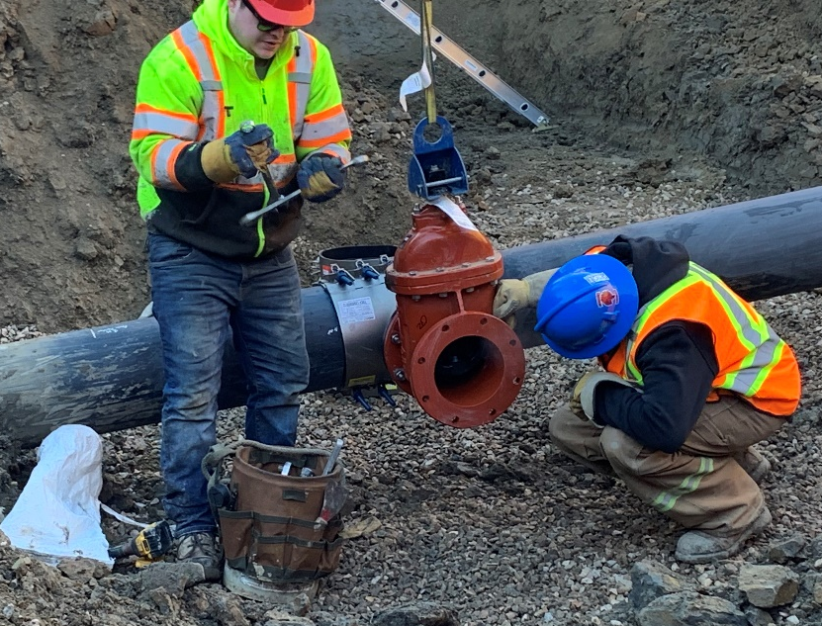
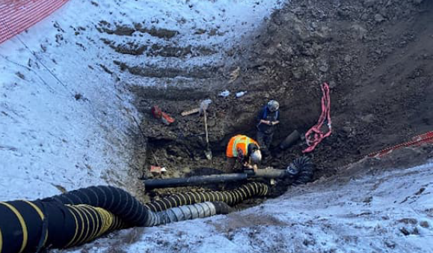
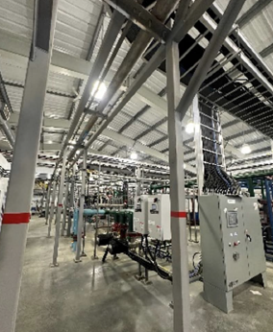
Kehewin Cree Nation
Water Phase 2
Engineer: WSP
Contractor: Options Excavating
Approximately 13km of 200 mm diameter mainline
110 waterline ties in and removal of cistern and trucking service
Install a PSV at the WTP and upgrade SCADA system
Over 10% of contract value invested back into Kehewin through local content commitments

Slide 10
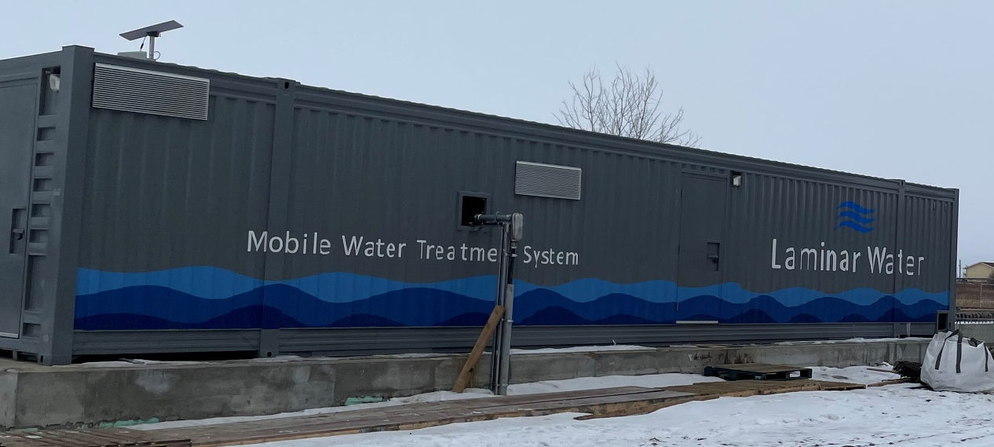
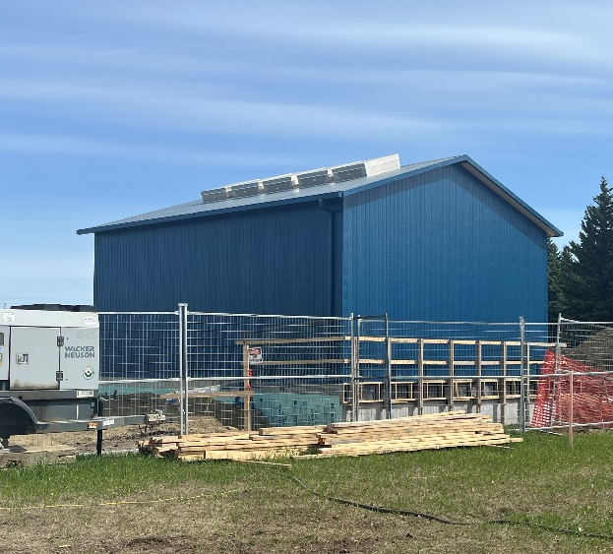
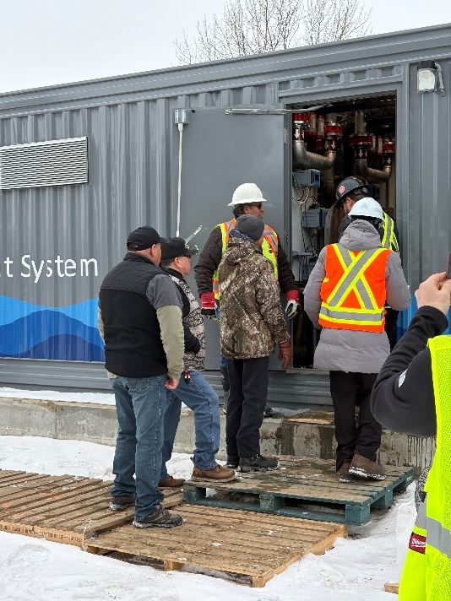
Louis Bull Band
Interim Water Treatment Plant
Engineer: WSP
Contractor: Laminar and Alpha Construction
New greensand filtration containerized treatment system
New pumphouse for distribution including reservoir expansion
WTP commissioned in January/February 2026

Slide 11
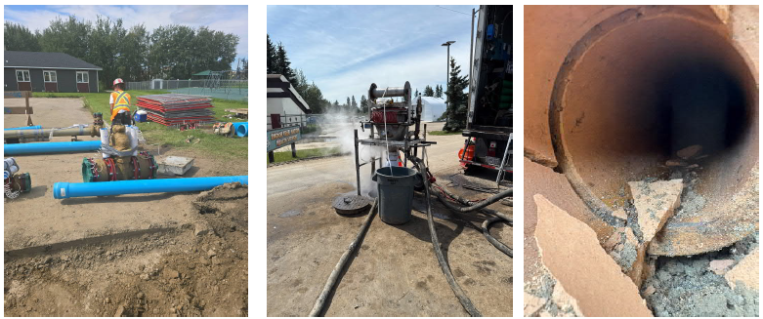
Enoch Cree Nation
Village Core Area – Water and Sewer Upgrades
Engineer: M2
Contractor: Pidherney’s
Project completed on time and on budget
1150 m of new sanitary sewer and 850 m CIPP sewer lining
925 m of replaced water mainline
25 services replaced
CEA Award recipient

Slide 12
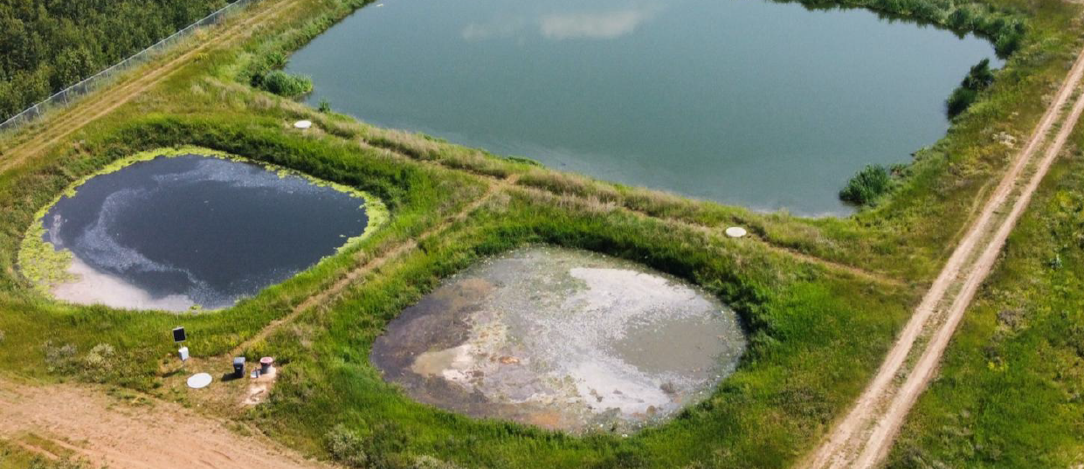
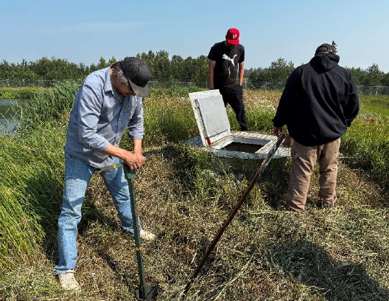
Saddle Lake Cree Nation
Lagoon Desludging
Engineer: ISL
Contractor: Lambourne
Approximately 650 m3 of sludge within anaerobic cells removed
Ongoing project to repair damaged liner in facultative cell and increase facultative treatment capacity while restoring flow to the storage cell

Slide 13
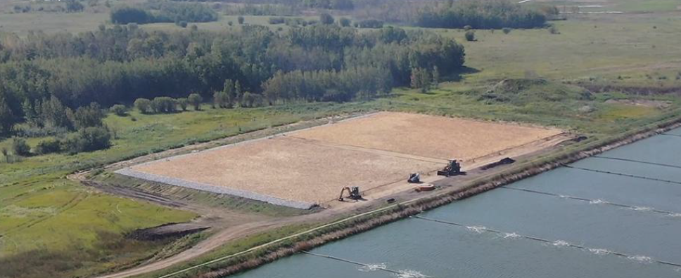
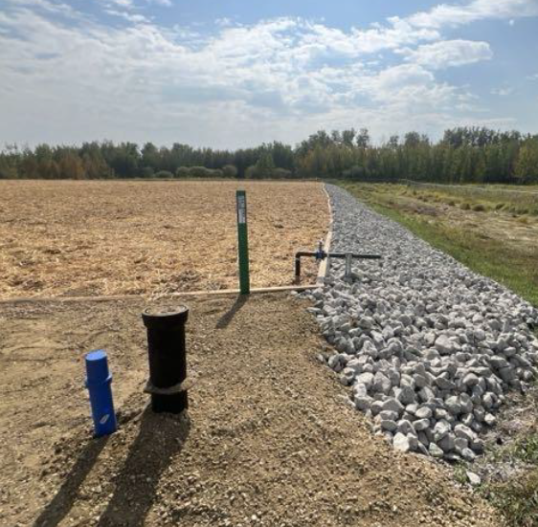
Samson Cree Nation
SAGR Cell Grass Fire Damage Repairs
Insurance Adjuster: Coast Claims
Engineer: Urban Systems
Contractor: Nexom, Nu Edge and Elgie & Sons
Support with bypass authorization to ECCC
Repair piping and HDPE liner damage
Replace insulation on control structures
Add firebreak around cells

Slide 14

What We Do
Annual Performance Inspections (API’s)
Neegan Burnside Report
An Initial National Assessment was completed by Neegan Burnside in 2009/10 and 2010/11.
A report was sent out to each First Nation.
Annual Performance Inspections
Completed on an annual basis.
Have been led by FNTSAG since 2011/12.
Summary letters are sent to Chief and Council with cc to Public Works Directors annually
API’s identify risks associated with water and wastewater systems.
Risks are categorized under five different headings.
The weighted risk for each category is combined to calculate an overall risk for each system.
Each system is identified as a high, medium, or low risk system.
WATER
Source Water – 10%
Design – 30%
Operations – 30%
Reporting – 10%
Operators – 20%
WASTEWATER
Effluent Receiver – 20%
Design – 25%
Operations – 25%
Reporting – 10%
Operators – 20%

Slide 15
What We Do
2025/26 API Results
Water Systems:
2 High Risk System
17 Medium Risk Systems
49 Low Risk Systems
Wastewater Systems:
6 High Risk Systems
38 Medium Risk Systems
21 Low Risk Systems

Slide 16
What We Do
Litigation Files
Team works with the Litigation Management Resolution Branch and the Department of Justice on various litigation files in the Region.
Policy, Protocol and Guideline Review
Team works with the ISC Strategic Water Management (SWM) team in HQ on review and updates to policies and protocols
Provincial Working Groups
Government of Alberta First Nation Regional Water Tie-In Program
Partnership with AB Indigenous Relations and AB Transportation
Funding targeted to support a potable water supply to FN boundary.
Program is opportunity driven (5 communities connected to date).
ISC is responsible for project costs that fall within the boundary of the FN.
GOA has allocated ~$100M for the program, which is reported to be fully allocated.

Slide 17
What We Do
Operations and Maintenance (O&M)
O&M funding is a subsidy to assist with operations and maintenance costs for eligible assets.
Funding is based on a national asset formula which takes into account factors such as the geographical location and proximity to city centers.
A review of the full formula was completed by headquarters and resulted in significant increases in the O&M funding provided.
Water and wastewater assets are now funded at 100% of the amount calculated by the formula.
bills for purchase of water from a regional water system are considered an eligible O&M expense and covered under the O&M program
A new tool has been developed to outline the labour component (in $) included in the O&M provided for water and wastewater
O&M funding levels are shared with leadership and portfolio holders at the start of every year.
Tracey Travis (Regional Program Development Advisor) leads the O&M program for Alberta Region.

Slide 18
What We Do
Drinking Water Advisory (DWA) Group
Regional Drinking Water Advisory (DWA) Group
An Initial National Assessment was initiated in 2010/11.
Collaborative approach in rectifying DWA issues.
Participants include:
ISC
ISC FNIHB
TSAG - CRTP
Meetings are held weekly to review the ISC FNIHB report.
Discuss common issues to resolve past, current, and outstanding drinking water advisories.
Work collaboratively to develop DWA Work Plans with the goal to mitigate ALL DWA’s.

Slide 19
Contact Information
Andrew Wujcik Director, Infrastructure, Lands and Environment
andrew.wujcik@sac-isc.gc.ca
Adam Kuehnbaum Engineering Manager, Water & Wastewater Infrastructure
adam.kuehnbaum@sac-isc.gc.ca
Naman Boodram Capital Manager
naman.boodram@sac-isc.gc.ca
Tracey Travis Acting Regional Program Development Advisor (O&M)
tracey.travis@sac-isc.gc.ca

Slide 20
Questions?

