Slide 1


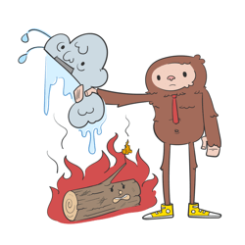

v
Fire Safety Course: K4-Gr3 Practice Makes Perfect!
First Nations
Technical Services
Advisory Group Inc.
Notes:
Added

Slide 2



Smoke Alarms Save Lives!
Beep!
Beep!
Beep!
tsag.net
Notes:
There are different types of smoke detectors. Some beep and others talk to you. Even though they may sound different they all have the same parts and all have test buttons.
Most smoke alarms make a loud Beep Beep Beep!
Smoke detectors are loud because it needs to warn everyone in the house-no matter where they are or what they are doing, even sleeping.

Slide 3

Make a Plan!
<iframe width="1128" height="635" src="https://www.youtube.com/embed/Vc-AkbpdSYk" title="Every Second Counts in a Home Fire—Practice Your Escape Plan" frameborder="0" allow="accelerometer; autoplay; clipboard-write; encrypted-media; gyroscope; picture-in-picture; web-share" referrerpolicy="strict-origin-when-cross-origin" allowfullscreen></iframe>
tsag.net

Slide 4
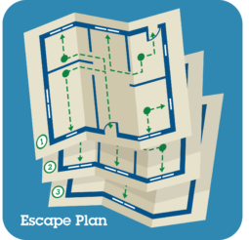
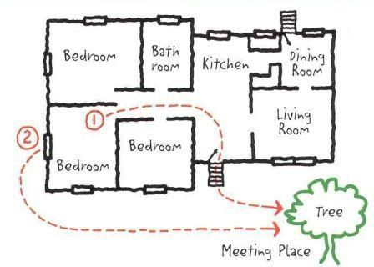
Plan Your Fire Escape
tsag.net
Notes:
Make sure your whole family knows your Fire Escape Plan.
Draw it out.
Talk about it.
Post it where everyone can see it.
Practice it.

Slide 5
Do You Know What To Do?
<iframe width="1128" height="635" src="https://www.youtube.com/embed/wlmGzmmYZfk" title="Fire Escape Plan A" frameborder="0" allow="accelerometer; autoplay; clipboard-write; encrypted-media; gyroscope; picture-in-picture; web-share" referrerpolicy="strict-origin-when-cross-origin" allowfullscreen></iframe>
tsag.net

Slide 6
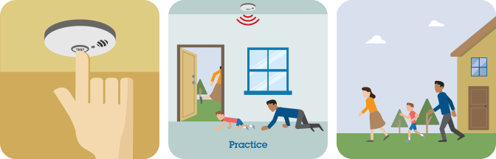
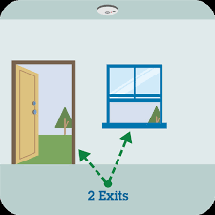
Practice Your Fire Escape
tsag.net
Notes:
Make sure your smoke alarm works.
Beep beep beep! means it works.
Chirp! means the battery needs to be replaced.
Know two ways out of every room.
This is usually a door way and a window.
Practice your escape.
Get Low & Go if there is smoke.

Slide 7
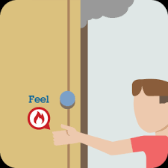
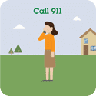
Get Out & Stay Out
tsag.net
Notes:
Keep doors closed if they are hot and escape another way.
Shut doors behind you as you leave the home.
Get out and stay out!
Go to the meeting spot.
Call 911 or the emergency number in your area.

