Slide 1


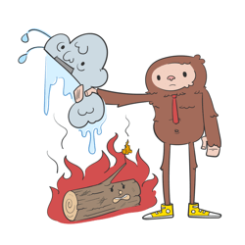

v
Fire Safety Course: K4-Gr3 Practice Makes Perfect!
First Nations
Technical Services
Advisory Group Inc.
Notes:
Added

Slide 2



Smoke Alarms Save Lives!
Beep!
Beep!
Beep!
tsag.net
Notes:
There are different types of smoke detectors. Some beep and others talk to you. Even though they may sound different they all have the same parts and all have test buttons.
Smoke detectors are loud because it needs to warn everyone in the house-no matter where they are or what they are doing, even sleeping.

Slide 3

Plan Your Escape
<iframe width="1280" height="720" src="https://www.youtube.com/embed/2CFiL0FAggg" title="FSRI: Plan Your Escape: Single-Story Home Fire" frameborder="0" allow="accelerometer; autoplay; clipboard-write; encrypted-media; gyroscope; picture-in-picture; web-share" referrerpolicy="strict-origin-when-cross-origin" allowfullscreen></iframe>
tsag.net
Notes:
What should you do if you hear a smoke alarm?
Where should there be smoke detectors in every house?
What about if you smell smoke but don’t hear an alarm?
What do you think you should do if you smell smoke or see a fire starting on the stove or in another area of your house? (Yell fire and get an adult)

Slide 4
Close Doors
<iframe width="1280" height="720" src="https://www.youtube.com/embed/bSP03BE74WA" title="See the Dramatic Difference a Door Can Make" frameborder="0" allow="accelerometer; autoplay; clipboard-write; encrypted-media; gyroscope; picture-in-picture; web-share" referrerpolicy="strict-origin-when-cross-origin" allowfullscreen></iframe>
tsag.net
Notes:
What should you do if you hear a smoke alarm?
Where should there be smoke detectors in every house?
What about if you smell smoke but don’t hear an alarm?
What do you think you should do if you smell smoke or see a fire starting on the stove or in another area of your house? (Yell fire and get an adult)

Slide 5
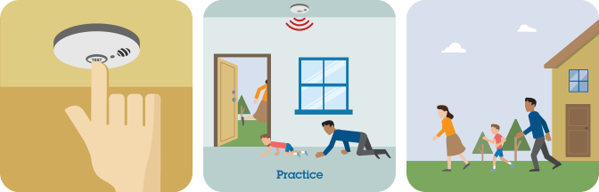
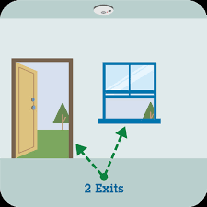
Practice Your Fire Escape
tsag.net
Notes:
Make sure your smoke alarm works.
Beep beep beep! means it works.
Know two ways out of every room - usually a door way and a window.
Get Low & Go if there is smoke.
Practice your escape twice a year.

Slide 6
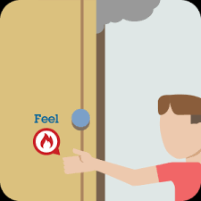
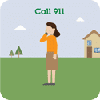
Get Out & Stay Out
tsag.net
Notes:
Keep doors closed if they are hot and escape another way.
Shut doors behind you as you leave the home to slow the spread of fire and give you more time to escape.
Get out and stay out! Do not go back in for anything – even your pet!
Go to the meeting spot – do not leave that spot until everyone in your household is there.
Call 911 or the emergency number in your area.

