Slide 1
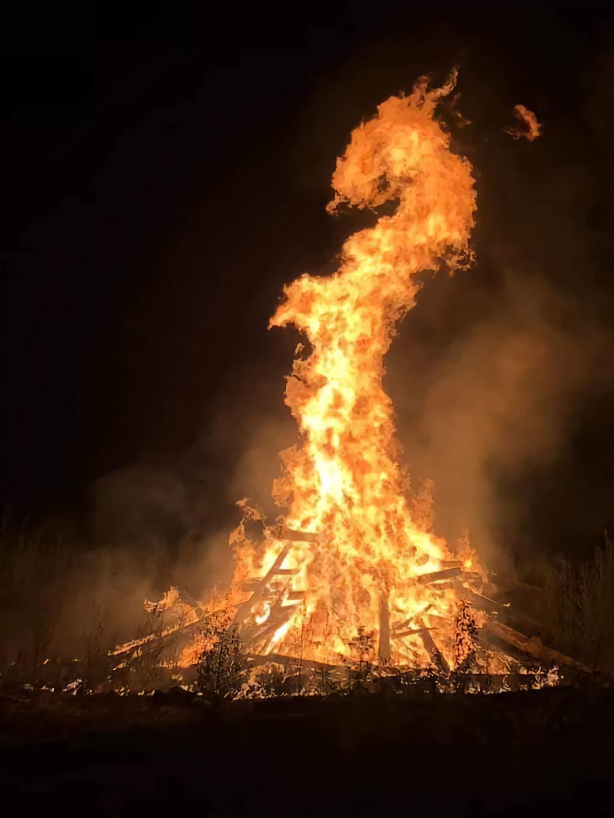
Jr Firefighter program
By Bigstone Fire Dept

Slide 2
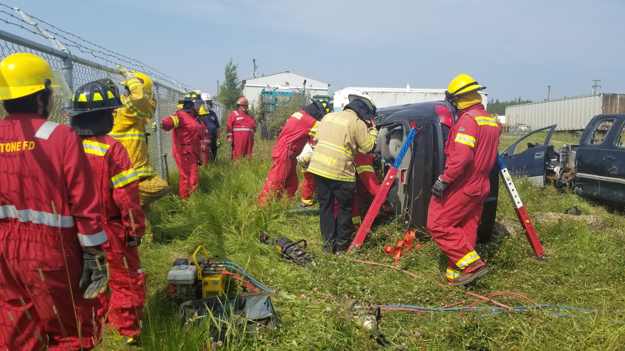
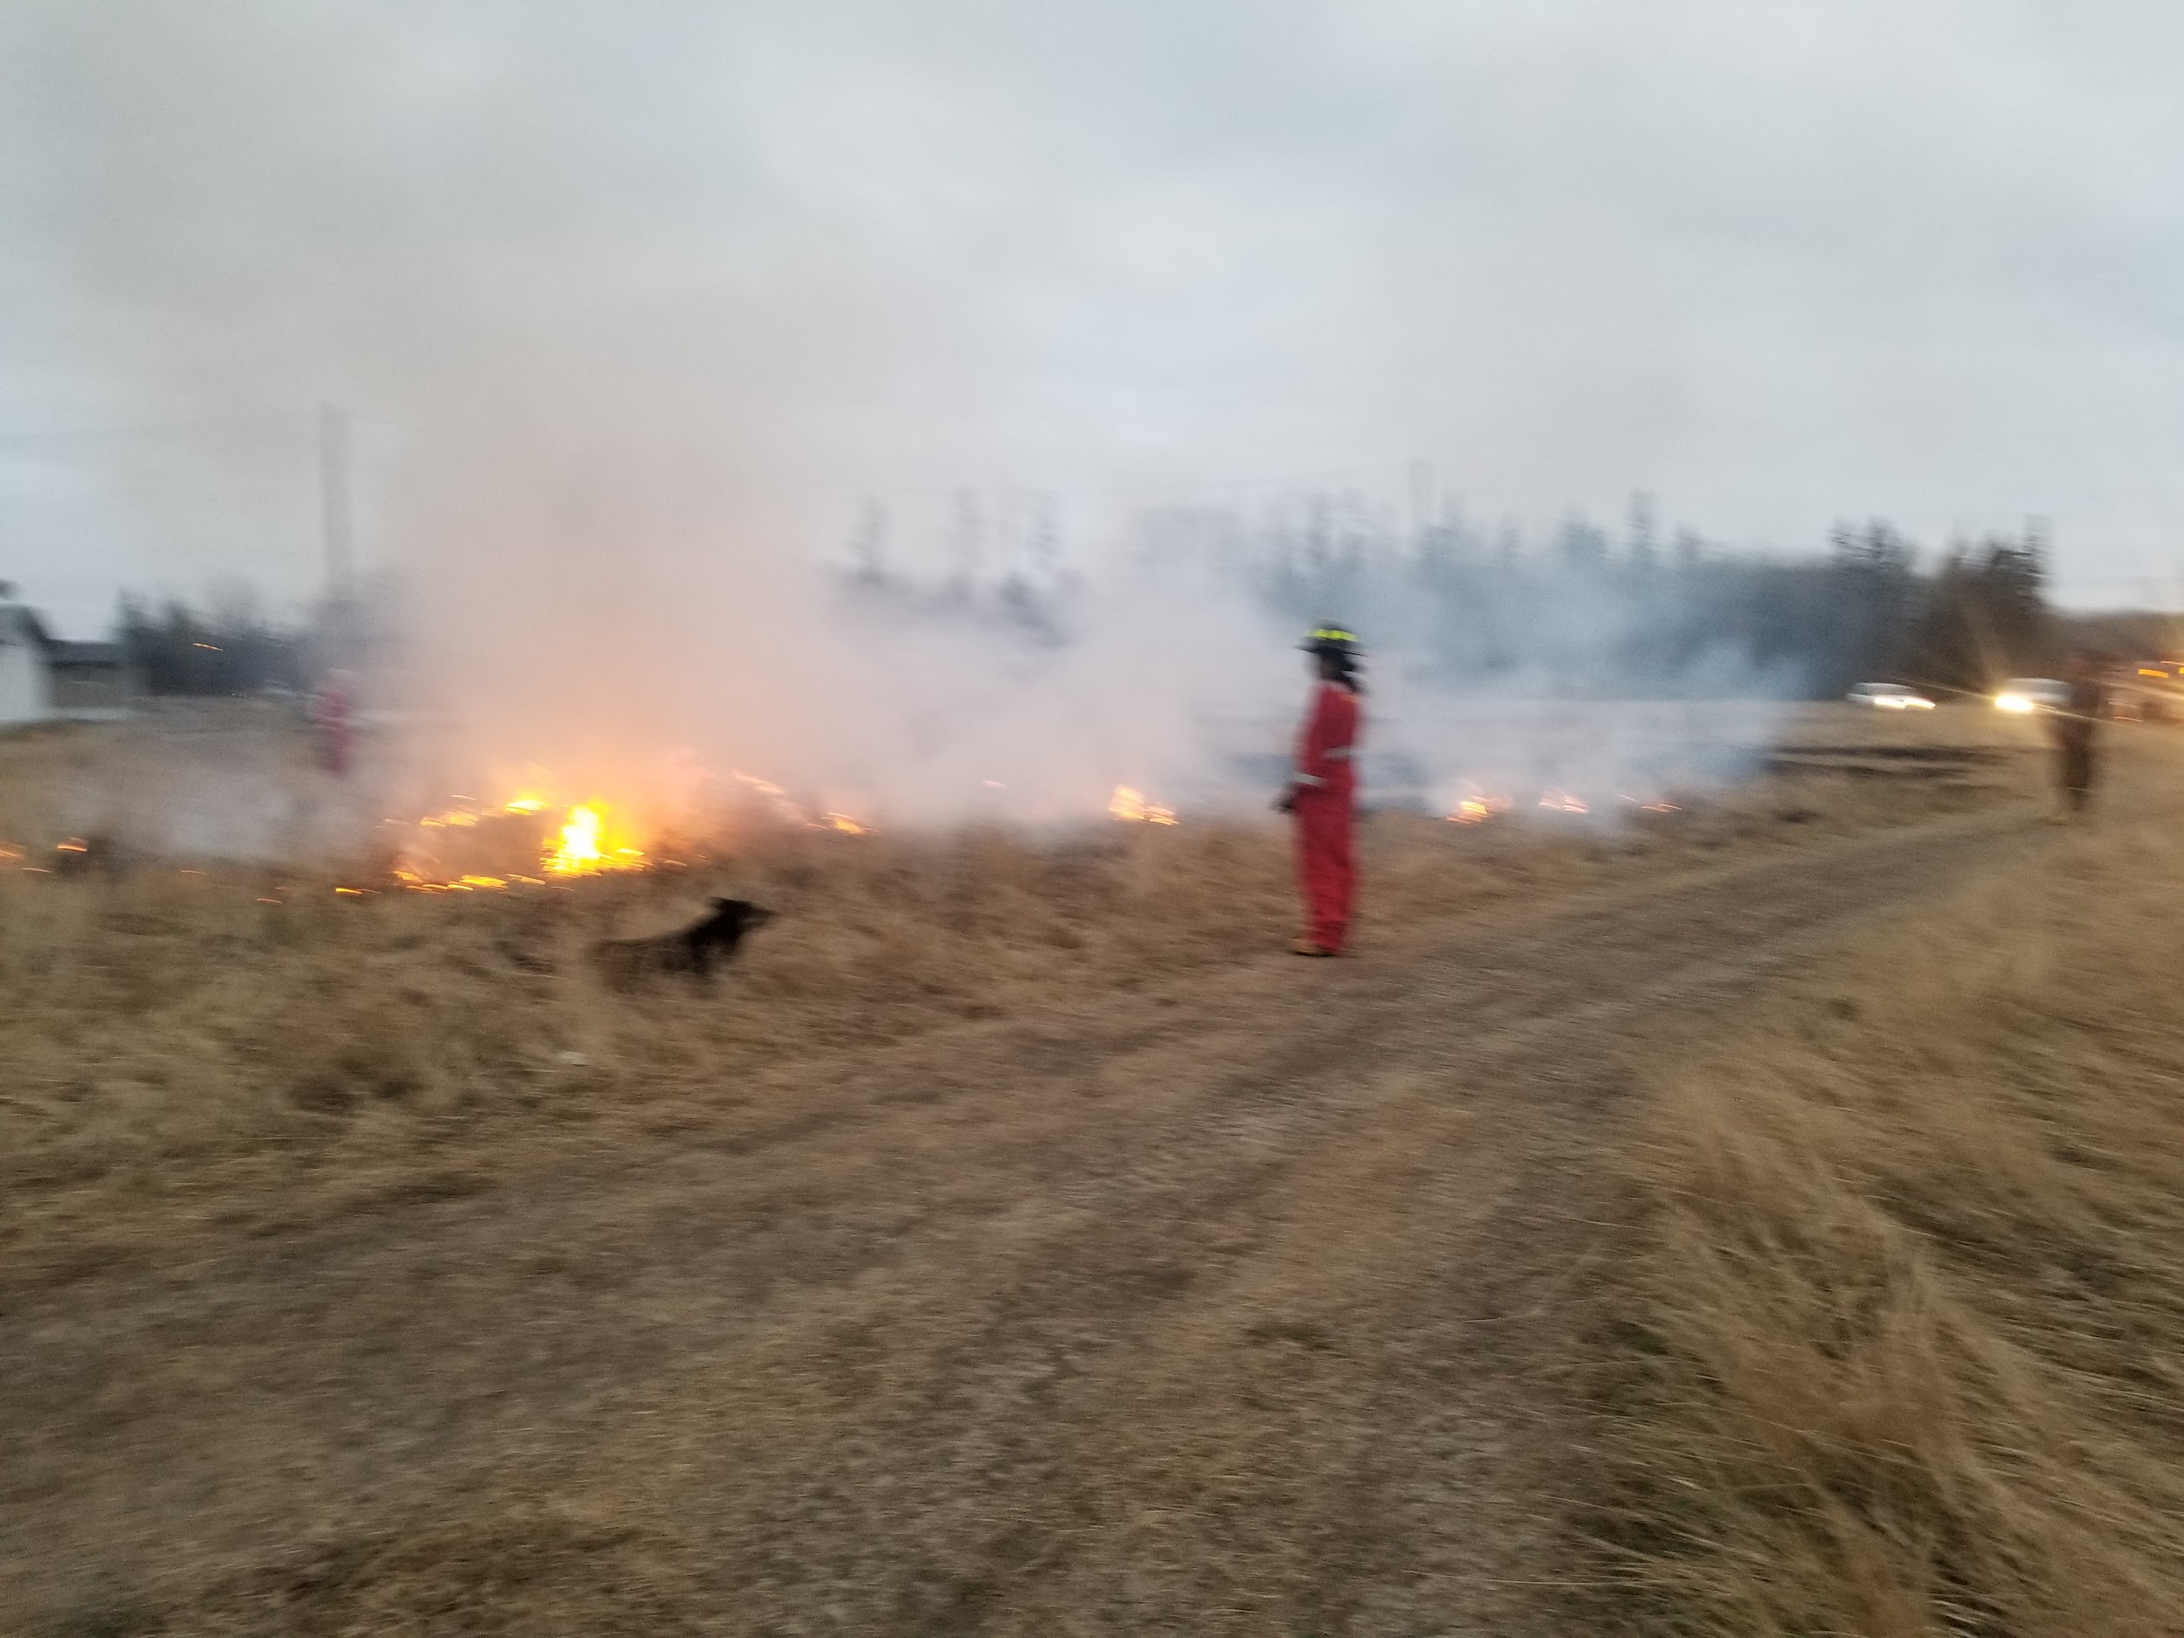
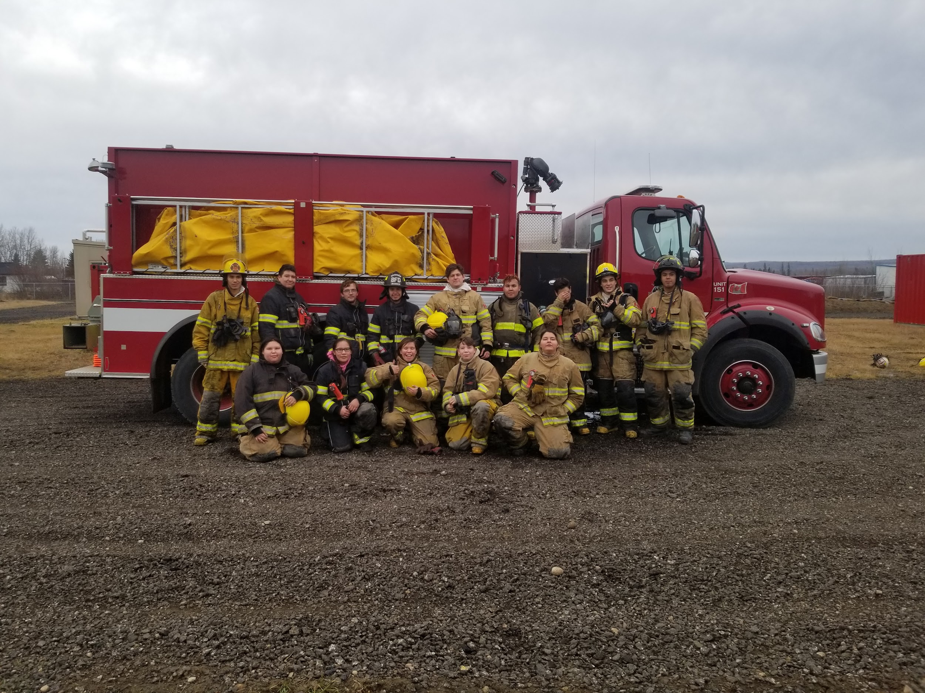
Requirements To Join The JR FireFighter program
Must be of age of 14 years old
Must have parents permission to join
Must fill out a Jr firefighter agreement
Must fill out an application and oath of confidentiality
Must Have No criminal record
Notes:
We can allow some with criminal charges depending on the station on the charges

Slide 3
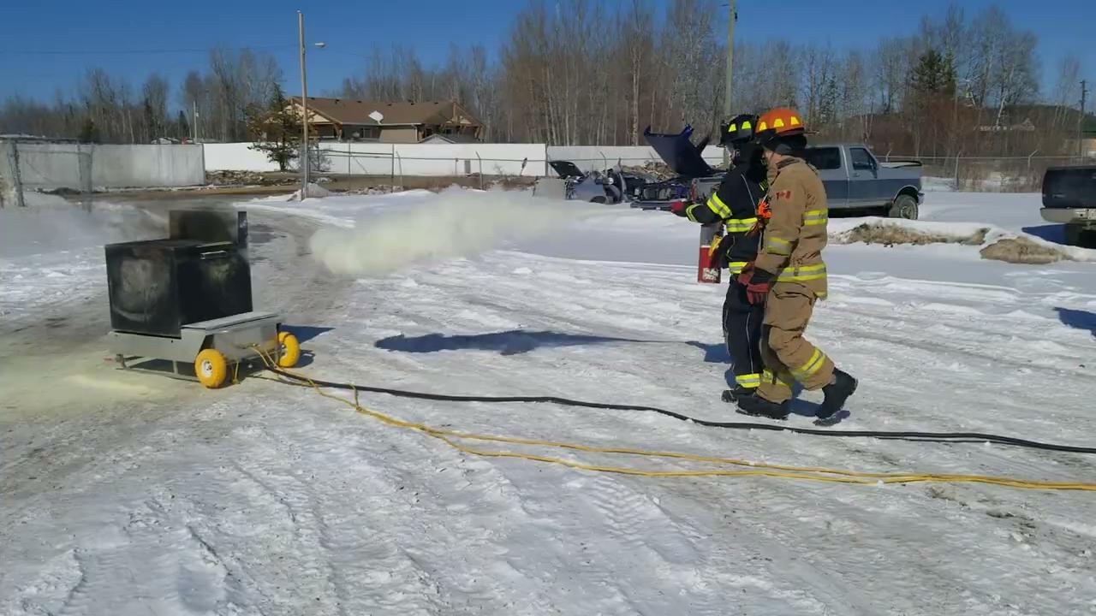

Slide 4
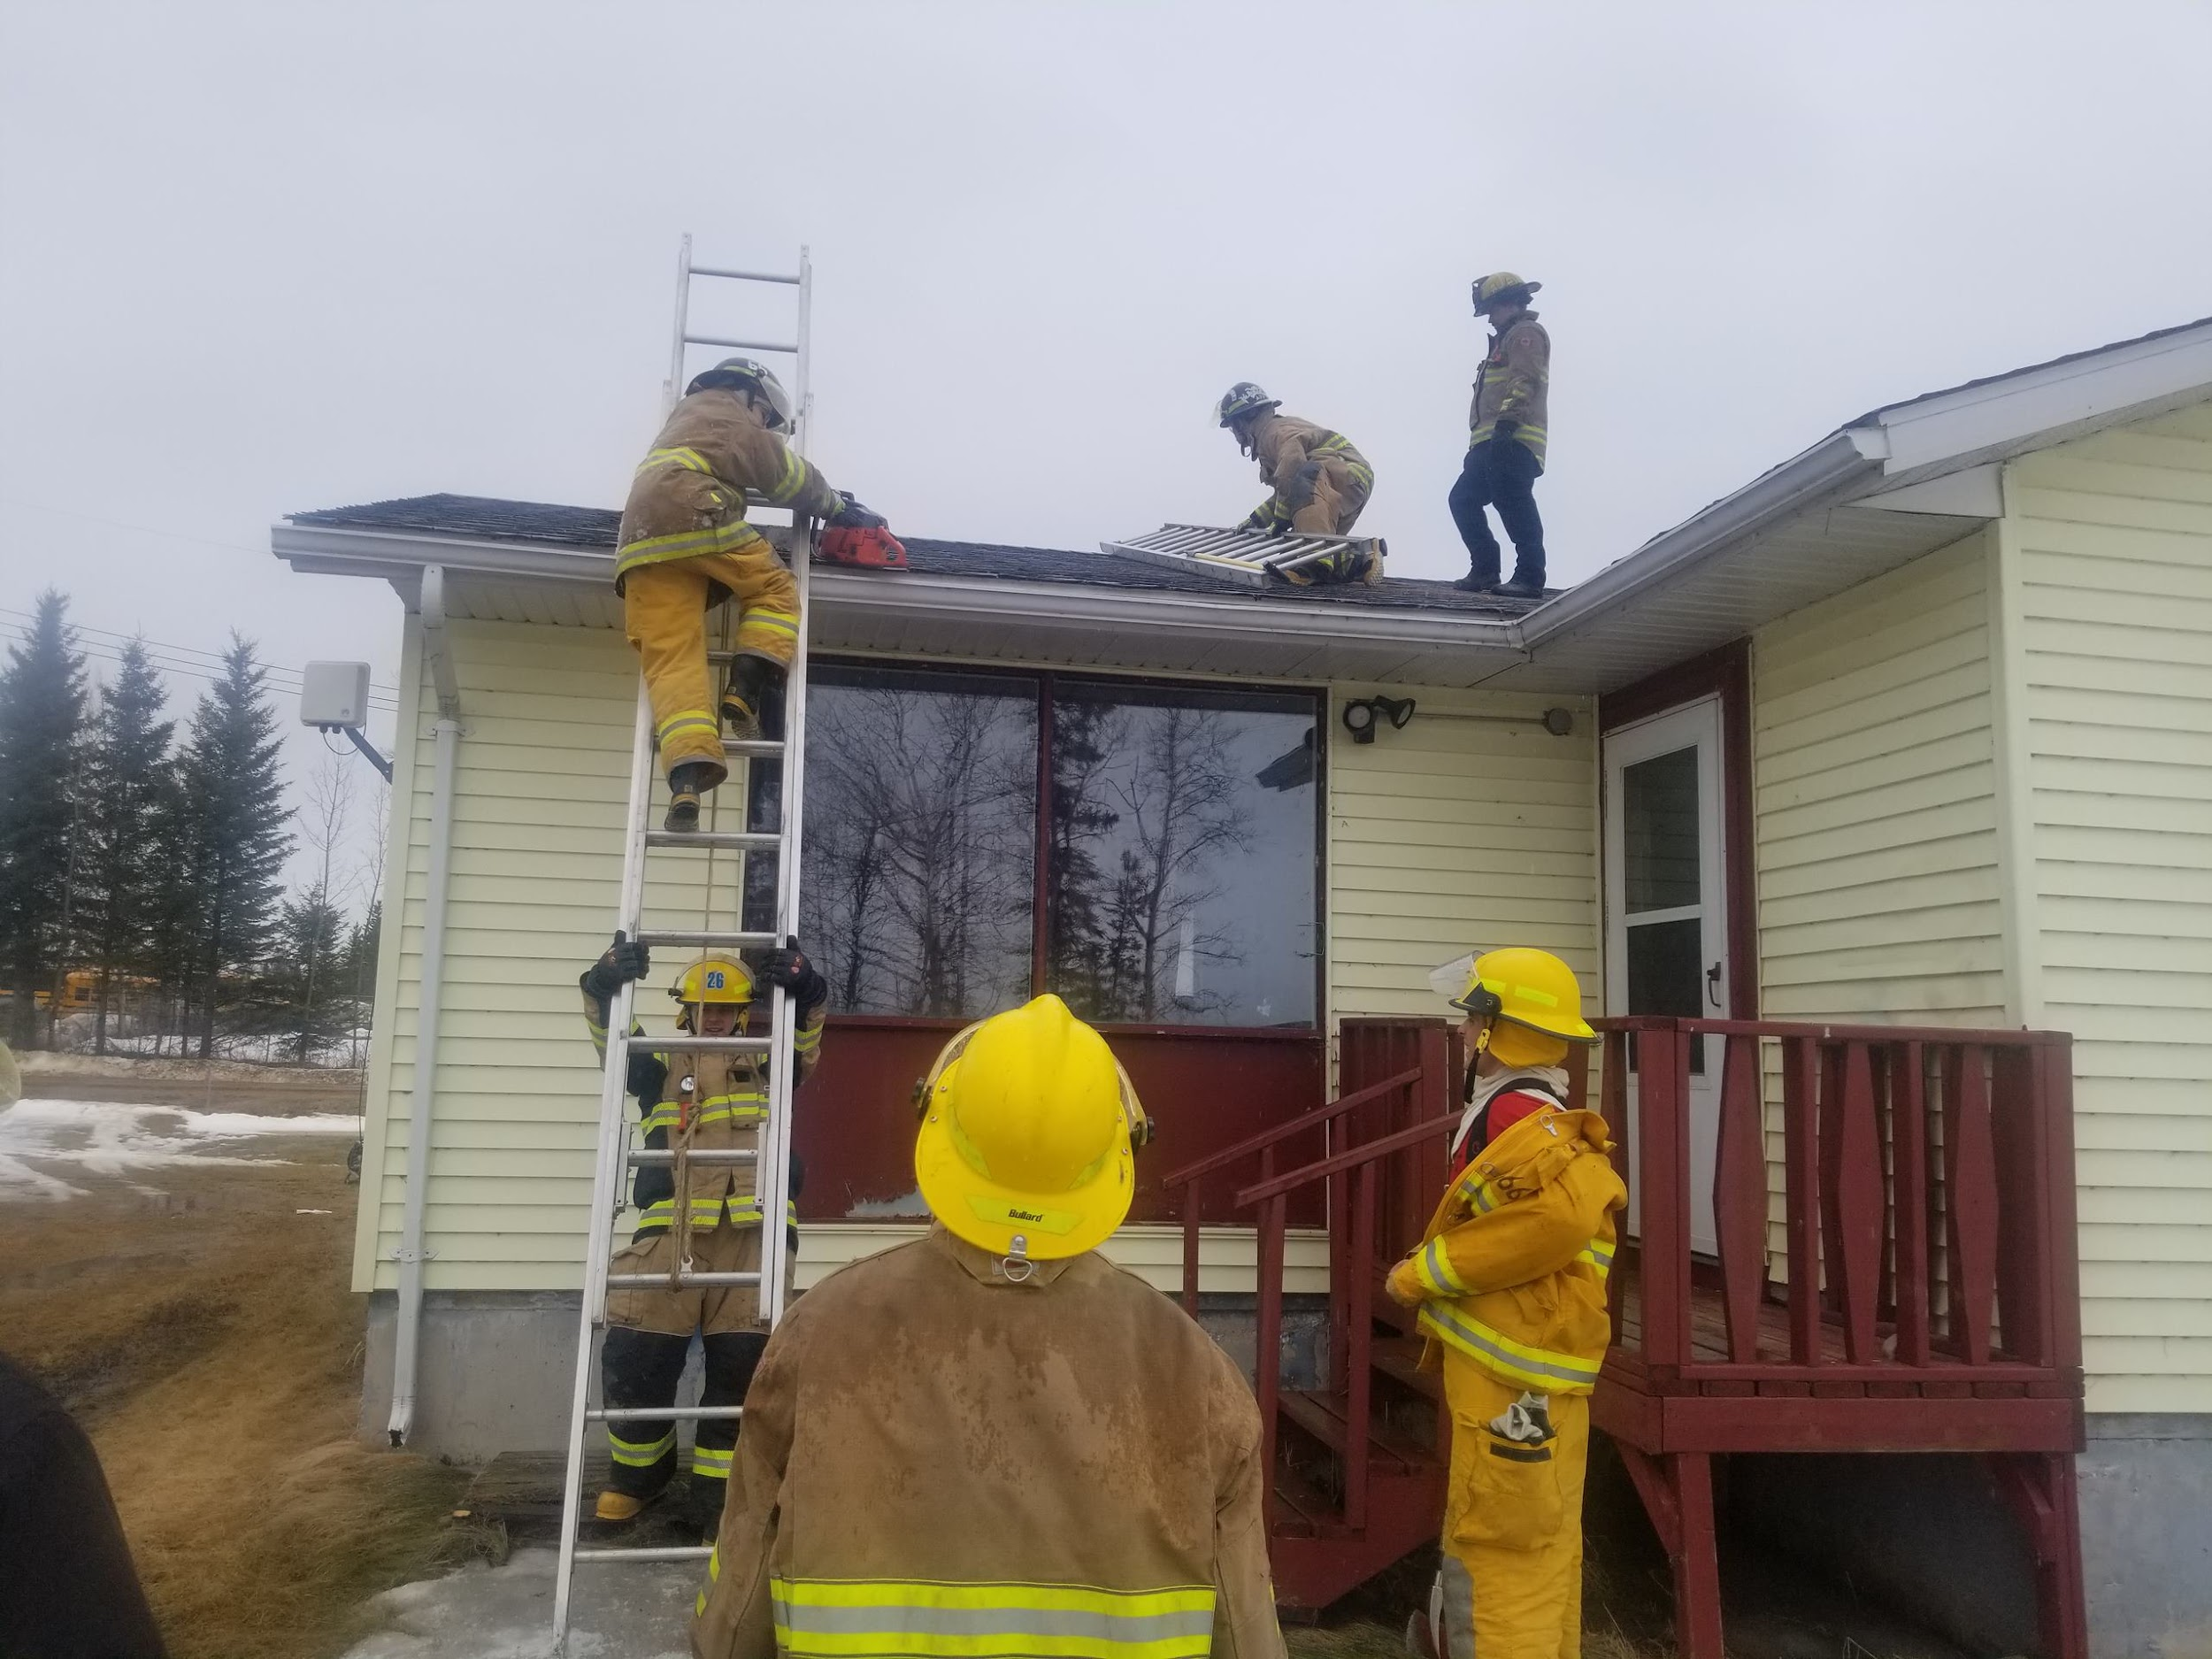
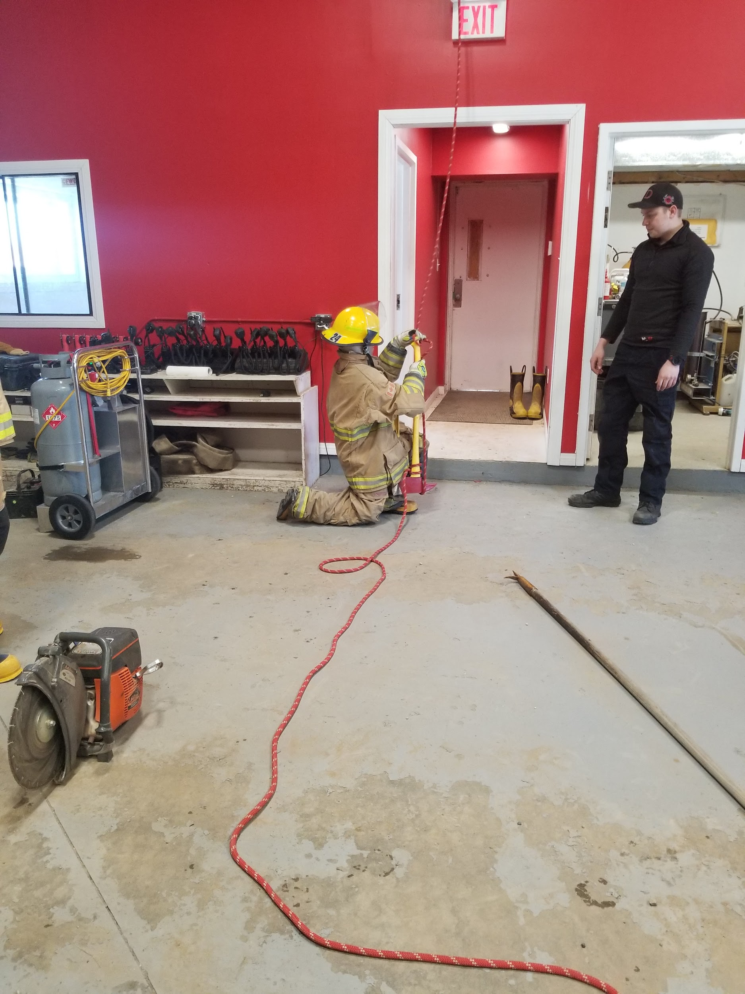
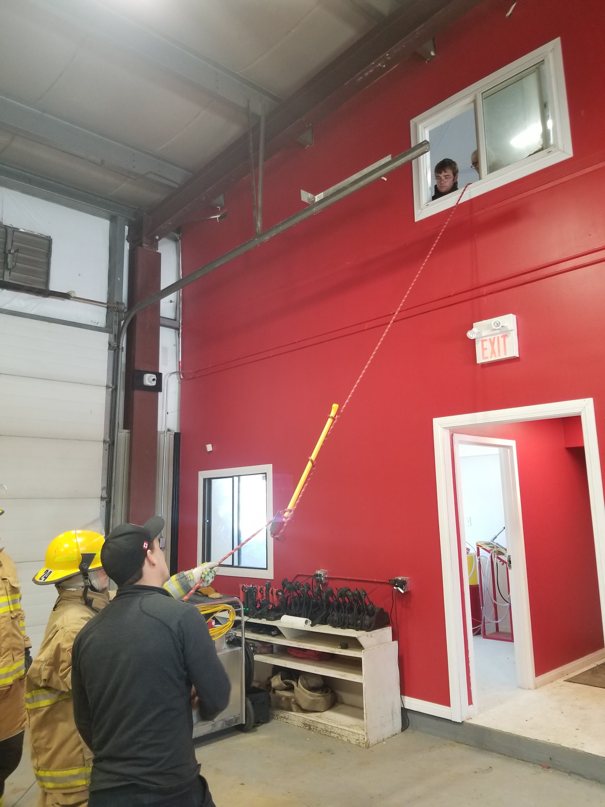
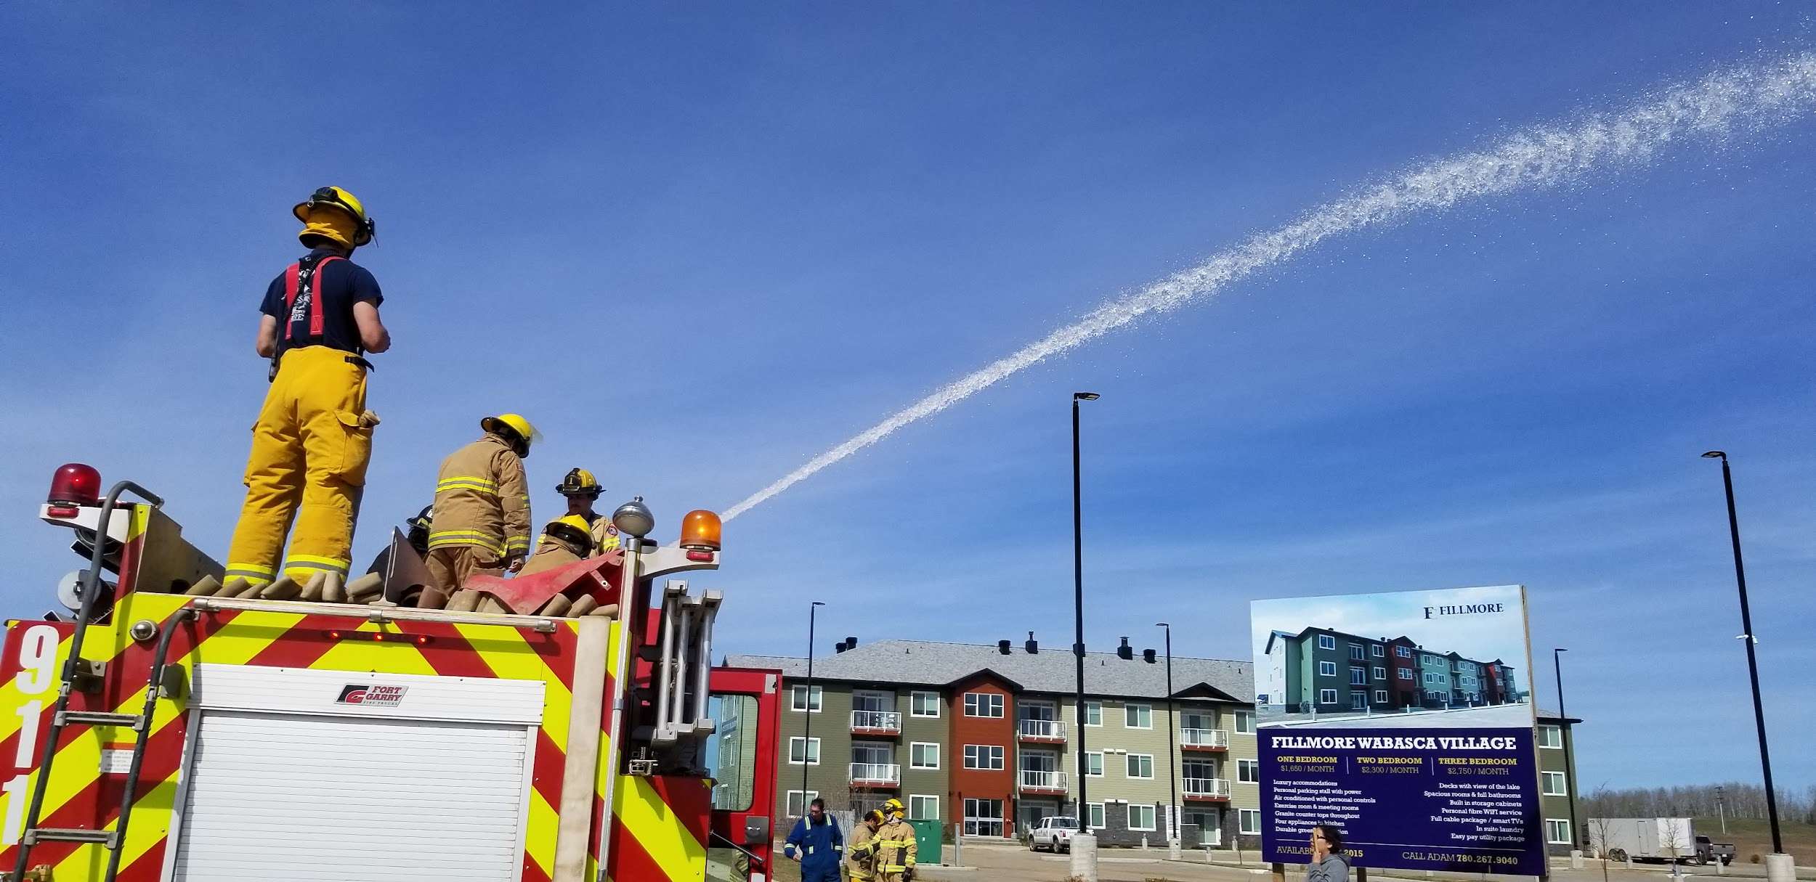
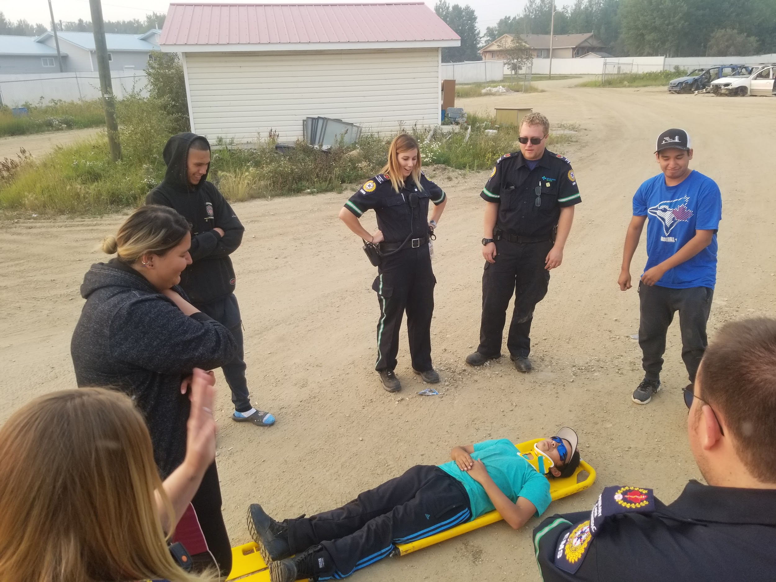
What does the Jr FireFighter Program Offer
Teaching the youth responsibility and accountability.
Teaching them teamwork and hands on skills.
Help with high school credits.
Help youth gain confidence.
Help the youth give back to the community and band members
Notes:
We teach them family
Confidanaity
Give them opatuintys
Life skills
Confidence better hope for the future
Away to stay away from trouble or bad habits

Slide 5
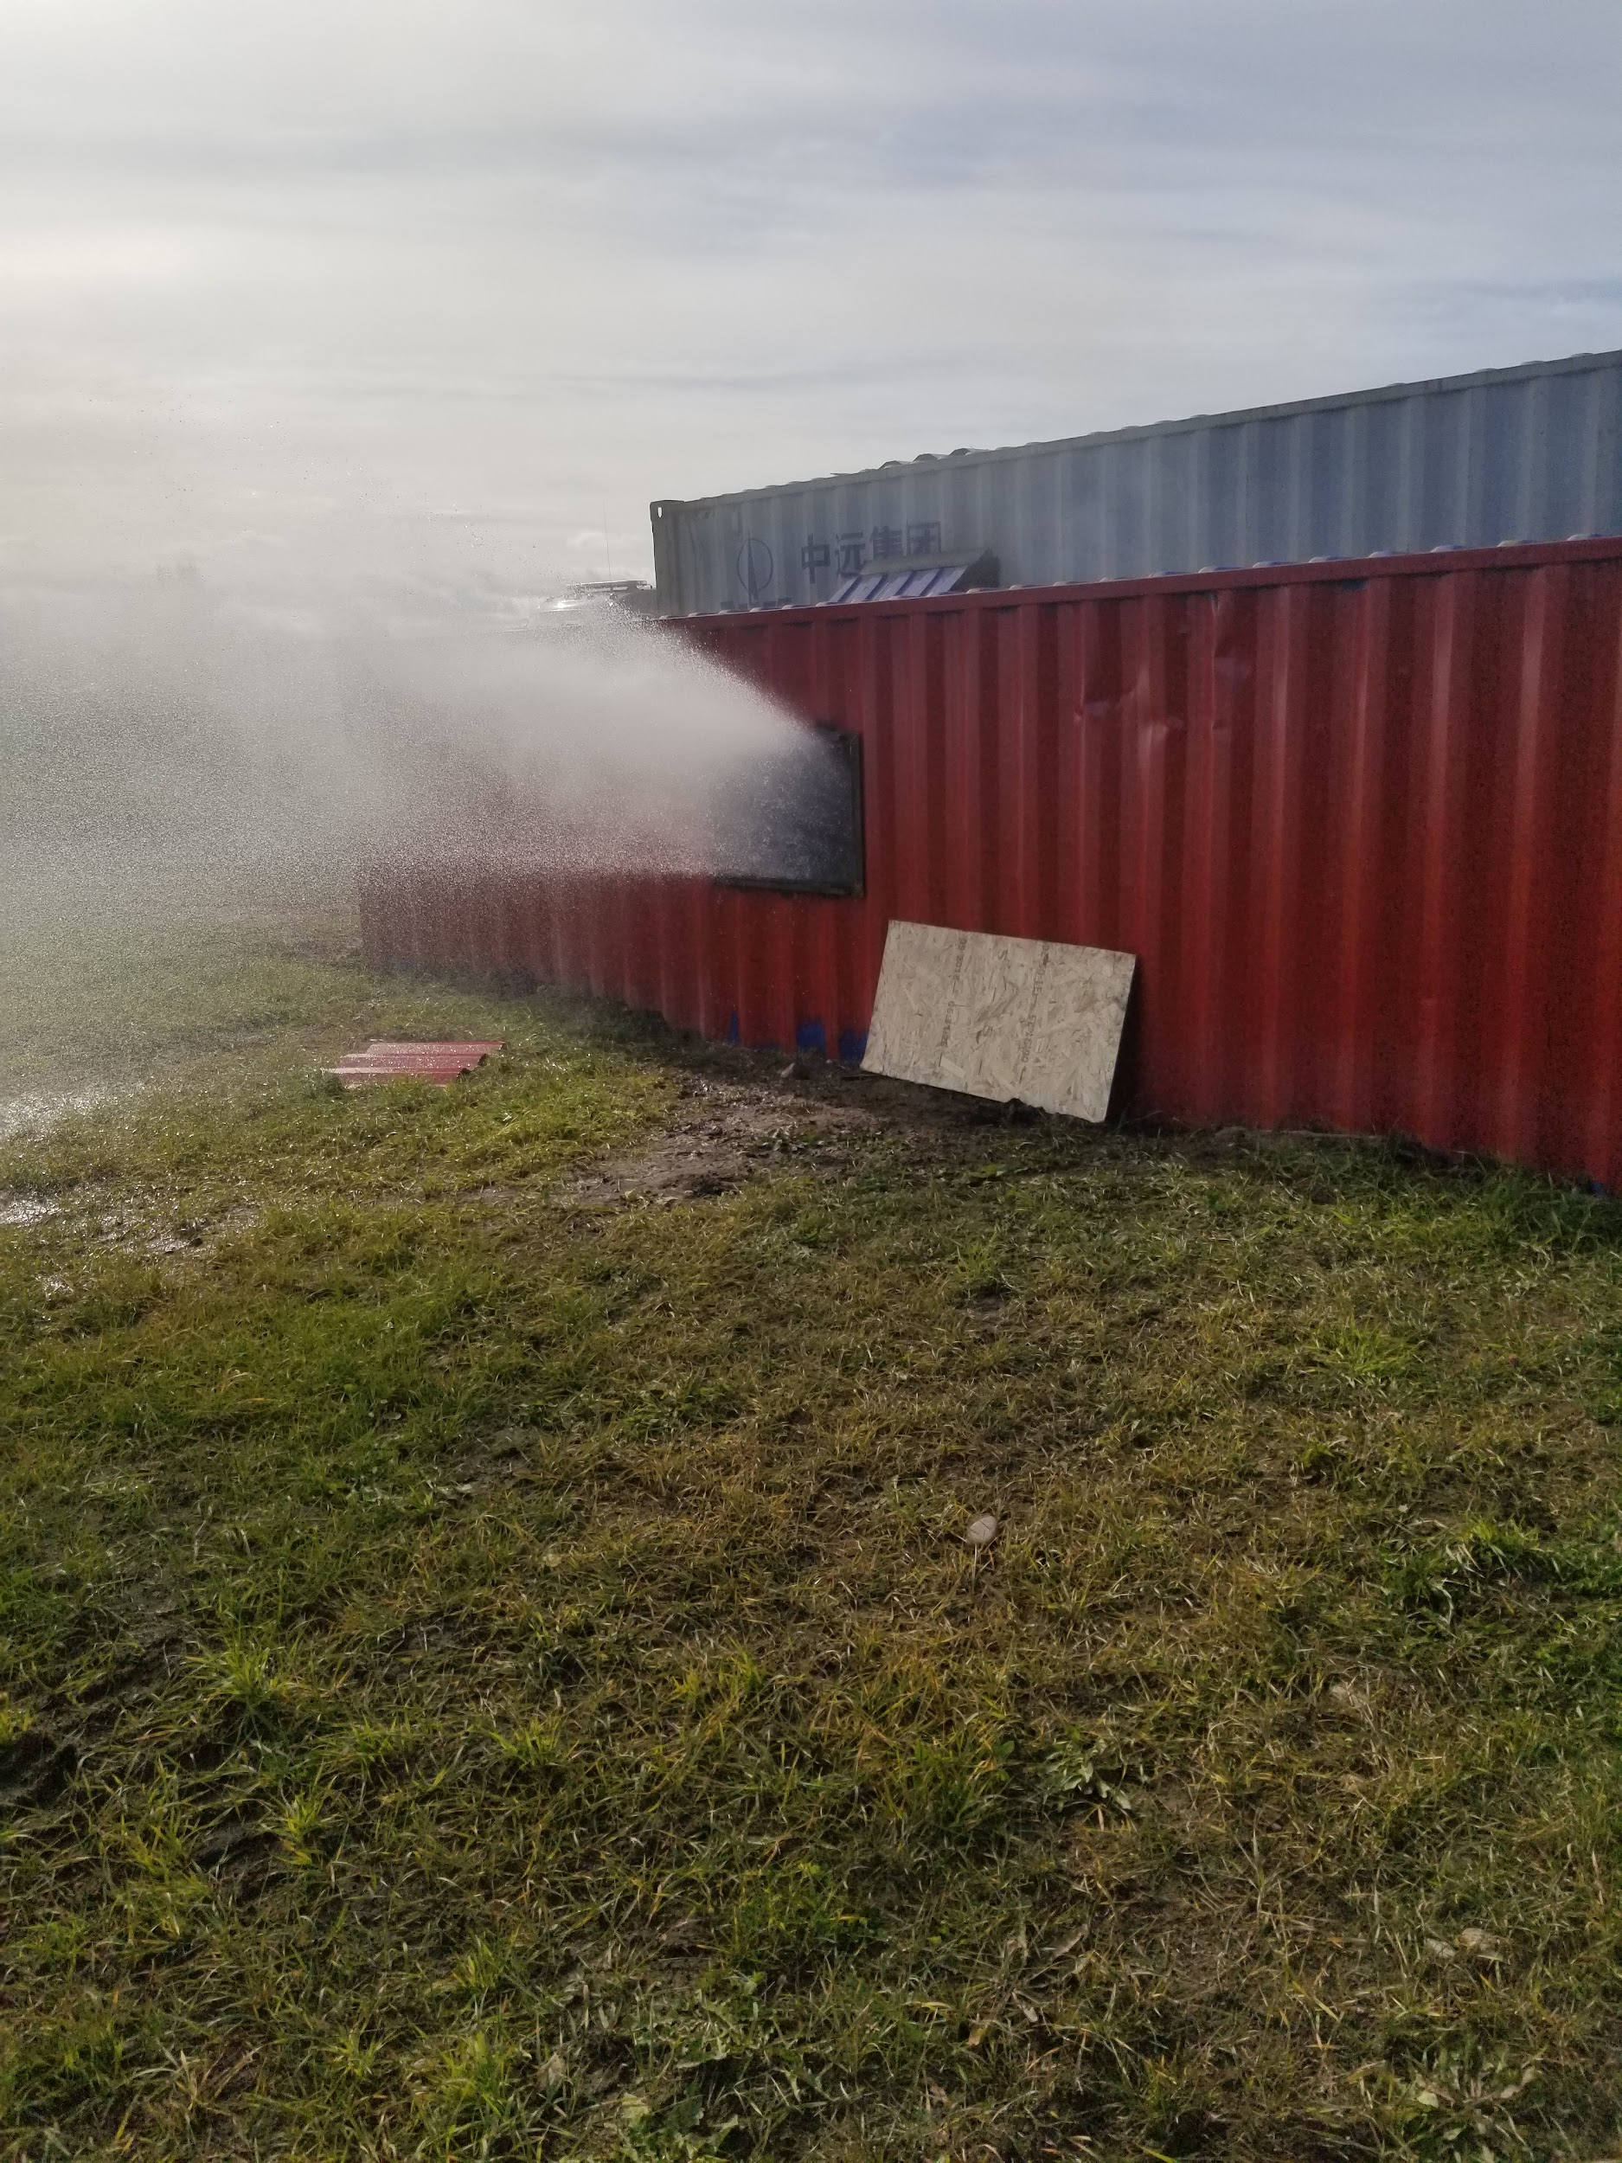
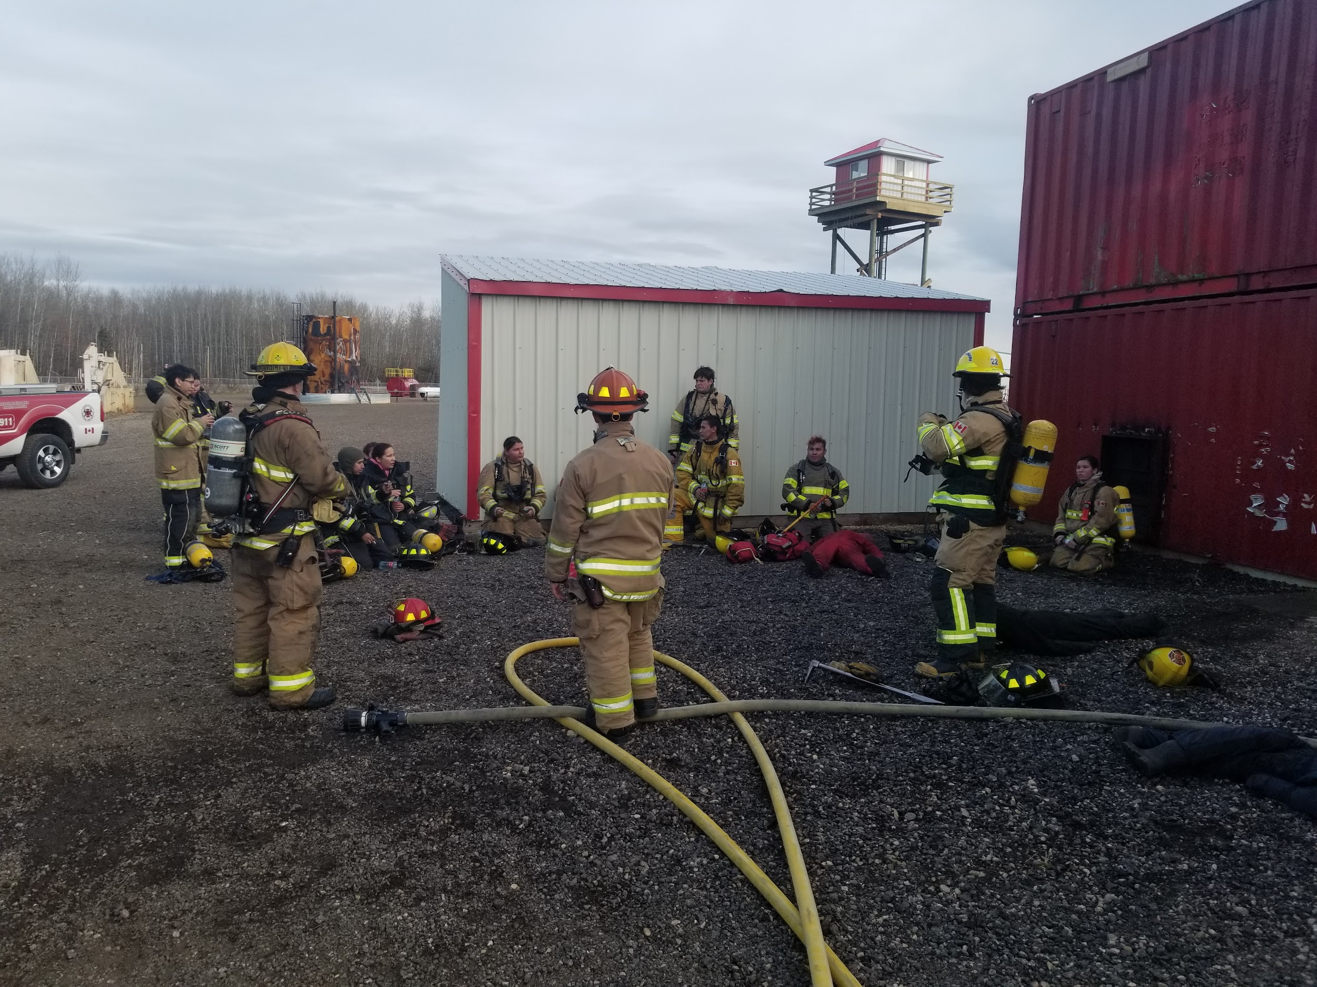
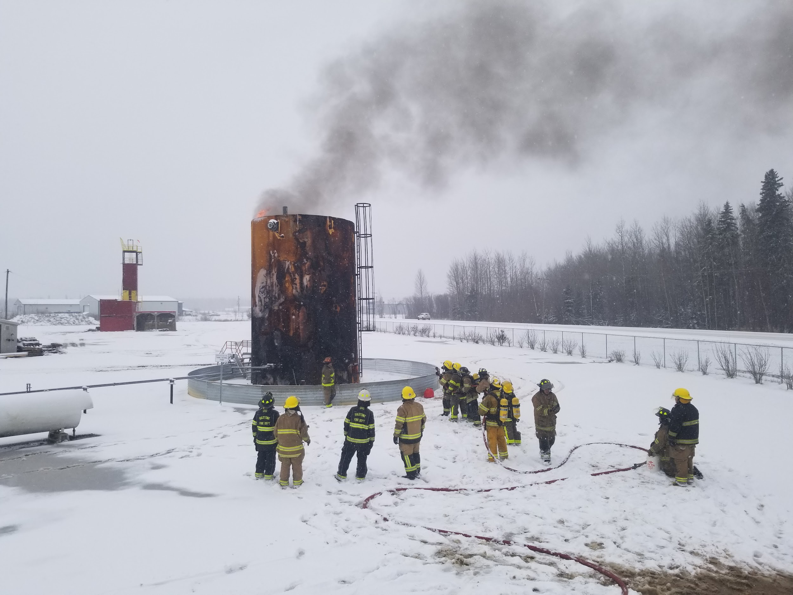
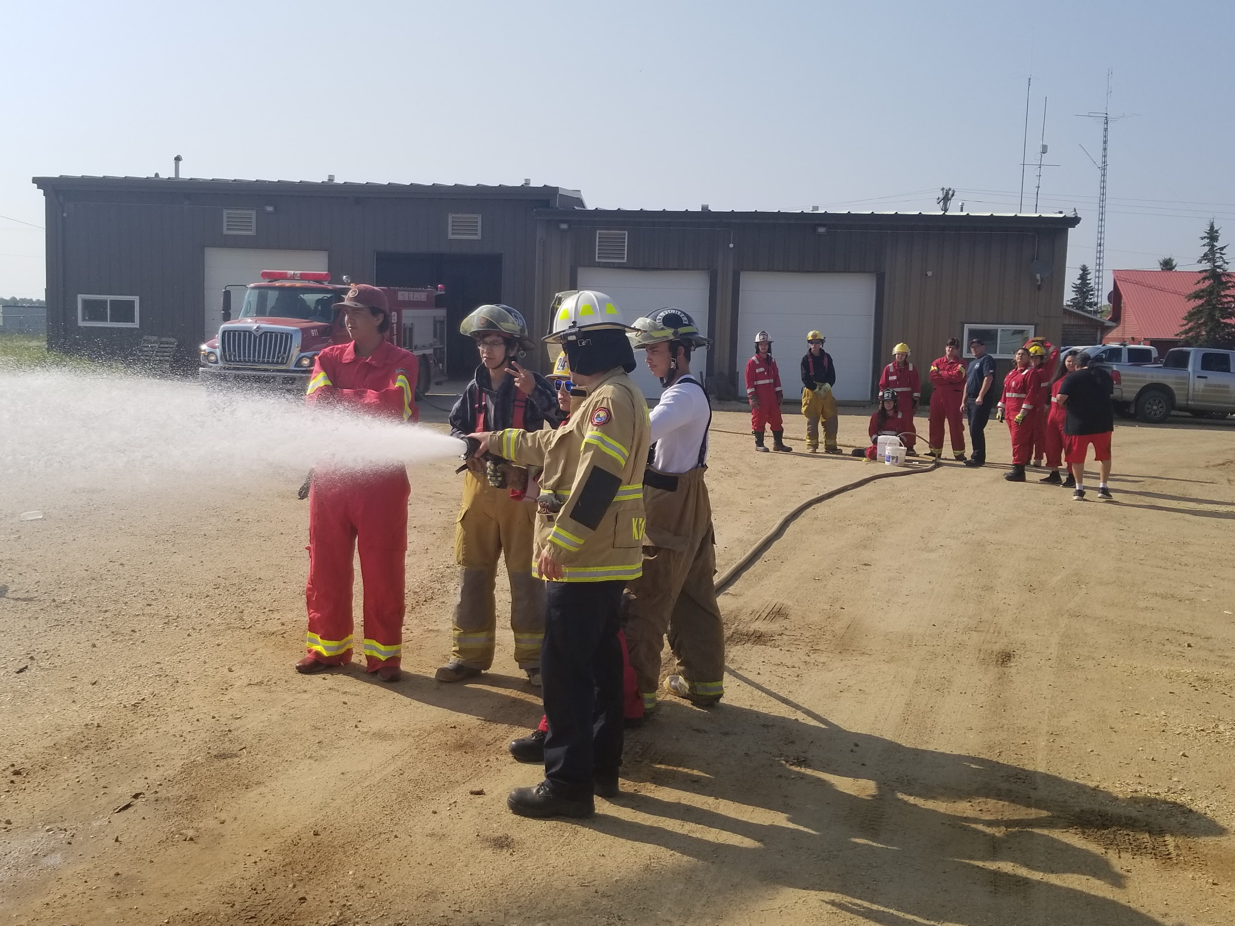
What Jr Firefighters Get to do.
They attend Practices / Training events with the regular members.
They get to attend some training courses if the instructors allow them to attend.
They get to help with control burns in the community.
They get to attend parades.
They get to help with community events ex. Toy drives and fire prevention week.
They can help out with clean up after calls and gain hrs doing so.

Slide 6
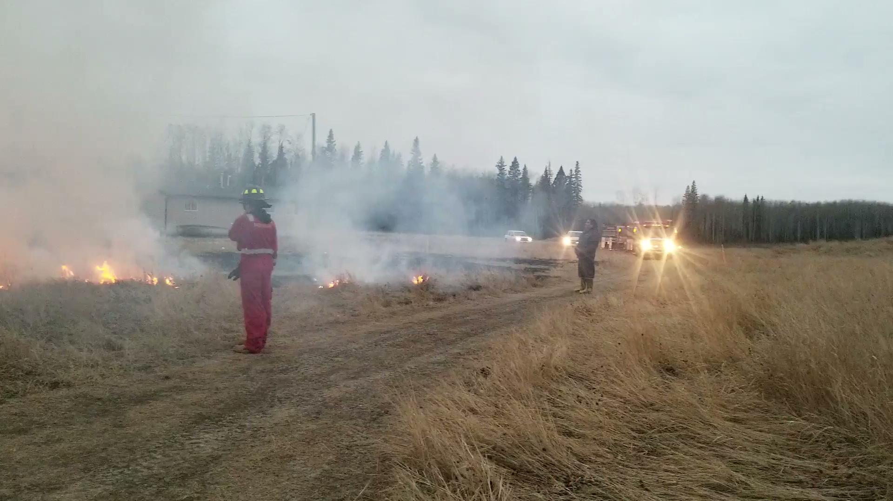

Slide 7
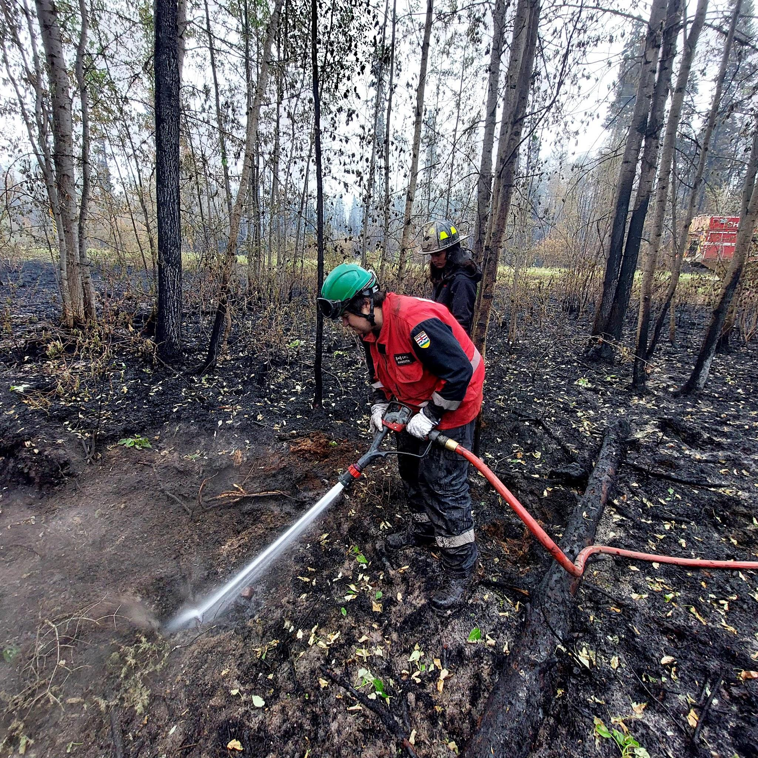
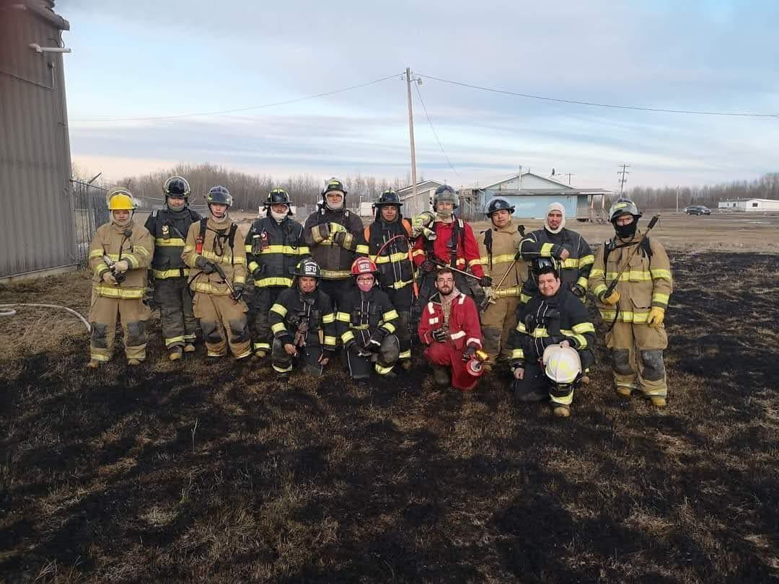
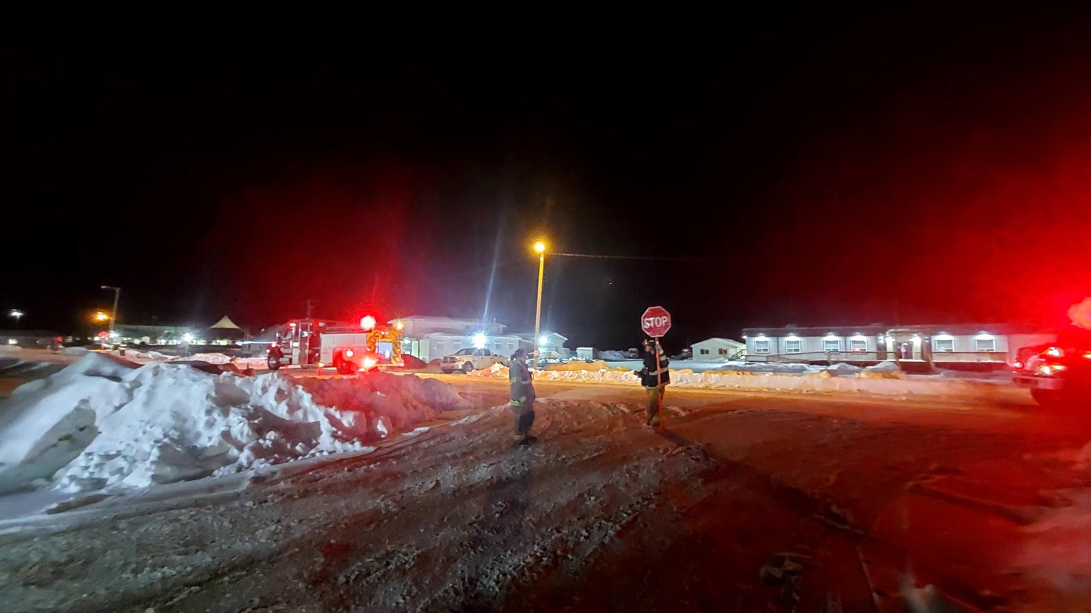
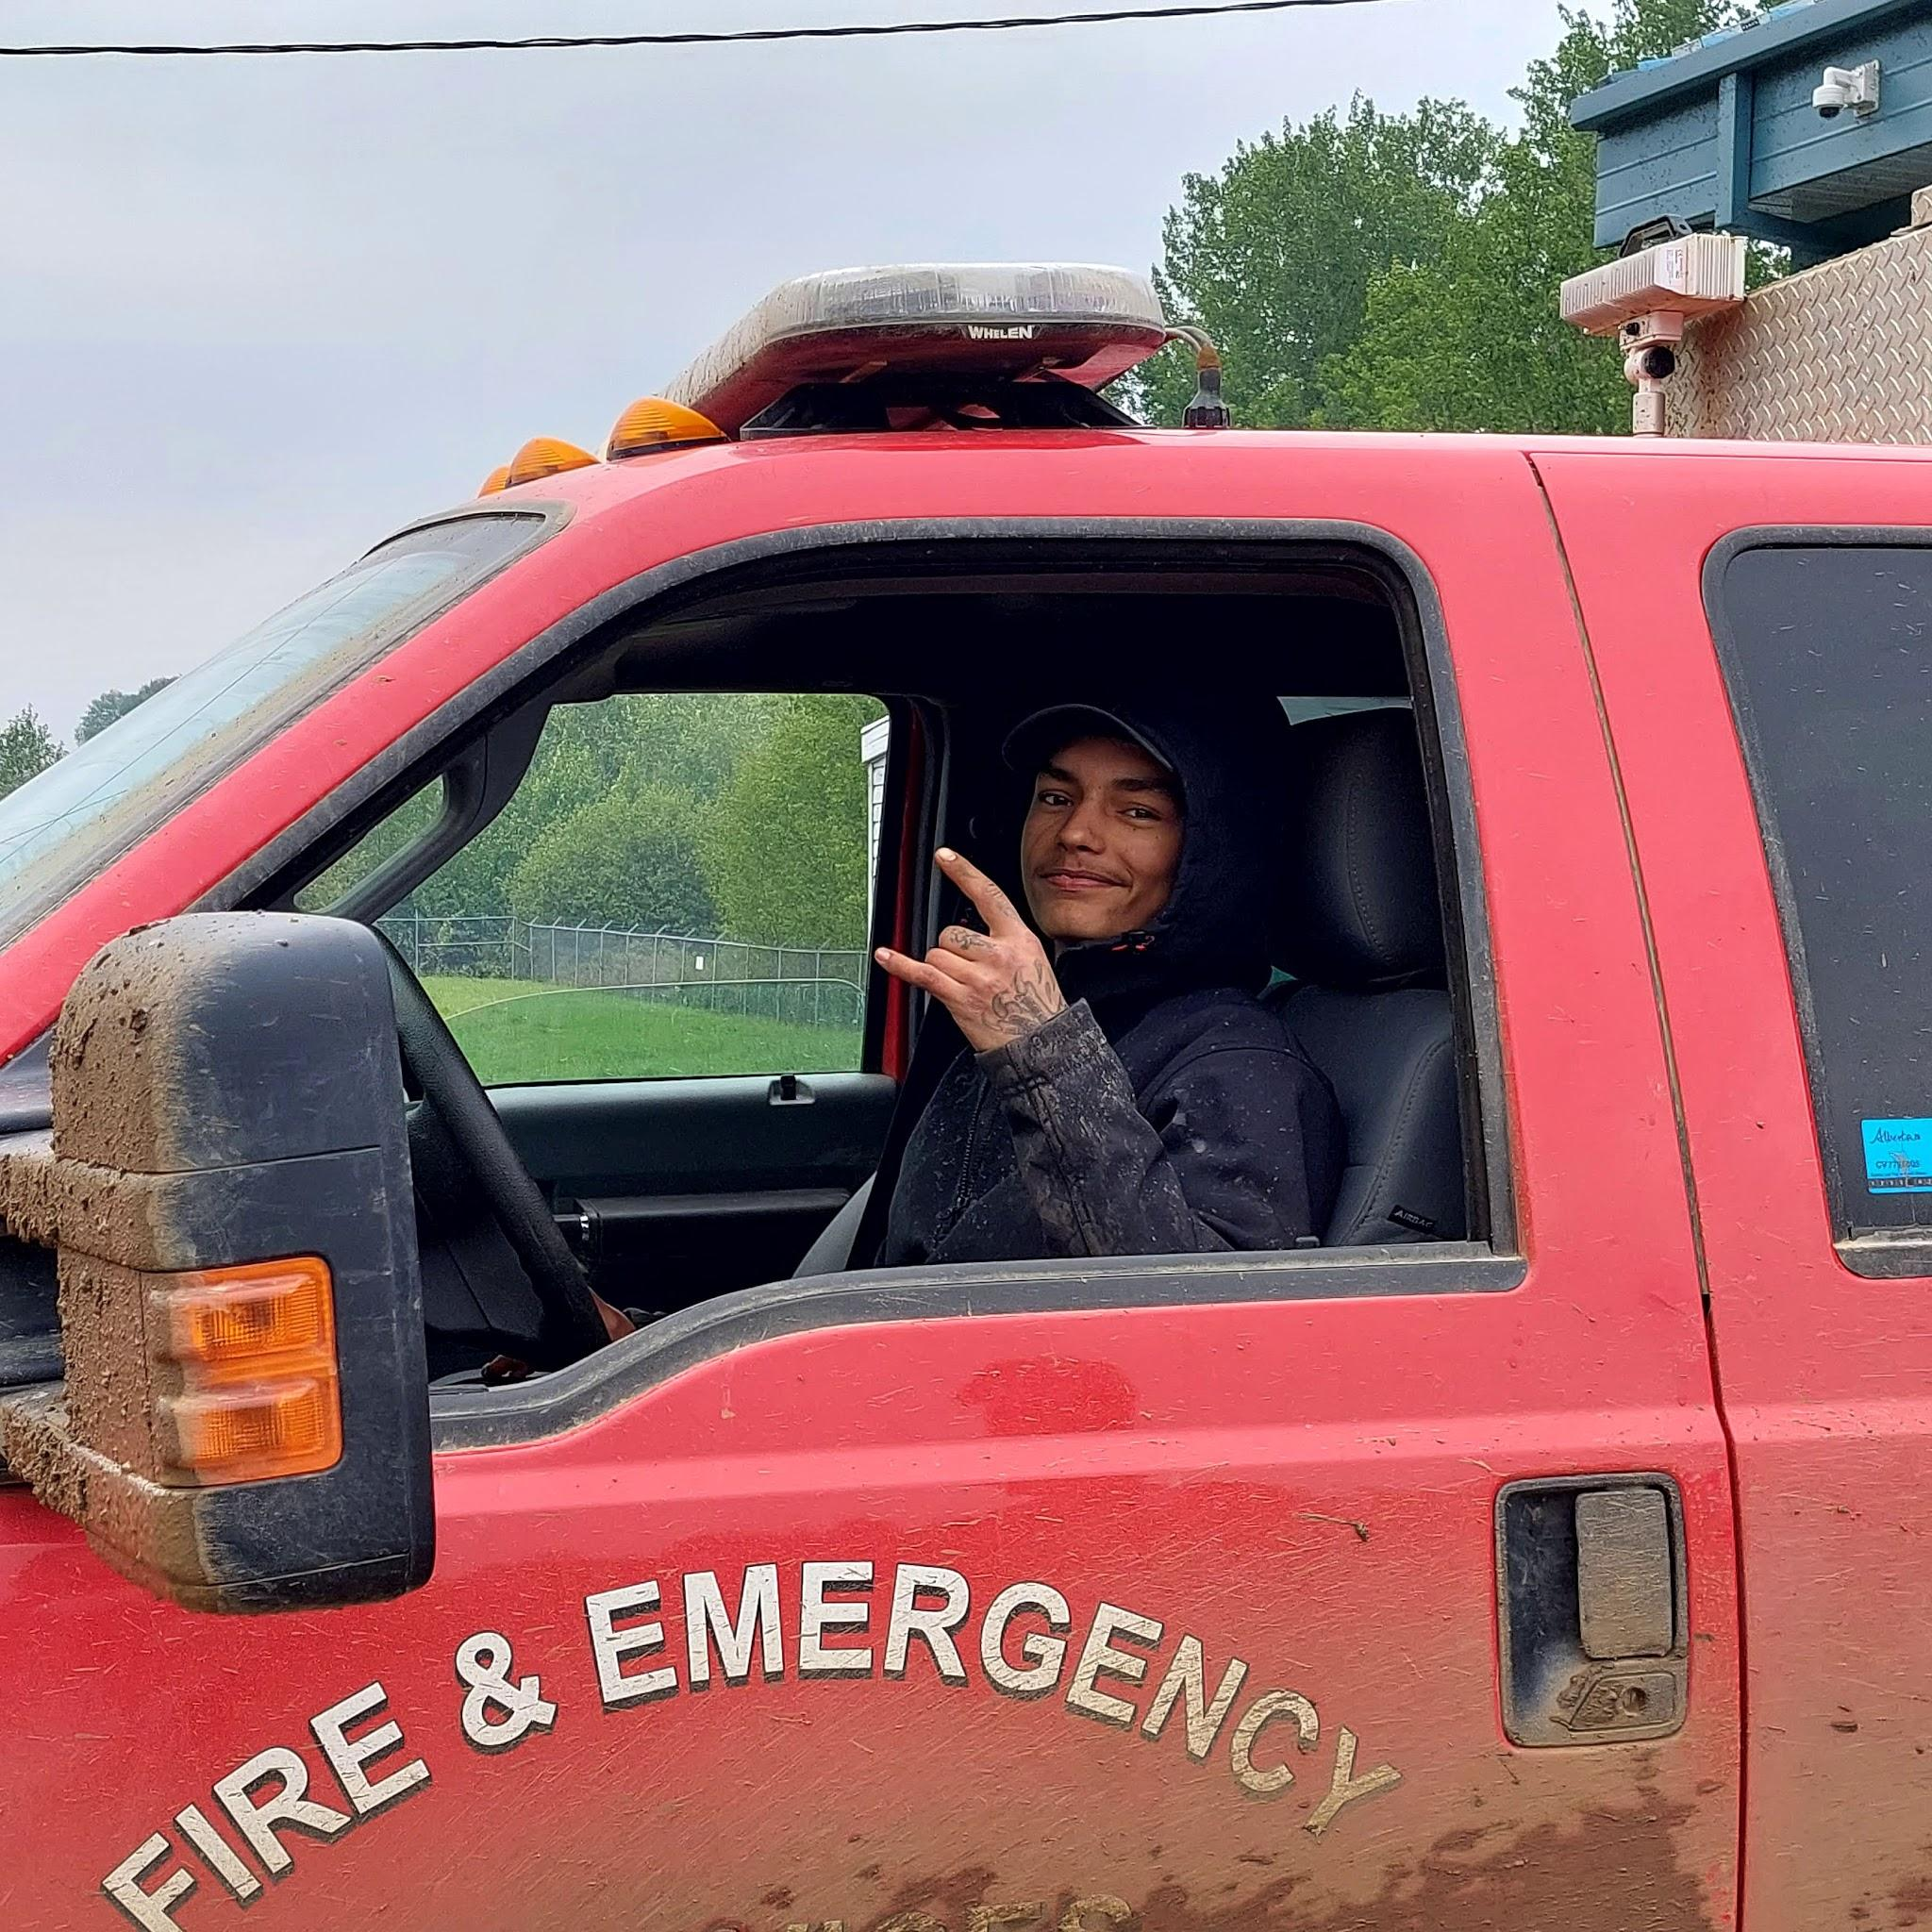
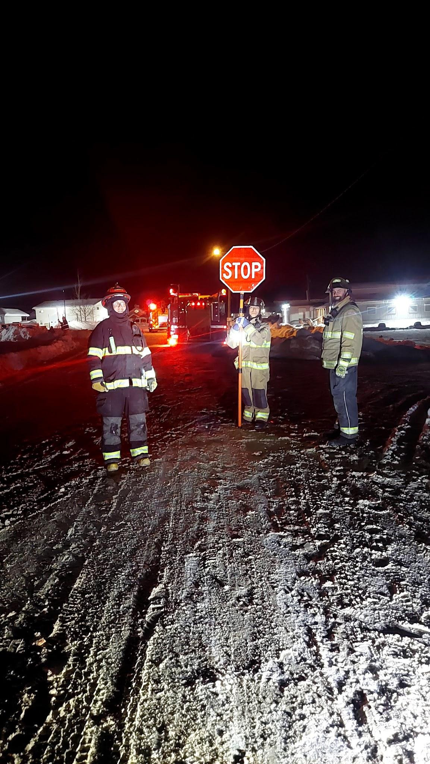
What Jr Firefighters Can't Do
Some junior firefighters cant attend certain training due to restrictions but we leave it to the instructors if the junior firefighters can attend
they cant come to any 911 call outs as they are under age for liability and insurance purposes. But they can attend clean up after calls.

Slide 8
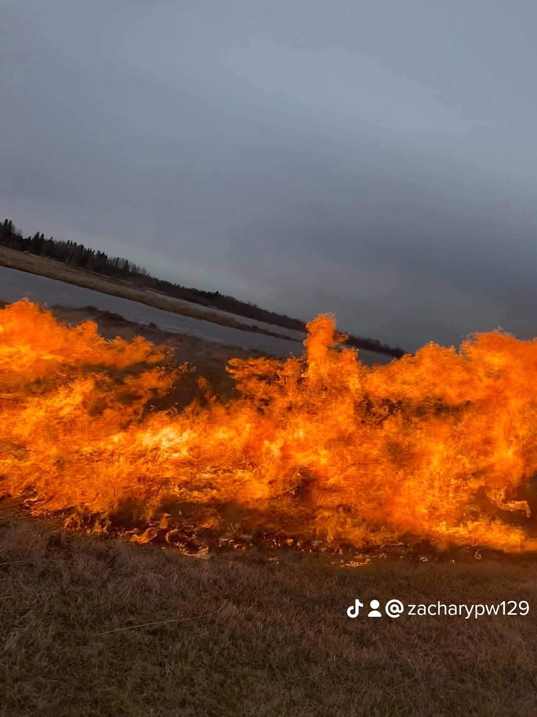
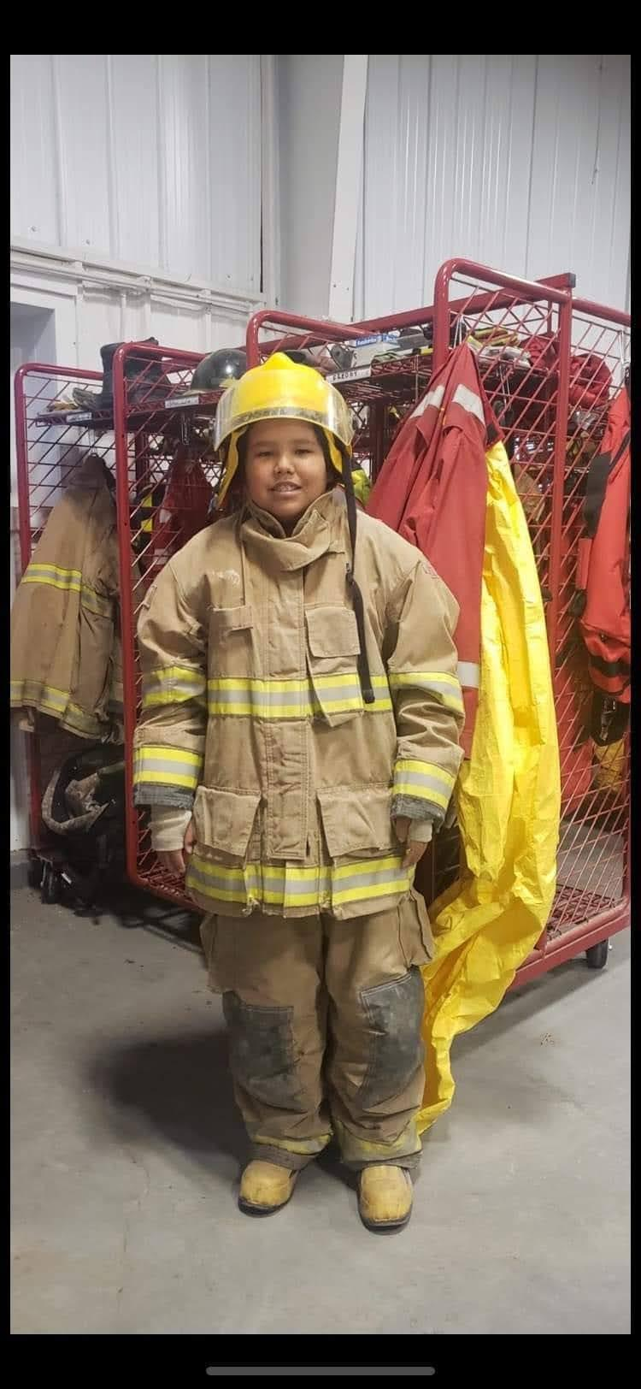
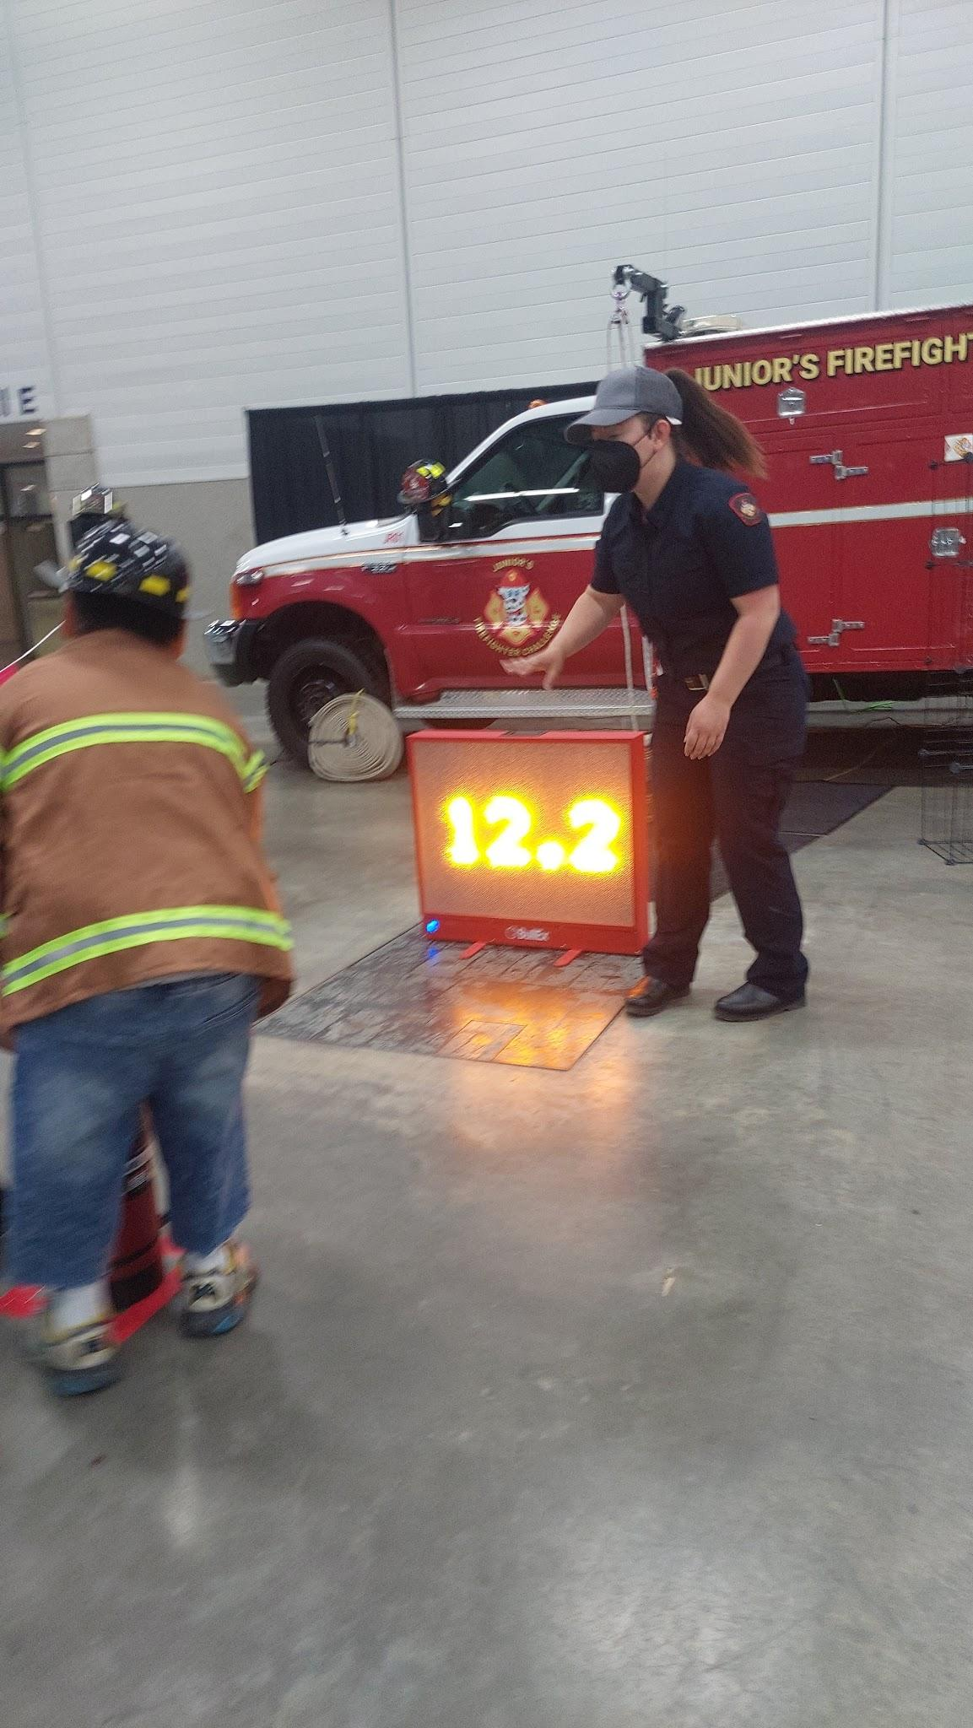
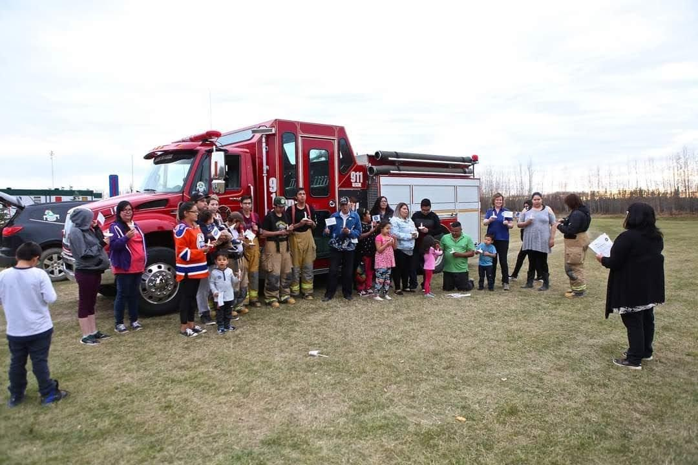
What Benefits Do Jr Firefighters Get
The jr firefighters get hand on skills and training for a career in the fire services
High School credits for every 25 hrs they do they get 1 credit in high school work experience
They also get an honorarium
They also get experience that they can't get anywhere else

Slide 9
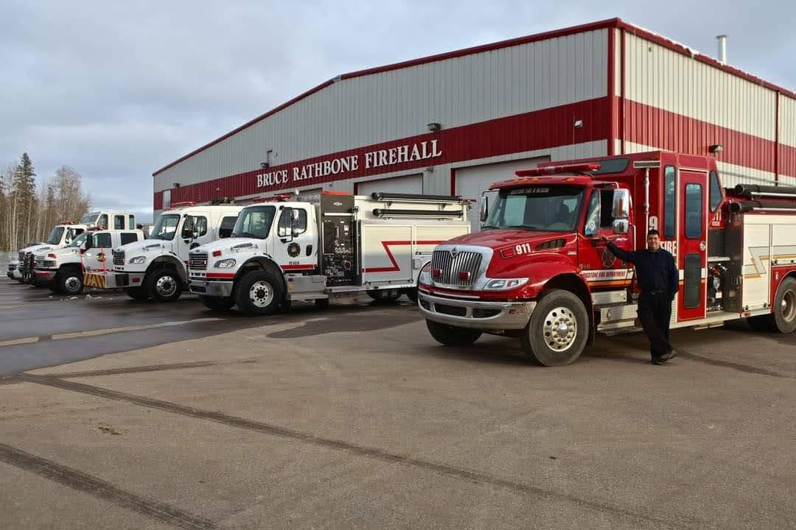
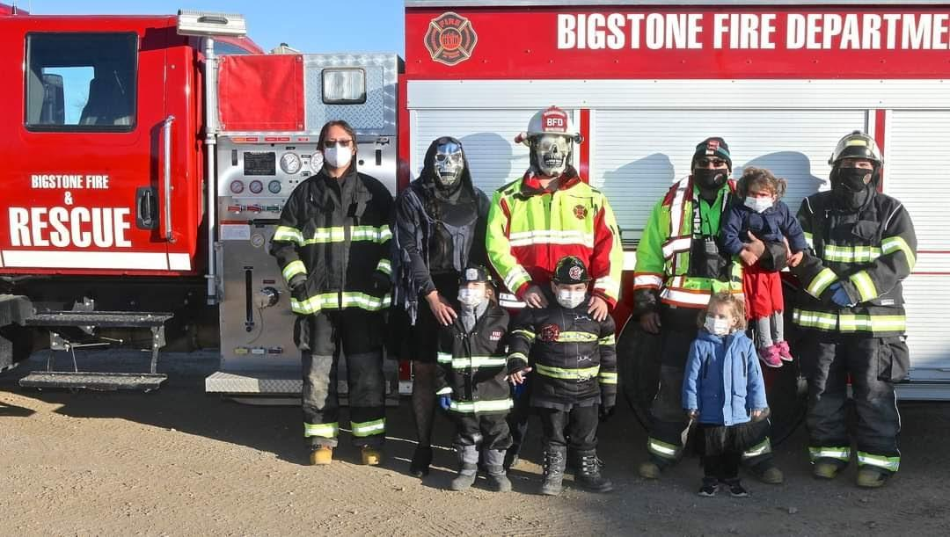
How do we keep are Jr Firefighters
We pay the jr firefighters an honorarium of 18 an hr
Help them with high school credits
Help them grow and learn ways to work in the fire service
Give them fire dept goods Ex. Cups / mask / hats/ badges and more

Slide 10
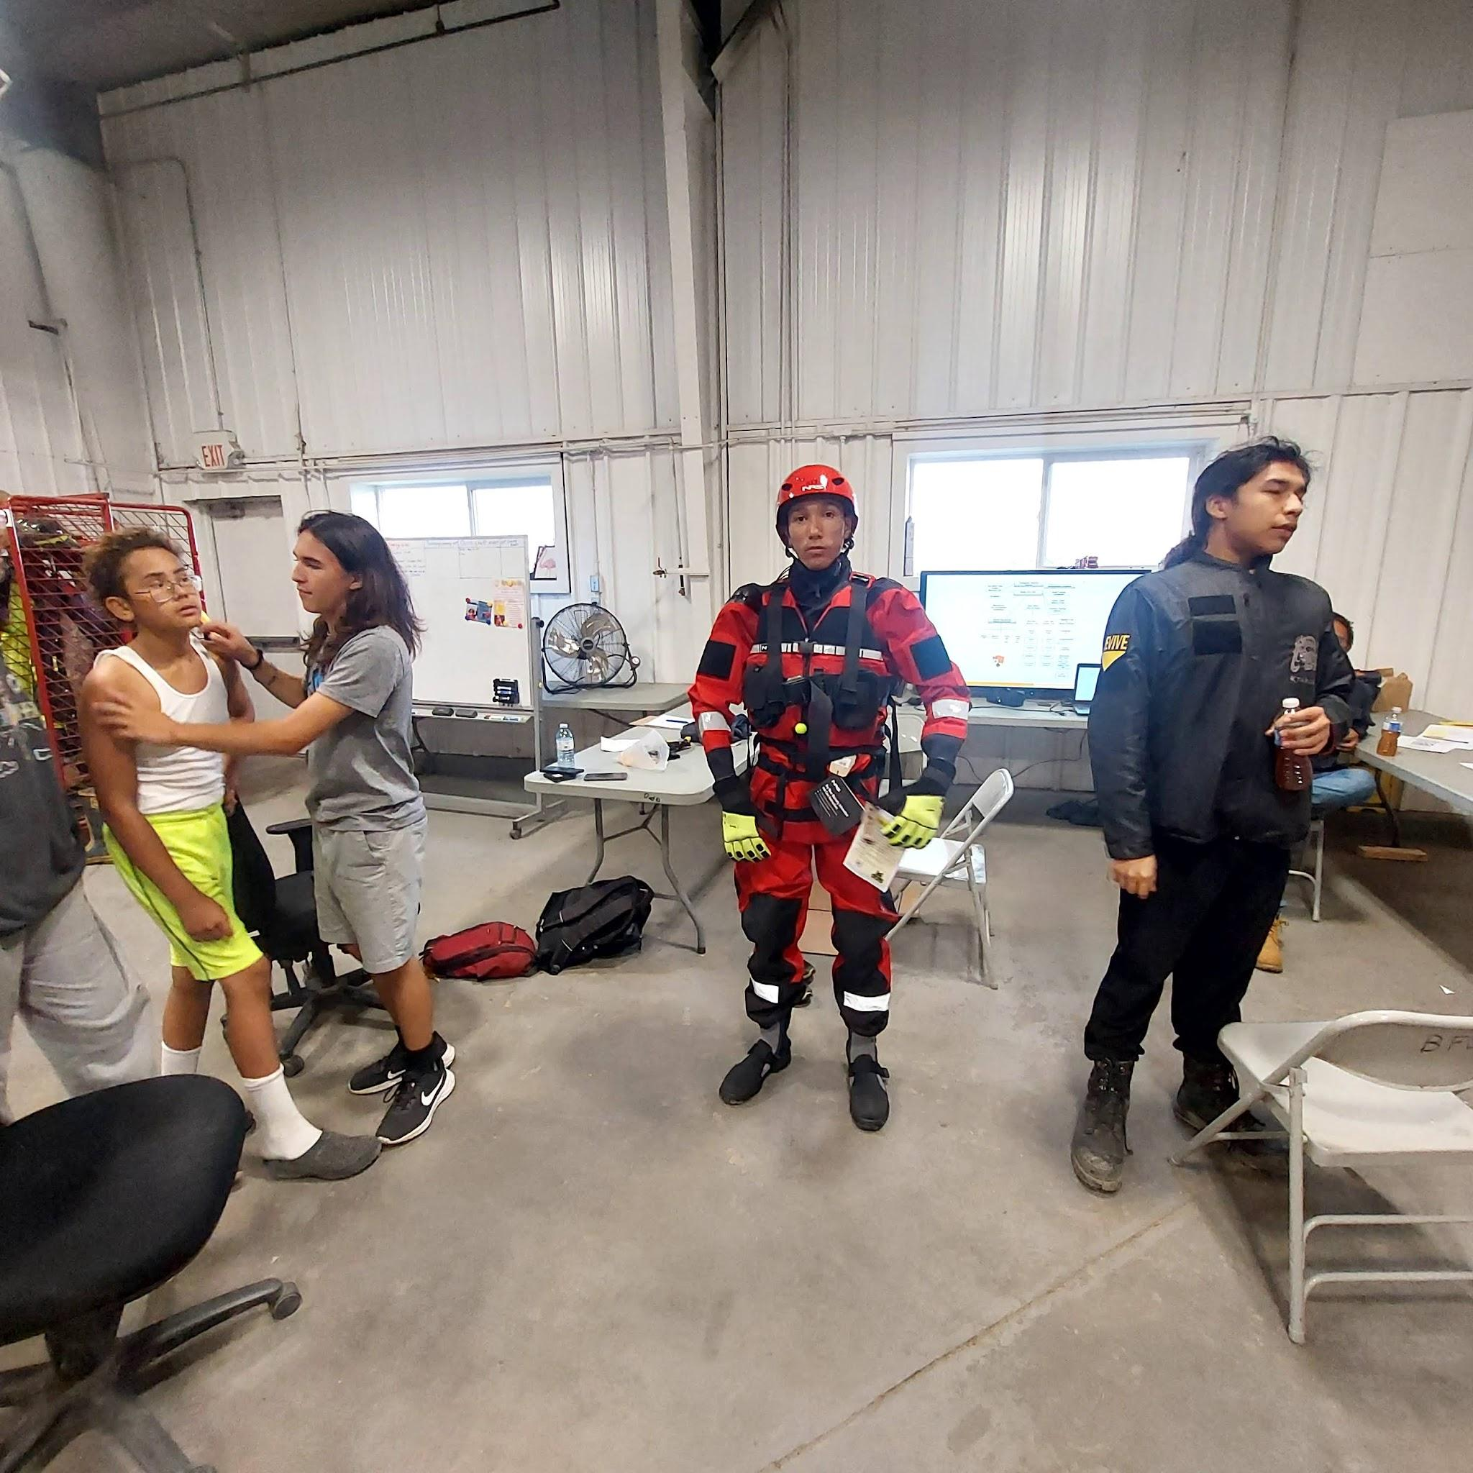
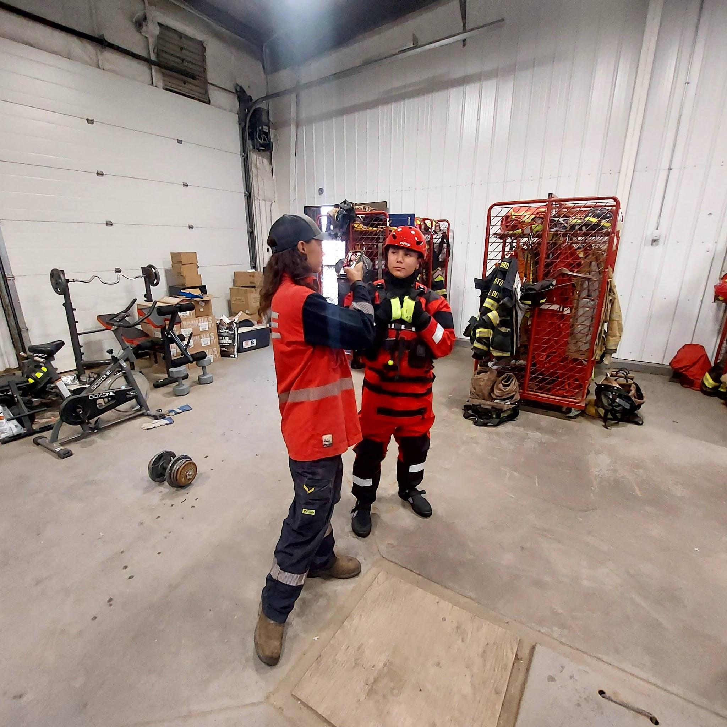
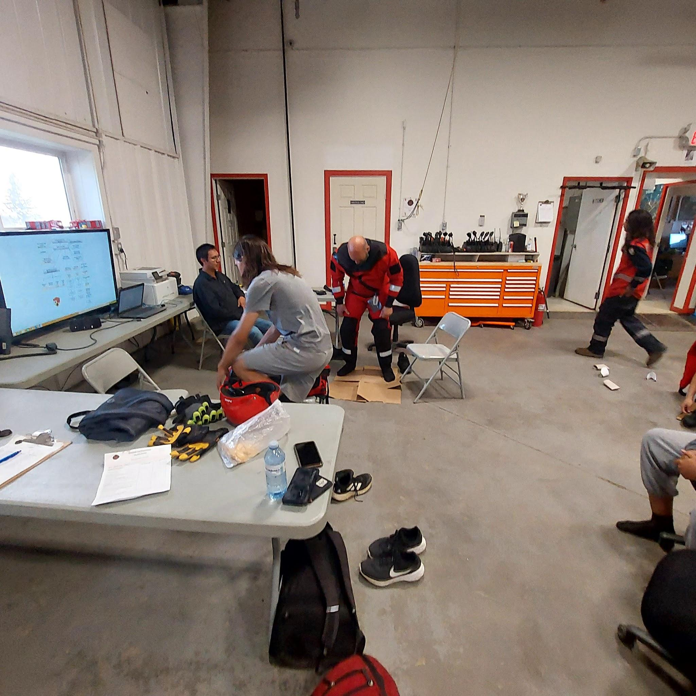
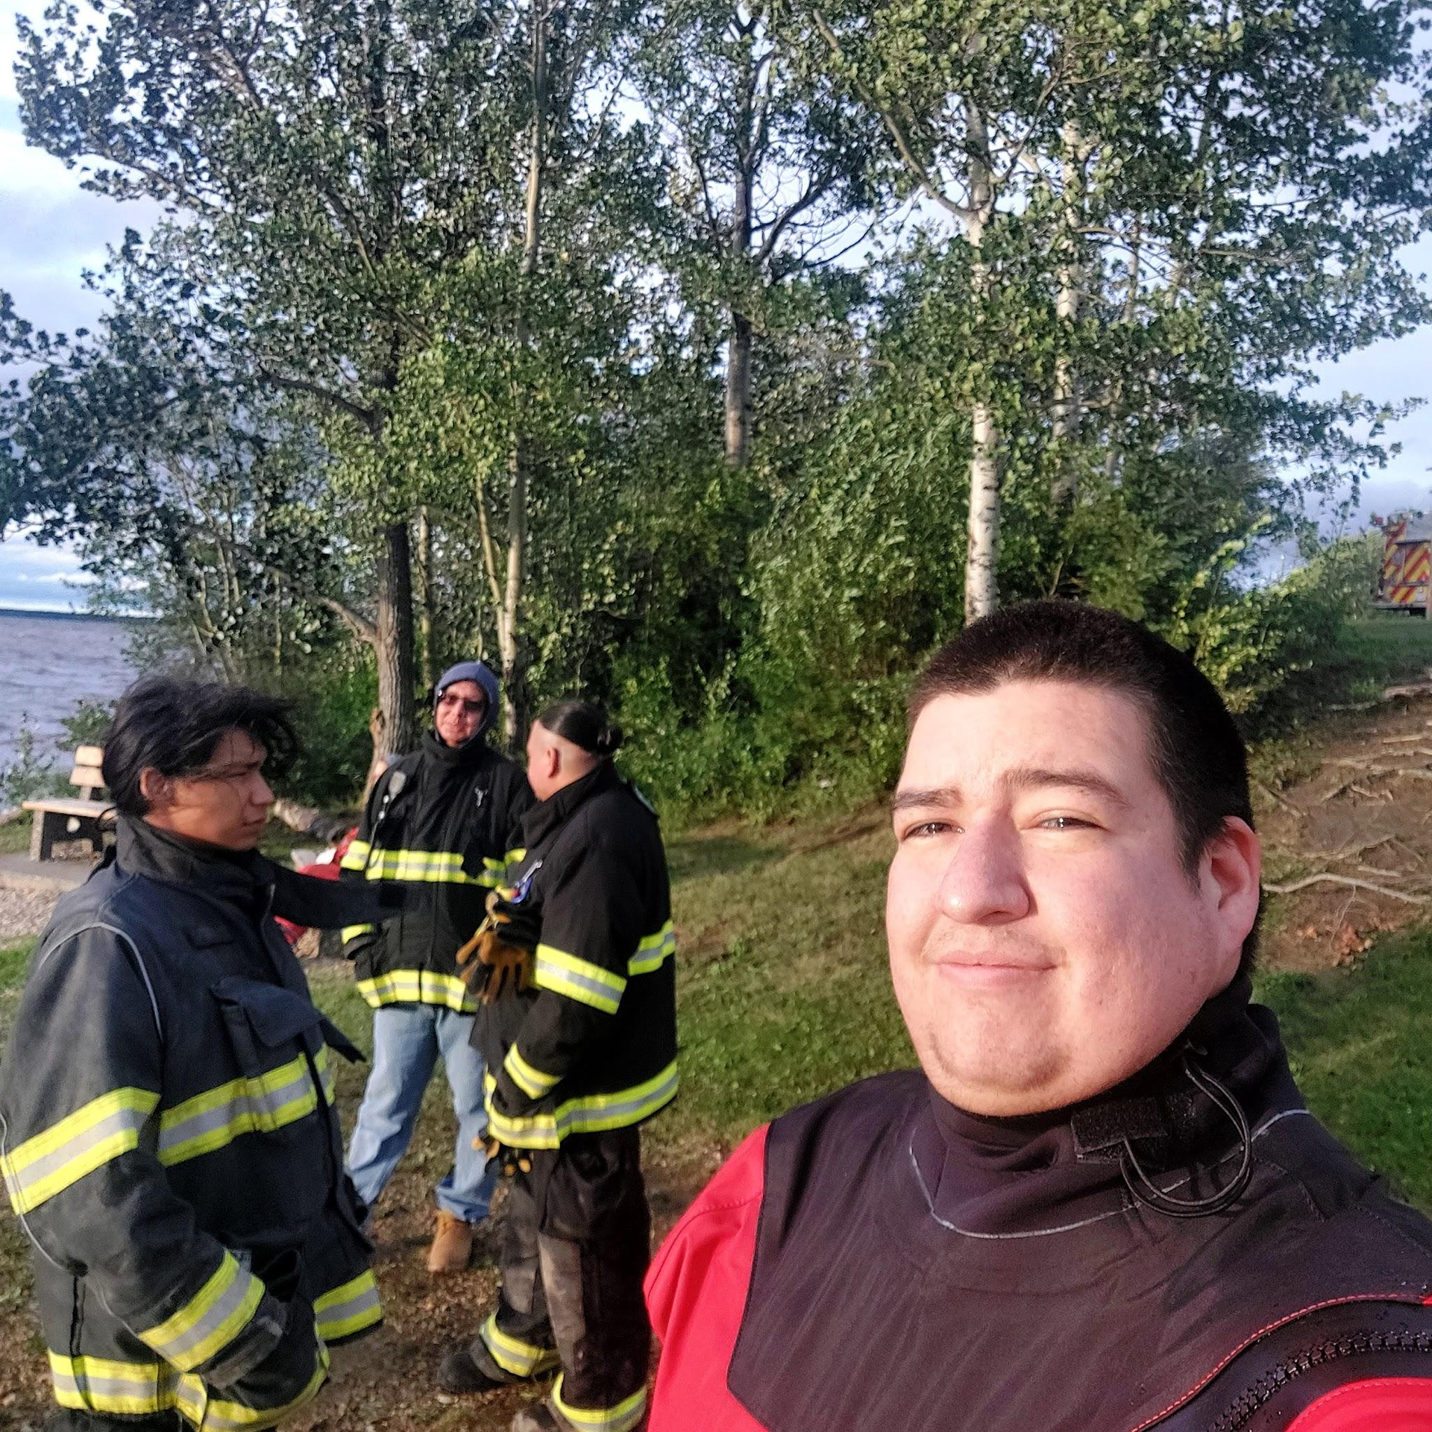
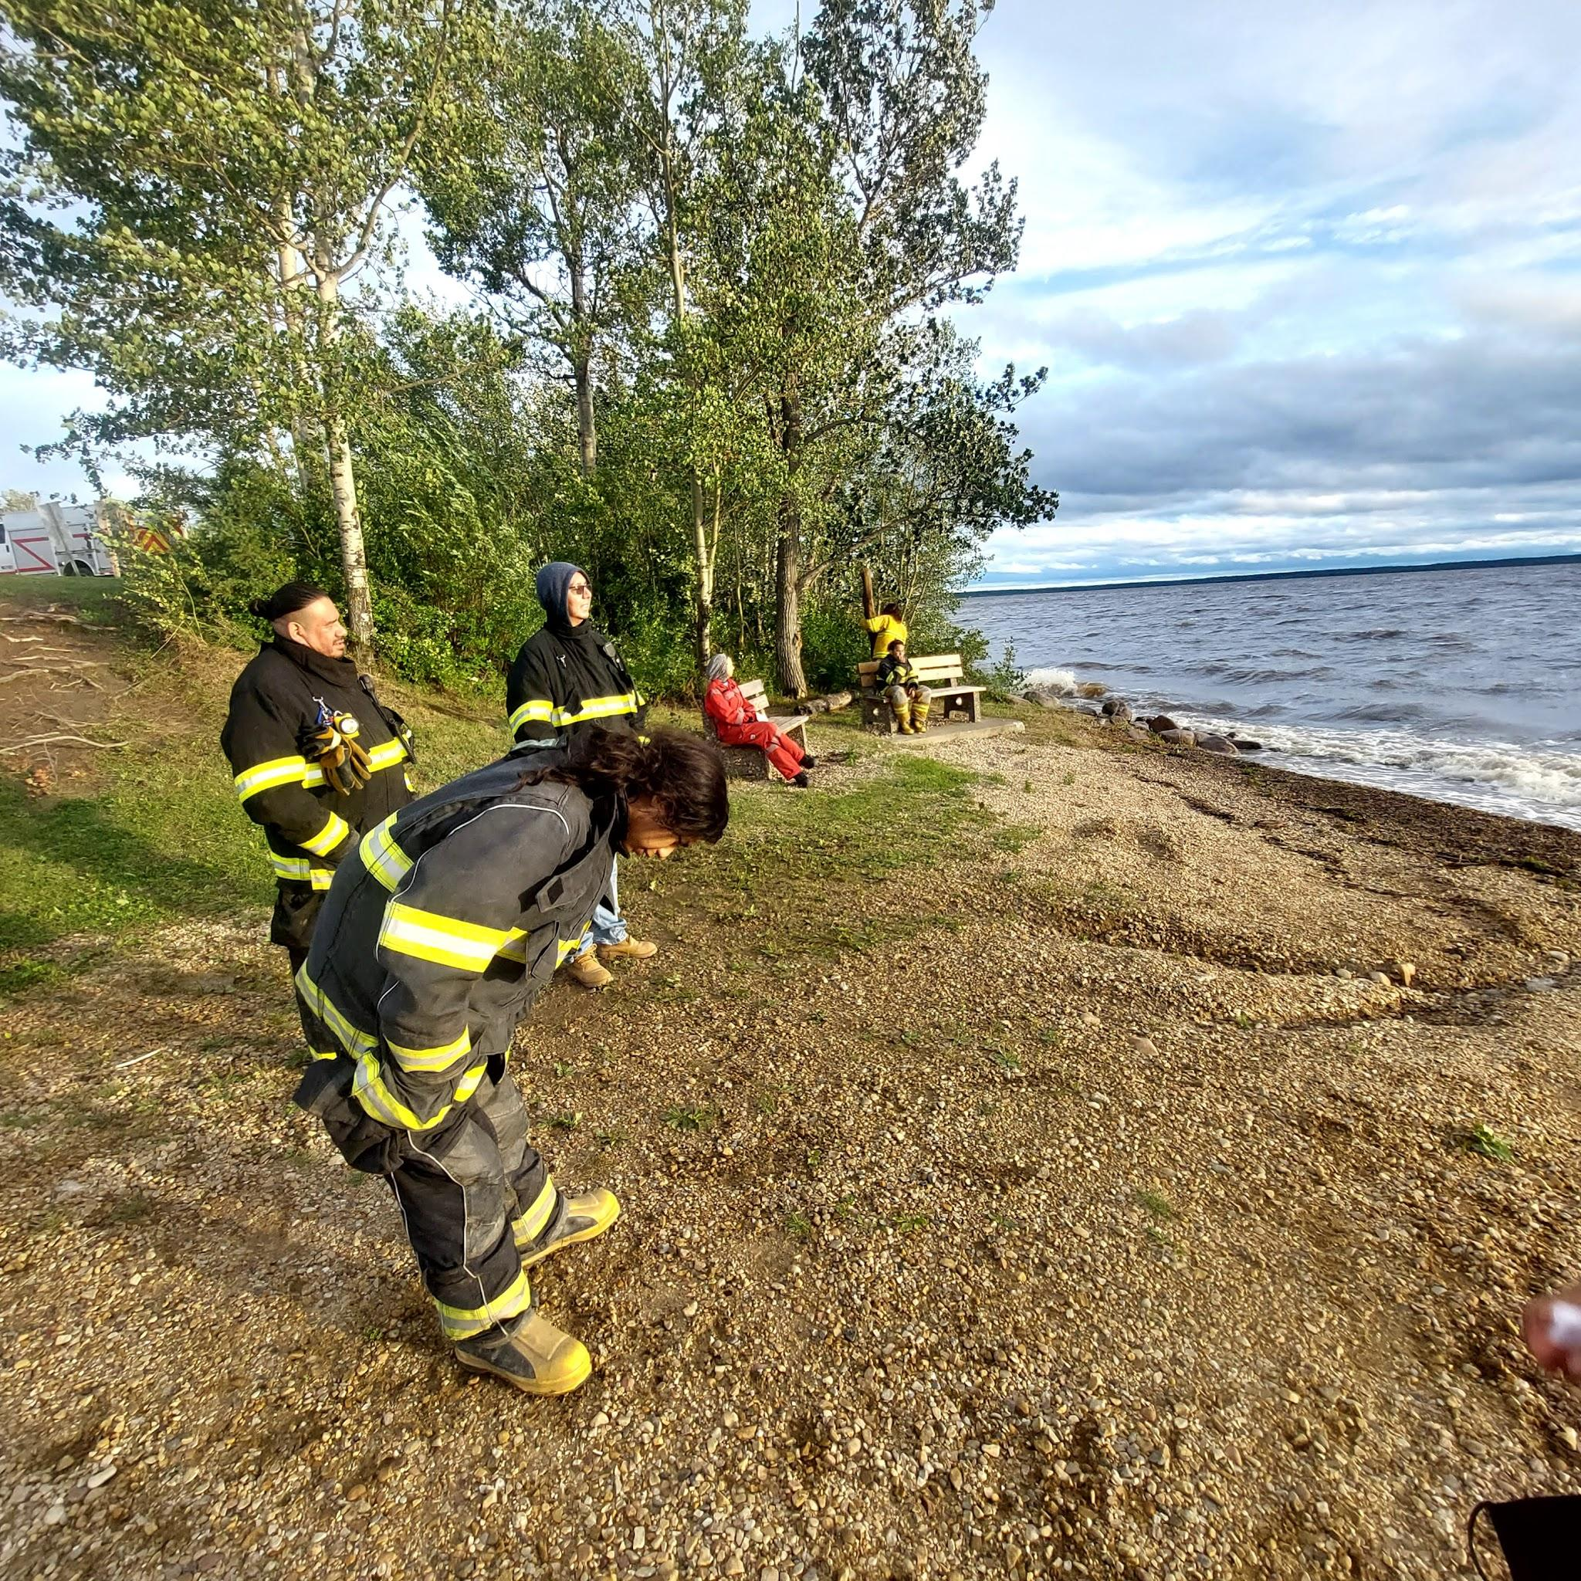
The process of Jr Firefighters Becoming Full Time Volunteer Members
Must complete basic firefighter training
Must show the knowledgeable understanding the firefighter skills
Must be the age of 18 years old
Must have no criminal background

Slide 11
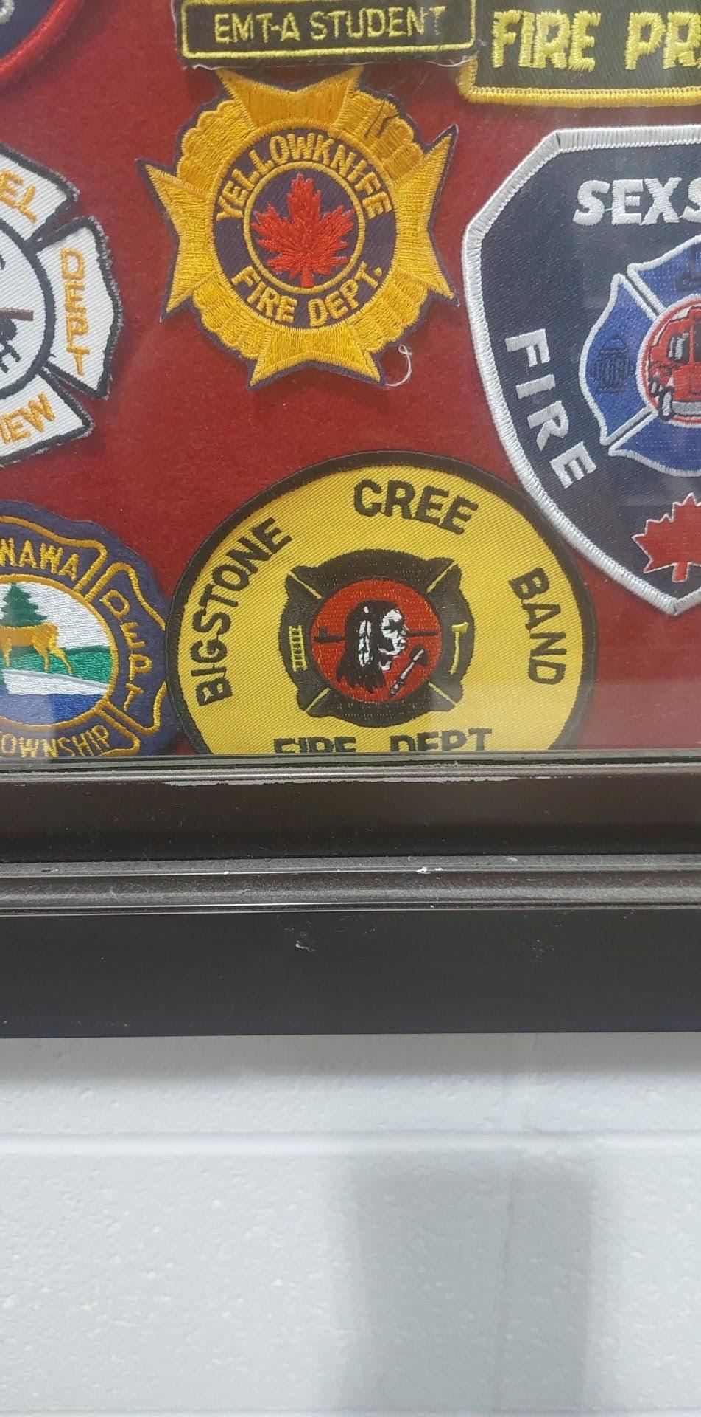
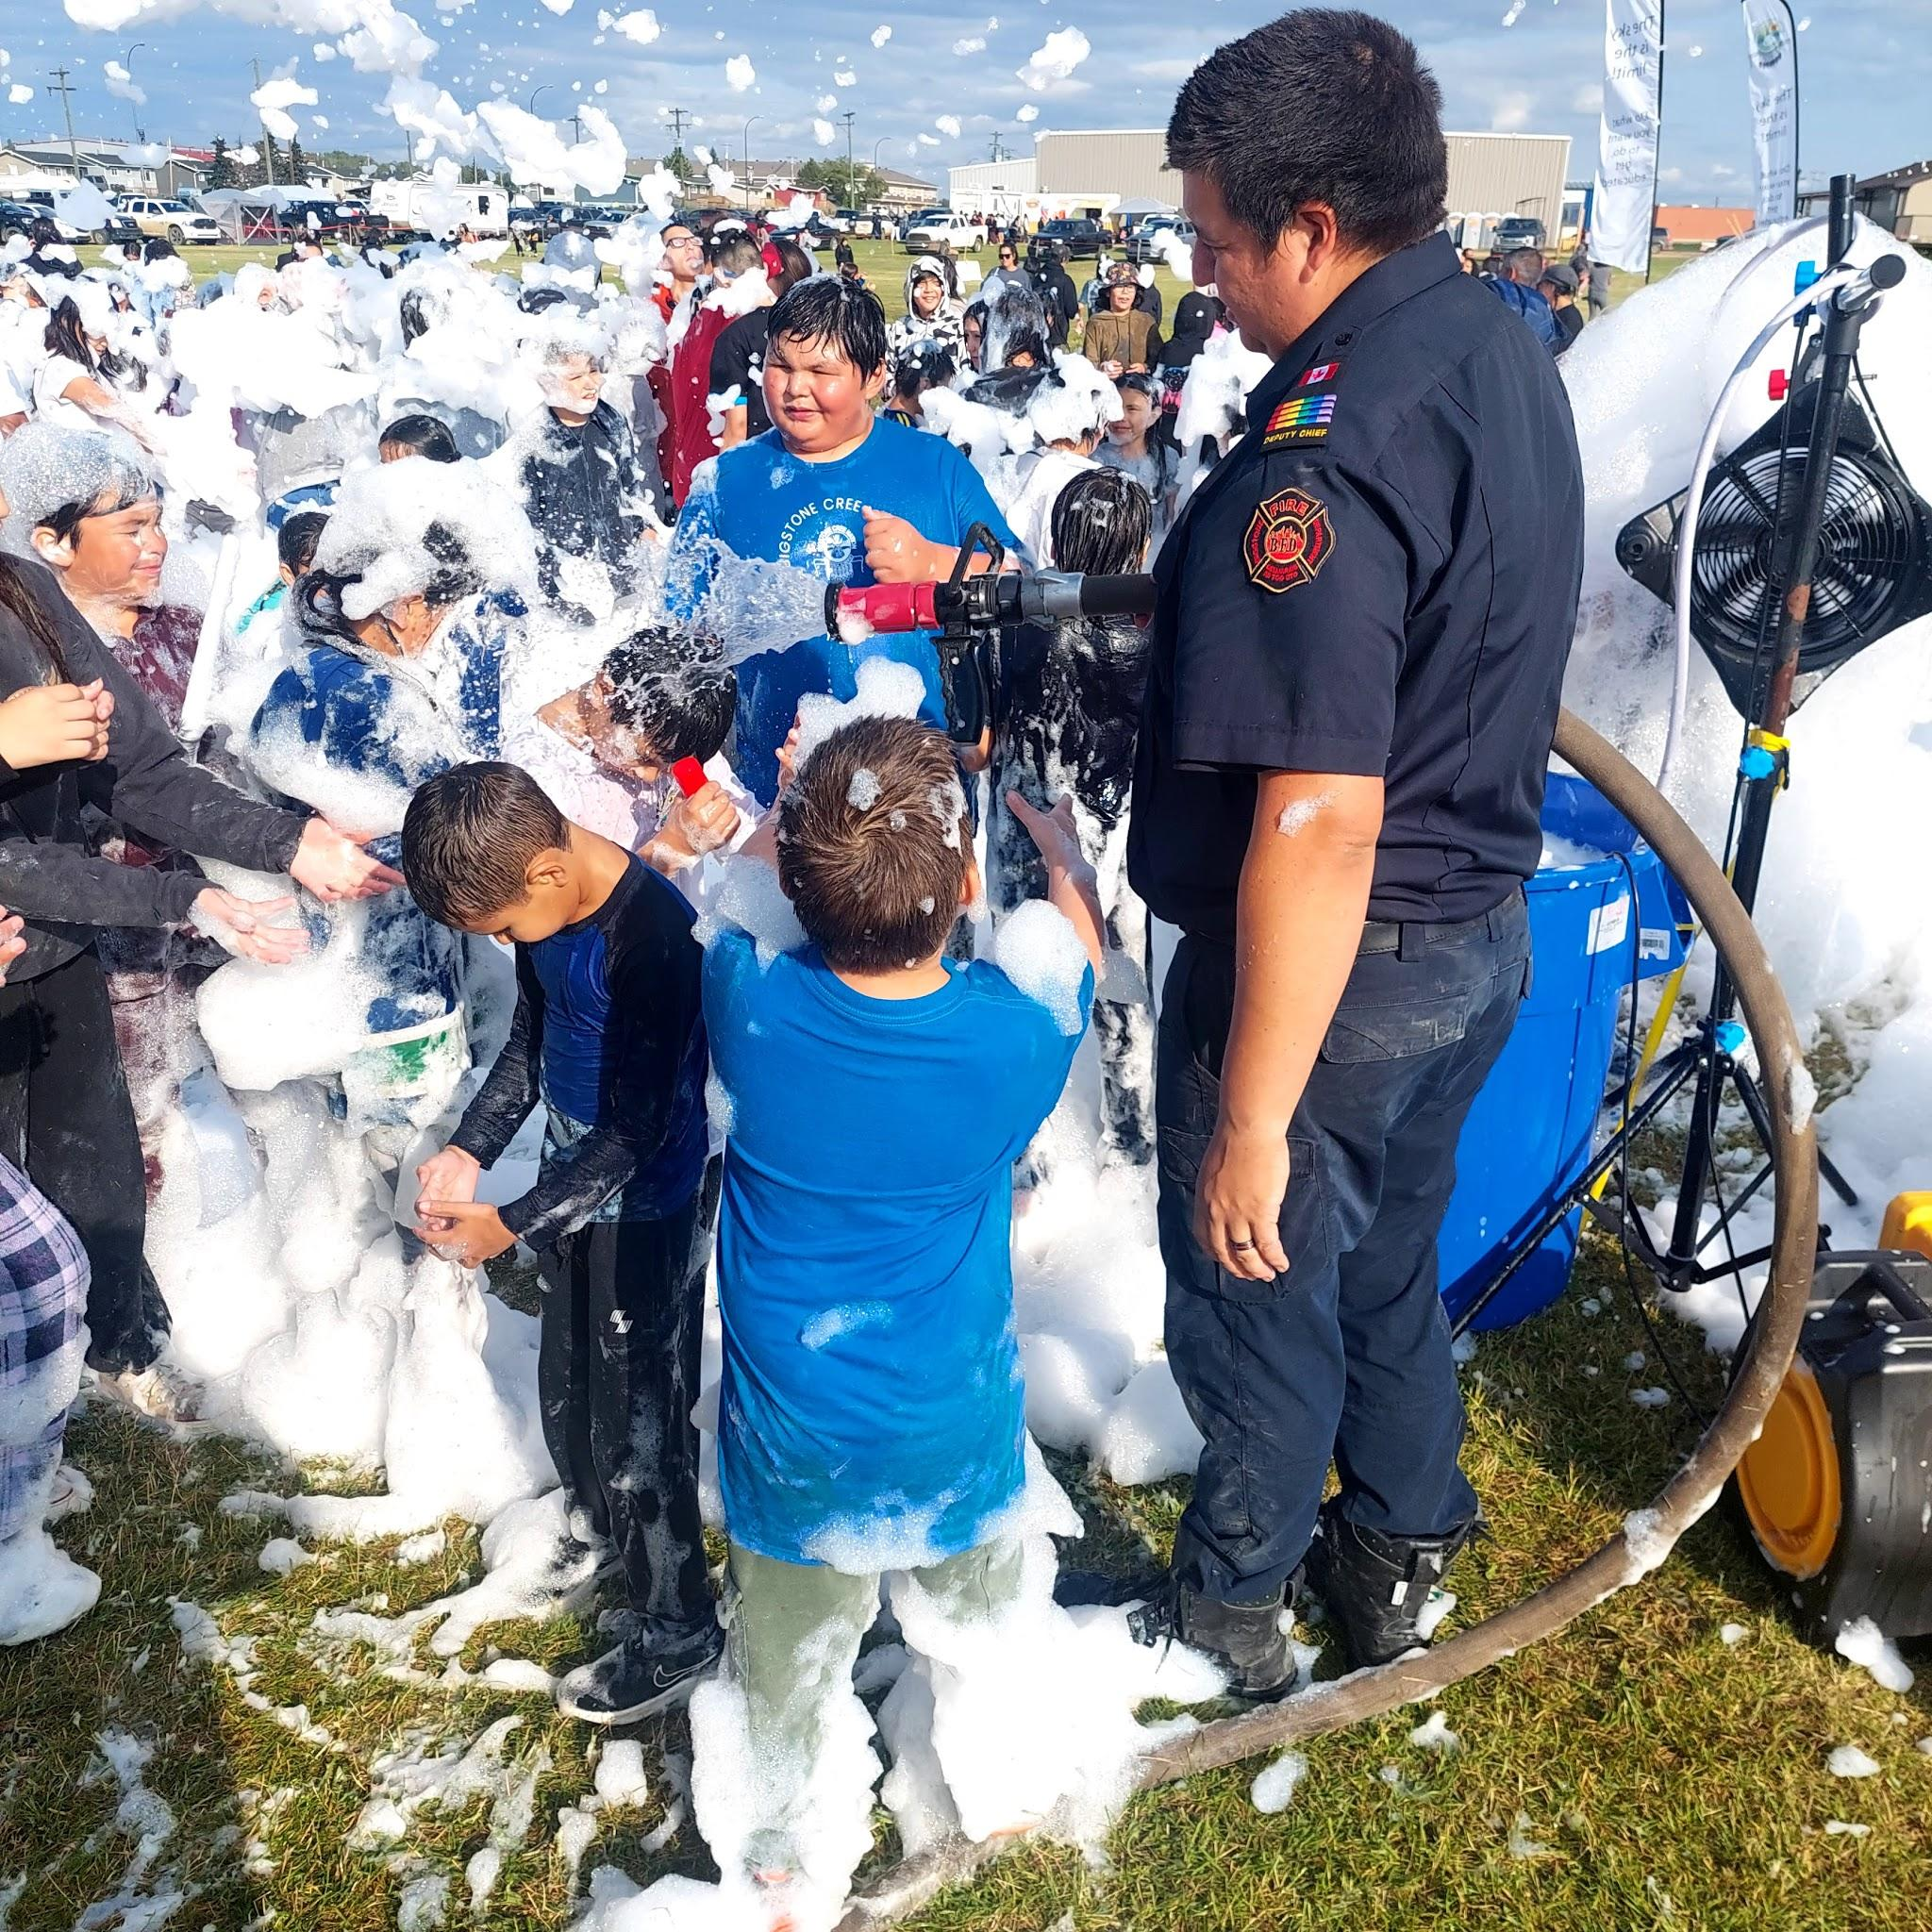
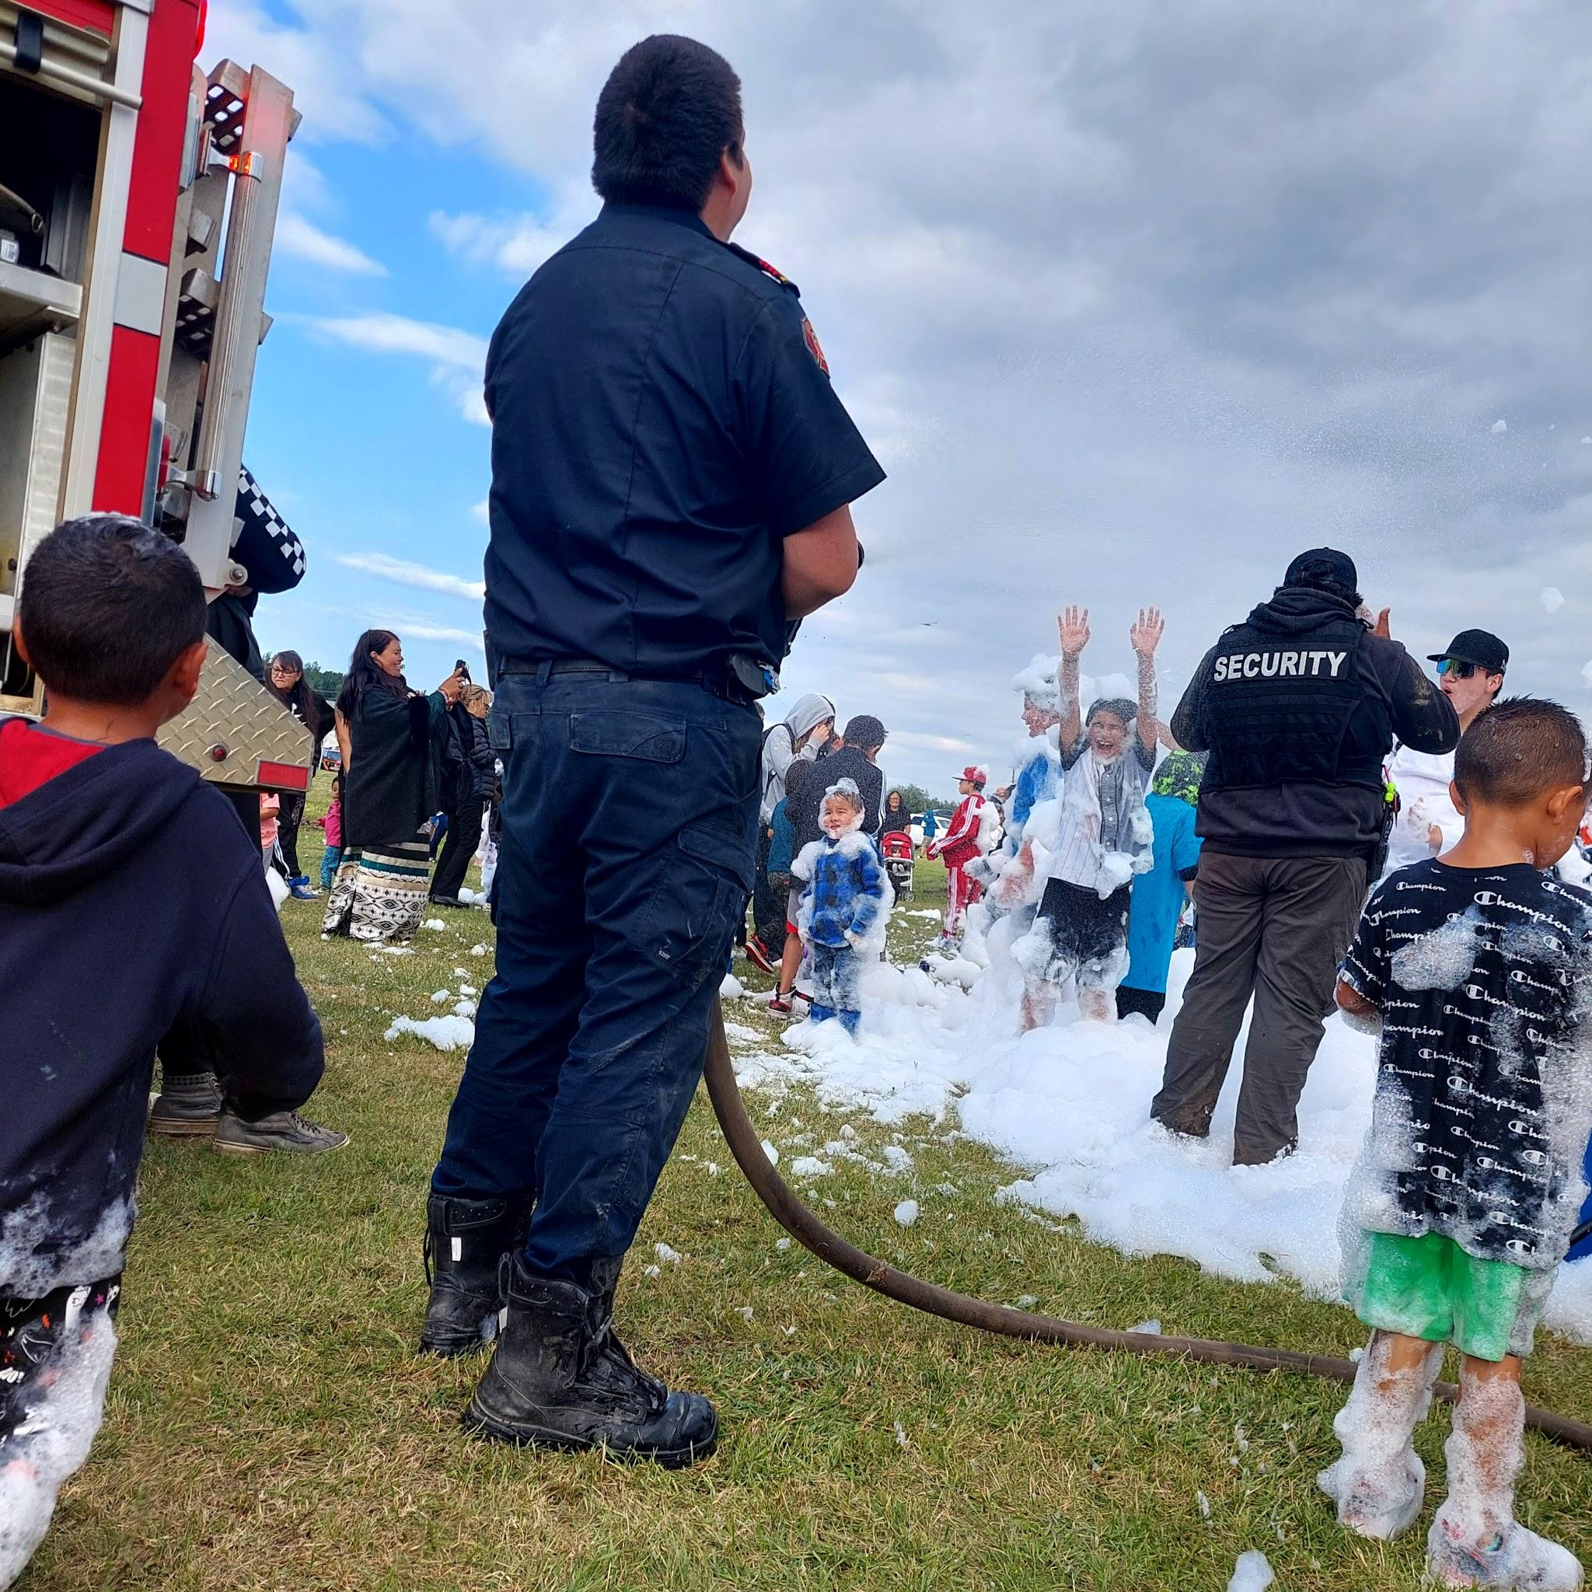
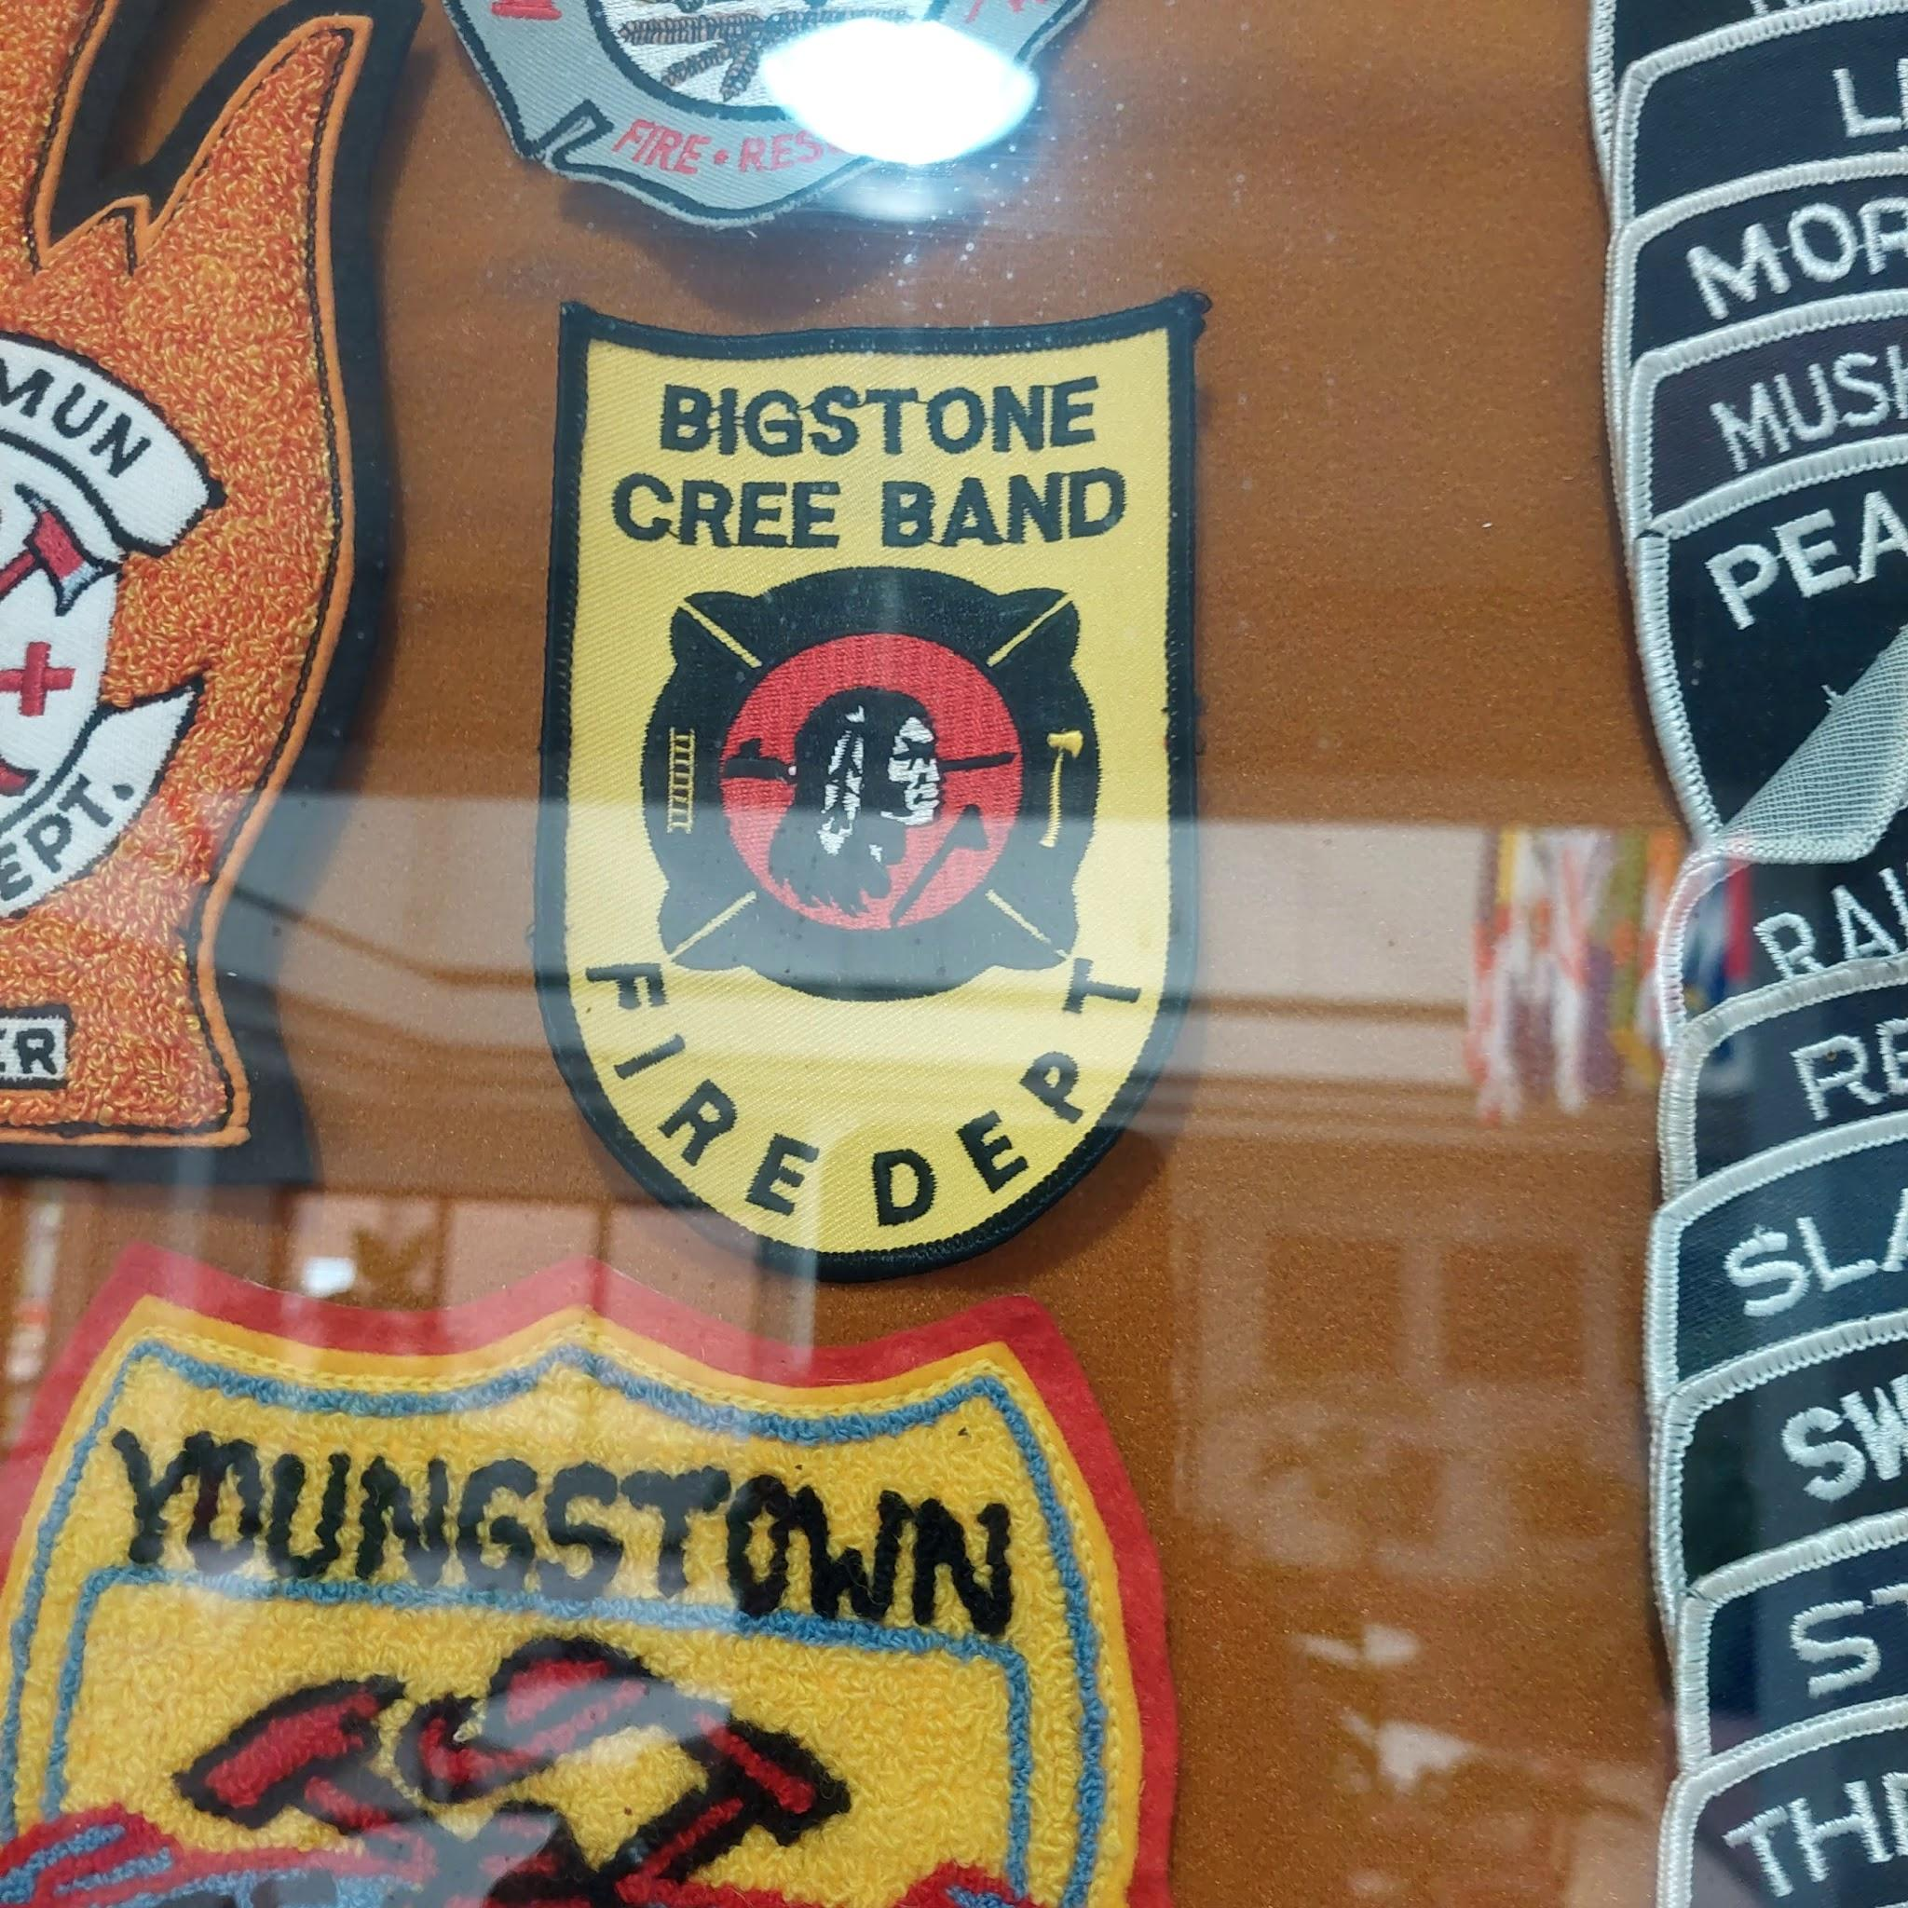
The Benefits of being a Full Time Volunteer Member
Respond to calls
Get more training opportunities
Get 30 dollars an hour for fire dept honours
Get access to the hall
Get life insurance

Slide 12
Thanks For Listening
If you have any questions? Feel free to email us at firehall@bigstone.ca or call us at 780-891-7154 hope you have a great day.

