Slide 1
Water Treatment Plants
Efficient ways to run your water plants
Lawrence Michetti, TSAG CRTP
May 2023

Slide 2
Conventional up flow
The conventional water plant consists of three major parts. Each of these parts must be treated separately to be run efficiently.
Stage One: Your flash mixer, flocculators.
Stage Two: Your settling tank,
Stage Three: The filters.
Remember that it is a domino effect if one process is not work right.
First we will explore the coagulation/flocculation process:
There is a great amount of science to this process, so understanding it is key.
We will list these in point form.

Slide 3
Conventional up flow continued
Stage 1: Your flash mixer, flocculators.
For your charge neutralization to work properly, your coagulant injection should be placed as close to the flash mixer as possible. The flash mixer creates high mixing energy to assist in good charge neutralization. It is one of the most important mixers for this reason.
Tapered flocculation usually has 2 or 3 sets of flocculators.
It is very important to get the velocity gradient (mixing energy) correct in each stage.
Many coagulants vary in the shear force applied to them. Alum, as an example, brakes apart much easier than pacl or ach.
Here are good starting ranges on flocculators:
#1 Flocculator: 65rpm, #2 Flocculator: 32 rpm, # 3 Flocculator: 15–20 rpm

Slide 4
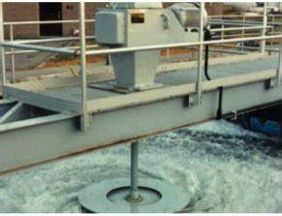
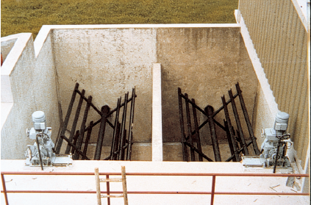
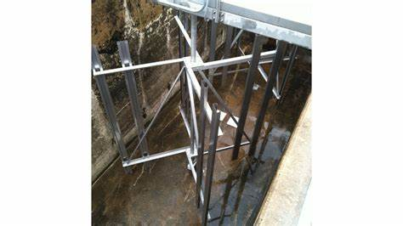
Mechanical flash mixer and flocculators
Flash Mixer
Horizontal Flocculator
Vertical flocculator

Slide 5
clarifiers (Settling tanks)
Stage 2: The Settling Tank
There is a real science to these tanks.
First off, they are usually taped at an angle part way down. Two reasons. As you fill or release water, it allows the tank to expand or contract without damaging the walls. It is also angled to allow the sludge blanket to settle by gravity more consistently.
The blanket is very important to the operation of how this plant performs. As the floc particles settle underneath, the water hydraulics want to push the sludge particles up the clarifier and then into your filter. The clarifier will also have sample tubes on the side. This is to test your blanket level and its state. To dark and septic of a blanket could float it and bring carryover to the filters. The top port should be fairly clear. Tube settlers are installed to add more surface area and promote good settling.

Slide 6
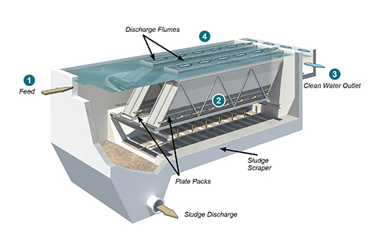
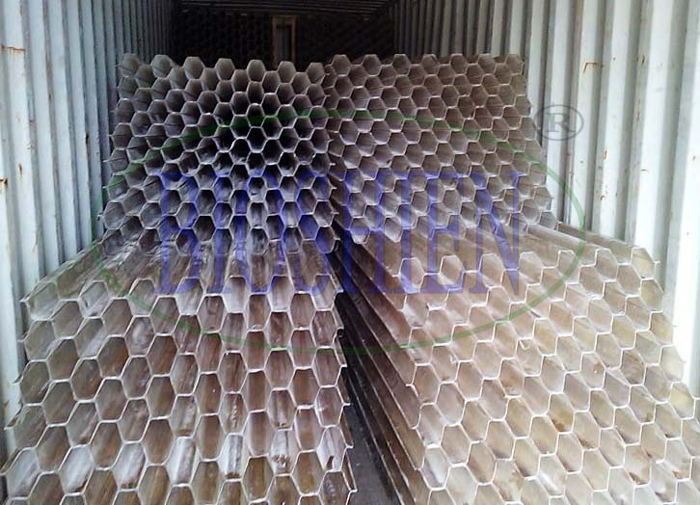
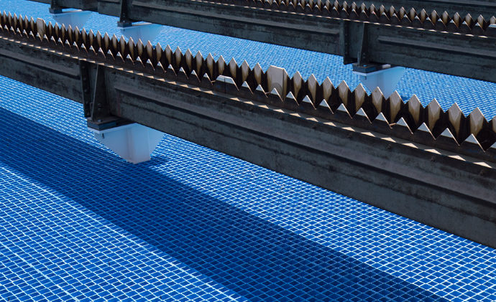
Clarifier and tube settlers
clarifier
Tube settlers
Tube settlers

Slide 7
Clarifier Facts

Slide 8
Sludge blanket samples

Slide 9
Facts continued

Slide 10
Facts continued

Slide 11
Clarifier Tips
Do Not let sludge age too long; Check it every day.
Never let turn septic or you will have carryover to your filter. Adjust your de sludge time. Top sample port should be clear.
You may have to increase your de sludge rate if density current are affecting your clarifier.
Tube settlers increase the surface area of your clarifier by two to three times the surface. They also trap carry over floc till its dense enough to slough off back down.
You may have to de sludge your plant below the tube settlers more often if loading rate on plant is to high, Therefore producing more sludge.
It is better to have short draw offs than long ones on your de sludge times. a cone of depression will form and you will only de sludge water and not sludge.

Slide 12
Dual media filters

Slide 13
Filter media
Stage 3: The Filters
Anthracite (basically its crushed coal)
Its light weight allows it to settle on top the sand later. It covers the whole top area and distributes an even pressure over the sand. It traps particles and aids in the sand from plugging up to fast. It also works on the low adsorption principle. Used to remove turbidity and suspended solids.
Sand:
The sand removes the smaller turbidity by adhesion and straining. Usually as small as 20 -30 microns. Helps remove turbidity, fluoride, iron particles, manganese particles, silt, algae, etc.
Gravel:
supports the media and protects the under drains.

Slide 14
dissolved air floatation (Daf) Addition to filter

Slide 15
Reasons for DAF addition to filter
Aids in floating carry over in plant upsets.
Helps with algae removal.
Aids in iron and manganese removal.
Saves money on removing filter aids.
Extends filter runtimes by reducing filter loading rates.

Slide 16
Direct filtration (df) Plants
Direct filtration plants are used when good source water is found.
They are another type of conventional plant, except they do not have a clarifier.
Flash mix, flocculation with gravel or plastic beads to trap it. Then straight into filtration.
It is designed for source water with less than 10 ntu, low color, low toc, low algae. Floc particle sizes are smaller in df plants because no settling of particles is needed without a clarification process. The advantages are longer filter runs because of a deeper filter bed, less sludge production, less coagulation amounts, and the volume of solids applied to filters are less.

Slide 17
Direct filtration

Slide 18
DAF (dissolved air floatation)
A DAF is an advanced clarification system.
This system utilizes air in the water with a special pressurized pump or saturation tower. The dissolved oxygen then is released in the water by backpressure flowing through needle valves. It then breaks out in solution at atmospheric pressure producing micro bubbles. Coagulant is introduced at the flash mixer and flocculators and flows against a deflector plate that mixes with the micro bubbles. The micro bubbles then attach to the floc and is floated up to the top of the water and then skimmed of to a waste trough. The clean water is collected on the bottom of the tank. 10-20% of the water is recycled back to the saturation tower and the rest proceeds to the filter.

Slide 19
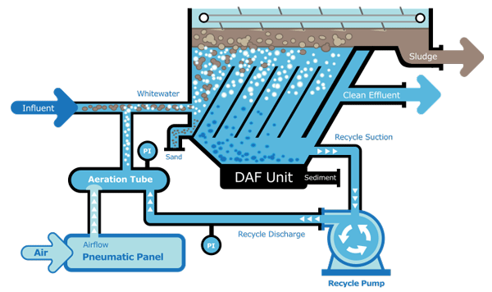
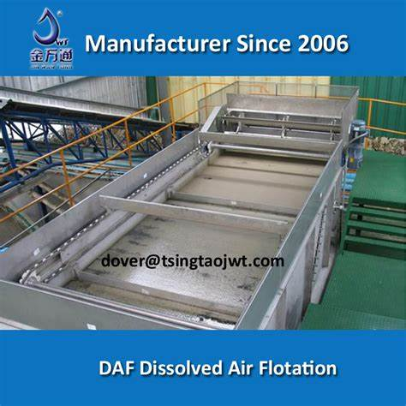
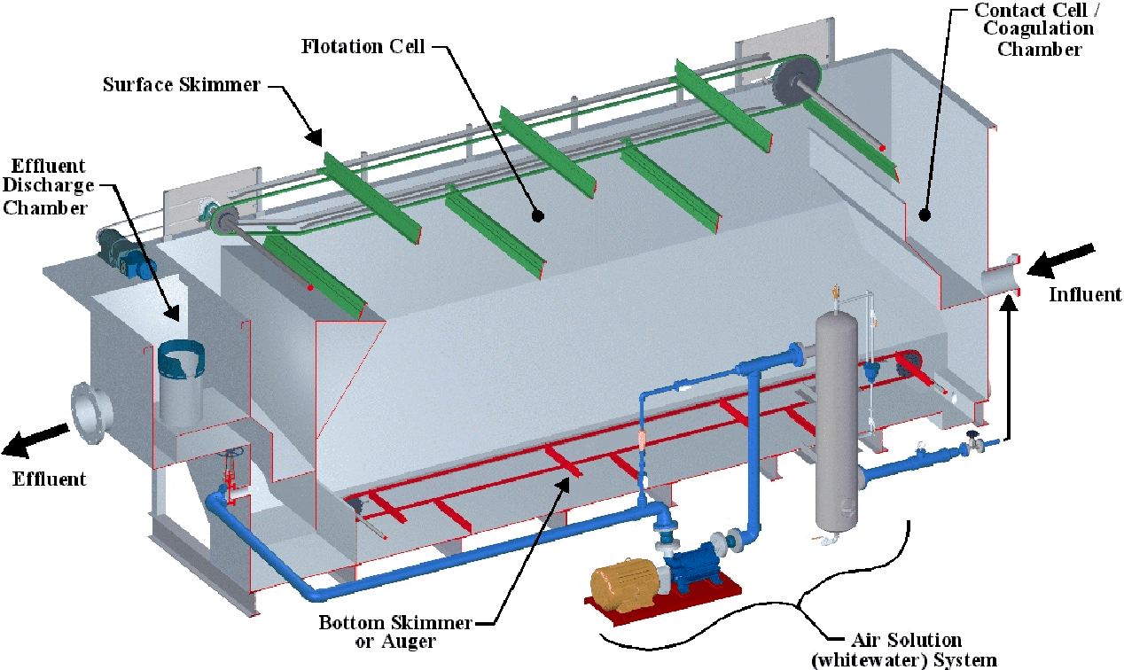
DAF illustration
DAF
DAF
DAF

Slide 20
Daf advantages
Reduces foot print
Can remove small turbidity in short detention time
Removes hydrocarbons, algae (without disrupting cell walls; blue green algae without neurotoxic dumping), volatiles.
Assists in the removal of inorganics like iron and manganese
Aids in removal of toc with coagulants
Designed for highly colored water removal
Easy to retrofit older clarifier systems than building new plant saving millions of dollars.
Made to operate in cold climates more efficiently than standard clarification
Produce two to three times water faster than conventional plant with half the foot print.
One disadvantage is only able to float blanket with turbidity under 100 ntu

Slide 21
Membrane technology
There are many types of membrane technology since the evolution of membranes came into the water treatment world.
They are listed by their pore sizes from largest to smallest.
Micro: pore size 0.1-5 micron (um)
Ultra: pore size 0.02-0.05 um (seldom used)
Nano: pore size 0.2-2 um
Ro: pore size 0.0001 um

Slide 22
Membranes continued
Micro membranes:
Removes suspended solids, microbes, some fats and proteins.
Used as pre treatment to other membranes.
UF membranes:
bacteria, viruses, small particles, some organics, some hardness.
Nano membranes:
Removes some natural minerals, divalent ions, most (nom), and a range of salts, alkalinity, hardness

Slide 23
MEMBRANES continued
Reverse osmosis:
Removes metal ions, aqueous salts, sodium, lead, fluoride, arsenic, chloride, chromium, copper, radium, sulfates, calcium, magnesium, potassium, nitrate, phosphorous, TOC, NOM, hardness these are only some examples.
Lets discuss what flux means:
“flux is the flow rate of water applied per unit area of the membrane”. Meaning the flow rate of the water that has passed through the membrane.

Slide 24
Efficiency of membrane
If your membrane is rejecting between 0-25%:
your membrane is good.
If it falls below 26%:
you may need to change out membrane.
here is how you check it:
Conductivity in minus conductivity out multiply by 100.
Or 1- (TDS)OUT)/(TDS)IN x 100 = % efficiency
This could also be a check if a CIP is needed.

Slide 25
Bio Filter Data
How bio filters work

Slide 26
Iron and Manganese
Iron and manganese in water can be a concern.
In well water, they can both exist above the MAC set by health Canada.
The oldest form of removal has been by oxidation of Potassium Permanganate, Chlorine, Chlorine Dioxide and Ozone. The newest technology has been to use the Bio Chemistry of natural occurring bacteria.
By using a fixed media to allow these bacteria to adhere to, they can then grow and utilize there aerobic metabolism to convert iron and manganese from soluble to in-soluble states, which then can get removed by filtration.
The media that they grow in is Granular activated carbon, crushed coconut shells , Glass glow, anthracite, greensand. The precipitate particles get caught media such as greensand, rapid sand. They are placed in the same pressure filter to achieve oxidation and removal.

Slide 27
Health Canada Objectives
The current standard for manganese in drinking water in Canada was an MAC of 0.05 mg/L.
Health Canada has proposed a guideline of a maximum allowable concentration (MAC) of 0.01 mg/L based on neurological effects on rodents and an aesthetic objective of 0.02 mg/L based on consumer complaints of discolored water.
More recent research has indicated that high levels of manganese in drinking water has neurotoxic effects Children exposed to high levels of manganese in drinking water reported lower Iqs. The current MAC of iron is 0.3 mg/L.

Slide 28
Iron cycle

Slide 29
Iron Cycle
In the above diagram, ferrous iron (soluble iron) is being introduced to oxygen and microbiological IOB’s (iron oxidizing bacteria), the pH increases and the soluble iron becomes FE+3 from FE+2. The FE+3 is now in particle form and able to be filtered out. The diagram above also shows the reverse condition.
It is important to note that ferrous iron (FE+2) actually kills MOB,s (manganese oxidizing bacteria). Therefore; if your iron bacteria or oxygen levels aren’t correct for this process, This will affect your manganese removal in the end.

Slide 30
Manganese cycle

Slide 31
Manganese cycle
Depicted in the picture above is the soluble to in-soluble cycle of manganese. Generally when in an anaerobic condition manganese is always in a MN +2 state. As it is oxidized it starts to transition from this state to MN+3 then Mn+4. The +4 is the charge when it is in a precipitate (particle) state. This can occur if pH, temperature and oxidation has occurred. Manganese will oxidize much quicker if pH is above 8.3 and optimal at 9. current conditions in a Bio filter should be aerobic at all times. for Iron the oxygen should be minimum 0.3 and max 5mg/L. for manganese, because the bacteria exists at the lower part of the filter, the oxygen going into the filter should be 8-10.( also if nitrifying bacteria exist)

Slide 32
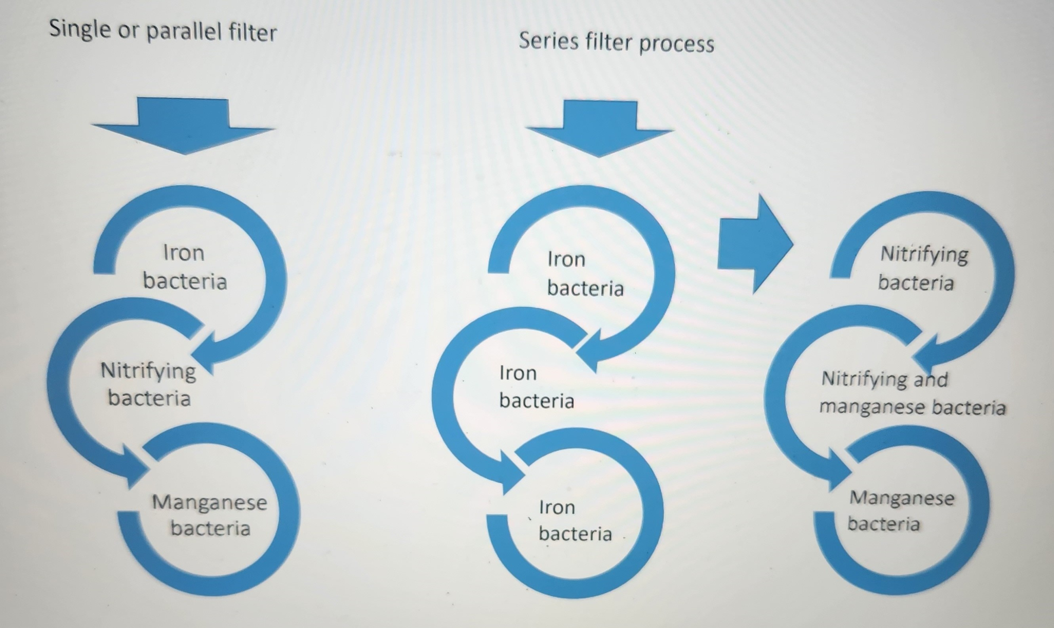

Slide 33
Single or parallel filters
In the diagram above, the filter on the left represents a filter being feed directly. There could also be two filters begin fed directly in parallel. The first third of the filter will have IOB (iron oxidizing bacteria), they are there to take out the soluble iron. Then the water passes through the middle of the filter which will have a small amount of nitrifying bacteria. They deal with ammonia- nitrogen in the water. The last stage deals with manganese, MOB ( manganese oxidizing bacteria). they convert soluble manganese to insoluble manganese. It is best in this configuration to have DO (dissolved oxygen at 10mg/L with a residual after the filter of 2mg/L). This ensures the MOB’s don’t go anaerobic. This type of filter is mainly used to remove Iron and manganese. It is not really designed for nitrification removal

Slide 34
Series filter configuration
This type of configuration is designed to remove iron, Manganese, ammonia-Nitrogen. The first filter is used to remove the iron that is soluble in the water to in soluble, and trap the particles in the media. The oxygen should be 4mg/L with a minimum of 0.3mg/L. The water then flows to filter 2. The oxygen should be 10 mg/L going into filter as nitrifying and manganese oxidizing bacteria use a lot of dissolved oxygen to complete these processes. There should be an excess of 2mg/L of oxygen after the filter to show the MOB’s have not gone into anaerobic state. If you find your manganese is higher in the finished water than the raw, then not enough oxygen is present

Slide 35
Backwash cycles for Bio filters
In single or parallel filters it is best to follow engineering O & M manual to follow these requirements. Their should be a differential pressure on top of the filter to the bottom of the filter to tell you the filter is starting to plug off. It could be 4 to 6 psi differential. Follow O & M manual for this procedure.
For filters in series, the first filter taking out iron is suggested to be back washed every 3 days. The second filter, is recommended to be backwashed every 5 days. Again, refer to your plants O & M manual for differential pressures as well

Slide 36
Questions
Or
Discussion points?

Slide 37
Thank you all for
attending the conference

