Slide 1
Overview of ISC – FNIHB
Drinking Water Safety Program
Presented by: Kyle Wonsiak, CPHI(C)
Environmental Public Health Services
First Nations & Inuit Health Branch, ISC, AB Region

Slide 2
Presentation Outline
Mandate of Environmental Public Health Services (EPHS)
Role of the Environmental Public Health Officer (EPHO)
Overview of the Drinking Water Safety Program (DWSP)
  Community-Based Water Quality Monitoring
  Water System Classifications
  Drinking Water Advisories
    Current Advisory Picture for Alberta
  Regional Drinking Water Advisory Team
  2020 Water Forums and Next Steps

Slide 3
Mandate of EPHS
EPHS works to identify and prevent environmental public health risks that could adversely impact the health of a community and its citizens.
Programming includes: public health inspections, environmental monitoring (e.g. drinking water quality), delivering training / building capacity and raising awareness about potential environmental public health risks and providing information to people in order to protect themselves and their families from EPH risks.
Prevention is a key principle of environmental public health.

Slide 4
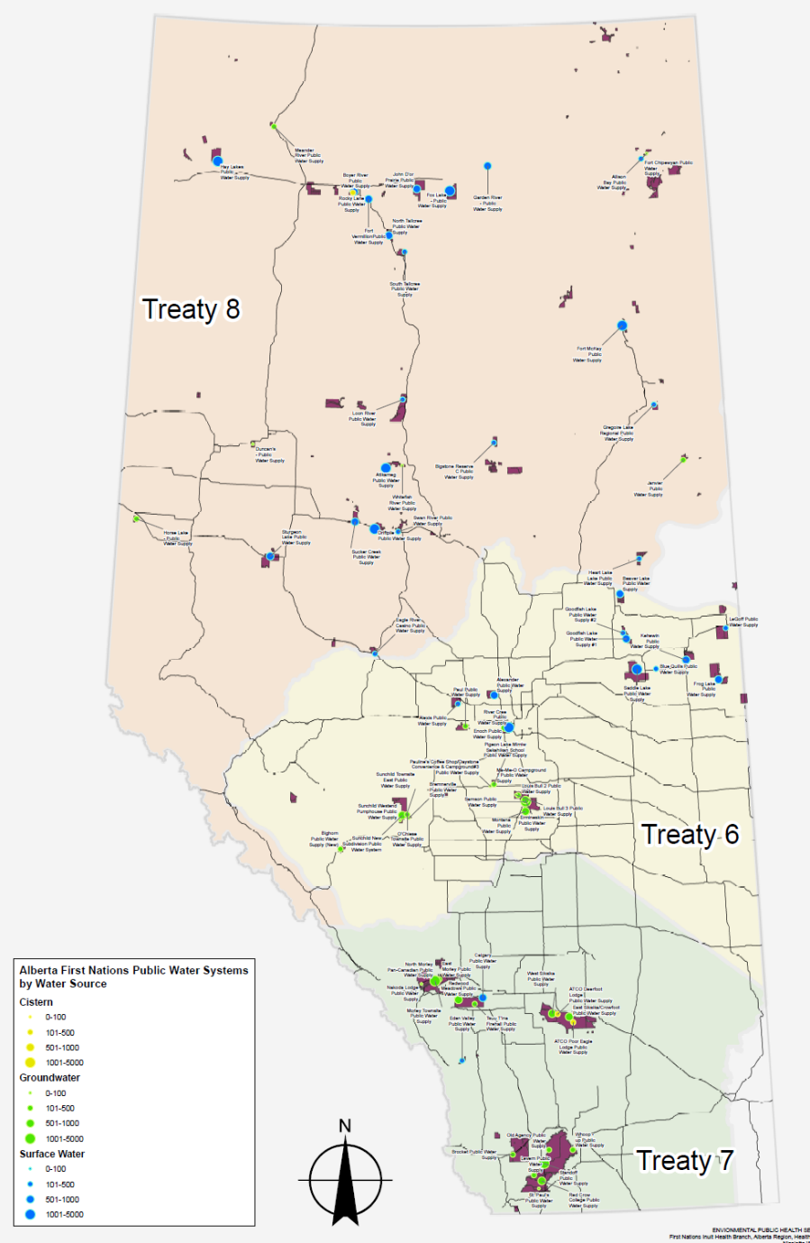
EPHS Alberta Region
45 First Nations
134 Communities
3 Treaty Areas
1 Regional Manager
2 Senior EPHOs (Supervisors)
~18 Field Environmental Public Health Officers
4 Admin. Staff
3 Data Team staff
Offices in Calgary (Tsuut’ina) & Edmonton (Canada Place)

Slide 5
Role of an Environmental Public Health Officer
EPHOs provide advice, guidance, education, public health inspections and recommendations to First Nations and their leadership to assist them manage public health risks associated with the environment.
They gather and analyze data and provide advice on health protection and promotion activities in First Nations communities.
Have a role in training and building capacity within First Nations communities in environmental health programming.
All EPHOs are Certified Public Health Inspectors In Canada and hold the professional designation of CPHI(C) and are regulated by a professional body (CIPHI)

Slide 6
Role of an Environmental Public Health Officer
Conduct Environmental Public Health Inspections and investigations.
Provide public health resources and community specific data/information.
Review and approvals (e.g. private sewage disposal systems).
Plan Reviews
  EPHS contracts public health engineers for review of community infrastructure plans such as new facilities or upgrades to water plants, wastewater facilities, solid waste facilities etc.
  Purpose is to ensure public health guidelines and standards are adhered to and considered with new and upgraded infrastructure.

Slide 7
Role of an Environmental Public Health Officer
Training
  Community-Based Water Monitors
  Water Truck Drivers
  Food Safety & Sanitation
Advocacy
  Supporting communities on any environmental public health issues.
After-Hours Support
  An On-Call EPHO is available 24/7 to respond to community needs outside of normal office hours: (780) 719-8782.

Slide 8
Core Program Areas
Food Safety Program
Drinking Water Quality
Wastewater (private & community systems)
Health and Housing
Communicable Disease Control / Animal Exposures
Emergency Preparedness and Response
Solid Waste (transfer stations, landfills)
Facilities Inspections and Risk Assessments

Slide 9
Drinking Water Safety Program – Stakeholders
Drinking water safety is a shared responsibility between EPHS, FN communities and key government partners (TSAG – Technical Services Advisory Group, Regional Operations, ISC).
Each partner has a role to play with respect to the Multi-Barrier Approach to safe drinking water – this ensures water remains as safe as possible from source to tap.

Slide 10
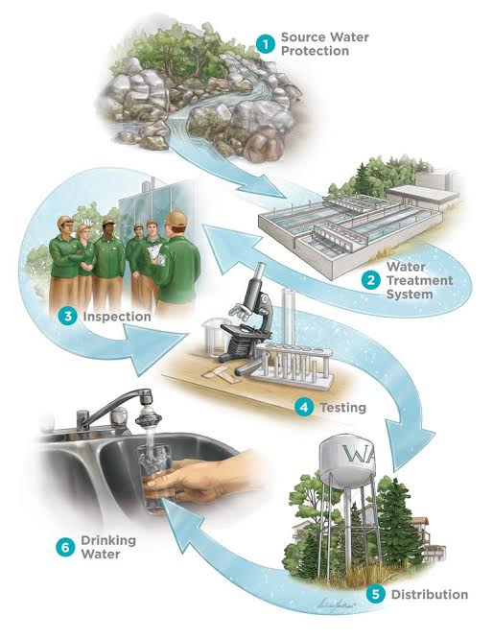
Drinking Water Safety Program The Multi-Barrier Approach

Slide 11
Drinking Water Safety Program
Our mandate is to implement and oversee a drinking water monitoring program in First Nation (FN) communities across Canada (the final barrier in the multi-barrier approach). This is in partnership with FNs and carried out by Community Health Representatives (CHR) and/or Community-Based Water Monitors (CBWM).
The purpose of the monitoring program is to ensure safety of the drinking water supply and to protect public health. Therefore, routine sampling must occur at the required levels.
If monitoring activities indicate a potential risk to the public, EPHS will investigate the concern and, if necessary, issue an advisory.

Slide 12
Drinking Water Safety Program
Roughly 30,000 samples per year are submitted for microbiological analysis.
  Collection and submission of samples is conducted by CHR/CBWM.
  Analyses carried out by a fully accredited lab, the Provincial Laboratory for Public Health, ProvLab (MOA).
Comprehensive chemical analysis also done on PWS, SPWS twice per year (quarterly for Disinfection By Products where required).
  Chemical sampling is carried out by EPHOs and analysis done by accredited contract laboratory.
Private wells and cisterns monitored for bacteriological quality and chemical quality (wells only).
All data and reports are provided directly to the communities.

Slide 13
Drinking Water Safety Program –
Community-Based Water Monitors
The success of the water quality monitoring program hinges on the dedication and hard work of the CHRs and CBWMs.
All CBWMs must undergo formal training and certification as per the national drinking water program and recommendations provided by the Office of the Auditor General
Community EPHOs deliver certification training to CBWMs
  Consists of a 2 day training course with knowledge and practical evaluation.
  Training offered every 2 years and as needed on ad-hoc basis.
  The most recent CBWM workshops were held in the Spring of 2022 with a total of 2 sessions and 118 participants. The CBWM training is coordinated through TSAG.
EPHOs provide ongoing support, communication, collaboration and training.

Slide 14
Annual Microbiological sampling and testing of drinking water from public and semi-public water supplies 2012/13 to 2021/22
2021/2022 testing rate is 83% * subject to adjustment
Source: ISC, FNIHB – Alberta Region, Drinking Water Quality Database via ELPHIS

Slide 15
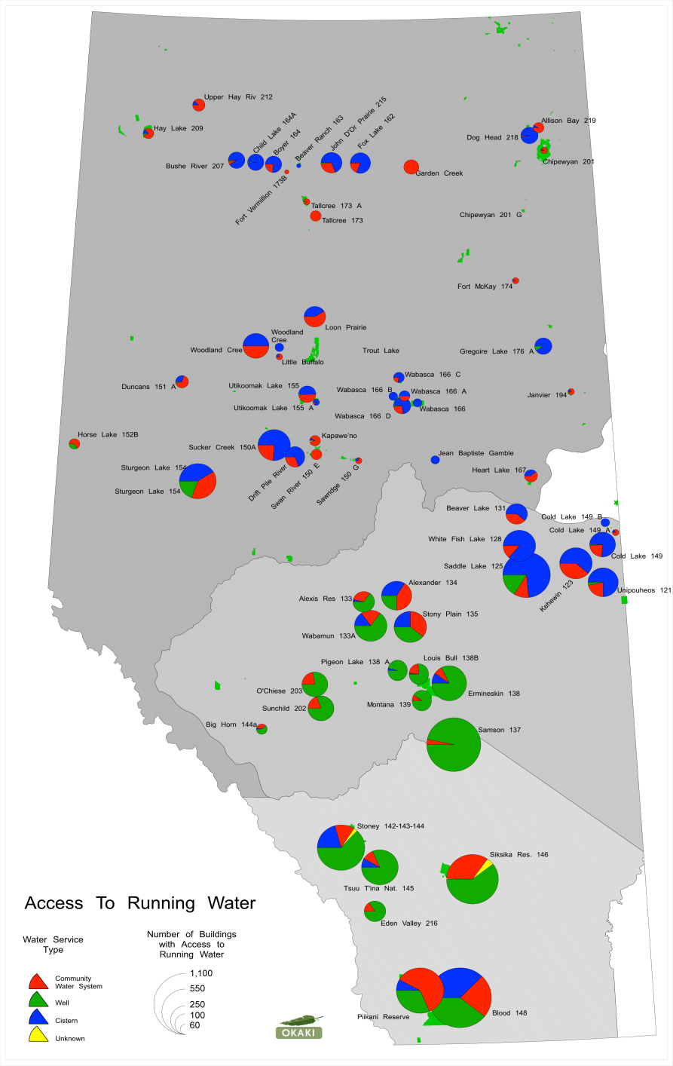
Drinking Water Systems in Alberta First Nations
Public Water Systems (PWS): 80
Semi-Public Water Systems (SPWS): 140
Private Water Systems (PrWS):
Wells: 3796
  Cisterns: 5511
  Total 9307
Source: ELPHIS Database
EPHS AB Region

Slide 16
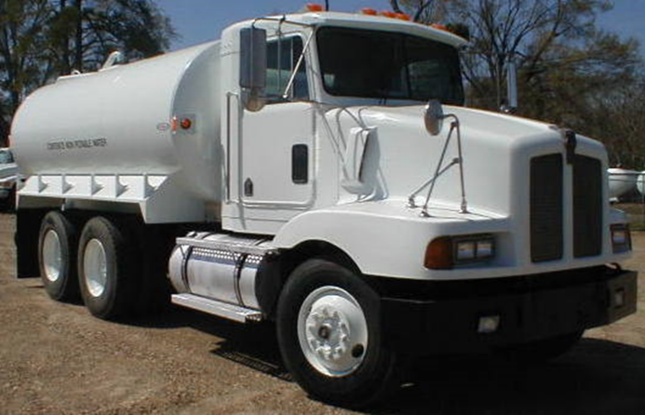
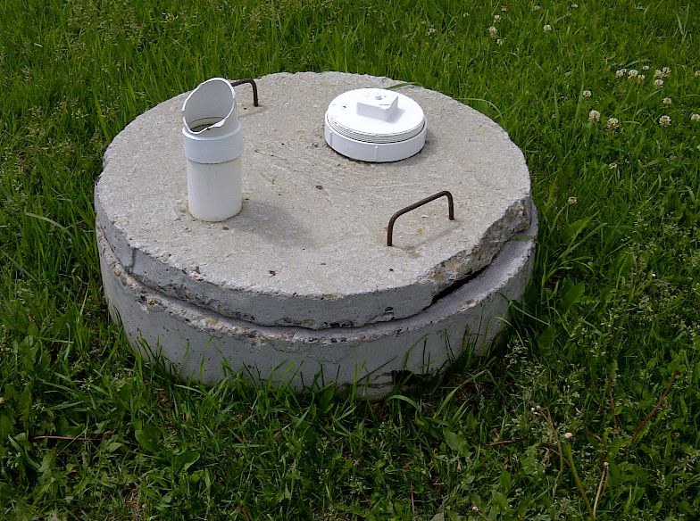
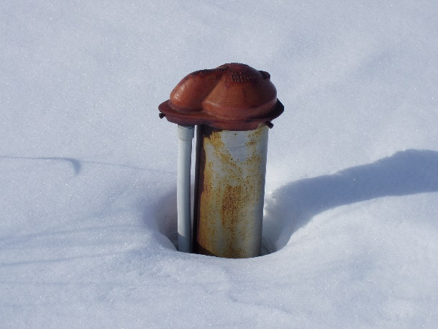
Drinking Water Systems
Only about one-third of First Nations are connected to a piped distribution system or regional water line.
Two-thirds of First Nation homes must rely on wells or truck hauling to cisterns for their drinking water.

Slide 17
Exposure to Contaminated Drinking Water
Consuming contaminated water can lead to a waterborne disease caused by waterborne pathogens.
Water that is colourless, tastes good and smells normal can still be contaminated.
Common symptoms that result from drinking water that is contaminated with pathogens include nausea, vomiting, diarrhea, cramps and fever.
These effects can be more serious, chronic or even deadly in vulnerable people who are infected, such as infants, the elderly or people with compromised immune systems.

Slide 18
Drinking Water Advisories
The EPHO will issue a drinking water advisory (DWA) when it is determined that there is a significant risk to public health from consuming the water.
DWAs are a means of health protection and disease prevention.
DWAs are not indicators of fault or operator neglect, they signify the identification of an issue or event that may adversely impact public health.
  In most cases, the issue is identified by the operator and communicated to the EPHO and corrective actions follow.

Slide 19
Drinking Water Advisories
Each and every advisory issued by our program is based on a thorough risk assessment and site specific knowledge of the EPHO.
The EPHO consults with water treatment plant operators, community representatives and Circuit Rider Trainers with TSAG.
Each water system is unique with its own challenges depending on source water and level of treatment.

Slide 20
Conditions that Lead to Advisories
Reasons may include a single, or combination of adverse conditions that result in an advisory:
    Treatment system compromised (e.g. lack of chemicals, filter failure, emergency events).
    Lack of (trained) operator.
    Lack of monitoring.
    Source water challenges (e.g. Blue-green algae, elevated turbidity).
    Distribution system failure or pressure loss (e.g. dist. pump failure, line break, scheduled maintenance, quantity/volume issues).
    Unacceptable microbiological quality (e.g. detection of TC or EC).
    Lack of chlorine residual or excessive chlorine residual.
    Outbreak of disease where water may be implicated.

Slide 21
Types of Drinking Water Advisories
Boil Water Advisory (BWA)
  Most common advisory issued.
  Water must be brought to a rolling boil for 1 minute to destroy or inactivate pathogens.
  Once water has been boiled and cooled it may be used for drinking, cooking and cleaning.
  This type of advisory is only issued for biological risks; boiling water will not address chemical contaminants (e.g. nitrates).

Slide 22
Types of Drinking Water Advisories
Do Not Consume (DNC) Advisory
  May be issued if the levels of disinfection residuals or naturally occurring chemicals (nitrates) are too high—these would not be removed by boiling.
  While a Do Not Consume Advisory is in place, water should not be used for anything that could create a risk that it would enter the body (brushing teeth, cooking, washing dishes, etc.).
  It can still be used for fighting fires, flushing toilets, etc. or other non – potable purposes.

Slide 23
Types of Drinking Water Advisories
Do Not Use (DNU) Advisory
  Issued when any contact either through dermal absorption and / or ingestion of water is unsafe.
  Circumstances warranting a DNU Advisory include toxins from Blue-Green algae blooms, or excessive levels of chlorine in the water supply.

Slide 25
Notes:
40 DWA
Boil water advisory/order 37
Do not consume advisory 1
Do not use advisory 2
50% of advisories due to either planned maintenance or pressure loss in the distribution system.

Slide 28
Notes:
11 DWAs: All Boil Water Advisories

Slide 33
Alberta Region Drinking Water Advisories 2021/2022
System Type | Total Number of Systems | Number of Advisories | Percent of Total Advisories
Public | 80 | 20 | 1.7 %
Semi-Public | 140 | 9 | 0.8 %
Private (wells & Cisterns) | 9307 | 1139 | 97.5%
Source: ISC, FNIHB – Alberta Region, Drinking Water Quality Database via ELPHIS

Slide 34
Drinking Water Advisories (DWA)

Slide 35
Regional DWA Team Update
The regional DWA working group has been in place in 2007 as a way to bring stakeholders together on this common issue.
Consists of representation from:
  ISC Regional Operations (RO)
  ISC First Nations & Inuit Health Branch (FNIHB)
  TSAG Circuit Rider Training Program (CRTP)
Meet weekly to discuss all DWAs in the region and collaborate towards potential solutions.
Proactive and team based approach to the issue that has been effective.

Slide 36
Next Steps for FNIHB-EPHS
  Continued focus and emphasis community and regional sampling goals and CBWM training and certification.
  Re-establishing and enhancing Community Drinking Water Teams
  Focus on enhancing community capacity, training and education on wells and cisterns (private systems) as outlined in the findings of the 2020 water forum.
  Continue updating assessment and information on wells and cisterns in the region (well & cistern survey).
  Enhance opportunity and support for community capacity, training and education on wastewater.
  Continued collaborative work to reduce the overall number of drinking water advisories with the ultimate goal of improving access to safe drinking water.

Slide 37

Discussion & Questions?
Kyle Wonsiak
A/Senior Environmental Public Health Officer
First Nations and Inuit Health Branch, Alberta Region
kyle.wonsiak@sac-isc.gc.ca
780-495-7037
Simon Sihota
Regional Manager, Environmental Public Health Services
First Nations and Inuit Health Branch, Alberta Region
Indigenous Services Canada
simon.sihota@sac-isc.gc.ca
780.495.5114

Slide 38


