Slide 1
Water and Wastewater Technician Program
Darren Demchuk, Chair - WWW

Slide 2
WWW Program Overview
One year certificate
Three semesters
Theory on Water and Wastewater Treatment, Water Distribution & Wastewater Collection Systems aligned with ABC Need-to-Know Criteria
Hands on lab training
Industry Practicum

Slide 3
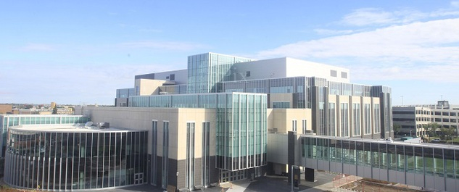
Program Locations
NAIT Main Campus
Four discipline specific labs
Simulators, lab testing equipment, and www specific tools.

Slide 4
WWW Semesters
WWW Fall Intake
WWW Winter Intake
Semester One (Theory)
September to December
Semester Two (Theory)
January to April
Semester Three
(Industry Practicum)
May to August
Semester One (theory)
January to April
Semester Two
(Industry Practicum)
May to August
Semester Three (Theory)
September to December

Slide 5
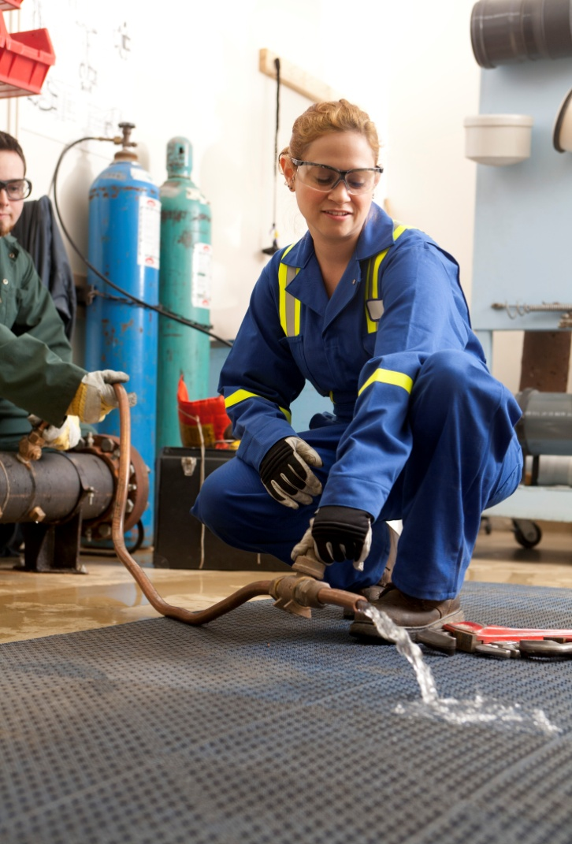
WWW Courses
Water Distribution Foundations & Intermediate
Learn about components and operation of water distribution systems including water main repair, valve/hydrant maintenance & repair, water meter installation, etc.

Slide 6
WWW Courses
Water Treatment Foundations & Intermediate
Topics covered include raw water sources, reservoir management, coagulation/flocculation/ sedimentation process, disinfection, filtration, taste/odour, softening, etc.
Water quality analysis, testing and calibration of equipment in a laboratory setting.

Slide 7
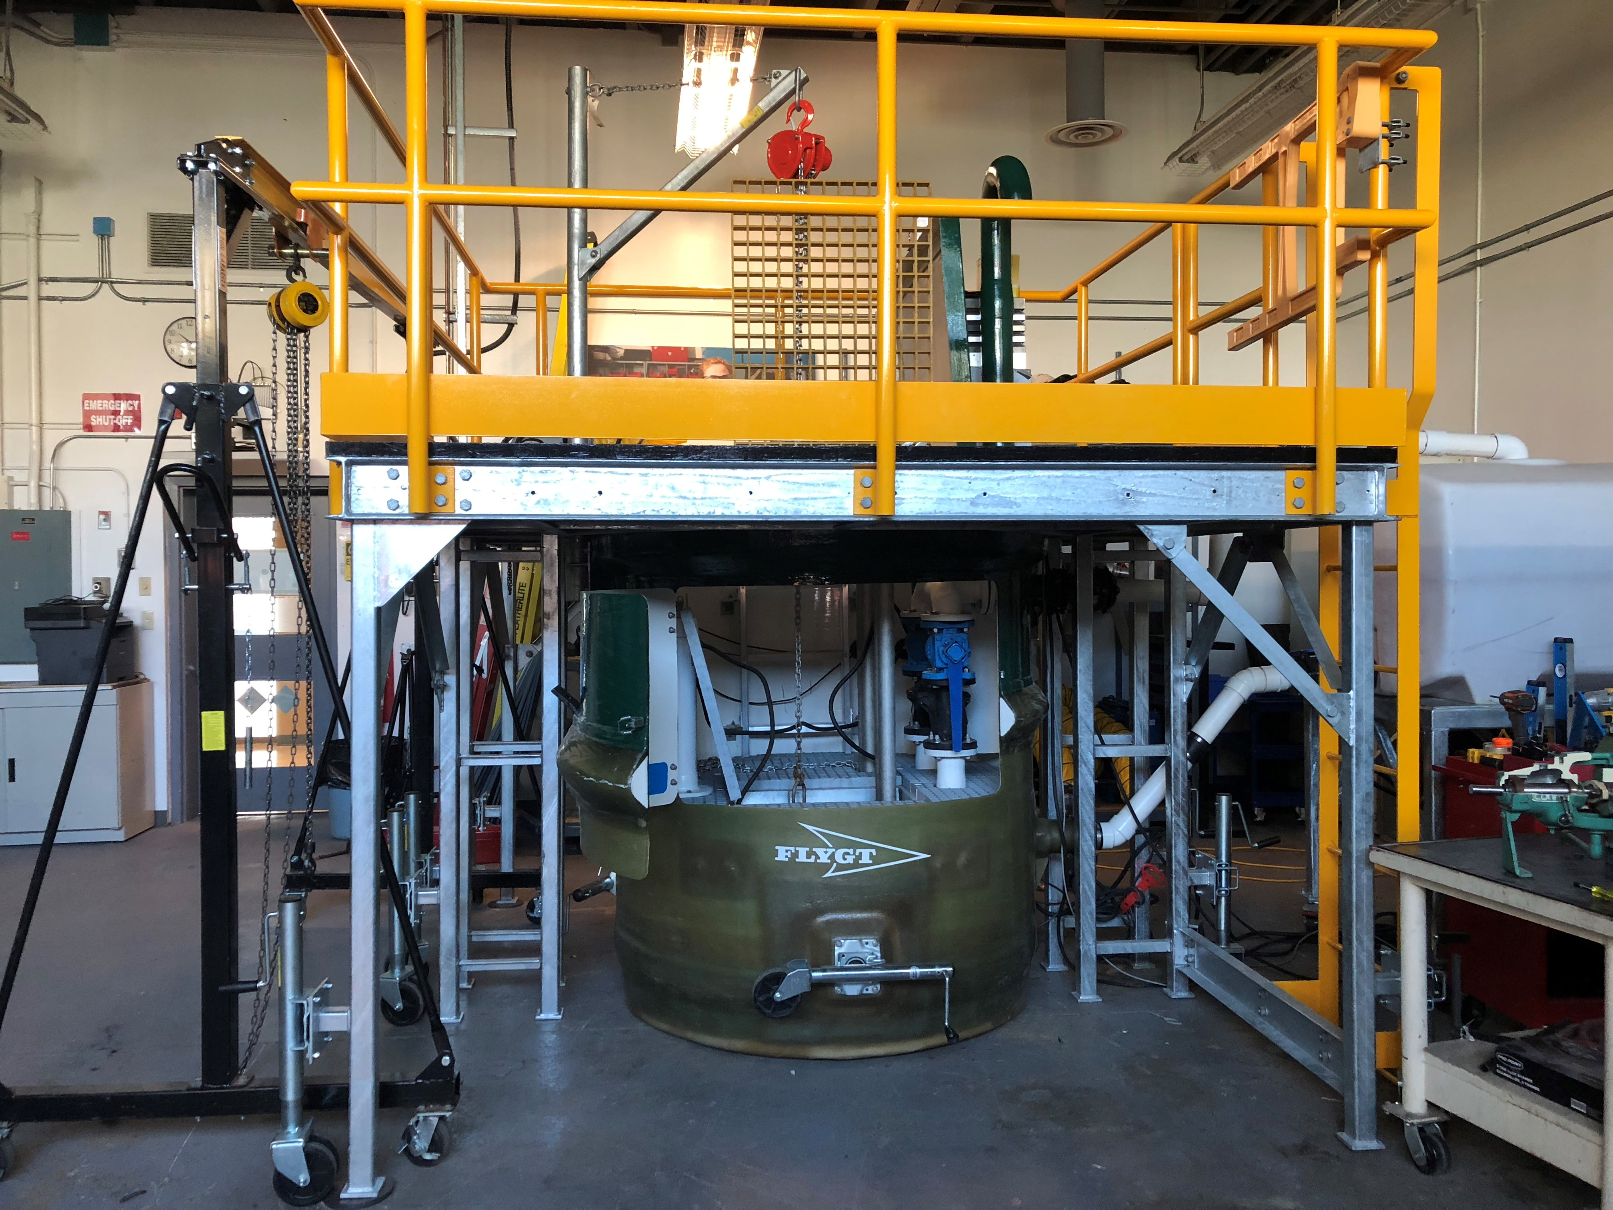
WWW Courses
Wastewater Collection Foundations & Intermediate
Operation and maintenance of collection systems including inspections, confined space awareness, locating of utilities, lift station operation, pump and valve repair, etc.
Hydraulics, piping, pumps, compressors, maintenance and troubleshooting of the equipment.

Slide 8
WWW Courses
Wastewater Treatment Foundations & Intermediate
Components of the wastewater treatment processes covered including maintenance of screens/racks, grit removal, sedimentation, RBCs, activated sludge, digestion, lagoons, disinfection, filtration, etc.
Students introduced to wastewater lab equipment, testing and analysis using QA/QC methods.
Basic automation and control concepts used to control equipment in water and wastewater facilities

Slide 9
WWW Courses
Water and Wastewater Industry Awareness
Describe and interpret applicable water and wastewater industry standards and legislation, safety standards and legislation and how these are applied to protect the public and environment.
Work integration learning concepts and skills will be covered including reviewing professional employment documents tailored to the water and wastewater industry.
Become proficient in the use of various hand/power tools/equipment used in water and wastewater systems and facilities..

Slide 10
WWW Courses
WWWT 1191 Industry Practicum
Examples of industry practicum employers:
EPCOR
Town of Edson
Strathcona County
City of Red Deer
City of Spruce Grove
Dow Chemical
Many more…

Slide 11
Admission Requirements
Grade 12 English
Grade 11 Math
Grade 11 Science (one)
Career Investigation not required but recommended

Slide 12
Post Graduation
Graduates find employment with:
Cities, Towns, Villages, Counties, & Municipal Districts
Private Water and Wastewater Maintenance Companies
Water and Wastewater suppliers
Municipal Engineering Companies

Slide 13
WWW Program
Full Time Day program worth 90 continuing education units (CEU) with attendance requirement met through Alberta Environment & Protected Areas

Slide 14
NAIT Industry Solutions
Continuing Education Department
Individual registrations to multiple areas including business, technologies, etc. via classroom, online or a combination
Cooperate/International Training Department
Customized training for groups/clients in areas of business leadership, trades and technologies, international and aboriginal initiatives

Slide 15
WWW Continuing Education
Theory courses: flexible, self-paced online format, 4 months to complete.
Recognized by Alberta Environment & Protected Areas for CEUs.
Please visit our website www.nait.ca for more information.

Slide 16
WWW Contact Info.
Darren Demchuk, Chair
demchukd@nait.ca
WWW program general email
www@nait.ca
Any other info. refer to www.nait.ca

