Slide 1
AWWOA
Committed to the success of
Alberta Water & Wastewater Operators
Making a Splash
TSAG Water Conference 2023
Dan Rites, Executive Director
drites@awwoa.ca

Slide 2
Presentation Outline
Who We Are
Education & Training
Certification Prep Resources
Networking Events
Information Sharing
Career & Industry Awareness
Water School Charity
Notes:
We do not Certify! We are not the regulator – That falls on AEPA

Slide 3
AWWOA
AWWOA is Alberta’s Resource for Water and Wastewater
Training
News
Events

Slide 4
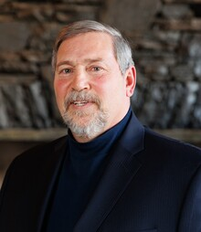
AWWOA
Non-for-Profit Organization
2,200 Members across Alberta
Governed by an elected Board of Directors
15 members Board of Directors from different community sizes in Alberta
All 15 Directors have an operator background
Mike Bureaud, AWWOA Chair

Slide 5
AWWOA Composition

Slide 6
Location of our Members

Slide 7
Population Served

Slide 8
Training Highlights
1768 participants
82 courses/workshops
+95% satisfaction
Notes:
During the 2022 training season we had 1768 participants in various training sessions.
Our In-class numbers bounced back well after covid and we are on track to beat this number in the current year.
AWWOA offered 82 courses/ workshops with over 95% positive satisfaction ratings.
Our bread and butter is our certification prep courses. We do as much as we can to ensure our members are prepared to successfully complete the certification exams

Slide 9
AWWOA.CA
Notes:
Our website is chalk full of information for operators from training to links to industry to regulatory news etc.

Slide 10
AWWOA Resources
How to Become a Certified Operator
Career Videos
Career Postings
Career Attraction Resources
Notes:
Certification info – easy to follow links to access the information from the Alberta Environment website.
Really interesting career videos that I wish were available when I was first interested in a career in this field.
The most visited page on our website – the Career posting area. There can be 20 to 30 posting available on our website (average lately)
Finally, Career attraction which I will talk more about in a few slides

Slide 11
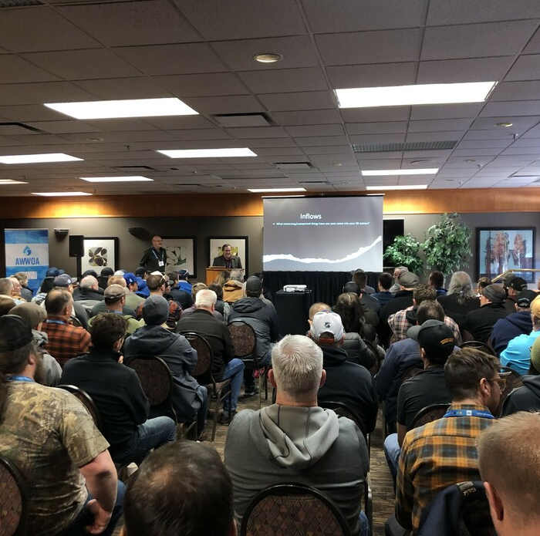
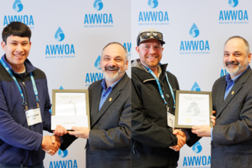
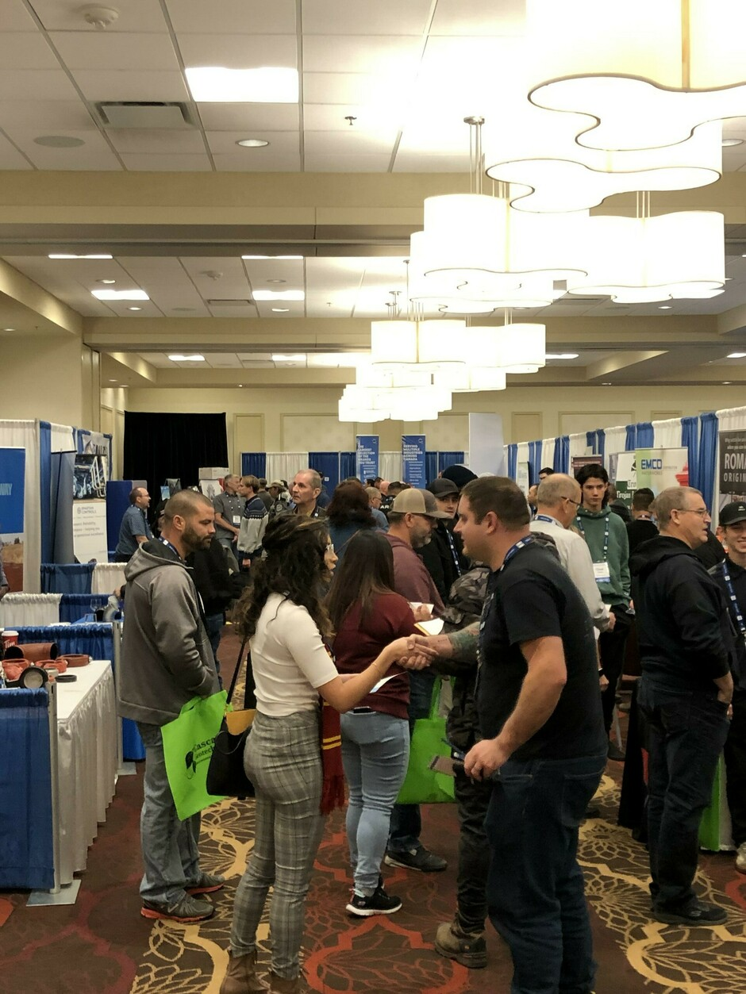
Networking Events
Annual Seminar in Banff (March)
Annual Golf Tournament (June)
Annual Conference in Edmonton (November)
Notes:
3 Major Events each year (possibly growing to 4 soon)
Our goal in all our events is to help operators gain education, to award and recognize operators and to create an environment of networking/ a water community of colleagues in this industry…

Slide 12
How We Share Information
Direct Email
Website
Newsletter
Social Media

Slide 13
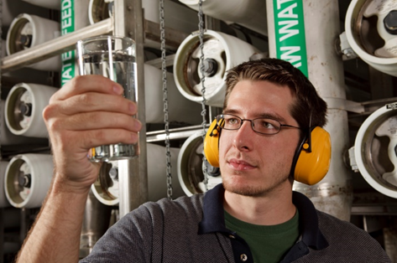
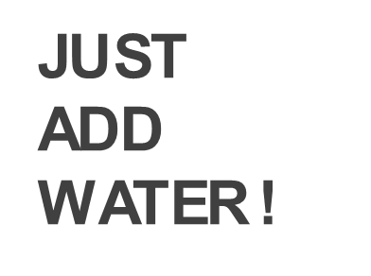
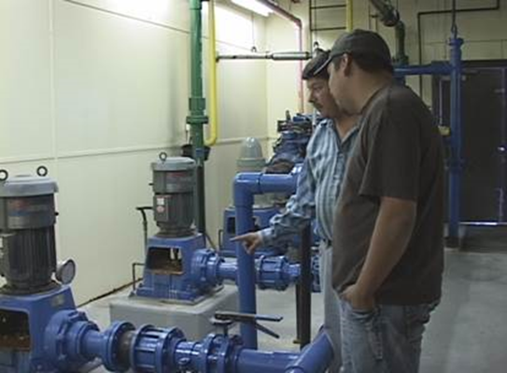
Career Awareness
Notes:
We do a lot of work on Career Awareness.
We have a number of career attraction resources that anyone can use for open houses, career fairs etc… We are also present at annual career fairs, High Schools and other conferences as a way to raise awareness about the operator profession and career path.

Slide 14
Water & Wastewater Services
Essential Services:
…are those public services that if interrupted would endanger the life, personal safety or health of the public.

Slide 15
Age

Slide 16
Retirement

Slide 17
Labour Shortages?

Slide 18
Solutions
Succession Planning
Inter-municipal Agreements
Technology
W&WW Career Awareness
Training/ Education
Funding
Notes:
Solutions to ensure your operations are sustainable…

Slide 19
Salary

Slide 20
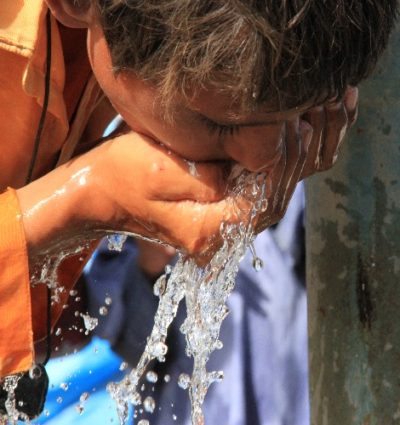
Giving Highlights
$6,000 student scholarships
$1,000 student achievement awards
$4,500 student bursaries
$30,000 small centre subsidy
$24,000 to The Water School
Notes:
AWWOA is a charitable organization - Our goal is to raise over 20K each year for the Water School Charity.

Slide 21
Keep up the Great Work!
THANK YOU!
Questions
Notes:
Add more pictures…

