Slide 1
v
Fire Safety Course:
Sun, Sun Summertime K-1
First Nations
Technical Services
Advisory Group Inc.
Fire Prevention is Everyone’s Responsibility
Notes:
Added

Slide 2
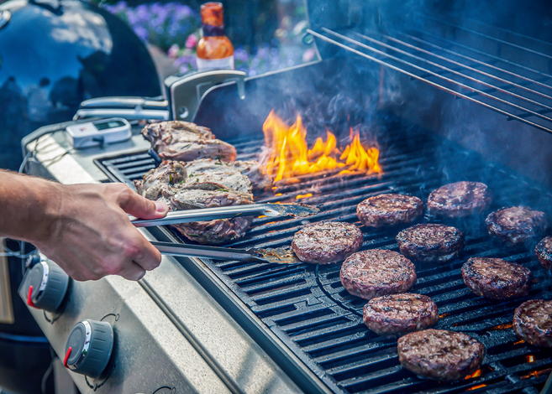
tsag.net
Notes:
What kind of fire is this?
Who should use this?
How far away should you be from a Barbeque?

Slide 3
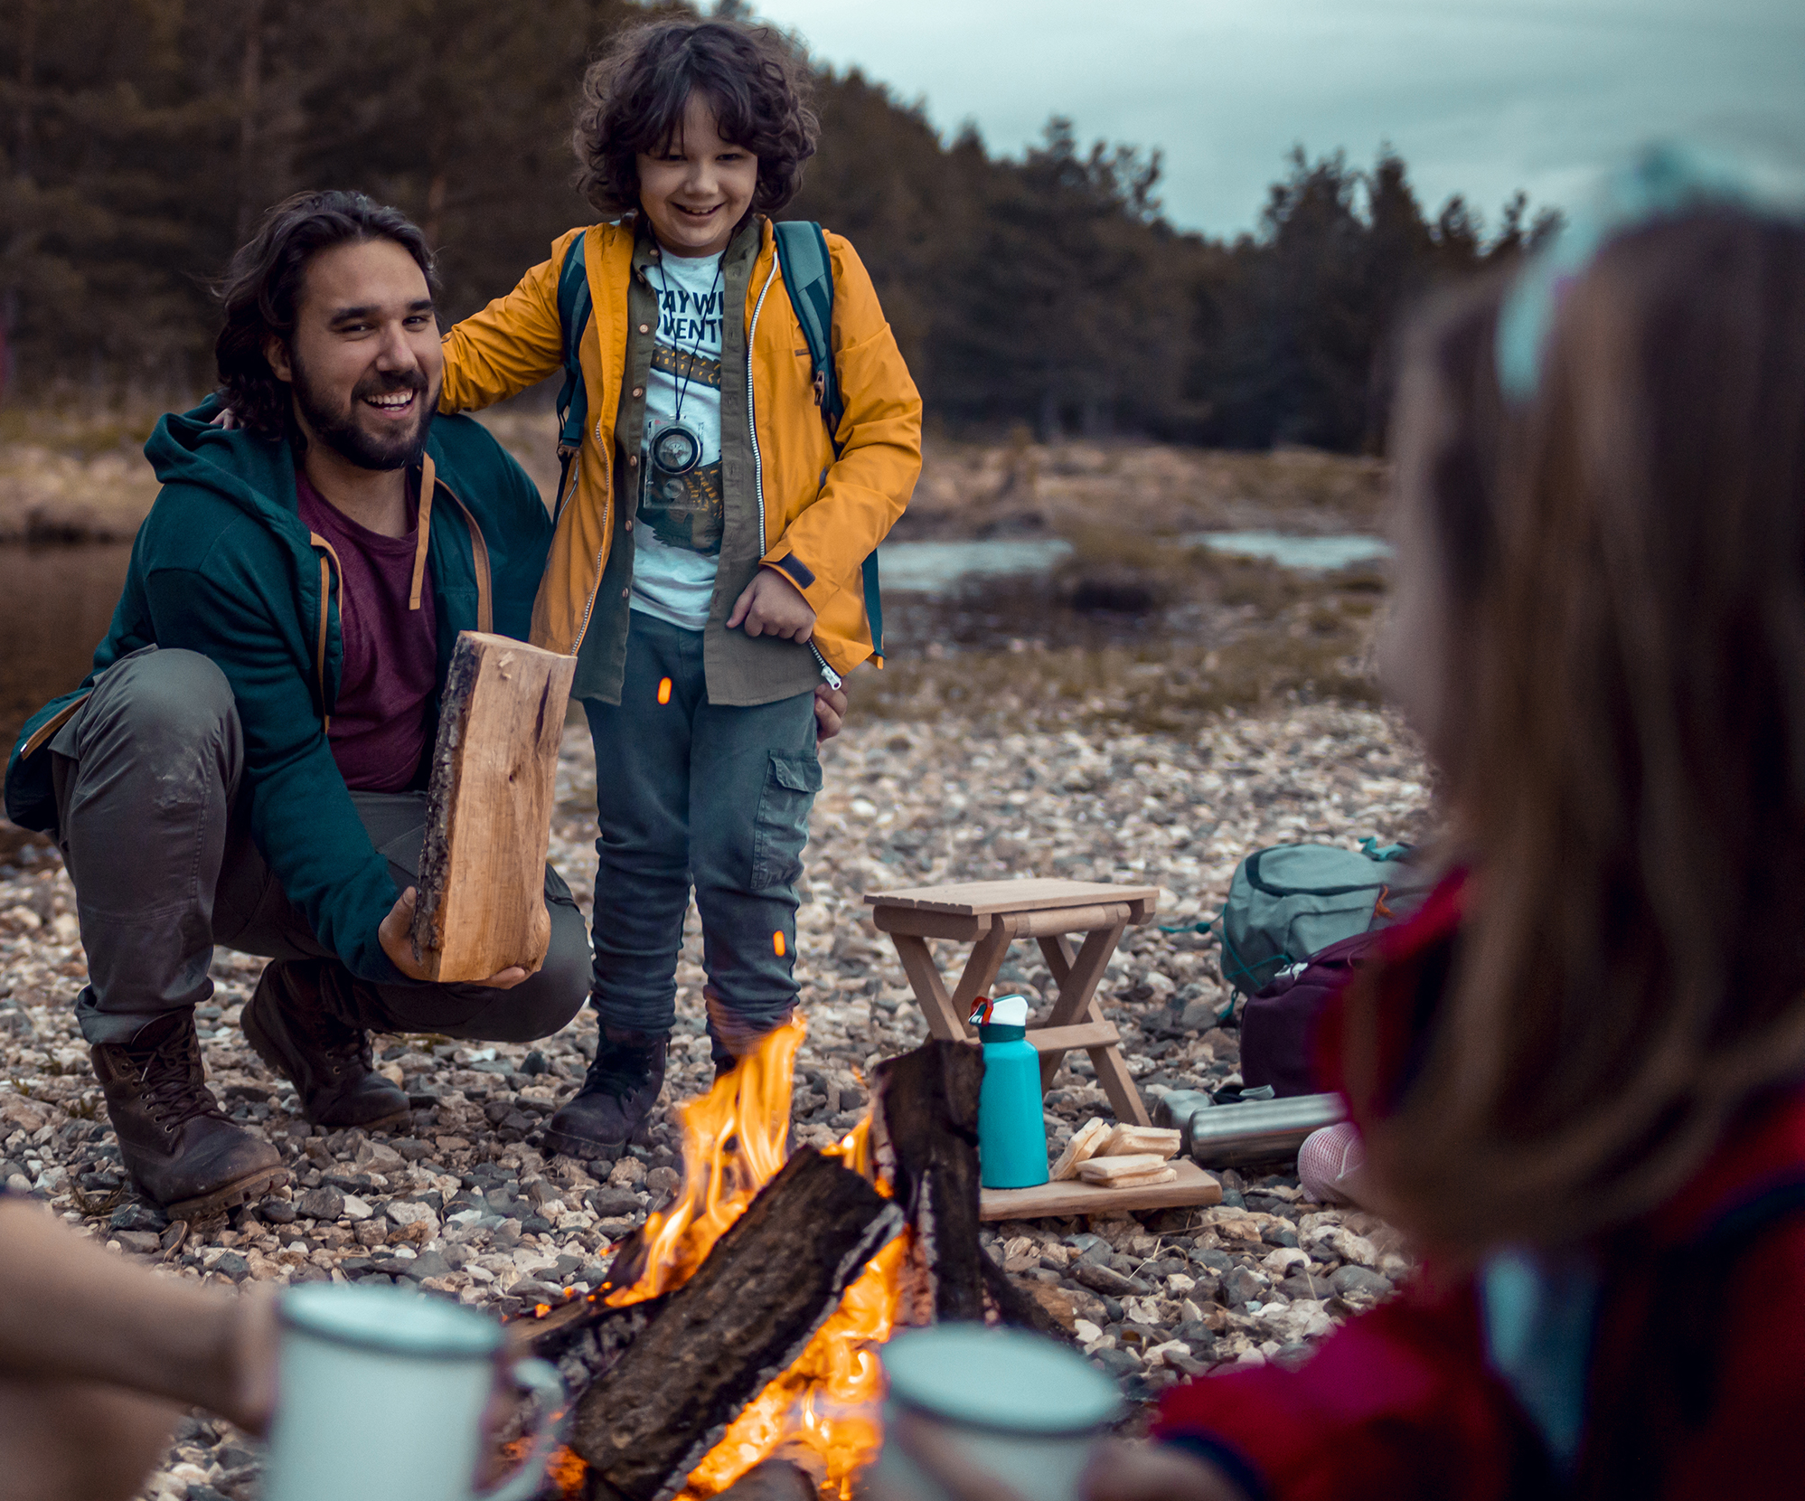
tsag.net
Notes:
What kind of fire is this?
Should a campfire be built around trees or dry grass?
Where should a campfire be built?
Who should build and supervise a campfire?
How do we keep a campfire from spreading?
How far away should you be from a campfire?

Slide 4
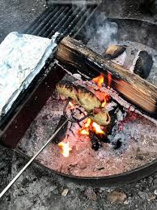
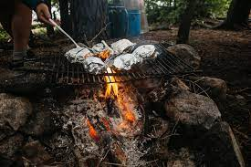
https://www.google.com/search?q=bannock+over+a+campfire&rlz=1C1JZAP_enCA970CA970&sxsrf=ALiCzsYiyo5_KW4WCwgpCEJkqIMxy1P7kA:1661956617346&source=lnms&tbm=isch&sa=X&ved=2ahUKEwji1LjupvH5AhU4ATQIHYZVCp0Q_AUoAXoECAEQAw&biw=1536&bih=656&dpr=1.25#imgrc=yGZl_SzYftr-mM
https://www.google.com/search?q=bannock+over+a+campfire&rlz=1C1JZAP_enCA970CA970&sxsrf=ALiCzsYiyo5_KW4WCwgpCEJkqIMxy1P7kA:1661956617346&source=lnms&tbm=isch&sa=X&ved=2ahUKEwji1LjupvH5AhU4ATQIHYZVCp0Q_AUoAXoECAEQAw&biw=1536&bih=656&dpr=1.25#imgrc=hvMgHLwFVq9NRM
tsag.net
Notes:
What are they making in these pictures?
Should this fire be built around trees or dry grass?
Who should use this?
How far away should you stay from this fire?

Slide 5
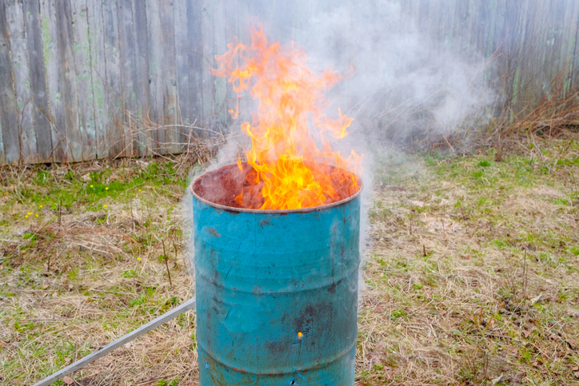
tsag.net
Notes:
What kind of fire is this?
What is it used for?
Who should be in charge of this fire?
How far away should you be from this fire?

Slide 6
tsag.net
Notes:
What kind of fire is this?
What are some rules that you should have around this type of fire? (stay close to an adult, only let adults light the fireworks, do not use them around forested areas or dry grasses)

Slide 7
tsag.net
Notes:
What are some good rules that you should have around these type of fires? (stand at least 1 meter away, stay close to an adult, don’t let it get too big, let the adults look after the fire, don’t leave it unattended, always put it out when you are finished with it)
How are these fires a danger to the environment in your community (they can spread to forests)?

Slide 8
Sparky’s ABC’s of Fire Safety
National Fire Protection Association Kids. (n.d.-h). Sparky’s ABC’s of Fire Safety - Full [Video]. https://www.sparky.org/videos?playlistVideoId=6237284199001
tsag.net

