Slide 1
v
Fire Safety Course: Sun, Sun Summertime! Grades 2-3
First Nations
Technical Services
Advisory Group Inc.
Fire Prevention is Everyone’s Responsibility
Notes:
Added

Slide 2
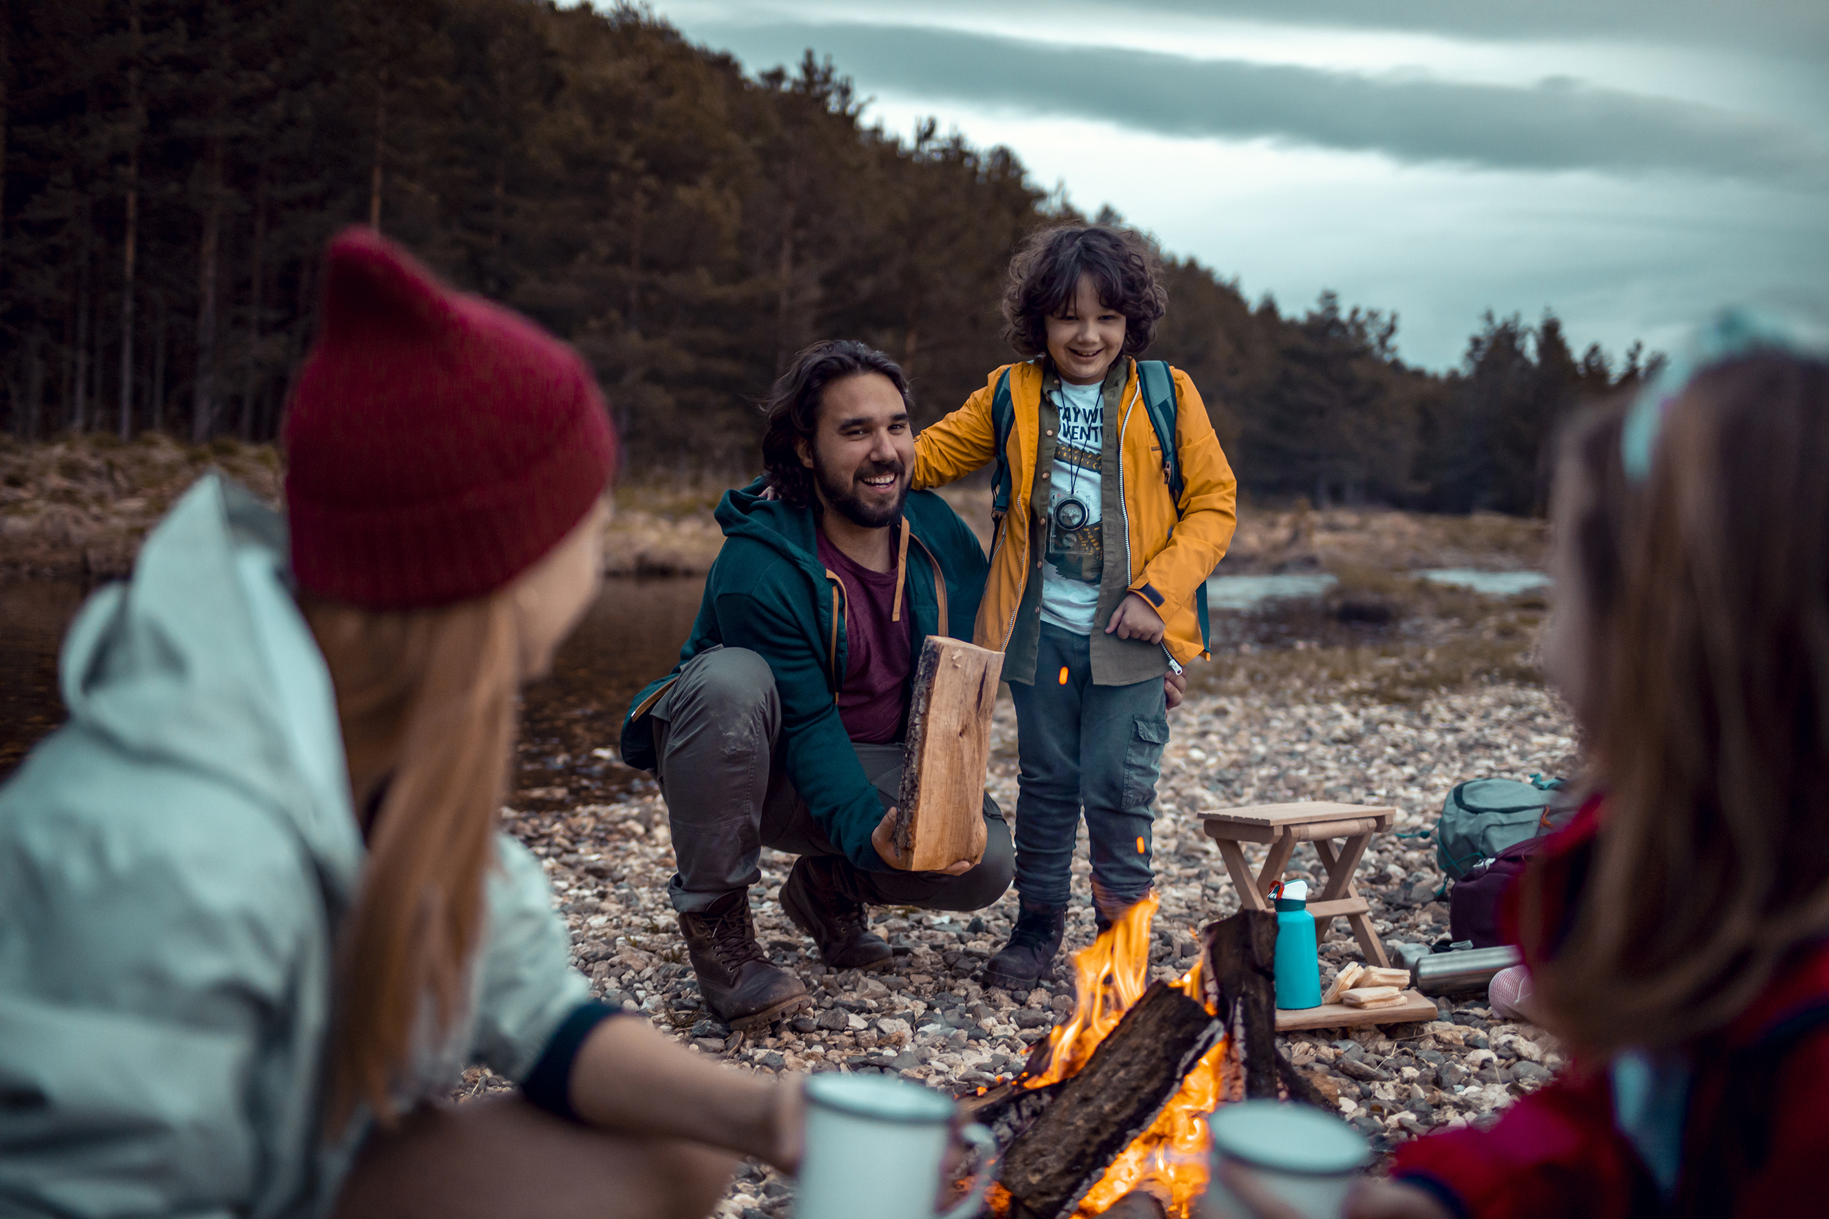
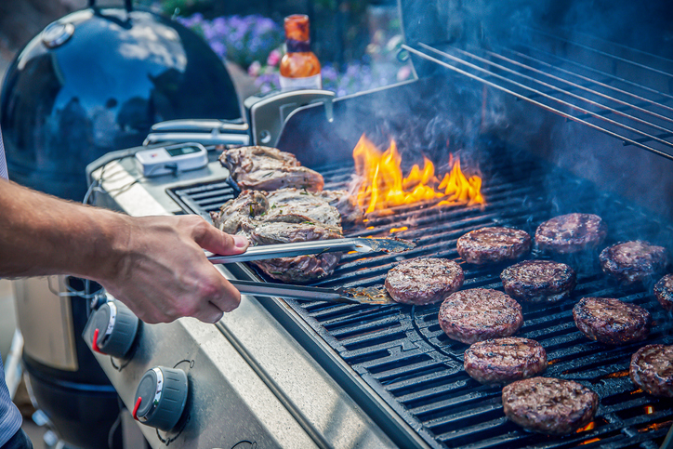
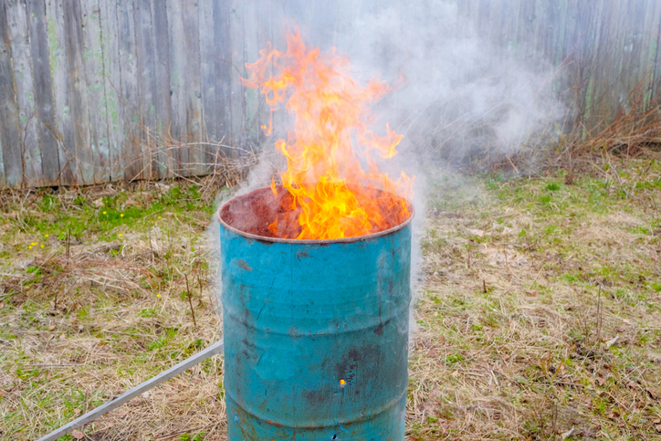
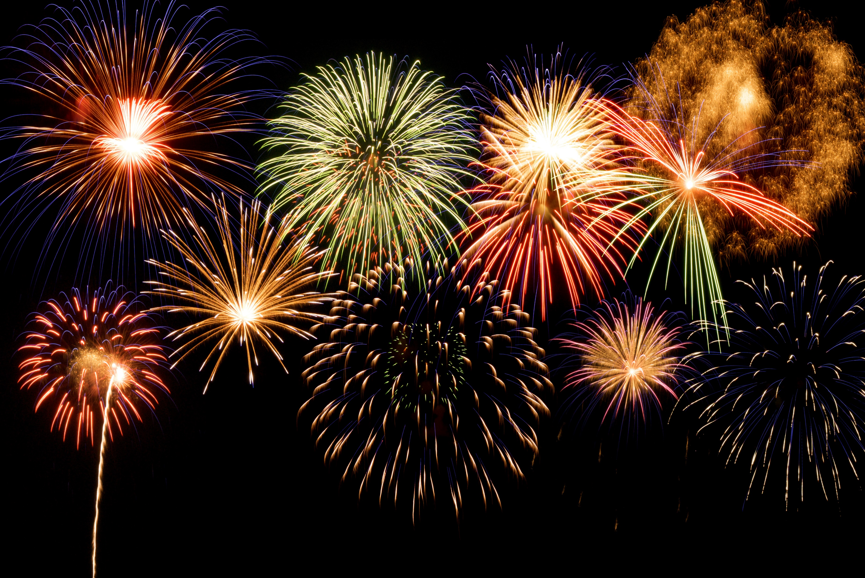
tsag.net
Notes:
What kind of fire are these?
How are they different from the fires we have been talking about in the last few months?
How else does your family use fire in the warmer months?
What are some rules that you should have around these types of fire? (Stand at least 1 meter away), stay close to an adult, let the adults look after the fire, make sure it is not left unattended, make sure someone always put it out when you are finished with it.
What do you need to keep a campfire safe? (built on rocks, sand or dirt, no low-lying branches or flammables nearby, bucket of water and shovel nearby).
Who should feed a campfire?
What would you do if your clothes caught on fire? (stop, drop and roll- remember to cover your face)
How are these fires a danger to the environment in your community? (they can spread to forests)

Slide 3
Wildfires| Wildfire Reasons
learning junction. (2019, September 16). Wildfires || wildfires reasons [Video]. YouTube. https://www.youtube.com/watch?v=S38h6cjGg3k
tsag.net

Slide 4
Sparky and NFPA’s Wildfire Safety Tips for Kids and Parents
NFPA Kids. (2021, June 5). Sparky and NFPA’s Wildfire Safety Checklist for Kids and Parents [Video]. YouTube. https://www.youtube.com/watch?v=Z7c9h9JlNz0&t=3s
tsag.net

Slide 5
Sparky’s ABC’s of Fire Safety
National Fire Protection Association Kids. (n.d.-h). Sparky’s ABC’s of Fire Safety - Full [Video]. https://www.sparky.org/videos?playlistVideoId=6237284199001
tsag.net

