Slide 1
v
Fire Safety Course: Sun, Sun Summertime! Grades 10-12
First Nations
Technical Services
Advisory Group Inc.
Fire Prevention is Everyone’s Responsibility
Notes:
Added

Slide 2
Fire Ravages City of Fort McMurray, Alberta
ABC News. (2016, May 4). Fire Ravages City of Fort McMurray, Alberta [Video]. YouTube. https://www.youtube.com/watch?v=sLz8qJhi054
tsag.net
Notes:
On May 1, 2016, a wildfire began southwest of Fort McMurray, Alberta, Canada. On May 3, it swept through the community, forcing the largest wildfire evacuation in Alberta's history, with upwards of 88,000 people forced from their homes
Cost: $9.9 billion (direct and indirect costs)
Burned area: 589,552 ha (1,456,810 acres)
Buildings destroyed: 3,244
It is suspected to have been caused by humans in a remote area 15 km (9.3 mi) from Fort McMurray, but no official cause has been determined to date.
What is the first thing that comes to your mind when you see this video?
How do you think this fire impacted the community of Fort McMurray?
What do you think the impact to our community would be if a wildfire destroyed it or part of it?
Wikimedia Foundation. (2022, August 10). 2016 Fort McMurray wildfire. Wikipedia. Retrieved September 27, 2022, from https://en.wikipedia.org/wiki/2016_Fort_McMurray_wildfire

Slide 3
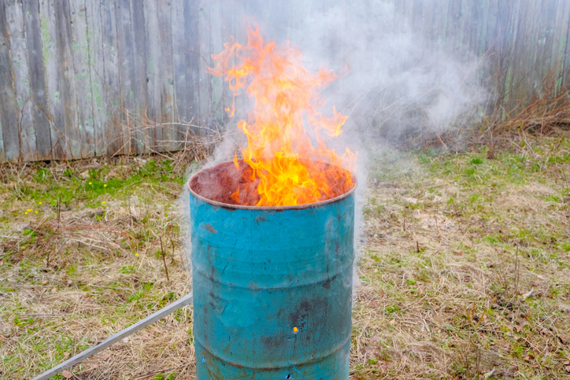
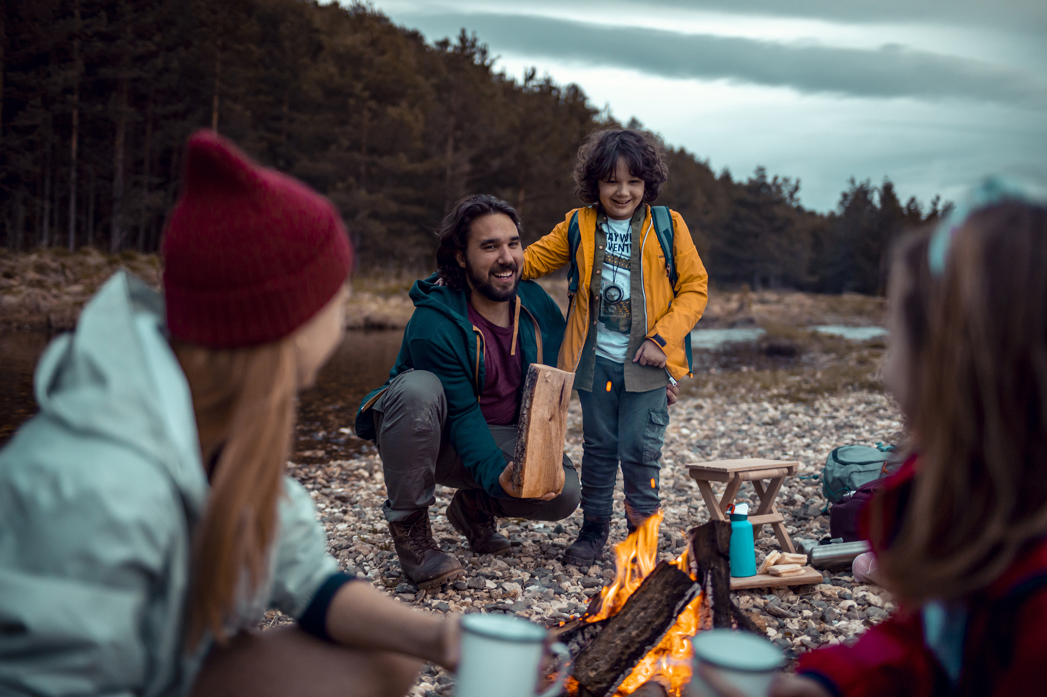
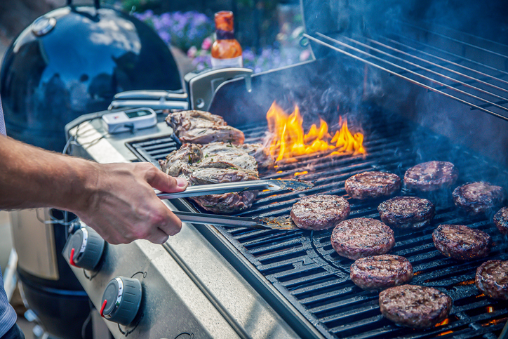
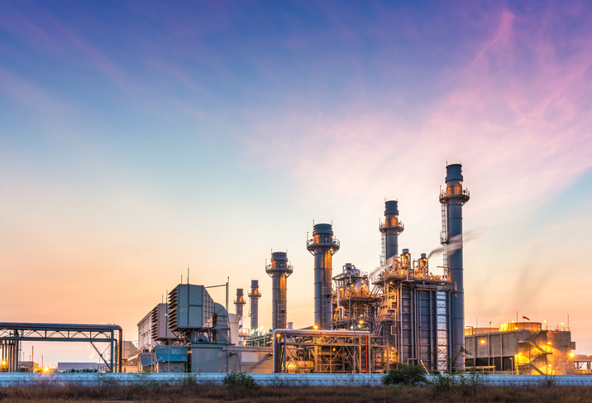
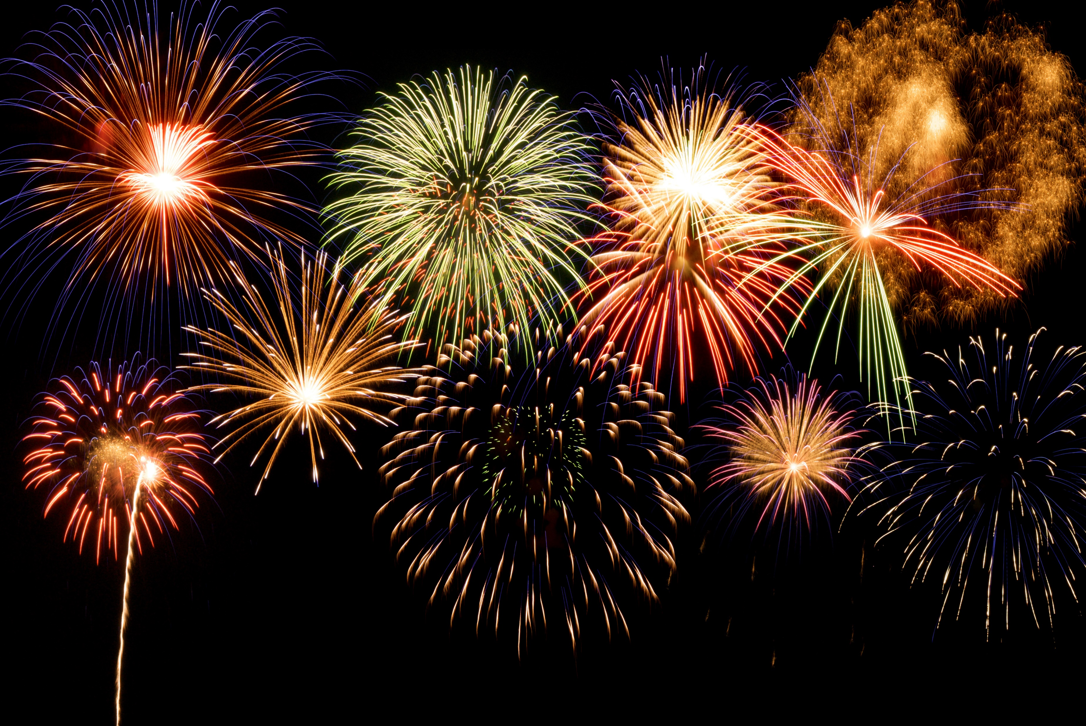
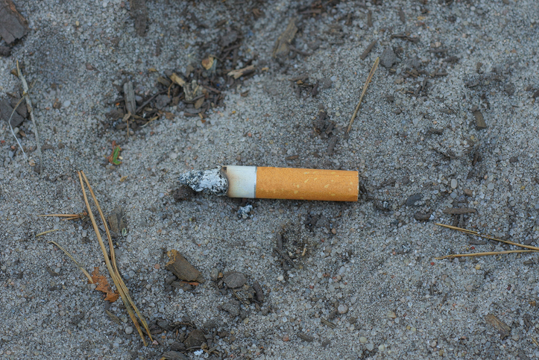
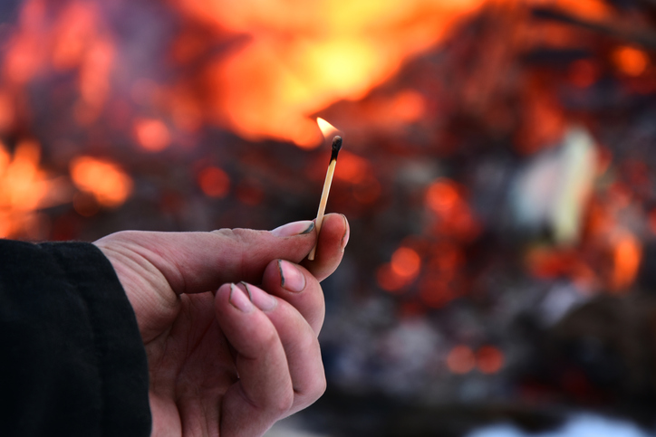
Causes of Wildfires
tsag.net
Notes:
Most common sources of human caused wildfires
Open burning
Vehicle and engine use
Industrial activity
Fireworks, sky-lanterns, outdoor flame lighting
Discarding burning items (cigarettes)
Arson
Human Activity causes approximately 40% of all wildfires

Slide 4
FireSmart Home Ignition Zone
FireSmart Canada. (2018, June 20). FireSmart Home Ignition Zone [Video]. YouTube.
https://www.youtube.com/watch?v=k0ClodnHp2c&amp;t=74s
tsag.net
Notes:
What are some of the things you can do for your community?

Slide 5
Last Minute Wildfire Checklist
FireSmart Canada. (2020, June 25). Last-Minute Wildfire Checklist [Video]. YouTube.
https://www.youtube.com/watch?v=Oze9GLb1lMo&t=3s
tsag.net

