Slide 1
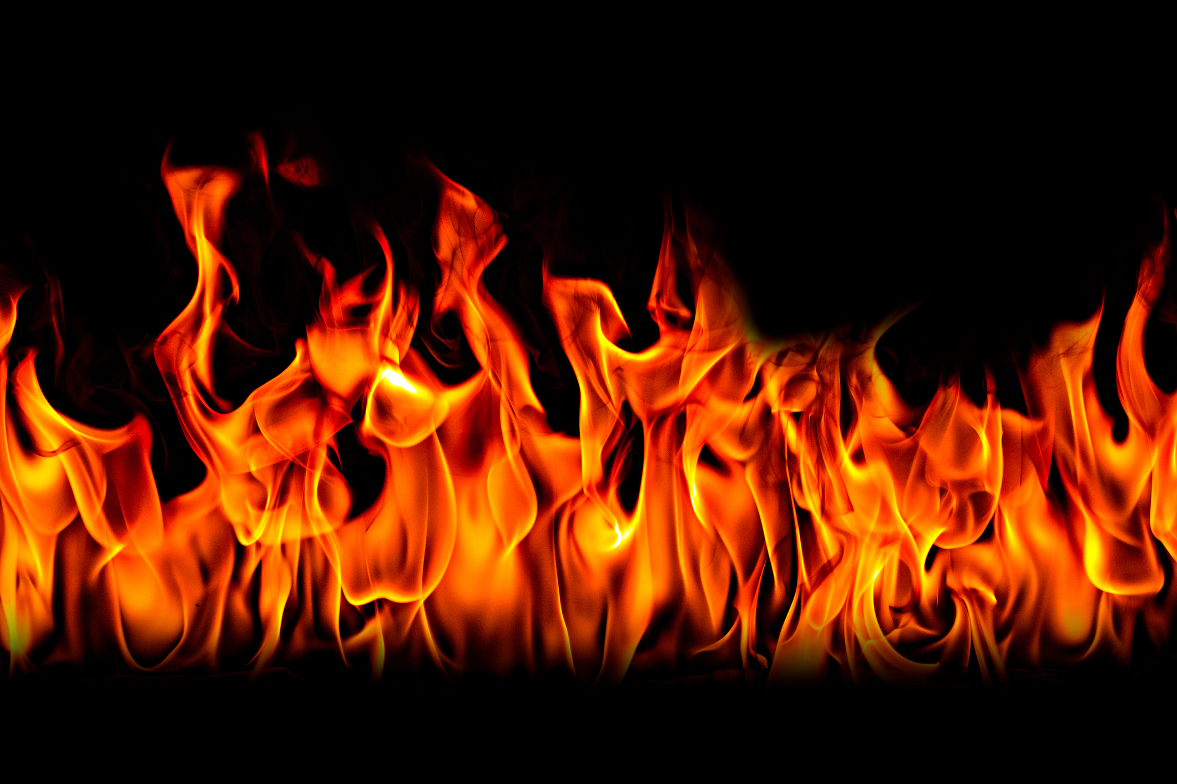
Fire Protection

Slide 2
1
3
2
A
1
3
2
B
1
3
2
C

Slide 3
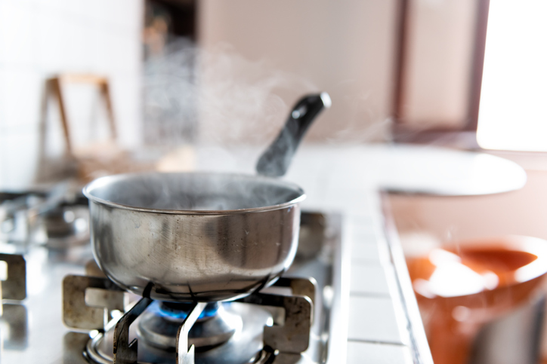
A - 1
Touching the hot stove
Touching the burner
Tipping over the contents and having them fall on you.

Slide 4
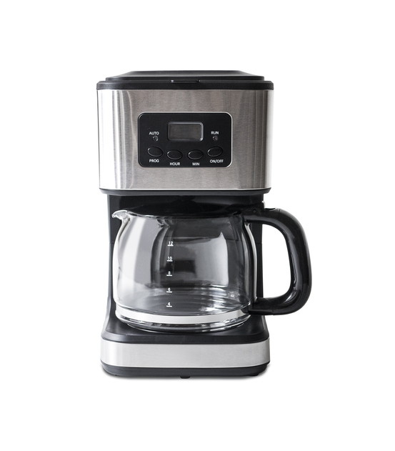
A -2
Touching the burner or the hot pot
Knocking over the pot and having the contents spill on you

Slide 5
A - 3
Touching the candle
Leaning over the candle and having your clothes catch fire
Leaning over candles and burning your hair

Slide 6
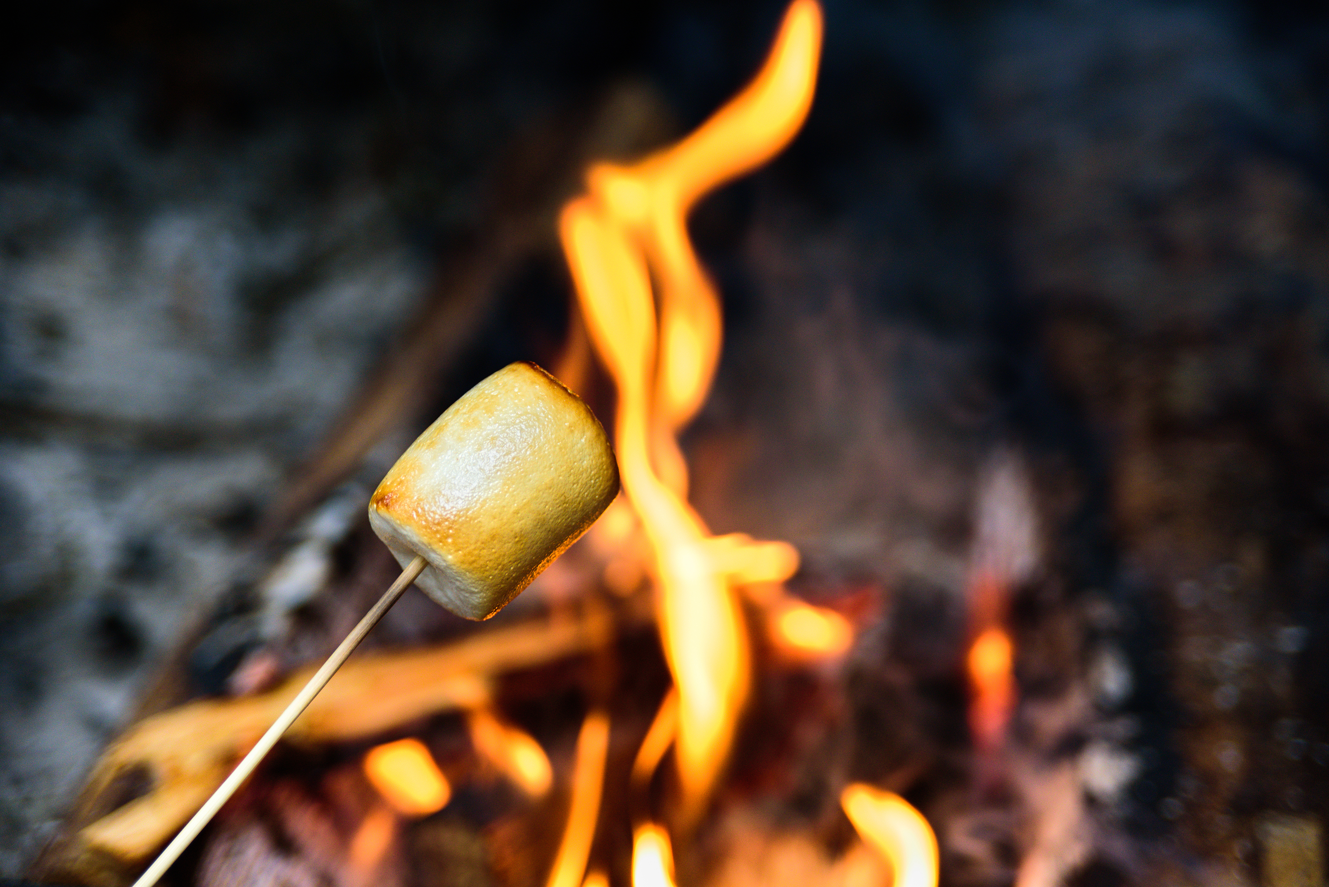
B - 1
Getting too close to the fire and burning your skin, hair or clothes
Eating it when it is too hot and burning your mouth
Burning your fingers as you take the marshmallow off

Slide 7
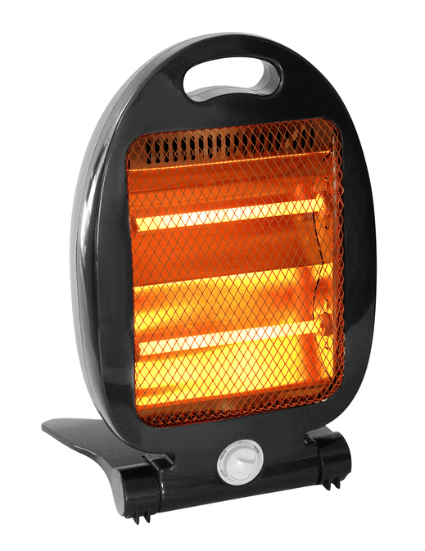
B - 2
Getting to close to the heater and burning your skin or clothing.
Lifting it or moving it and burning your hands

Slide 8
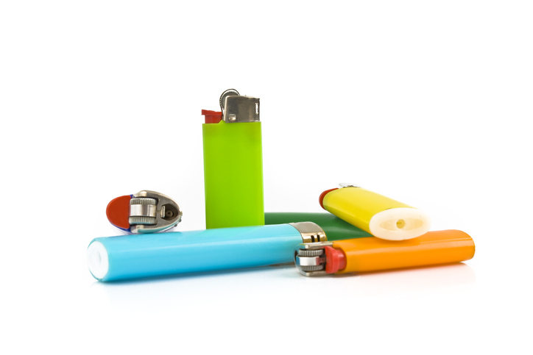
B - 3
Playing with them and starting a fire

Slide 9
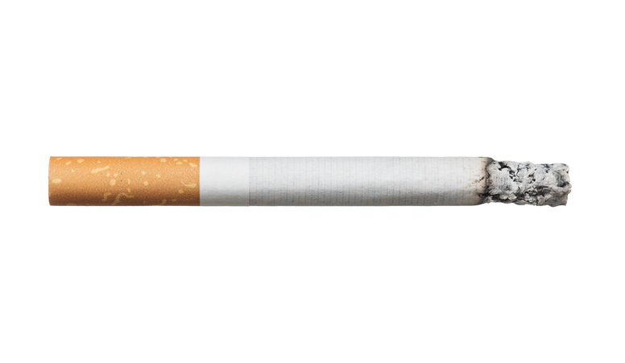
C- 1
Playing near an ashtray and bumping the cigarette
Moving an cigarette
Playing with cigarettes. You could burn your fingers, clothing
or start a fire

Slide 10
C - 2
Leaning over or getting to close to a hot iron
Knocking over a hot curling iron
You could Burn your fingers, hands or clothing

Slide 11
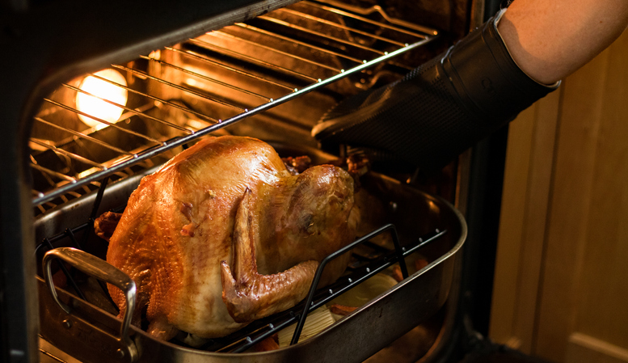
C - 3
Getting too close to an oven you could get burned from the heat or touching something hot that just came out of the oven
You could burn your face, hands or clothing

