Slide 1
Fire Safety Course:
Fire Protection Grades 2-3
First Nations
Technical Services
Advisory Group Inc.
Fire Prevention is Everyone’s Responsibility
Notes:
Added

Slide 2
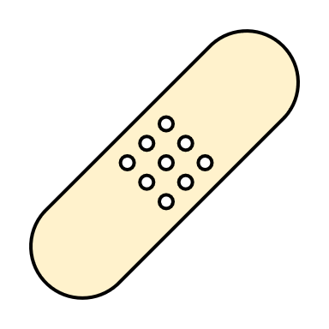
What do you do if you get burned?
1. Tell an Adult
2. Hold the burn under cool water for 15 minutes
3. Cover it with a bandage.
tsag.net
Notes:
Added

Slide 3
Science for Kids| Bad Burns
Operation Ouch. (2018, January 26). Science for kids – Bad burns | Experiments for kids | Operation Ouch [Video]. YouTube. https://www.youtube.com/watch?v=CRfvCCKFsHk
tsag.net
Notes:
Added

