Slide 1
Fire Safety Course:
Fire Protection Grades 10-12
First Nations
Technical Services
Advisory Group Inc.
Fire Prevention is Everyone’s Responsibility
Notes:
Added

Slide 2
First-Degree Burns
Hot Water
tsag.net
Notes:
First degree burn only hurt the the top layer of skin. Symptoms: red coloring, slight swelling, painful. Does not have blisters
First degree burns can be caused by:
Hot water
Some Household cleaners
Stove burners, hot pans, ovens, or toaster ovens
Hair Straighteners and curling irons
Sun burn
Electrical cords or outlets

Slide 3
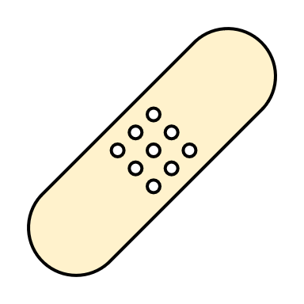
If you get a first degree burn:
1. Remove any clothing or jewelry from the burn area.
3. Cover it with a bandage.
2. Hold the burn under cool water for at least 15 minutes.
tsag.net
Notes:
If an infant or elderly person experiences a burn of any degree, you should seek medical attention. See a doctor for burns that wrap all the way around a body part, such as the leg) and burns to the face, neck, hands, or feet.
Treatment. (n.d.). Canadian Skin Patient Alliance. Retrieved September 27, 2022, from https://canadianskin.ca/burns/45-treatment-1

Slide 4
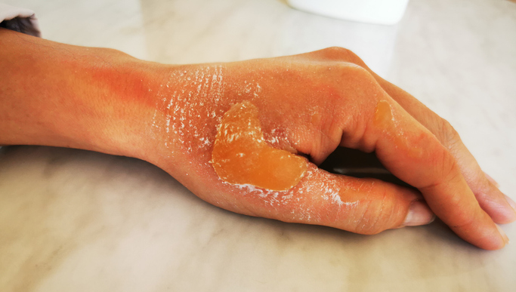
Second-Degree Burns
Hot Water
tsag.net
Notes:
There are two types of second-degree burns. The more mild penetrate the surface layer of skin and into the next layer of skin, the dermis. The more severe second-degree burns go well into the dermis. They cause blistering or open sores on the skin, are more painful, and take longer to heal.
Some common causes of second-degree burns include:
severe sunburn,
accidents with ovens and stoves
exposure to fire
contact with boiling water

Slide 5
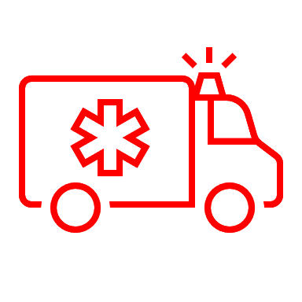
If you get a second degree burn:
4. If it is a mild second- degree burn, cover the burn with antibiotic ointment to keep the burn moist for several days. Seek medical advice is the burn is bigger than 3 inches wide or is on the face, feet hands or across a joint or caused by chemicals or electricity
1. Remove any clothing or jewelry from the burn area.
2. Hold the burn under cool water for at least 15 minutes.
3. Cover it with a bandage.
tsag.net
Notes:
If an infant or elderly person experiences a burn of any degree, you should seek medical attention. Seek medical attention if the burn area is bigger than 2-3 cm, for burns that wrap all the way around a body part, such as the leg) and burns to the face, neck, hands, or feet.
Treatment. (n.d.). Canadian Skin Patient Alliance. Retrieved September 27, 2022, from https://canadianskin.ca/burns/45-treatment-1

Slide 6
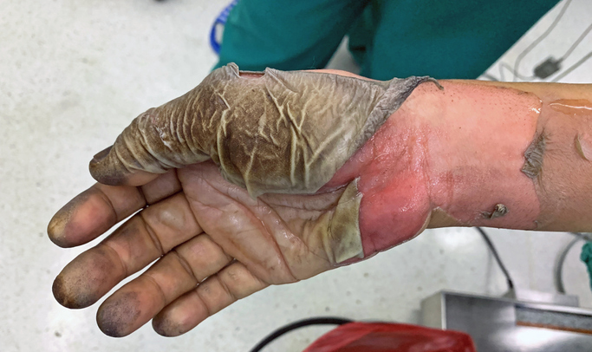
Third and Fourth Degree Burns
tsag.net
Notes:
This burn is from an electrical injury. Burns may not hurt, may be white, grey, black, brown, yellow, charred, waxy, dry, or leathery.
Third degree burns are a type of burn go through all layers of skin. The skin dies and turns white. People with third degree burns over large parts of their bodies can go into shock and die.
Fourth degree burns go through the skin, and into the muscle and bones. People can die from these burns they may not hurt because they go so deep that they cause damage to the nerve endings.
These types of burns can be caused by:
flames
flash from an explosion
chemicals such as acids
electricity
scalding liquids
contact with an extremely hot object for an extended period
Always call emergency services for these types of burns. People with these burns must seek medical attention!
Treatment. (n.d.). Canadian Skin Patient Alliance. Retrieved September 27, 2022, from https://canadianskin.ca/burns/45-treatment-1
Morales-Brown, L. (2021, February 15). What to know about third degree burns. Medical News Today. Retrieved September 27, 2022, from https://www.medicalnewstoday.com/articles/third-degree-burns#causes

Slide 7
Burn Facts
More than 3200 Canadians were admitted to hospitals for burns in 2005-2006.
Most of these burns were caused by hot substances (such as water, steam or chemicals).
Adults aged 40 to 49 are the most likely to be admitted to hospital, followed by children.
Exposure for just three seconds to water which is 140 degrees F (the temperature of the average home’s hot water as it comes from the tap) can result in a third degree burn on a child or an older adult.
Children’s skin is thinner and burns more quickly and deeply than an adult’s skin.
Over 10,000 children (0 to 19 years) were admitted to a Canadian hospital with burn injuries between 1994 and 2003.
https://canadianskin.ca/burns#fast-facts
Hot Water
tsag.net

Slide 8
Burn Accident
Tipping over a hot pot full of water
• Taking something out of an oven
• Clothes catching fire and burning skin
Burn Prevention
Keep pot handles turned in
Always use pot holders or oven mitts
• Make sure sleeves are close fitting
Hot Water
tsag.net

