Slide 1


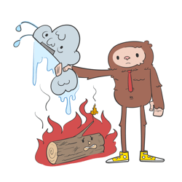


v
Fire Safety Course: Fire Facts Grades 4-6
First Nations
Technical Services
Advisory Group Inc.
Fire Prevention is Everyone’s Responsibility
Notes:
Added

Slide 2


The Fire Triangle
Fuel
Air
Heat
tsag.net
Notes:
Fire can be defined as a chemical reaction. When oxygen (air), fuel, and heat get together, they cause a reaction. For example, when fuel such as wood burns, it turns to charcoal and as it does it releases gases like carbon dioxide, and carbon monoxide. Fires can be prevented if you keep these three items apart.
Ask:
What are some examples of fuel? (combustible liquids, solids and gases- get specific examples)
What are some examples of heat (electric appliance such as heaters, curling irons, stove burners, and flames)
You can put out a fire by taking away one of these three elements. This is called inhibiting a chemical reaction.
You can remove the air by covering up the fire ( like putting a lid on a pot, or rolling on the ground)
You can remove the heat (put water on the fire, or use a fire extinguisher
You can remove the fuel (take it away from the heat source)

Slide 3
Your neighbor puts out a his garbage fire with water. What element was taken away?
You left your homework near the stove. Your sister moved it to the table. What element was taken away?
You are cooking and the sleeve of your shirt catches fire. You roll on the ground and the fire goes out. What element was taken away?
Heat
Fuel
Air (oxygen)
You are camping and you put soil over the campfire when you leave. What element was taken away?
The electric heater is inches away from the curtains, so you tie the curtains up and away from the heater. What element was taken away?
Your sister left her curling iron in the bathroom close to a towel. You unplugged it. What element was taken away?
Air (Oxygen)
Heat
Fuel
tsag.net

Slide 4
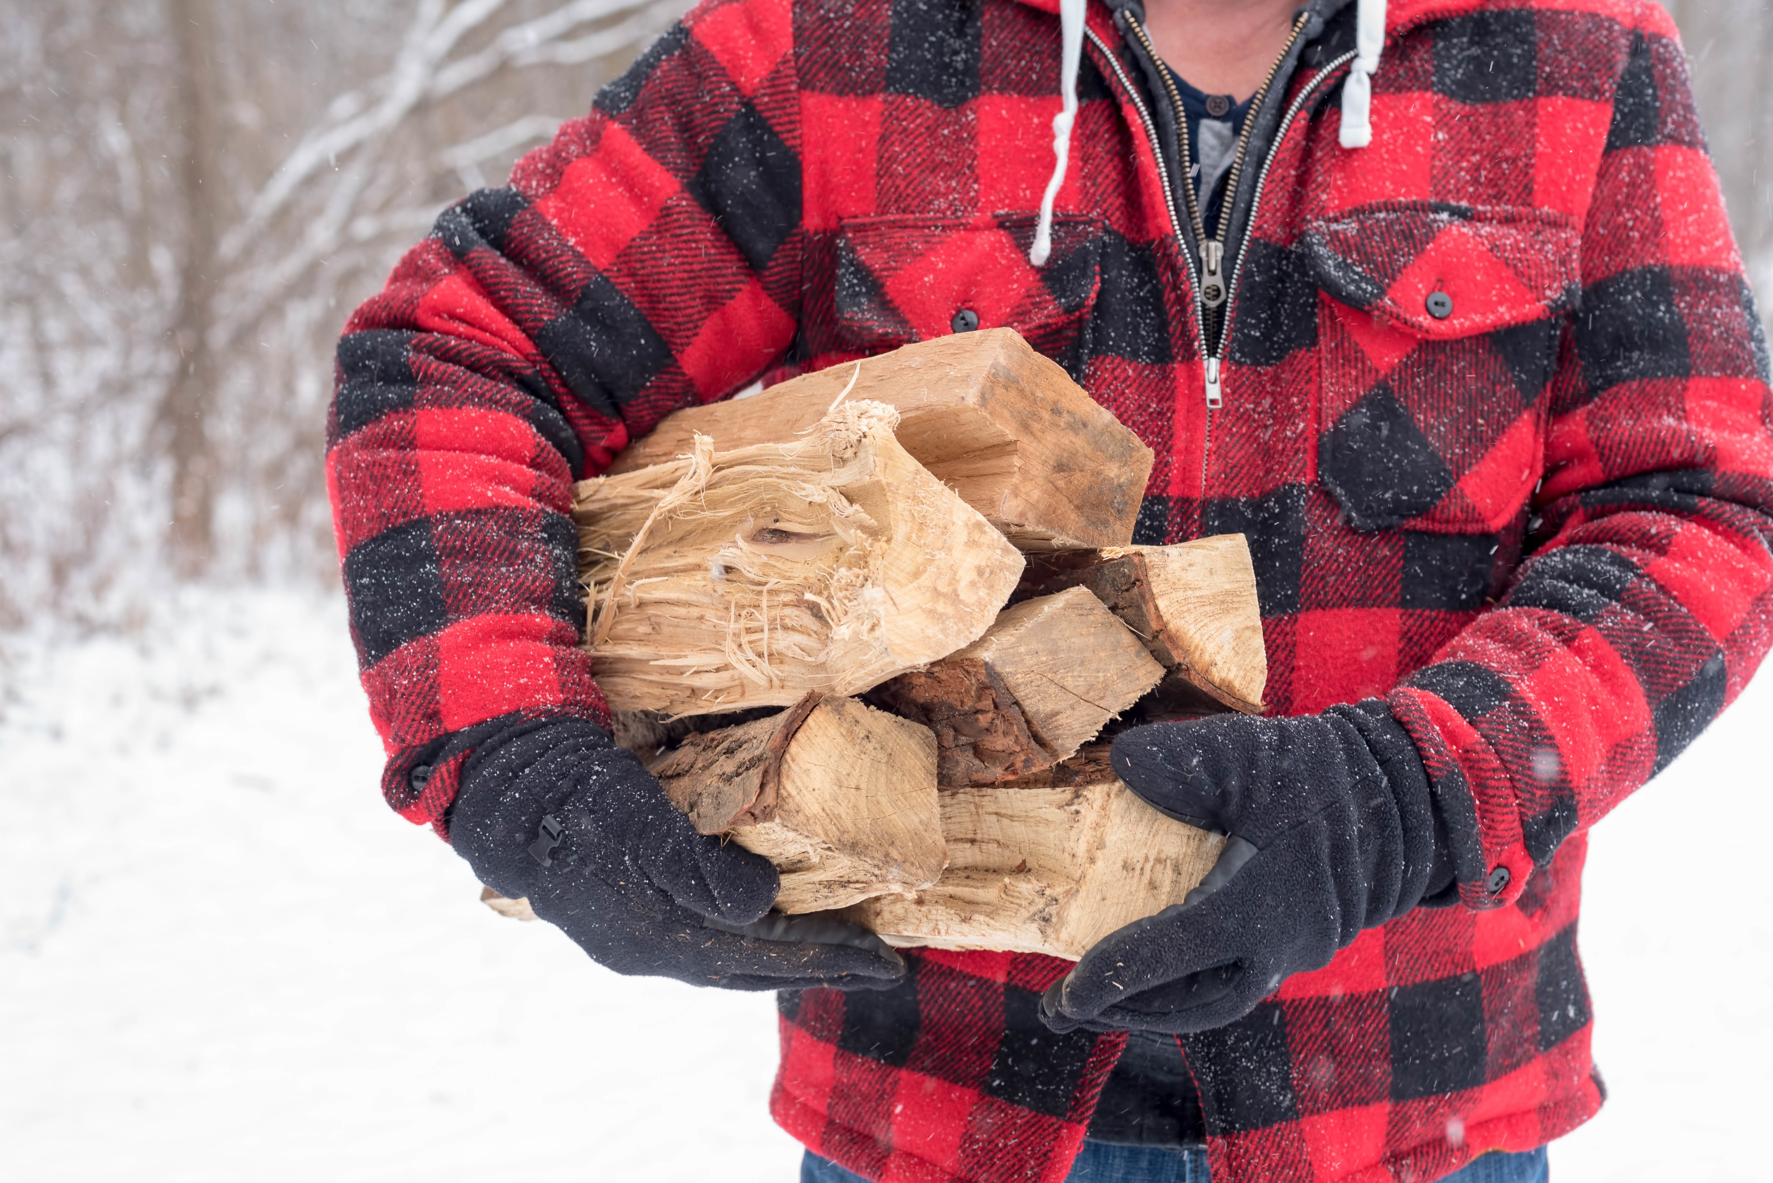

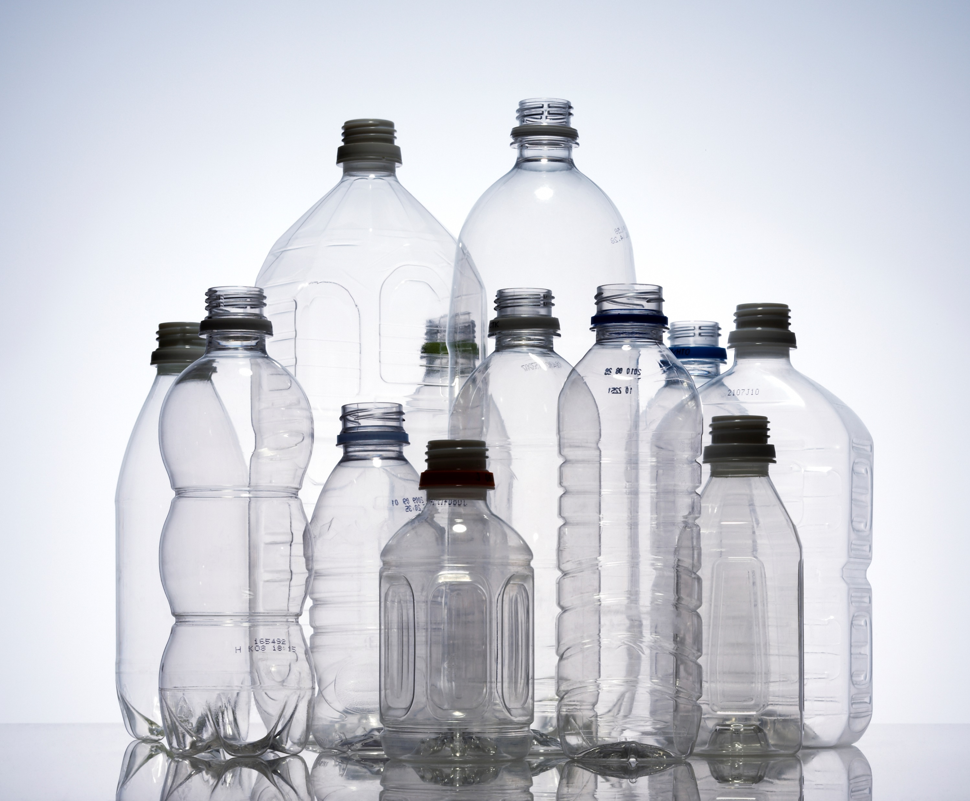

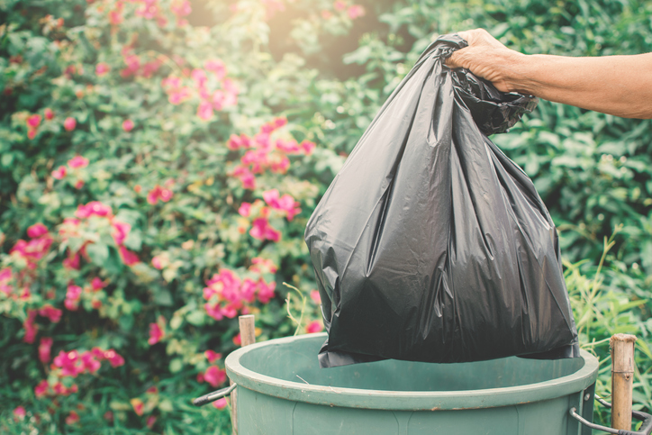
Type or Class A:Solid Fuels- Paper, Wood, Cloth, Rubber Plastic
tsag.net
Notes:
There are 5 classes of fires but only 3 really are related to house fires.
What other solid fuels can you think of? (drapes, paper, rubber…)

Slide 5
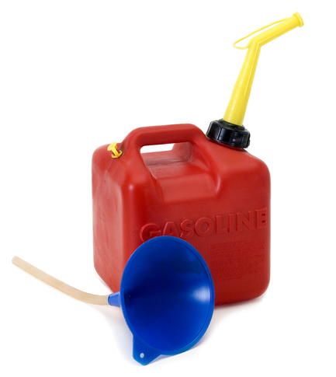
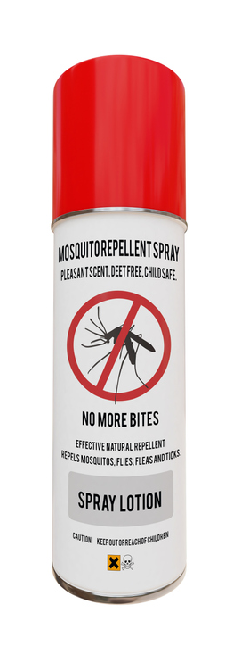

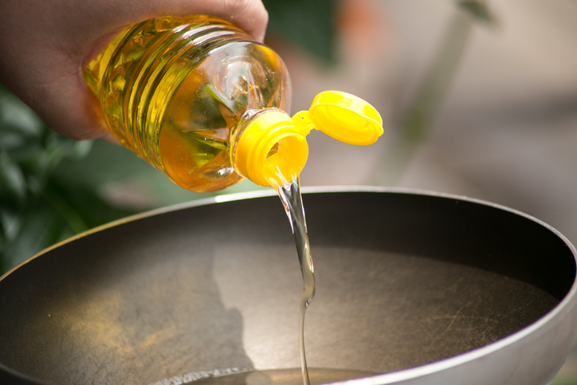

Type or Class B Flammable Liquids Gases, Oils, Paints or Lacquers
tsag.net
Notes:
What does flammable mean? (ignites easily)
What other flammable liquids can you think of? (some cleaning agents, animal fat, kerosene)
What makes flammables more dangerous? (they ignite faster and can do more damage)
Where do you think flammables should be stored? (away from heat)

Slide 6


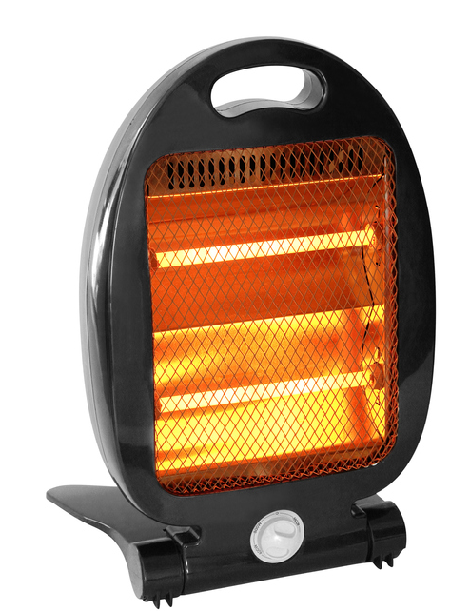
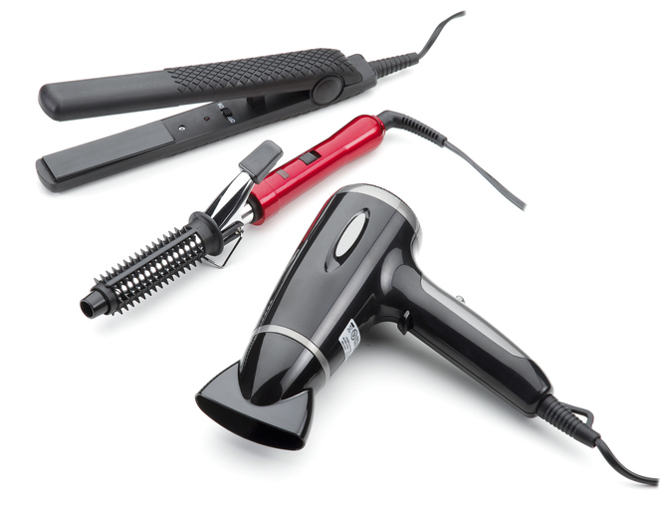

Type C: Electrical Equipment- Appliances, Power Tools and Motors
tsag.net
Notes:
What other electrical appliances/fuels can you think of? (house wiring, stereo, fans)

Slide 7

Electricity is
The presence or flow of tiny charged particles called electrons.
The flow of the tiny electrons creates power that appliances use to work.
The presence or flow of tiny electrons also creates heat.
The presence or flow of tiny electrons also turns motors.
tsag.net
Notes:
“A city’s power plant produces a powerful electric current and sends it through wires. The electricity used for lighting, heating, and running appliances is made by machines called generators. Generators cause a current to flow by moving a magnet past a coil of wire, which pushes electrons through the wires of the coil. Wires carrying the current travel to houses and other buildings. More wires connect to the power outlets in rooms. When a person plugs in an iron or another electric device, the current travels into the device. The current then makes the device work.” https://kids.britannica.com/kids/article/electricity/353091

Slide 8
What is Electricity?
Technovation. (2016, February 24). What is electricity? | STEM kids [Video]. YouTube. https://www.youtube.com/watch?v=oB1v-wh7EGU
tsag.net
Notes:
Who can describe electricity in 10 words or less?

Slide 9
What Causes Electrical Fires?
Our Local Services. (2021, April 7). What Causes Electrical Fires? [Video]. YouTube. https://www.youtube.com/watch?v=DbTqWC9IbbU
tsag.net
Notes:
Do you see any examples of these electrical fire hazards in your house?

Slide 10
Electrical Fire Safety at Home
City of Vaughan. (2022, September 19). Electrical Fire Safety at Home [Video]. YouTube. https://www.youtube.com/watch?v=2rV6zq-i2N4
tsag.net
Notes:
Electrical Equipment is one of the top 5 causes of house fires in Canada. (https://www.canadarestorationservices.com/about-canada-restoration-services).
What are some good safety practices you heard in this film?
What do you already do to practice electrical safety?

Slide 11
Electrical Fire Hazards
SAMFSMedia. (2020, June 3). Electrical fire hazards [Video]. YouTube. https://www.youtube.com/watch?v=oMY3Bfta6xM
tsag.net
Notes:
What are three safety tips to use with a cell phone?

Slide 12
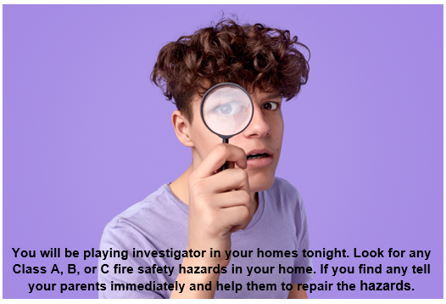
Take Home Activity
tsag.net
Notes:
What are three safety tips to use with a cell phone?

