Slide 1


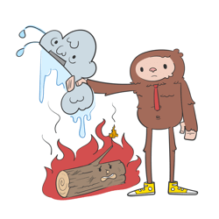


v
Fire Safety Course: Grades 4-6 It’s a New Year, Are You Ready?
First Nations
Technical Services
Advisory Group Inc.
Fire Prevention is Everyone’s Responsibility
Notes:
Added

Slide 2
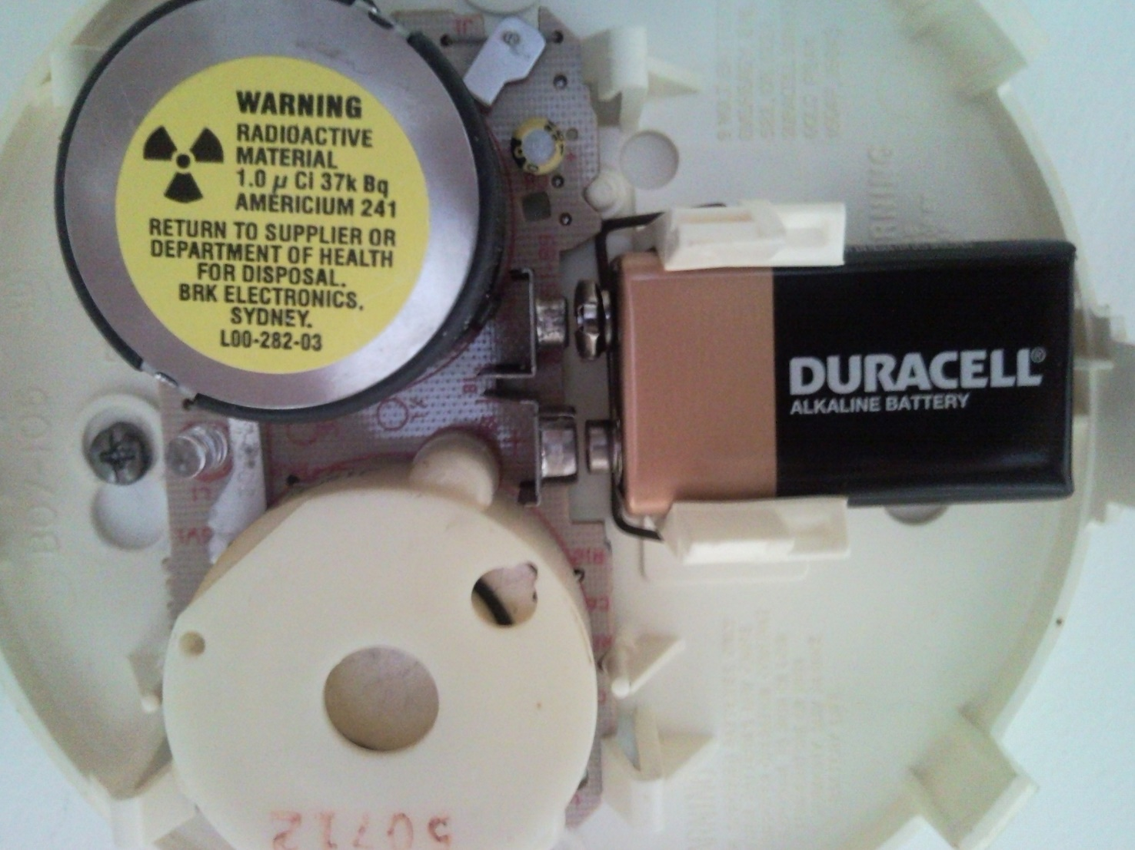


Beeper
Battery
Nose
tsag.net
Notes:
Explain how a smoke detector works (They detect fires by sensing small particles in the air. When there is a high count of smoke particles this signals the alarm).

Slide 3
Where Should You Place Smoke Alarms in Your Home
Strategicfire. (2020, January 6). Where Should You Place Smoke Alarms in Your Home? [Video]. YouTube. https://www.youtube.com/watch?v=8UNzcS02l8w
tsag.net
Notes:
Is smoke from a fire going to be warm or hot?
Why do you think that smoke alarms should be placed up high on a wall or on the ceiling?
Smoke is warm and warm air rises. If you put it on the ceiling where it is gathering, it will alert you as soon as there is the first trace of smoke.
How often should you change the battery in your smoke detector?
Once a year. Batteries in a Carbon Monoxide detector should also be changed at least once a year
How often should you replace your smoke detector?
At least every 10 years from manufacture date. Show them the date of manufacture on the smoke detector)

Slide 4
Smoke and Carbon Monoxide Detectors
AMRE Supply. (2018, March 12). Smoke & Carbon Monoxide Detectors | Spec. Sense [Video].
YouTube. https://www.youtube.com/watch?v=JNnnxe6ze78
tsag.net
Notes:
What is the difference between smoke and carbon monoxide detectors?
What kinds of things give off carbon monoxide in your home?

Slide 5
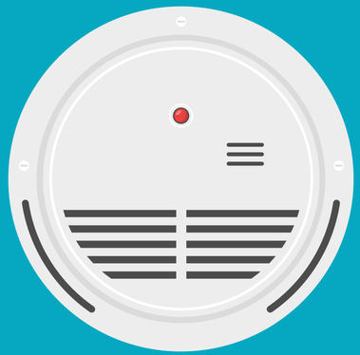
Smoke Alarm Checklist
Replace smoke detectors every 10 years (check the manufacturing date on the back).
Change the batteries when you hear the smoke alarm chirp.
Test smoke alarms once a month.
Install smoke alarm on every floor.
Install smoke alarms outside each sleeping area.
Install a smoke alarm inside every bedroom.
Install smoke alarms at least 10 feet away from cooking appliances.
Change the batteries in the smoke detector once a year.
tsag.net
Notes:
What would be a good way to remember to change the battery?
put it on your calendar

Slide 6
In a Fire
1. Get low and go to the nearest exit.
2. If the door is closed-use the back of your hand to check to make sure it is not hot.
3. If the door is cool, open it slowly to see if there is smoke or fire along your escape route.
4. Go to your family meeting place.
tsag.net
Notes:
Get low means you can either crawl or crouch/walk.

Slide 7



If Your Clothing Catches Fire!
tsag.net
Notes:
If your clothing should ever catch fire you should stop, drop and roll. When you do this it squishes the flames, which takes oxygen away from the flames which fed the fire. It is important to ALWAYS cover your face!

Slide 8
Every Second Counts in a Home Fire
National Fire Protection Association. (2020, March 17). Every Second Counts in a Home Fire – Practice Your Escape Plan [Video]. YouTube. https://www.youtube.com/watch?v=Vc-AkbpdSYk
tsag.net
Notes:
Why do you need a home fire escape plan?

Slide 9
Making a Home Fire Escape Plan
National Fire Protection Association Kids. (n.d.-f). Making a Home Fire Escape Plan – Fire Prevention Week [Video]. https://www.sparky.org/videos?playlistVideoId=6307686168112
tsag.net
Notes:
What are steps to making your home fire escape plan?

Slide 10
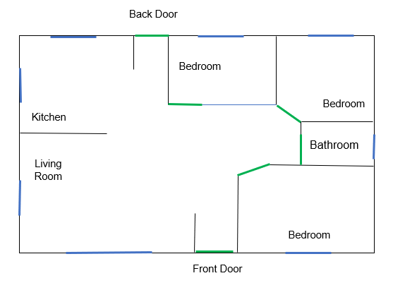
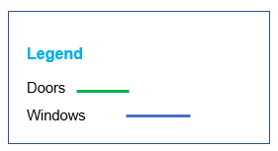

Smoke Alarm
tsag.net
Notes:
To make your fire escape plan:
Draw a map of all the rooms in your house.
Mark 2 exits from every room (usually a window and a door)
Mark a path from each exit to the outside.
Include the location of the smoke alarms.
Choose a meeting place in front of your home where everyone can meet
Put the local emergency number on your plan

Slide 11
1. Type of Emergency
911
2. Your Name
3. Your Address or GPS Coordinates
4. A Phone Number
tsag.net
Notes:
Added

