Slide 1
v
Fire Safety Course: Fire Facts Grades 10-12
First Nations
Technical Services
Advisory Group Inc.
Fire Prevention is Everyone’s Responsibility
Notes:
Added

Slide 2
Fire & The Fire Triangle
New México EPSCoR. (2013, March 1). Fire & The Fire Triangle [Video]. YouTube. https://www.youtube.com/watch?v=tx14SBh2e9c
tsag.net
Notes:
Fire needs fuel, oxygen, and heat to start.
Ask
What are some examples of fuel? (combustible liquids, solids and gases- get specific examples)
What makes certain flammable especially liquids and gases) more dangerous? (they ignite faster and can do more damage)
What are some examples of heat (electric appliance such as heaters, curling irons, stove burners… and flames)
Fires can be prevented if you keep these three items apart.
What are some examples of keeping heat and fuel apart? (moving clothing away from a hot curling iron, moving a space heater away from the drapes, removing paper away from the stove)
What do you need to do to put out a fire? (remove one of the three elements)
You can remove the air by covering up the fire ( like putting a lid on a pot, or rolling on the ground)
You can remove the heat (put water on the fire, or use a fire extinguisher
You can remove the fuel (take it away from the heat source)

Slide 3
10 Household Items That Are Highly Flammable
SCIENCE and TECHNOLOGY. (2018, March 5). 10 Household Items That Are Highly Flammable [Video]. YouTube. https://www.youtube.com/watch?v=O1er6VFbp48
tsag.net
Notes:
How many of these items do you have in your home?
What made this items highly flammable? (what they are made of)
What does this video tell you about where and how to store certain household items?
Can you think of any other items in your home that might be flammable

Slide 4
Hidden Home Fire Hazards
Mark D. Olenjniczak Realty, Inc. (2020, September 17). Hidden Home Fire Hazards [Video]. YouTube. https://www.youtube.com/watch?v=tQxAf2o1FEI
tsag.net
Notes:
What are some of the home hazards you just saw?
What are some ways you could prevent these from starting fires?

Slide 5
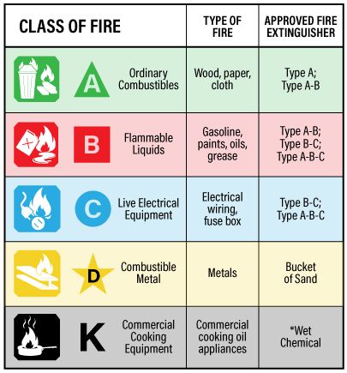
Canadian Centre for Occupational Health and Safety. (2021, March 29). OSH Answers Fact Sheets. Retrieved October 9, 2022, from https://www.ccohs.ca/oshanswers/safety_haz/fire_extinguishers.html
tsag.net
Notes:
There are 5 classes of fires but only 3 really are related to house fires.
CLASS A : In this class, all the materials which are solid in nature and can become ash when burnt. Examples are wood, paper, textiles, plastic, coal etc. When Solids burn, usually the smoke is White in Colour.
(https://ertseshadri.com/2019/12/19/classification-of-fuel-fire/)
What do you think this means in terms of where and how we store these items? (not near flames or sources of heat)
CLASS B : This class is all about the flammable liquids like paints, oils, grease, gasoline , kerosene, and diesel.
What do you think this means in terms of where and how we store these items?
CLASS C : Live Electrical Equipment
Why do you think live electrical equipment is a fire hazard?
What other electrical fuels can you think of? (house wiring)
What are some good tips on how to safely use these items?
There are 3 main types of fire extinguishers: Water, Carbon Dioxide, and dry chemical
Dry Chemical fire extinguishers are the most common type of fire extinguisher separates fire from oxygen and interrupts the chemical process. They contain chemicals that can smother flames and coat fuel with a thin layer of dust.
Type D and K fire extinguishers are not typically used in home fires.

Slide 6
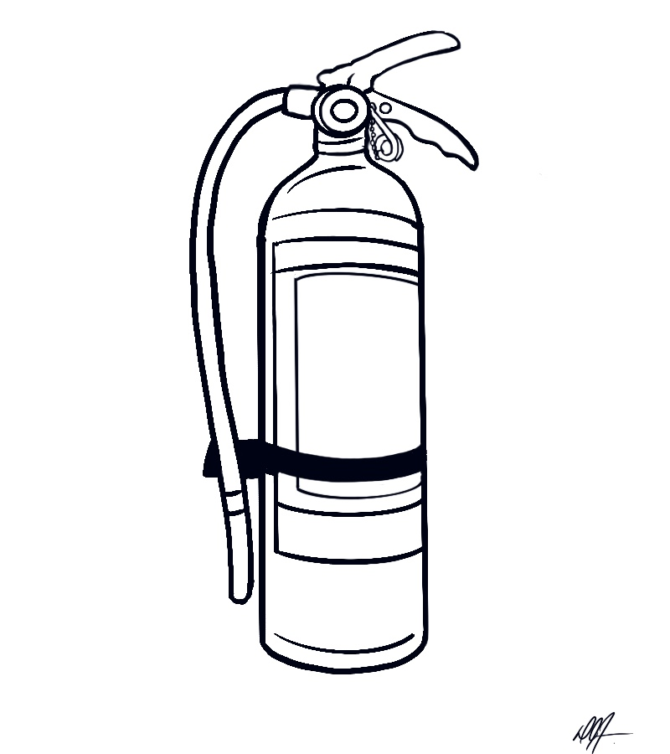
Parts of an ABC Fire Extinguisher
Release Lever
Handle
Pull Pin
Hose
Extinguishing Agent (inside)
Tank
tsag.net
Notes:
The most common type of home extinguisher is an ABC extinguisher because it will put out Type A,B and C types of fires. It is a dry chemical extinguisher.

Slide 7
How to Use a Fire Extinguisher
(fire extinguisher training)
Disaster Survival Skills. (2016, May 23). How To Use A Fire Extinguisher (fire extinguisher training) [Video]. YouTube. https://www.youtube.com/watch?v=Jz_m46qN35c
tsag.net
Notes:
What are some things you shouldn’t do when using a fire extinguisher?

Slide 8
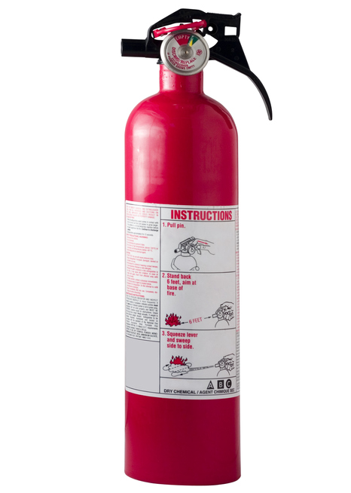
Remember the word PASS.
Pull the pin out of the top of the fire extinguisher. Turn the extinguisher away from your body and press the handle to make sure it works.
Stand a safe distance away from the fire and Aim the nozzle at the base of the fire.
Squeeze the handle to release extinguisher contents.
Move the nozzle from side to side in a Sweeping motion towards the base of the fire.
tsag.net

