Slide 1
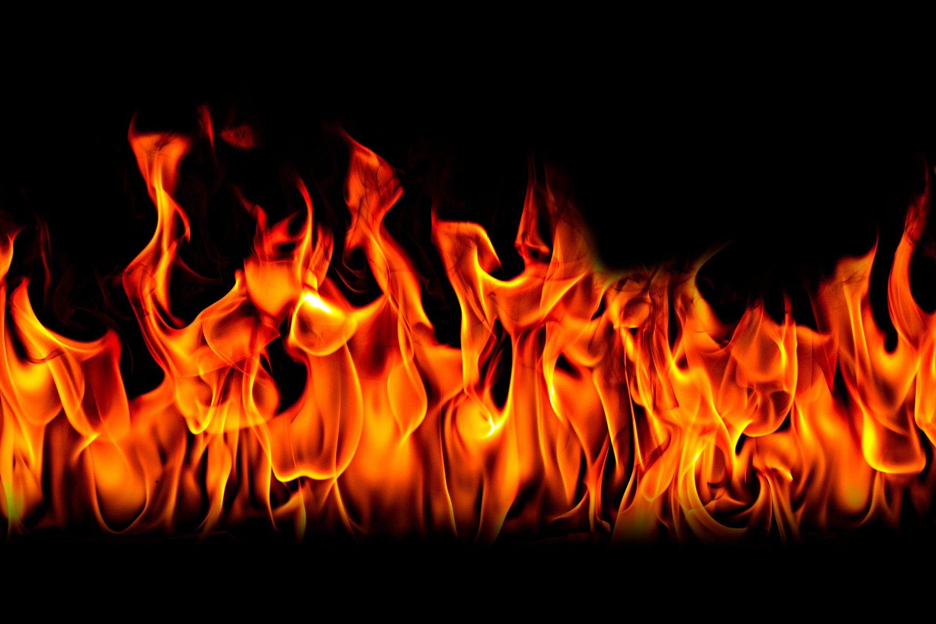


Cooking Safety

Slide 2
100
300
200
A
100
300
200
B
100
300
200
C

Slide 3
A - 100
What should you do to prevent and extinguish a grease fire in the kitchen?
To prevent: Be cautious when cooking with grease – do not let it overheat. Keep cooking surfaces free of spills and grease that may catch fire. Never leave cooking unattended as oil and fat can ignite.
To extinguish: Smother fire by sliding a lid or cookie sheet over the pot/pan. Turn the heat source off.
Notes:
Why wont water put out a grease fire? (water molecules are not attracted to oil molecules and are more dense. This causes the oil to float on top of the water. The water sinks and evaporates causing the flaming grease to explode.

Slide 4
A -200
What should you do to prevent and extinguish an oven fire in the kitchen?
To prevent: Clean oven regularly to keep it free of grease and food build-up.
To extinguish: Keep the oven door closed, turn the heat source off.

Slide 5
A - 300
What should you do to prevent and extinguish a microwave fire in the kitchen?
To prevent:
Clean microwave regularly to keep it free of grease and food build-up.
To extinguish:
  Keep the microwave door closed, turn the microwave off and unplug the unit.

Slide 6
B - 100
What should you do to prevent and extinguish an appliance fire in the kitchen?
  To prevent: Clean appliance surfaces to keep surfaces free of spills and grease that may catch fire. Don’t overload electrical outlets. Examine electrical cords and discard any that are damaged. Turn off and unplug electrical appliances when not in use.
  To extinguish: Use an appropriate fire extinguisher. Unplug the appliance.

Slide 7
B - 200
What should you do to prevent and extinguish a clothing fire?
To Prevent: Avoid loose sleeves that may contact elements and catch fire. Do not store items on or above the stove to prevent your clothing from contacting hot burners. Turn pot handles in. Stay alert while cooking.
To Extinguish: Stop, drop, and roll.

Slide 8
B - 300
What should you do to prevent and extinguish an electrical fire?
To Prevent: Don’t overload electrical outlets. Have an electrician repair any damaged or faulty wiring and plugs. Discard any damaged electrical cords.
To Extinguish: Use an appropriate fire extinguisher. Turn the power off.

Slide 9
C- 100
Why is it important for every family to create and practise a home escape plan?
Fire is fast, hot and dark. Within minutes the heat and toxic gases from fire may prevent escape. There is no time to stop and think. Your escape must be automatic. Practising a home escape plan ensures that every family member can get out quickly and safely. All family members should know two ways out of each room: the first usually a door, the second a window. Once out, stay out.

Slide 10
C - 300
What do you do if you get burned while cooking?
Depends on the severity of the burn.
However, if the burned area is larger or covers the hands, feet, face, groin, buttocks or a major joint, treat it as a major burn and seek immediate medical treatment.
Third- and fourth-degree burns (involve all layers of skin, fat, muscle and bone) always require medical attention!!!!

Slide 11
C - 200
How do we prevent burns in the kitchen?
Keep pot handles turned in
• Always use potholders or oven mitts
• Avoid storing items above the stove
• Make sure sleeves are close fitting
• Never leave cooking unattended
• Remove lids on microwaved foods carefully to avoid steam burns
• Stay alert when cooking
• Keep young children 1 meter from cooking area

