Slide 1




v
Fire Safety Course: Gr 7-9 Fire Escape Plan
First Nations
Technical Services
Advisory Group Inc.
Notes:
Added

Slide 2



Smoke Alarms Save Lives!
Beep!
Beep!
Beep!
tsag.net
Notes:
There are different types of smoke detectors. Some beep and others talk to you. Even though they may sound different, they all have the same parts and all have test buttons.
People in fires often inhale carbon monoxide, which can cause headaches, nausea, and vomiting.
Smoke can be incredibly toxic. Tar and carbon are just two of its common byproducts, but smoke can also contain heavy metals and other toxins.
Fine particles from smoke (fine particulate matter, or PM 2.5) can travel deeply into the respiratory tract, reaching the lungs. Inhaling fine particles can cause a variety of health effects, like respiratory irritation and shortness of breath. It can also worsen medical conditions such as asthma and heart disease.

Slide 3

Seconds Count
<iframe width="1094" height="729" src="https://www.youtube.com/embed/piofZLySsNc" title="Why Seconds Count" frameborder="0" allow="accelerometer; autoplay; clipboard-write; encrypted-media; gyroscope; picture-in-picture; web-share" referrerpolicy="strict-origin-when-cross-origin" allowfullscreen></iframe>
tsag.net

Slide 4
Plan Your Escape
<iframe width="1280" height="720" src="https://www.youtube.com/embed/2CFiL0FAggg" title="FSRI: Plan Your Escape: Single-Story Home Fire" frameborder="0" allow="accelerometer; autoplay; clipboard-write; encrypted-media; gyroscope; picture-in-picture; web-share" referrerpolicy="strict-origin-when-cross-origin" allowfullscreen></iframe>
tsag.net

Slide 5
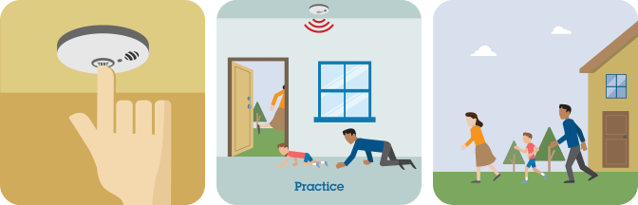
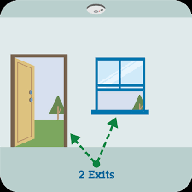
Practice Your Fire Escape
tsag.net
Notes:
Make sure your smoke alarm works.
Know two ways out of every room.
Practice your escape.
Get Low & Go if there is smoke.

Slide 6
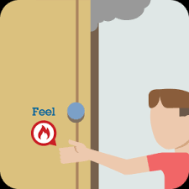
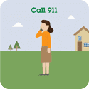
Get Out & Stay Out
tsag.net
Notes:
Yell FIRE!
If you can’t get to other members of your family, stick with the Fire Escape Plan!
Keep doors closed if they are hot and escape another way.
Shut doors behind you as you leave the home.
Get out and stay out!
Go to the meeting spot.
Call 911 or the emergency number in your area.

