Slide 1
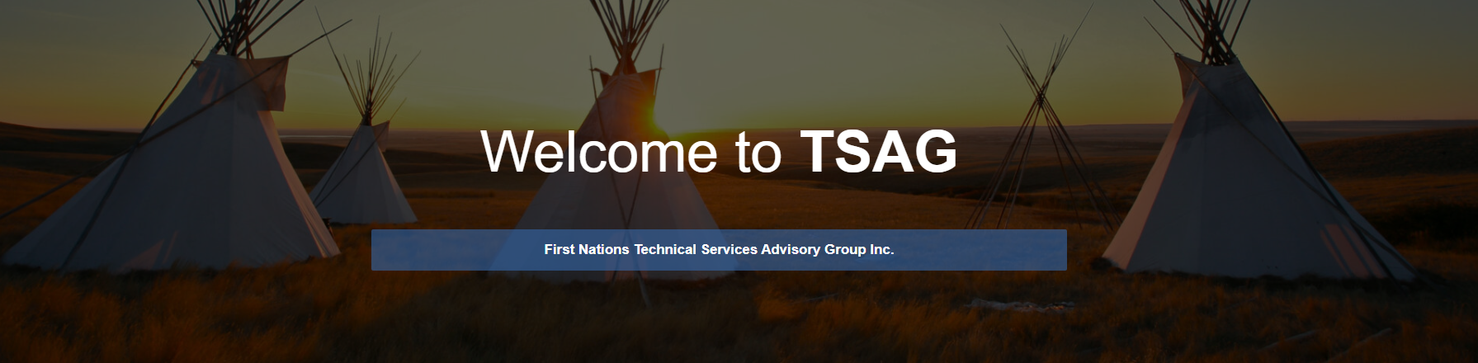
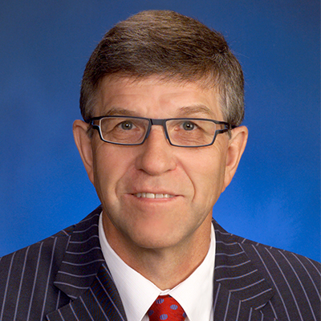
Building leaders in your workforce
Nolan Crouse
Serving in all treaty territories; we are all treaty people
Updated June 11-2023 file tsag-3

Slide 2
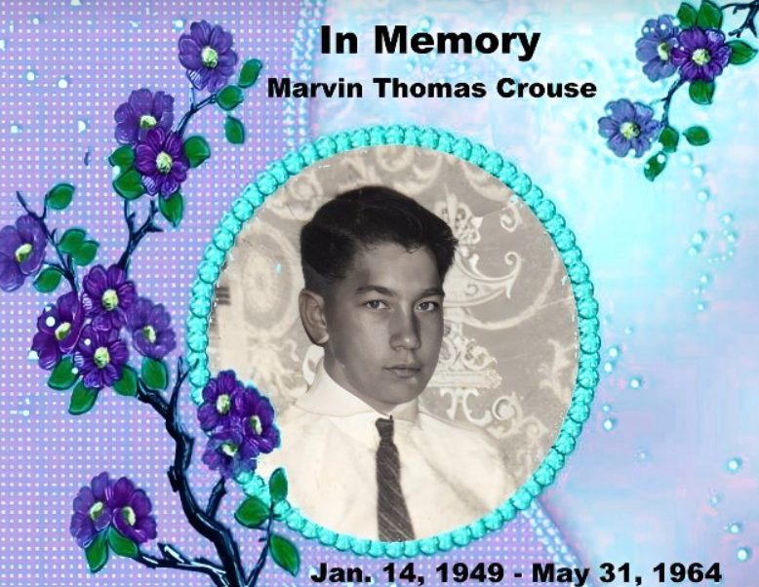
1964
The Battle River

Slide 3
Leadership opportunities come to us in all ways …
Tragedy
Opportunity
The world starves for leadership

Slide 4
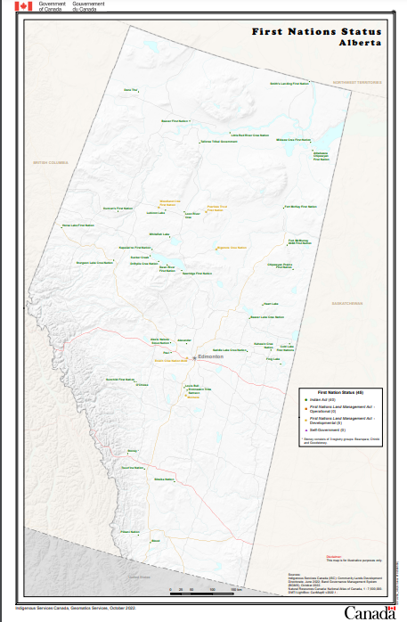
Serving all treaty territories;
All Canadians are treaty people in some way
I serve you and TSAG today

Slide 5
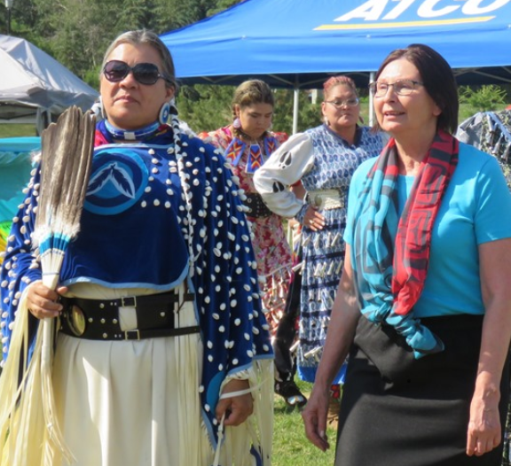
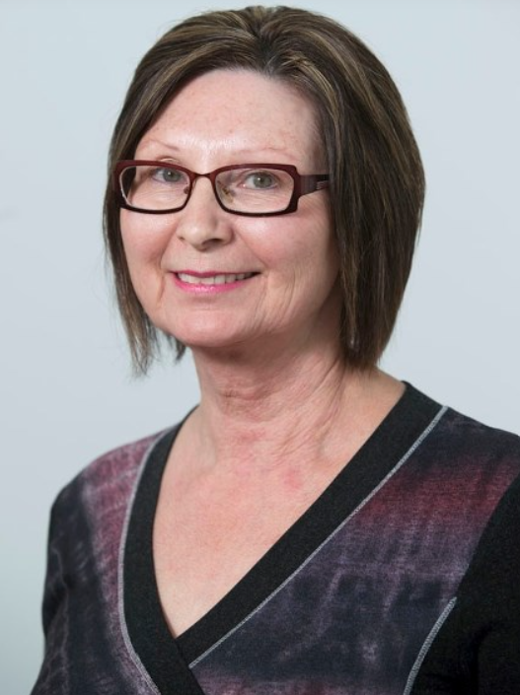

Slide 6
Opportunities
Sometimes we earn them
Sometimes handed to us
Sometimes we get lucky
Sometimes we search for them
Sometimes opportunities just happen

Slide 7
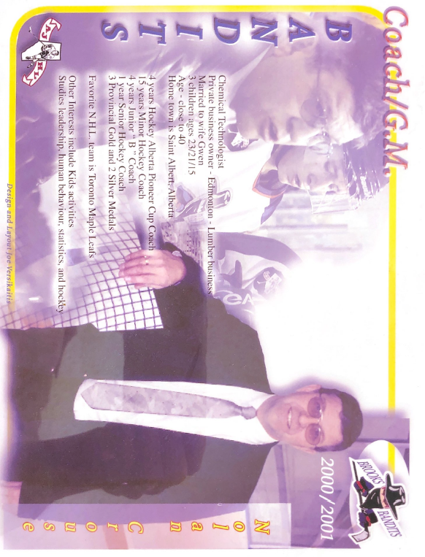

Slide 8
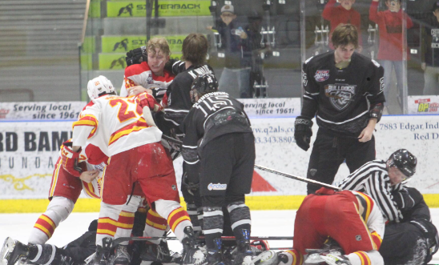
And leaders make mistakes …
Alberta Junior Hockey Record;
268 Penalty Minutes
One Game
One Period

Slide 9
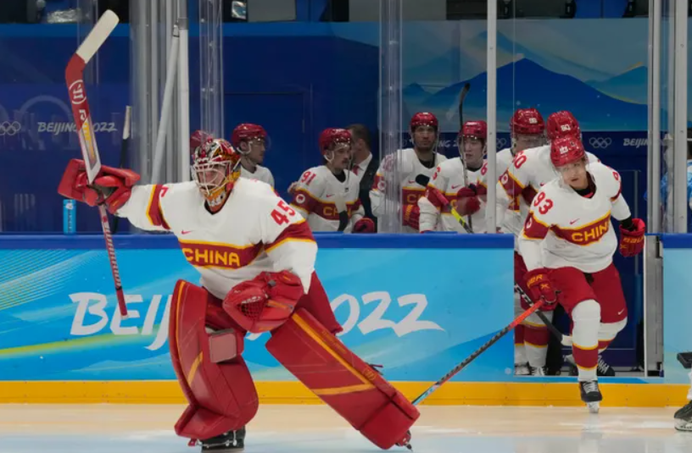

Slide 10


Slide 11
Leadership demonstrated in all ways …
This leader does not predict the power of his actions!!
https://www.youtube.com/watch?v=fW8amMCVAJQ

Slide 12
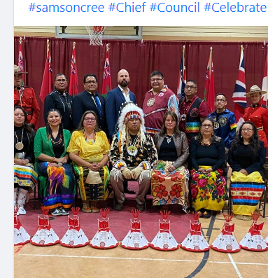
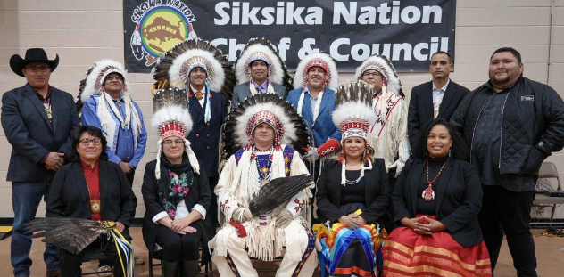

Slide 13
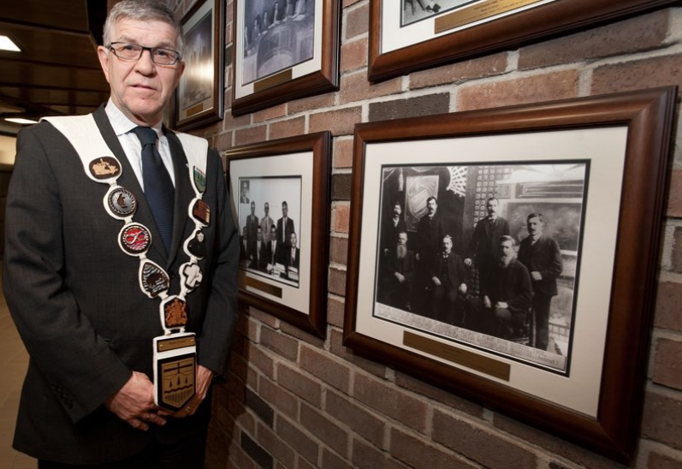

Slide 14
For You
Some of you are new
Some experienced
You may not even get noticed
But… you matter
The work that you do is significant

Slide 15
For You
You may not feel involved
You may not believe anyone cares
Ask your boss to be involved
Ask for a raise if you take on extra
Information is power – get information
Knowledge is power – gain knowledge

Slide 16
Fears
One of our deepest fears is that we are inadequate
We have another fear at times … a fear that we are powerful beyond measure
We ask: who am I to be brilliant, educated, promoted, fabulous?
      Actually, who are we not to be?

Slide 17
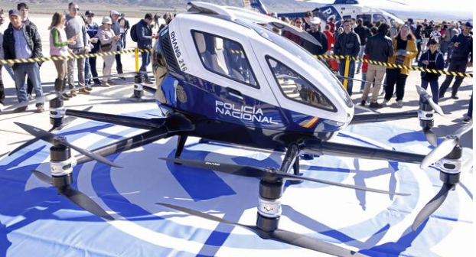
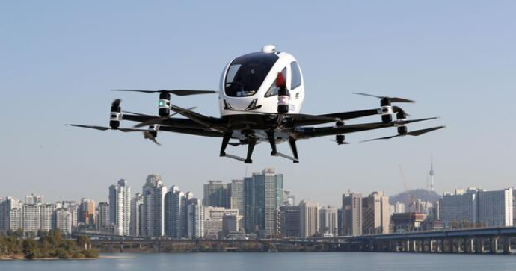
We all have the ability to dream

Slide 18
Another thought for you …
Prepare others for what you wish for
        Chat, discuss, talk with others
        Take your message to the top

Slide 19
Fears
Consider presenting to Chief and Council (confidence)
Consider working on policies that pay for added skills
Consider working toward certification
Consider cross training
We are the captains of our own ship

Slide 20
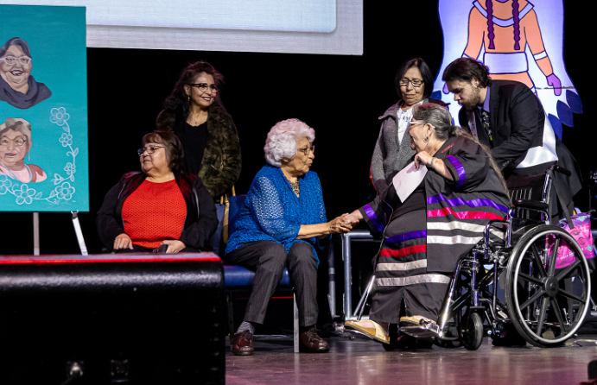
Fears

Slide 21
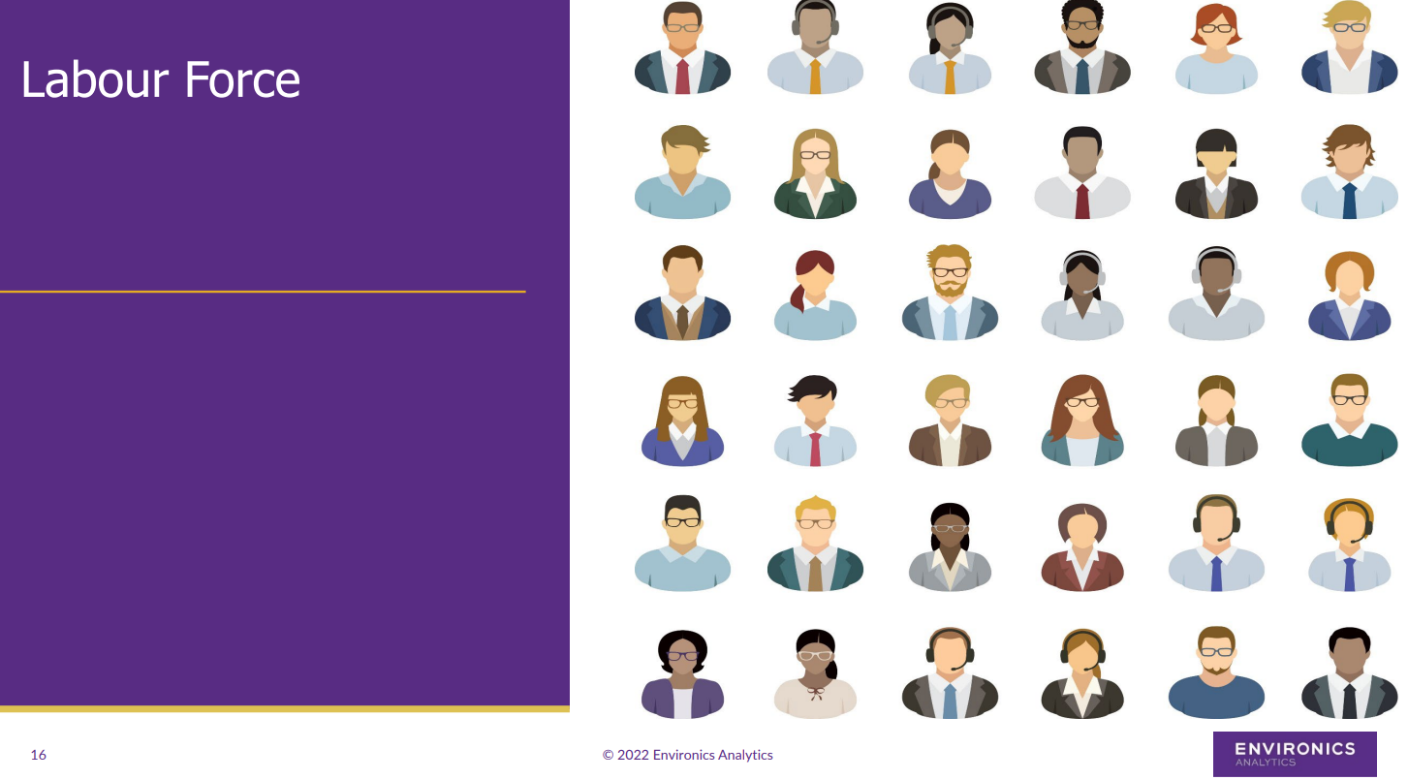
Our labour force is changing

Slide 22
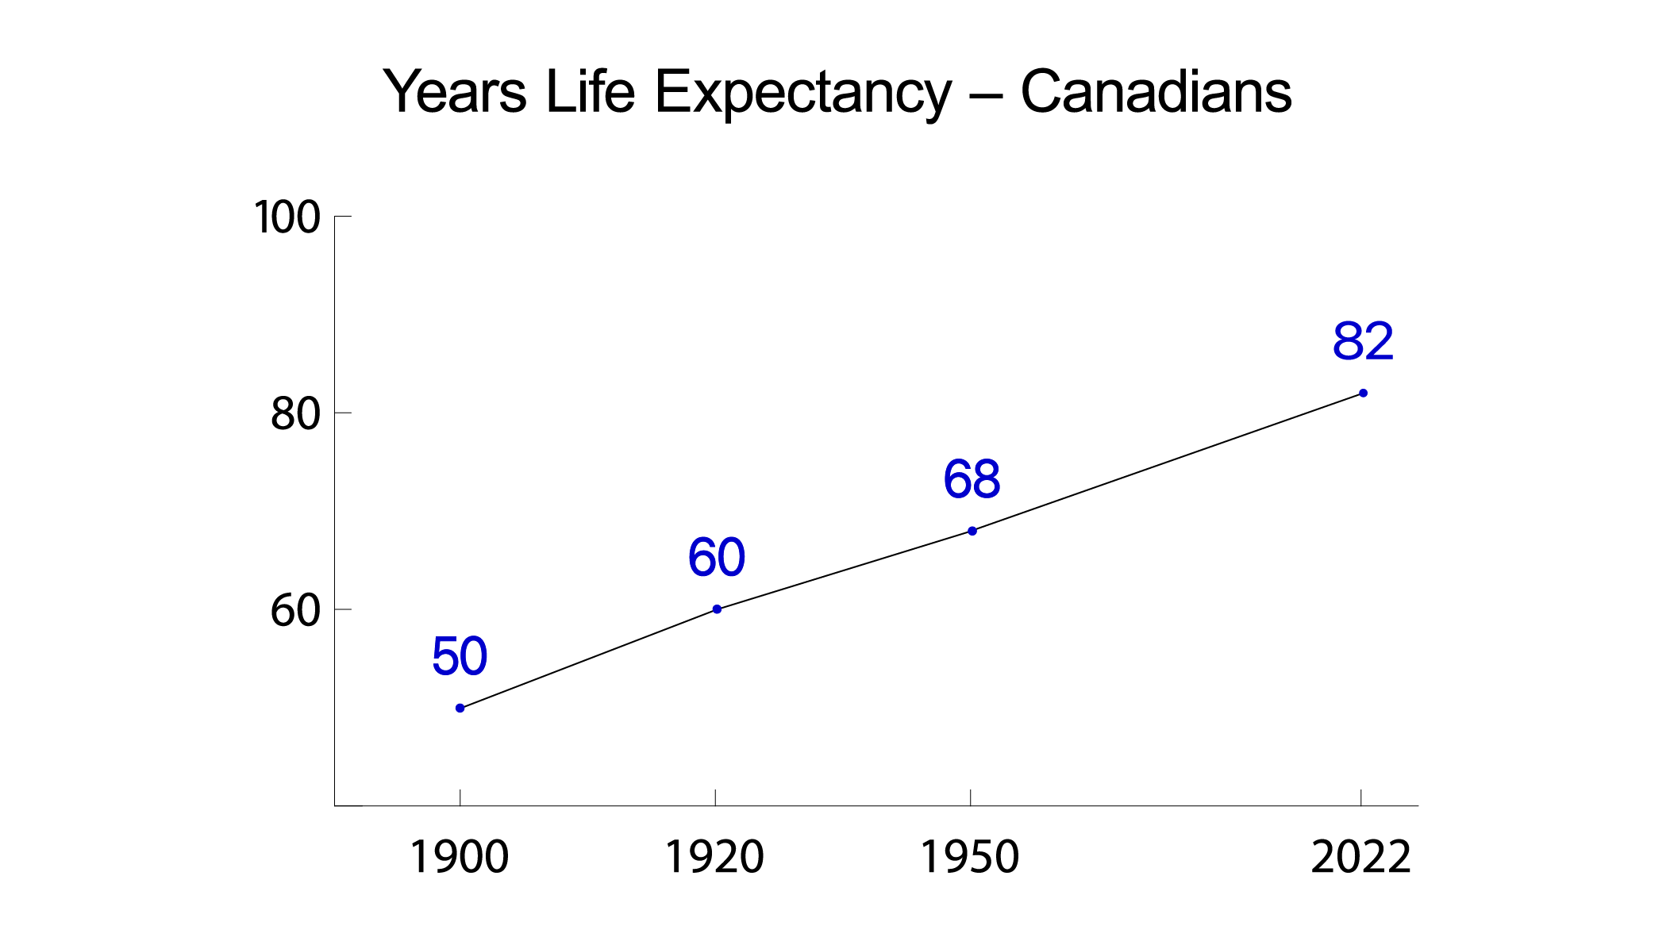

Slide 23
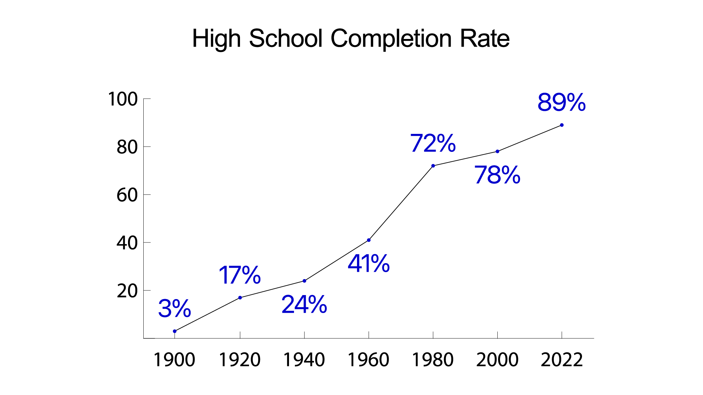

Slide 24
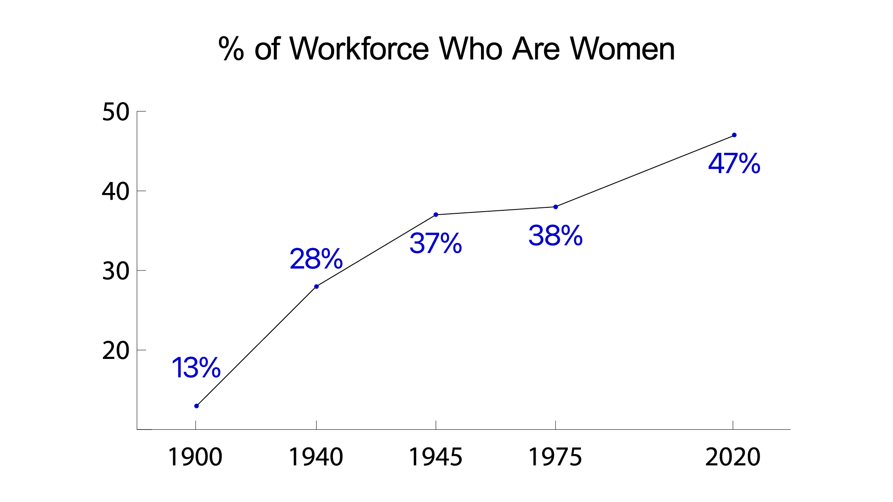

Slide 25
We are each dealt a hand
Some hands are lousy hands
Some hands are great hands
It is how we play the hands at times

Slide 26
My call to action
Consider that next course
Consider additional training
Network to beat hell

Slide 27


Slide 28
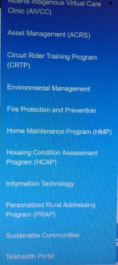
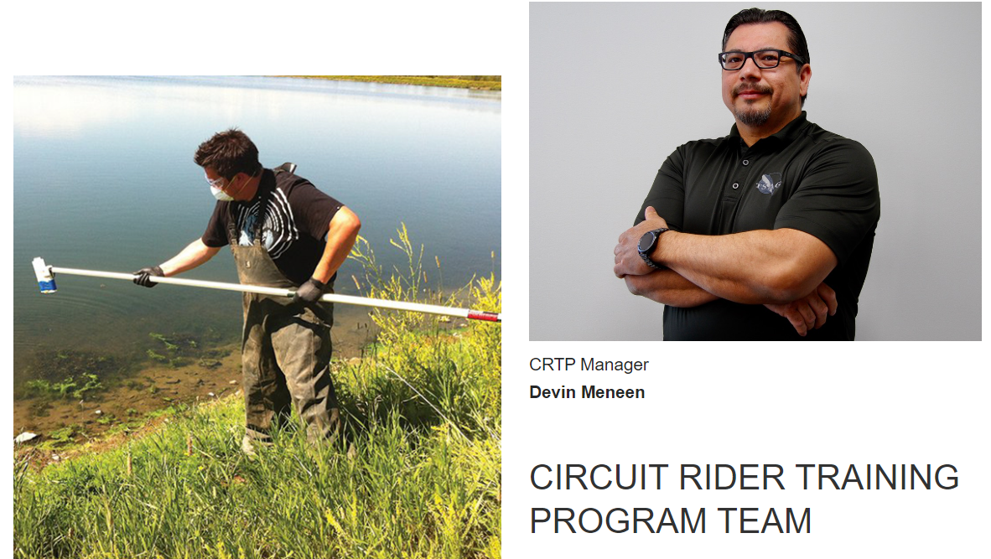

Slide 29
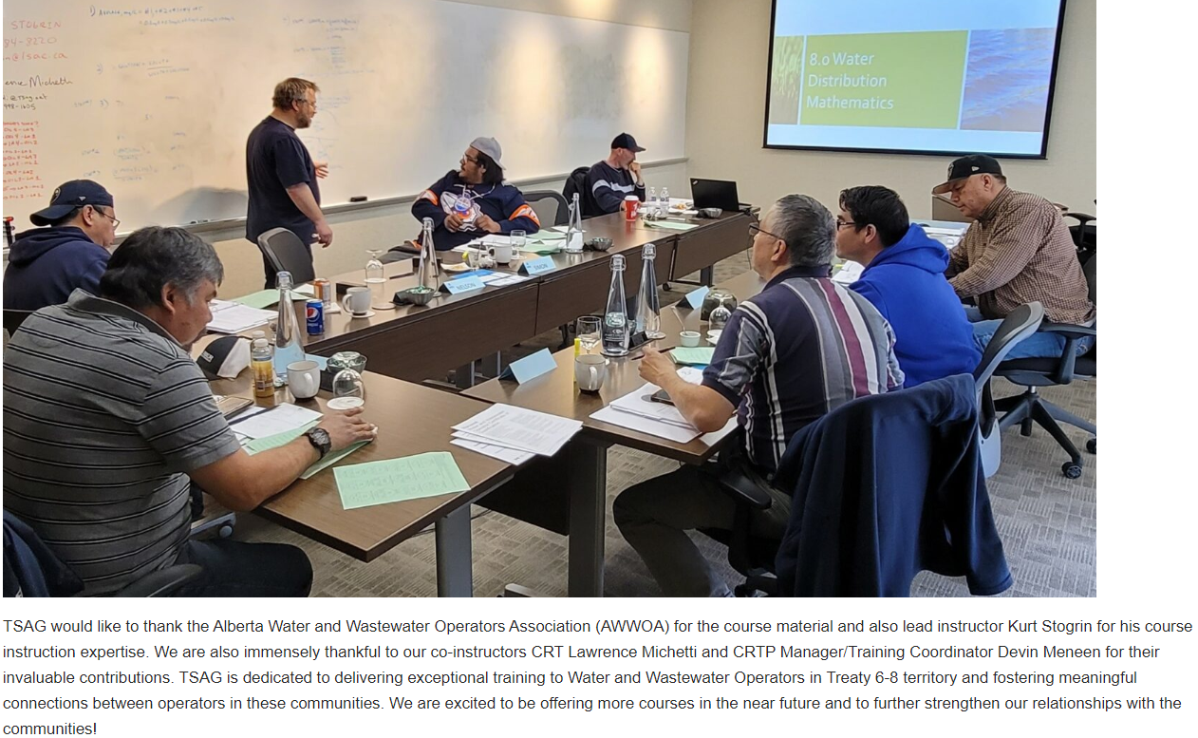

Slide 30
My call to action
Remember
The world starves for leaders
Set yourself up for more success

Slide 32


Slide 33

That’s it, that’s all
Thank You

