Slide 1

Wastewater systems effluent regulations
TSAG - 2023

Slide 2
DISCLAIMER
This material has been prepared for convenience of reference and accessibility and does not have official character. It is of general nature only.
For all purposes of interpreting and applying the regulations, users must consult the official version of the Wastewater Effluent System Regulations and seek their own legal advice as appropriate.

Slide 3
OUTLINE
Overview of the Wastewater Systems Effluent Regulations (WSER)
  Monitoring
  Sampling
  Reporting
Proposed Amendments

Slide 4
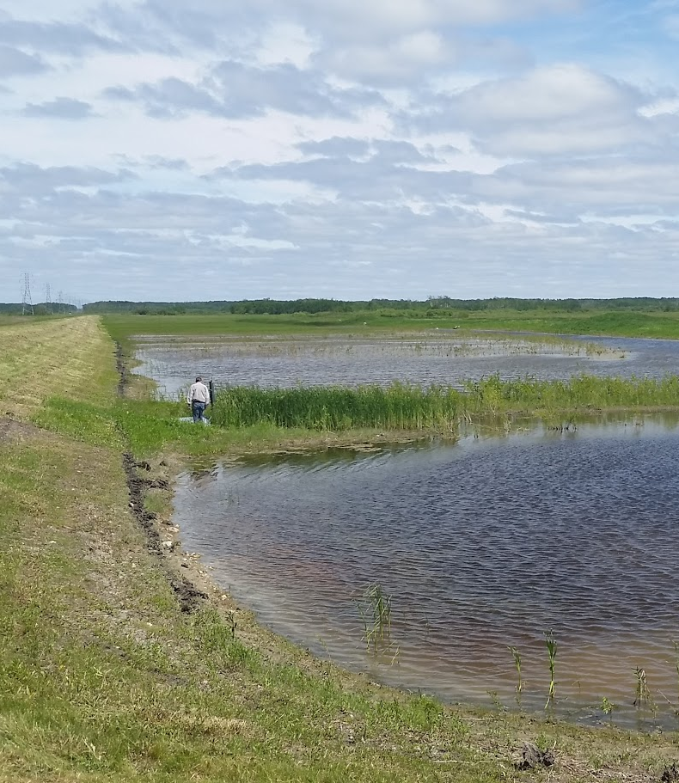
WSER OVERVIEW
Small wastewater systems that deposit an average daily volume of effluent that is ≤2,500m³
The WSER came into force on June 29, 2012 under the Fisheries Act
Notes:
These slides focus on the Wastewater Systems Effluent Regulations (WSER) requirements for smaller wastewater systems that deposit an average daily volume of effluent that is less than or equal to 2,500 m³
Effluent from wastewater systems is one of the largest sources of pollution by volume in Canadian waters.
Wastewater comes from domestic, industrial, commercial and institutional sources, and includes chemicals, pathogens and pollutants which if left untreated can be harmful to the environment and human health.

Slide 5
WSER OVERVIEW
Target the largest single source of pollution by volume in Canada
Reduce threats to the environment and human health
Set national baseline effluent quality standards achievable through a secondary level of wastewater treatment
Notes:
The purpose of the regulations is to:

Slide 6
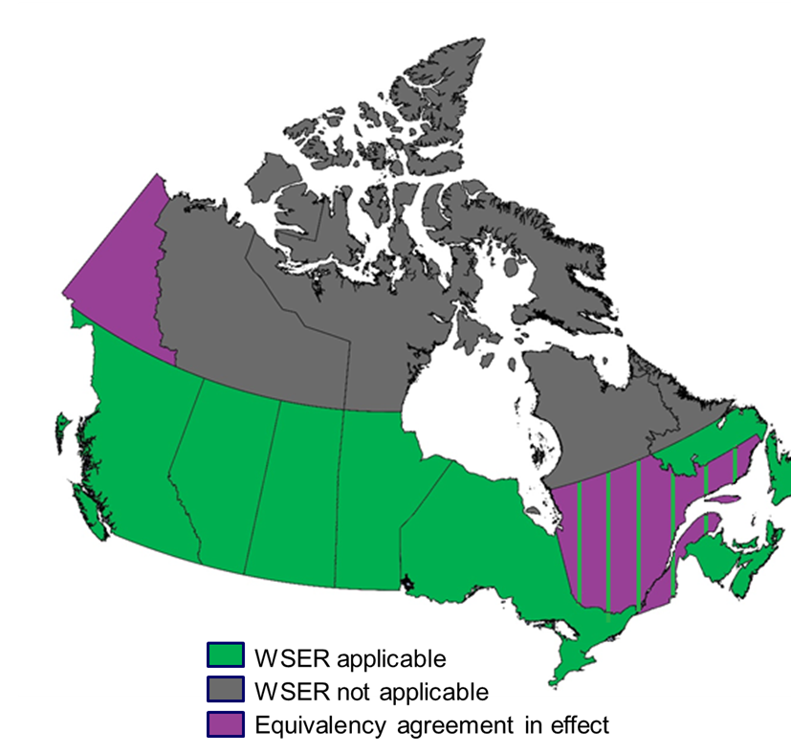
WSER OVERVIEW
Areas covered by the WSER
Notes:
The purpose of the regulations is to:

Slide 7
WSER OVERVIEW – Who is Regulated?
Wastewater systems that collect or are designed to collect an average wastewater volume of 100m³ (cubic metres)/100,000 litres) or more per day;
AND
Discharges effluent to water frequented by fish, or any place that can reach such water.
Notes:
Even the highest level of treated effluent is subject to the Fisheries Act.

Slide 8
WSER OVERVIEW –
Type of Wastewater System
Intermittent system
  Lagoon system discharging up to four times per year
Continuous system with HRT ≥ 5 days
  Lagoon system discharging on a continuous basis
Continuous system
  System continuously discharging like a mechanized plant
Notes:
Intermittent System:
Discharge periods must be separated by at least 7 days of no discharge
Hydraulic retention time (HRT) ≥ 90 days (seasonally discharging lagoons)
Continuous System – all other systems (also includes raw discharging outfalls)
Step 1: Identification of their system

Slide 9
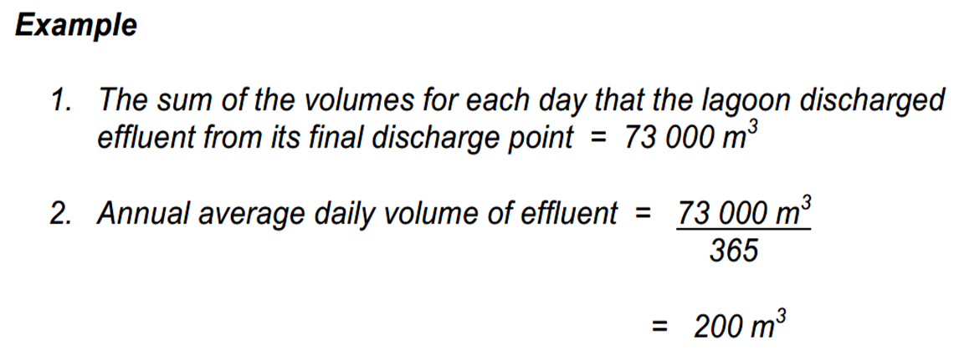
WSER OVERVIEW – Calculate Volume of Effluent
1. Add all the daily volumes of influent or effluent
2. Divide the total (from step one) by the number of days in the calendar year (365 days)

Slide 10
WSER OVERVIEW – Effluent Deposits
ECCC recommends wastewater systems take advantage of the authorization to deposit provided by the WSER
If a community with a wastewater system is not in compliance with the WSER, then it is not authorized under the Fisheries Act (FA) to deposit effluent into water frequented by fish or into a place where it could make its way to a body of water that is frequented by fish.
If the community makes an unauthorized deposit or fails to comply with any applicable requirements under the Regulations, they may be subject to enforcement actions.

Slide 11
WSER OVERVIEW – Authorization to Deposit
To comply with WSER the effluent must meet specific conditions during discharge:
  Limits on the concentrations of certain pollutants (CBOD, suspended solids, total residual chlorine and un-ionized ammonia)
  Effluent deposited cannot be acutely lethal to fish (i.e. poisonous)
  Effluent quality standards came into effect January 1, 2015
  Requirements for monitoring, record keeping, and reporting

Slide 12
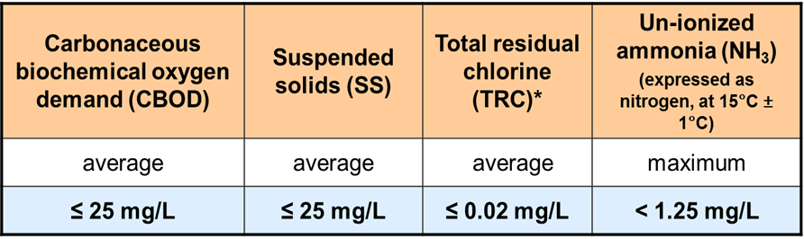
WSER OVERVIEW – Authorization to Deposit
*TRC standard for systems < 5000 m3/day is in effect since January 1, 2021
*Un-ionized ammonia (NH3) reporting requirements ended June 30, 2014, but the standard for NH3 must still be met
Notes:
Limits on the concentrations of certain pollutants (CBOD, suspended solids, total residual chlorine and un-ionized ammonia)
You must meet the limits for TRC and NH3 even though you don’t have to sample.

Slide 13
WSER OVERVIEW –
National Effluent Quality Standards
Pollutants | Limits | Sampling | Reporting results
Carbonaceous biochemical oxygen demand (CBOD) | Average ≤ 25 mg/L | Yes | Yes
Suspended solids (TSS) | Average ≤ 25 mg/L | Yes | Yes
Total residual chlorine | Average ≤ 0.02 mg/L | Not required | Not required
Unionized ammonia | Maximum < 1.25 mg/L | Not required | Not required
Notes:
*TRC standard for systems < 5000 m3/day is in effect since January 1, 2021
*Un-ionized ammonia (NH3) reporting requirements ended June 30, 2014, but the standard for NH3 must still be met

Slide 14
WSER OVERVIEW – Volume Determination
Average daily volume must be calculated for each monitoring period
Continuous Systems
Continuous measure of influent or effluent (i.e. flow meter)
Daily measure of rate of flow can be used to estimate daily volume (systems >2,500 m3/day)
Intermittent Systems
Continuous measure of influent or effluent (i.e. flow meter)
Daily measure of rate of flow
Estimation based on accepted engineering practices (within a margin of error of ±15)
For more information, ECCC has published a factsheet

Slide 15
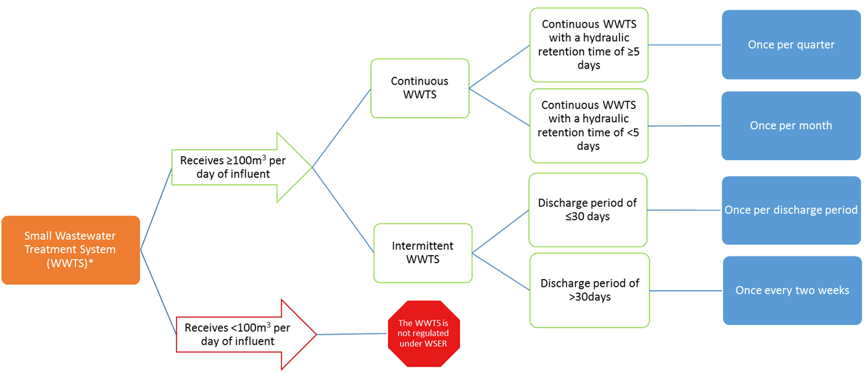
MONITORING –
Small Systems
Notes:
WSER is like protection from 36(3). The definition in the regulations for Acutely lethal is more than 5 fish. If not subject to WSER, still subject to FA 36(3). Including “sub-lethal effects”.
Intermittent wastewater treatment systems (WWTS) are those that:
discharge effluent no more than 4 periods per calendar year, and where
discharge periods are separated by a minimum of 7 days without discharging, and
have a hydraulic retention time of at least 90 days
All other WWTS are continuous.

Slide 16
MONITORING–
Intermittent Systems ≤ 2500m3/day
Averaging period: Calendar year
Volume: The volume of effluent must be determined for each day that effluent is deposited that provides:
  A continuous measure of the volume of influent or effluent (i.e. flow meter);
  Daily measure of rate of flow can be used to estimate daily volume (systems >2,500 m3/day)
  A method of estimation based on generally accepted engineering practices and with a margin of error of ±15%
Notes:
≤2500m3/day

Slide 17
MONITORING–
Intermittent Systems ≤ 2500m3/day
Sampling frequency for CBOD and suspended solids (SS)
  Effluent must be sampled once per period if the discharge period is ≤ 30 days
  Effluent must be sampled every two weeks, but at least seven days after any other sample, if the discharge period is greater than 30 days.
Notes:
≤2500m3/day

Slide 18
MONITORING–
Continuous Systems with HRT ≥ 5 days and depositing ≤ 2500 m³/day
Averaging period: Calendar year
Volume: The volume of effluent must be determined for each day that effluent is deposited by using monitoring equipment that provides:
  A continuous measure of the volume of influent or effluent (i.e. flow meter); or
  Daily measure of rate of flow can be used to estimate daily volume (systems >2,500 m3/day)
Notes:
≤2500m3/day

Slide 19
MONITORING–
Continuous Systems with HRT ≥ 5 days and depositing ≤ 2500 m³/day
Sampling frequency for CBOD and suspended solids (SS)
  Effluent must be sampled quarterly but at least 60 days after any other sample
  Any SS results > 25 mg/L in July, August, September and October are not to be taken into account
    If all SS results > 25 mg/L, the average SS is deemed to be 0 mg/L (All Lagoons)
Notes:
Exemption for lagoon system: RAIS- regulatory impact analysis statement -Algae blooms are not SS and not harmful as such. To avoid capturing Algae Blooms in the SS measurements, exceptions are given.

Slide 20
MONITORING–
Continuous Systems with HRT < 5 days and depositing ≤ 2500 m³/day
Averaging period: Quarterly
Volume: The volume of effluent must be determined for each day that effluent is deposited by using monitoring equipment that provides:
  A continuous measure of the volume of influent or effluent; or
  A continuous measure of the rate of flow of the influent or effluent upon which the daily volume can be estimated
Notes:
≤2500m3/day

Slide 21
MONITORING–
Continuous Systems with HRT ≥ 5 days and depositing ≤ 2500 m³/day
Sampling frequency for CBOD and suspended solids (SS)
  Effluent must be sampled monthly but at least 10 days after any other sample

Slide 22
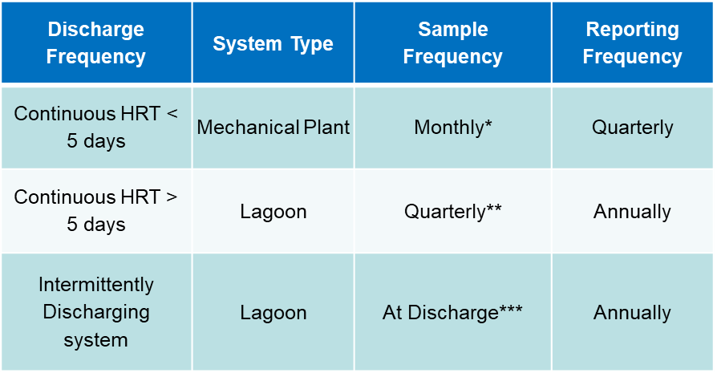
MONITORING–
For Small Systems ≤ 2500m3/day
*Sample at least 10 days after any other sample
**Sample at least 60 days after any other sample
***Sample every two weeks but at least seven days after any other sample if the discharge period is greater than 30 days
Notes:
Requirements vary depending on the type of wastewater system
By monitoring and tracking the effluent quality, you can find out if standards are being met. ECCC will be monitoring to see if reports are submitted and if the water quality is meeting the regulations –so it’s important to report!

Slide 23
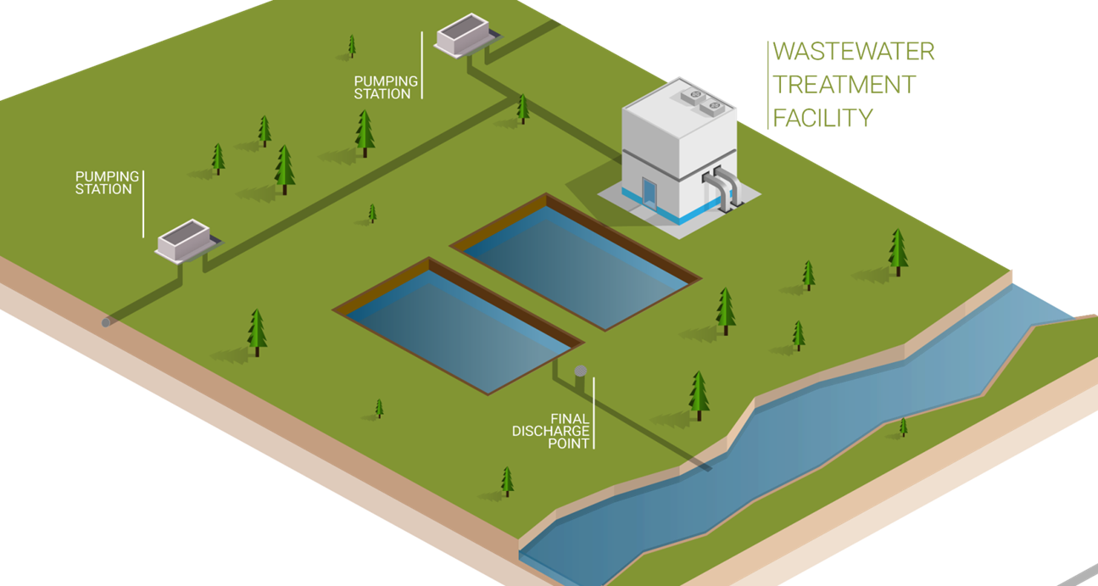
SAMPLING–
Final Discharge Point
Final discharge point: the point where the effluent leaves the outfall pipe and the operator would take the sample.
Notes:
Samples must be taken during discharge, not prior too. Reason being- WSER regulates the quality of the effluent being released to the receiving environment. A representative sample is during discharge. Final discharge point is the point beyond which operators no longer exercise control over the quality of the wastewater before it is deposited as effluent in water or a place

Slide 24
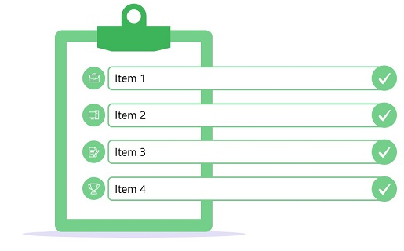
SAMPLING–
Checklist Before Sampling
Sampling Bottles
Other Materials
Chain of Custody (CofC) Form
Schedule for a courier to pick up samples
Notes:
I suggest a month before you plan on sampling to get all of your bottles and materials together.
-waterproof markers/pens
-ziplock bags
-garbage bag
Extra bottles/labels
Extra CofC
Cooler
Ice or freezer packs
Packing tape
Container to collect effluent (optional)

Slide 25
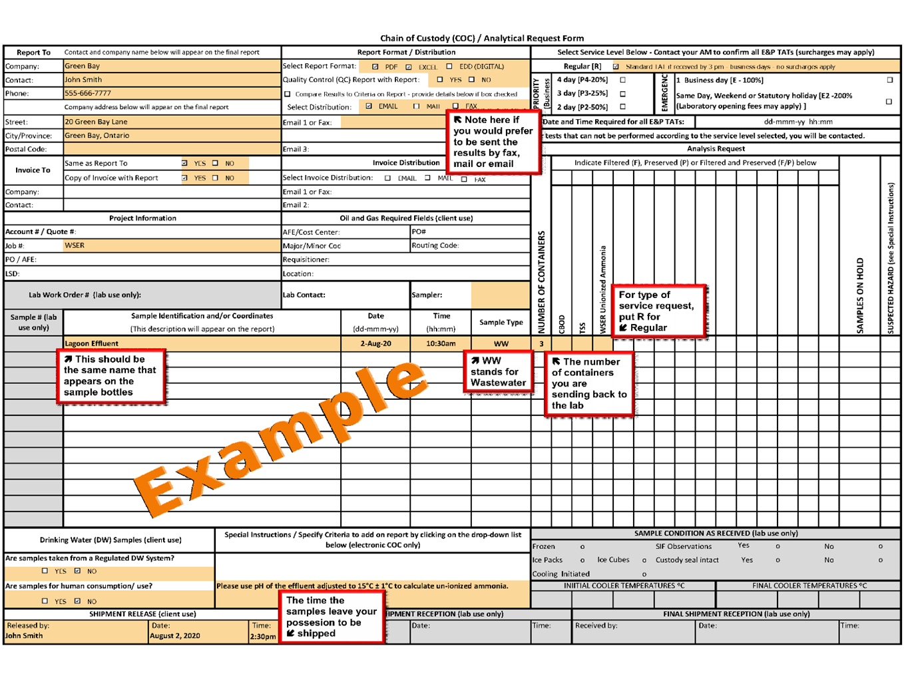

Slide 26
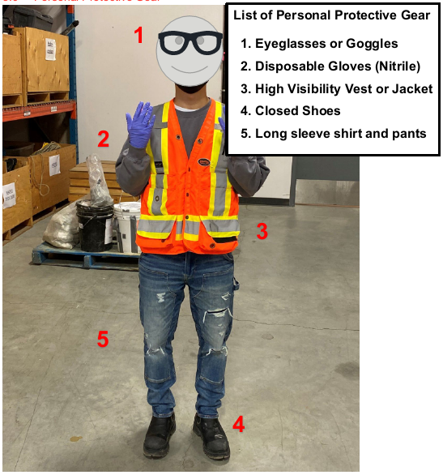
SAMPLING–
During Sampling
Notes:
It’s not a requirement but I recommend taking photos of the lagoon, sampling point, and the labelled samples so that if something happens in transport you have a record that they were taken, and packaged properly for the lab.
Photos will also help capture the weather conditions observed during the sampling process. –rain, wind, algae growth etc..
Wear the required Personal Protective Equipment (PPE)
Disposable gloves
Protective glasses
Long sleeves

Slide 27
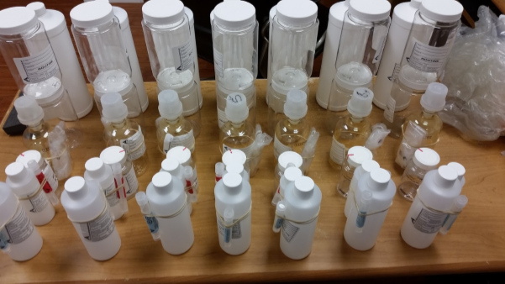
SAMPLING–
During Sampling
Label each bottle appropriately
Example: Lagoon Discharge, Name of Lagoon, your name, the date and time samples were taken
Notes:
It’s not a requirement but I recommend taking photos of the lagoon, sampling point, and the labelled samples so that if something happens in transport you have a record that they were taken, and packaged properly for the lab.
Photos will also help capture the weather conditions observed during the sampling process. –rain, wind, algae growth etc..
Wear the required Personal Protective Equipment (PPE)
Disposable gloves
Protective glasses
Long sleeves

Slide 28
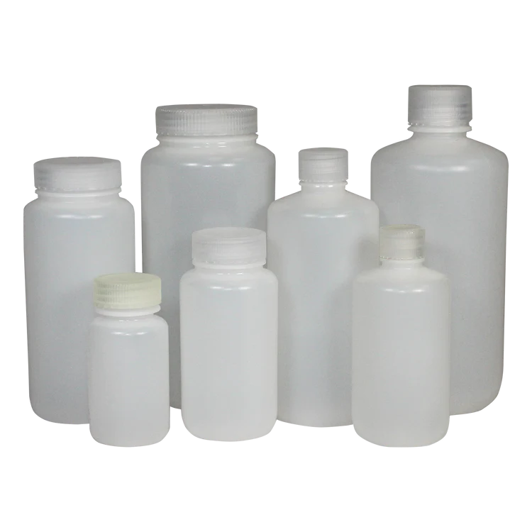
SAMPLING–
During Sampling
If a container is used to collect the effluent sample, ensure the effluent is well mixed before pouring into the sampling bottles
If sampling from a valve, purge the line before sampling
Notes:
It’s not a requirement but I recommend taking photos of the lagoon, sampling point, and the labelled samples so that if something happens in transport you have a record that they were taken, and packaged properly for the lab.
Photos will also help capture the weather conditions observed during the sampling process. –rain, wind, algae growth etc..
Wear the required Personal Protective Equipment (PPE)
Disposable gloves
Protective glasses
Long sleeves

Slide 29
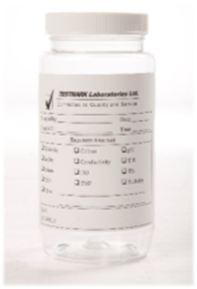
SAMPLING–
During Sampling – Un-ionized Ammonia (Optional)
Limit is <1.25mg/L
Small amount of sulfuric acid in the bottle
Do not overfill the bottle
Tell the lab you require the temperature adjusted to 15 degrees Celsius (+/-1oC) for pH
Notes:
Fill to line, leave space for acid. It is optional, but recommended that you test for this because it is known to be toxic to fish- as pH and temp increases, the un-ionized ammonia in the effluent also increases. Sulphuric acid stops the ammonia from being converted to nitrates and being eaten by the bacteria in the sample. If you don’t preserve the sample, the sample composition will change and the ammonia will dissipate. –Not representative.
In case someone asks why it’s optional:
Sampling and reporting for un-ionized ammonia was required under the Regulations until June 30, 2014. This data collection and reporting was intended to be used by owners and operators to determine if they need to apply for a Temporary Authorization to Deposit Un-ionized Ammonia. Requiring un-ionized ammonia to be calculated using pH of the effluent at 15°C ± 1°C gives an indication of whether or not the effluent would be acutely lethal due to the concentration of un-ionized ammonia.
As the requirements for acute lethality testing commence January 1, 2015 for wastewater systems that meet the WSER effluent quality standards for CBOD and suspended solids, continuing to test for un-ionized ammonia in this manner was no not needed. However, it should be noted that if a system applies for, and is issued, a Temporary Authorization to Deposit Un-ionized Ammonia, acute lethality testing would not be required over the duration of the Temporary Authorization, but the regular testing for un-ionized ammonia at 15°C would continue at the same frequency as that of the 18-month period.

Slide 30
SAMPLING–
During Sampling – CBOD
Limit is an average of ≤ 25 mg/L
CBOD is one way to assess how much treated effluent impacts a waterbody
CBOD reduces the amount of available oxygen for fish
Submerge the bottle when collecting your sample to reduce head space (air at top) in the sample
Notes:
carbonaceous biochemical oxygen demanding matter or CBOD is the test to determine the impact of organic matter on available oxygen. Effluent that is high in CBOD reduces the amount of available oxygen for fish and other aquatic life.

Slide 31
SAMPLING–
During Sampling – Suspended Solids
Limit is an average of ≤ 25 mg/L
SS is defined in the regulation as any solid matter contained in effluent on a filter of 2.0 micrometre or smaller pore size
SS clogs up spawning areas and suffocates eggs before they can hatch
Notes:
SS- Applies to lagoon systems only: Any SS test result that exceeds a concentration of 25 mg/L should not be included in the average if the sample was taken during the months of July, August, September or October . This is to account for algae growth that can happen in lagoons in warmer months.

Slide 32
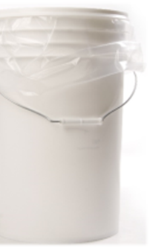
SAMPLING–
During Sampling – Toxicity
Optional for systems <2500m³/day)
Effluent cannot be acutely lethal to fish
Request the lab to perform a Single or Multi Concentration Rainbow Trout Test, with or without pH stabilization
Line a 20 L bucket with the plastic bag provided, fill the bucket to the very top, remove air from the plastic bag, replace lid on the bucket
Notes:
So RM50 is optional. In an ideal world, we would be following the prescribed method and have an RM13 fail before applying RM50. However, we allow regulatees to kick off with RM50 right away. Regulatees can do RM13 with or without RM50. If a regulatee's system experiences pH drifts in its effluent, we would recommend RM50 as they would avoid being non-compliant (i.e. acutely lethal) BUT if they don't experience any pH drift and pass RM13 most of the time, they may want to skip that steps to save on costs as I believe the RM13/RM50 combo is more expensive
RM13, we are unable to conclude if the mortality is due to the sample itself, or the way the RM13 test is run in the lab. To figure that out, you need to run the RM50. IF the RM50 passes, the RM13 failed due to how the test is run in the lab (Sample is aerated, CO2 was lost due to aeration, the pH drifted, thereby causing the unionized ammonia to increase.) Note: aeration is a requirement of the method. However if it fails both the RM50 and the RM13, then it was the sample that was the problem (sample is still aerated, but the lost CO2 is replaced in the sample. This means the pH doesn't drift, and the unionized ammonia doesn't increase. RM 13 is required, RM 50 is optional under WSER when system is over 2500 m3/day

Slide 33
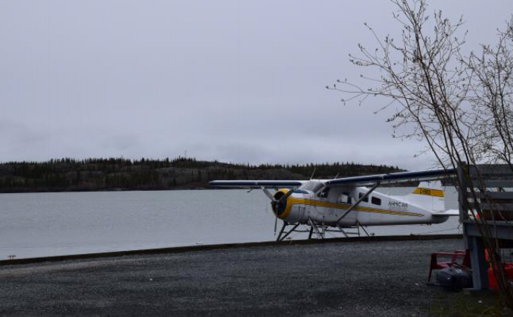
SAMPLING–
After Sampling
Put sample bottles in the fridge as soon as possible - immediately is ideal. Do not freeze!
Put the filled out CofC in a Ziploc bag and seal
Pack the sample bottles and CofC in the cooler with ice or freezer packs, make sure they are secure for transport, and send to the accredited lab
Transport of samples by air: notify the lab to pick up the samples at the airport
Notes:
So RM50 is optional. In an ideal world, we would be following the prescribed method and have an RM13 fail before applying RM50. However, we allow regulatees to kick off with RM50 right away. Regulatees can do RM13 with or without RM50. If a regulatee's system experiences pH drifts in its effluent, we would recommend RM50 as they would avoid being non-compliant (i.e. acutely lethal) BUT if they don't experience any pH drift and pass RM13 most of the time, they may want to skip that steps to save on costs as I believe the RM13/RM50 combo is more expensive
RM13, we are unable to conclude if the mortality is due to the sample itself, or the way the RM13 test is run in the lab. To figure that out, you need to run the RM50. IF the RM50 passes, the RM13 failed due to how the test is run in the lab (Sample is aerated, CO2 was lost due to aeration, the pH drifted, thereby causing the unionized ammonia to increase.) Note: aeration is a requirement of the method. However if it fails both the RM50 and the RM13, then it was the sample that was the problem (sample is still aerated, but the lost CO2 is replaced in the sample. This means the pH doesn't drift, and the unionized ammonia doesn't increase. RM 13 is required, RM 50 is optional under WSER when system is over 2500 m3/day

Slide 34
REPORTING –
Requirements
Identification report
All systems in operation must submit an ID report with all the required information including if the influent flowrate is ≥100m3 daily and discharges to water frequented by fish; or
New systems within 45 days after the system comes into operation
Monitoring reports
Due 45 days after calendar year end or quarter, depending on the type of system
Calendar year (February 14)
Intermittent systems ≤17500m3/d
Continuous systems with HRT ≥5 days and ≤2500 m3/d
Quarterly
Any other system
Reports submitted electronically using the Effluent Regulatory Reporting Information System (ERRIS) or in a paper copy sent to ECCC

Slide 35
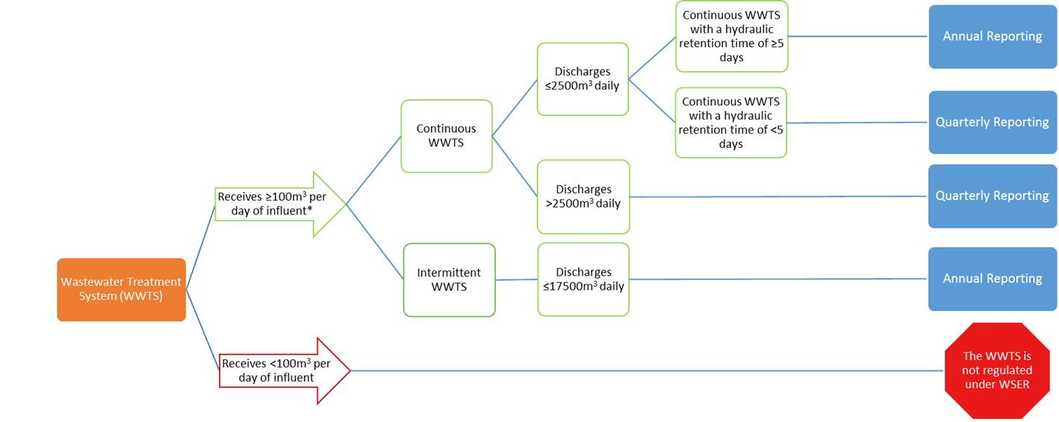
REPORTING –
Requirements
Annual Reports Due February 14
Notes:
Intermittent wastewater treatment systems (WWTS) are those that:
discharge effluent no more than 4 periods per calendar year, and where
discharge periods are separated by a minimum of 7 days without discharging, and
have a hydraulic retention time of at least 90 days
All other WWTS are continuous.
If not subject to WSER, still subject to FA 36(3). FA 38(5) Any deposit of a deleterious substance or serious and imminent danger of a deposit into water frequented by fish (or place where it may enter) without delay report to ECCC. Eg. Sewer line breaks or seepage, combined sewer discharges, lift station failures/overflows. Due Diligence: ALL reasonable measures that would have been taken by a reasonable person to prevent the offence. NOT due diligence: “we’ve always done it like this” “we didn’t know”

Slide 36
REPORTING –
Quarterly Report Deadlines
January 1 to March 15
April 1 to
June 30
July 1 to September 30
May 15
August 14
November 14
October 1 to December 31
February 14

Slide 37
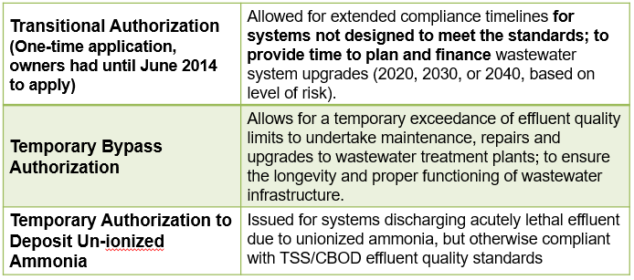
REPORTING –
Transitional and Temporary Authorizations
The Regulations provide a mechanism to apply for authorizations for systems to deposit effluent that does not meet the quality standards

Slide 38
REPORTING –
Temporary Bypass Authorizations
Temporary bypass authorizations may be issued by the authorization officer if:
  Release occurs at the wastewater system’s final discharge point
  Required for construction, maintenance or repairs
  Designed to minimize volume of effluent deposited and concentration of deleterious substances
  Made at least 45 days in advance
Communities must mitigate environment impacts to whatever extent is possible
ECCC may refuse to issue these authorizations if there is reasonable grounds to believe that the authorization would result in adverse effects on fish, fish habitat or the use by man of fish that cannot be mitigated
Factsheet with more information available here
Notes:
The Authorization sets the time period for which wastewater release may occur, usually a few hours to a few days, based on the period of time communities believe will be required to complete the work.

Slide 39
REPORTING –
Temporary Authorization to Deposit Un-ionized Ammonia
A wastewater system may apply for a temporary authorization to deposit un-ionized ammonia if the effluent from the system is acutely lethal due to the presence of un-ionized ammonia.
Temporary authorizations to deposit un-ionized ammonia may be issued by the authorization officer if:
  It is determined that the effluent was acutely lethal due to concentration of un-ionized ammonia, and
  The concentration of un-ionized ammonia in the receiving water at any point that is 100 m from the point of entry where the effluent is deposited must be less than or equal to 0.016 mg/L, expressed as nitrogen
Authorizations for un-ionized ammonia are granted for a period of three years and can be extended
Factsheet with more information available here

Slide 40
REPORTING –
WWTP Upgrades
When upgrading your WWTP, take the following steps:
Update your identification report in ERRIS
Contact eu-ww@ec.gc.ca for assistance
Determine if any changes are needed to your monitoring and reporting frequency
Apply for a Temporary Bypass Authorization if work may require releasing undertreated effluent from the final discharge point

Slide 41
REPORTING –
Unauthorized Wastewater Deposits
Combined Sewer Overflows (CSOs)
Planned Discharges
Wastewater Spills
Exceedances
  Overflows in combined sewer systems that collect stormwater and domestic wastewater in the same pipe
  Occur due to heavy rainfall or snowmelt where volume exceeds system capacity
  Releases from any overflow point of a wastewater collection system, other than final discharge point
  Scheduled to conduct construction, repair or maintenance work (e.g. Montreal 2015)
  Spills in the wastewater collection systems
  Resulted from system failures, negligence, or unforeseen circumstances
  Wastewater deposits from the final discharge point that do not meet the effluent quality standards.
Wastewater effluent discharge from small systems and northern systems are subject to the Fisheries Act general prohibition

Slide 42
REPORTING –
Unauthorized Wastewater Deposits
There occurs a deposit of a deleterious substance in water frequented by fish that is not authorized under the Act
There is a serious and imminent danger of such an occurrence
OR
AND
Detriment to fish habitat or fish or to the use by humans of fish results or may reasonably be expected to result from the occurrence

Slide 43
REPORTING –
Unauthorized Wastewater Deposits
There occurs a deposit of a deleterious substance in water frequented by fish that is not authorized under the Act
There is a serious and imminent danger of such an occurrence
OR
AND
Detriment to fish habitat or fish or to the use by humans of fish results or may reasonably be expected to result from the occurrence
There occurs a deposit of a deleterious substance in water frequented by fish that is not authorized under the Act |  | There is a serious and imminent danger of such an occurrence
 | Detriment to fish habitat or fish or to the use by humans of fish results or may reasonably be expected to result from the occurrence

Slide 44
Procedure for unauthorized deposits
There occurs a deposit of a deleterious substance in water frequented by fish that is not authorized under the Act
There is a serious and imminent danger of such an occurrence
OR
AND
Detriment to fish habitat or fish or to the use by humans of fish results or may reasonably be expected to result from the occurrence
Notify an inspector without delay of an unauthorized deposit, as required by subsection 38(5) of the Act, by calling the appropriate 24-hour Environmental emergency contacts;
Take all reasonable measures to prevent, or to counteract, mitigate or remedy any damages that result from such a deposit or that might reasonably be expected to result from [subsection 38(6)];
Submit a written report describing the deposit and send to inspector as soon as feasible after the occurrence or after learning of the danger of the occurrence [subsection 38(7)]
For more information, see this unauthorized deposit factsheet.

Slide 45
REPORTING –
SWIM & ERRIS
SWIM is the acronym for Single Window Information Manager
SWIM has tools to help manage information for organizations, facilities, and individuals
Serves as the “front door” to many reporting programs and provides a way of connecting individuals to these programs, including ERRIS
ERRIS is the acronym Effluent Regulatory Reporting Information System

Slide 46
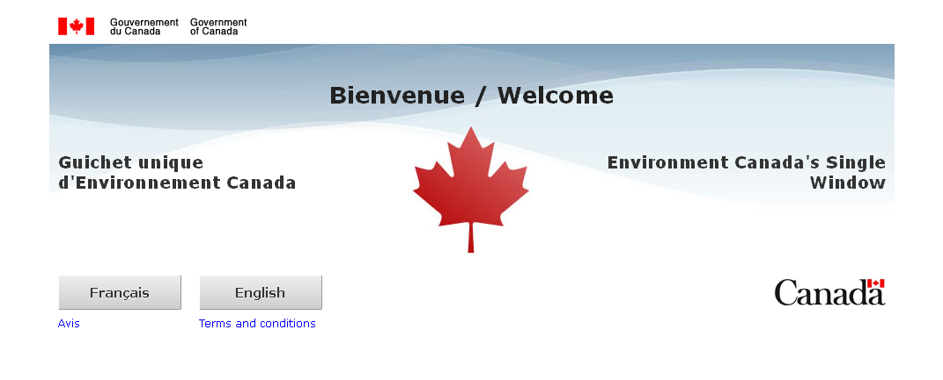
REPORTING –
SWIM & ERRIS
SWIM link: https://ec.ss.ec.gc.ca
Youtube Tutorials: https://youtu.be/xSlTL-O5Qcs?list=PLF90V7foF0CemVXJIRj4IlNIgIoRguRA7

Slide 47
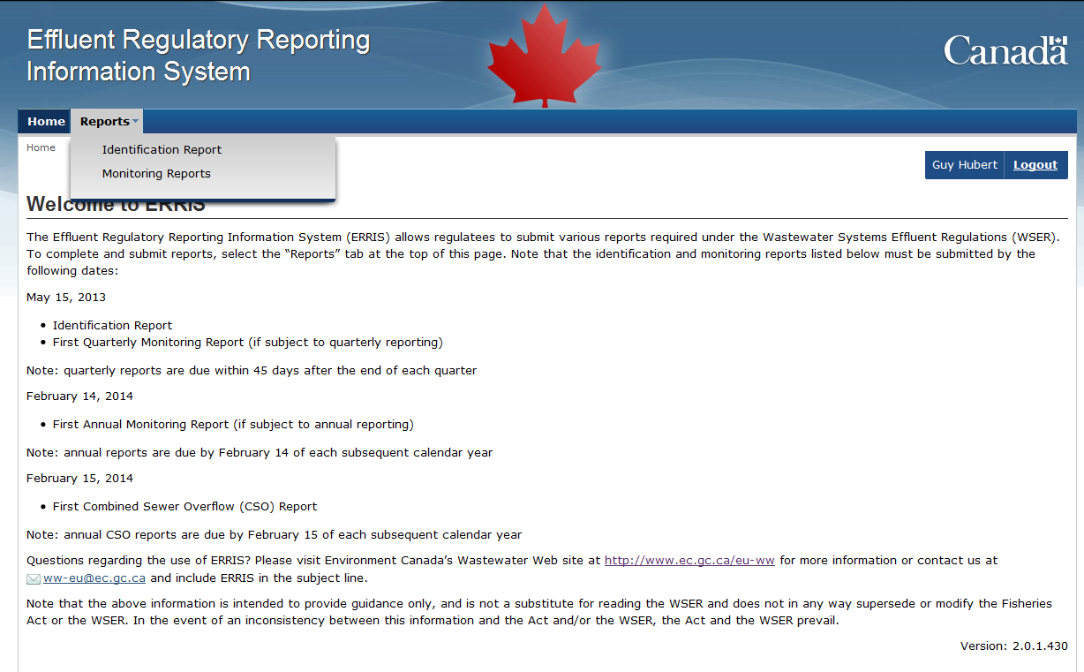
REPORTING –
ERRIS
Click

Slide 48
REPORTING –
Record Keeping Requirements
Dates of deposits and daily volumes
Dates of no deposit
Average annual daily volume deposited
Information on monitoring equipment
Combined sewer overflow reports (CSO)
Results of laboratory analysis
Types of sample taken (composite or grab) and dates of sampling
All records must be kept for 5 years

Slide 49
WSER Recap
Regulations have been in force for over 8 years
  ID reports should have been submitted by now
  Monitoring reports should be submitted as per your reporting schedule
Consequences of not complying with the Regulations
  Enforcement Officers will be doing inspections
  The Compliance and Enforcement Policy dictates the responses to violations but could vary from a warning letter to prosecution (the focus is always to get the systems into compliance)

Slide 50
Achieving Compliance
Compliance Promotion
(Canadian Wildlife Service, Environmental Protection Branch)
Warnings (verbal, written)
AMPs or Ticket / notice of violation
Compliance orders
Directions
Prosecutions
ECCC’s primary goal is always compliance
Notes:
The goal is to achieve compliance at the earliest point across the continuum.
EB has a range of enforcement action tools to address non-compliance
Fine range in cases of infraction under section 36(3)
Are found in section 40(2) of the Fisheries Act

Slide 51
Proposed Amendments to the WSER
ECCC has published Regulations Amending the Wastewater Systems Effluent Regulations in Canada Gazette I for a 60-day public consultation period until July 26, 2023
ECCC is hosting public information sessions and has developed factsheets to summarize the proposed amendments, available on Consultations webpage
ECCC invites all interested parties to review the proposed amended regulations and provide comments. Comments can be submitted directly on the Canada Gazette webpage
All comments provided will be considered in the drafting of the final amended regulations
Publication in Canada Gazette Part II – targeting 2024
For more information or questions, contact eu-ww@ec.gc.ca
Notes:
ECCC is looking for your comments on proposed amendments to the Wastewater Systems Effluent Regulations in the areas of:
Transitional Authorizations: ECCC is proposing to allow eligible communities another opportunity to receive an extension to comply with the Regulations. The rules to qualify for this extension, and the deadline to upgrade or build a new wastewater treatment facility would remain the same.
Expansion of existing temporary bypass authorization: ECCC is proposing to expand the existing temporary bypass authorizations to include planned releases of wastewater from sewer systems. This approach is considered to improve transparency and lead to the least possible impact on the environment.
Key administrative amendments: ECCC is proposing to amend administrative provisions to provide greater clarity and resolve implementation issues.

Slide 52

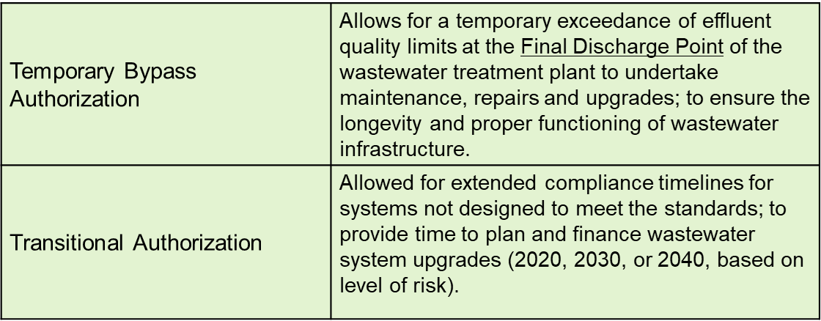
Proposed Amendments
ECCC is proposing to amend the regulations: transitional and temporary authorizations
ECCC will also take this opportunity to clarify, simplify or revise other areas of the regulation

Slide 53
Proposed Amendments
Temporary Bypass Authorization:
  ECCC is proposing to expand the existing temporary bypass authorizations in the Regulations to include planned releases of wastewater from sewer systems (overflow points) with set of conditions.
Transitional Authorization:
  Regulatees had until June 30, 2014 to apply for a transitional authorization. A number of regulatees who may have been eligible to receive one did not apply at that time
  ECCC is proposing to amend WSER to allow communities that would have been eligible for a transitional authorization until 2030 and 2040 to apply and receive one

Slide 54
Proposed Amendments –
Timeline
Email sent to regulatees on July 7, 2020
ECCC has initiated early discussions and engagements Fall 2020 with Indigenous groups and stakeholders
ECCC will continue consulting in 2021- 2022
  Consultation Paper publication will be published in the coming months
Targeting publication in Canada Gazette, Part I, in late 2022
Videos outlining proposed amendments are available here.
ECCC is happy to take comments/questions about the proposed amendments :
  Via email : eu-ww@ec.gc.ca
Notes:
We have published the Regulations Amending the Wastewater Systems Effluent Regulations in Canada Gazette I on May 27 for a 60 day public consultation period. An email has been sent to regulatees, Indigenous communities and organizations, key stakeholders and other interested parties to inform them of the publication as well as details on methods for engaging and providing feedback.
Factsheets and additional information are available on our webpage: Consultations on wastewater - Canada.ca. We invite you to share any feedback and perspectives directly with us by July 26, 2023. All comments received during the consultation phase will inform the final amended regulations.

Slide 55
Resources
The Wastewater Systems Effluent Regulations are available online at: http://laws-lois.justice.gc.ca/eng/regulations/SOR-2012-139/FullText.html
Sampling Guidance Toolkit: https://publications.gc.ca/site/eng/9.896119/publication.html
Additional information may also be obtained at ECCC’s website:
www.Canada.ca/wastewater

Slide 56
Questions and Contacts
Melissa Maissan
Telephone: 780-288-3709
Email: Melissa.Maissan@ec.gc.ca
Ayesha Sohail
Telephone: 587-336-0849
Email: Ayesha.Sohail@ec.gc.ca
National Wastewater Section
Telephone: 819-420-7727
Email: eu-ww@ec.gc.ca

