Slide 1


Importance of Record Keeping and Reporting

Slide 2
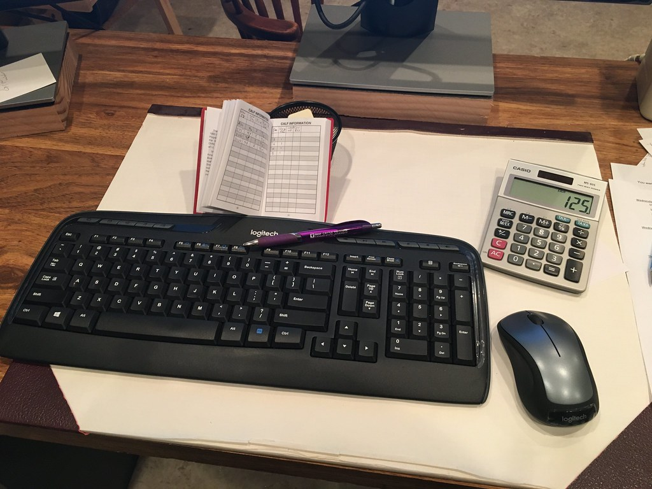
Overview
This Photo by Unknown Author is licensed under CC BY

Slide 3
Overview
Importance of proper record keeping

Slide 4
Overview
Importance of proper record keeping
Recording for operation reports

Slide 5
Overview
Importance of proper record keeping
Recording for operation reports
Different types of record keeping

Slide 6
Overview
Importance of proper record keeping
Recording for operation reports
Different types of record keeping
Records of the physical plant

Slide 7
Overview
Importance of proper record keeping
Recording for operation reports
Different types of record keeping
Records of the physical plant
Records of operation

Slide 8
Overview
Importance of proper record keeping
Recording for operation reports
Different types of record keeping
Records of the physical plant
Records of operation
Records of water quality results

Slide 9
Overview
Importance of proper record keeping
Recording for operation reports
Different types of record keeping
Records of the physical plant
Records of operation
Records of water quality results
Records for regulatory agencies

Slide 10
Overview
Preventative maintenance records

Slide 11
Overview
Preventative maintenance records
Personnel records

Slide 12
Overview
Preventative maintenance records
Personnel records
Emergency Condition records

Slide 13
Overview
Preventative maintenance records
Personnel record’s
Emergency Condition record’s
Example of a Emergency Condition report

Slide 14
Overview
Preventative maintenance records
Personnel record’s
Emergency Condition record’s
Example of a Emergency Condition report
Preservation of records

Slide 15
Overview
Preventative maintenance records
Personnel record’s
Emergency Condition record’s
Example of a Emergency Condition report
Preservation of records
Conclusion

Slide 16

Importance of record keeping

Slide 17
Importance of record keeping
Regular records of the operation of water treatment and
distribution facilities are helpful to those directly
responsible for the system, as well as band officials,
consulting engineers, and federal regulatory
agencies.

Slide 18
Importance of record keeping
Regular records of the operation of water treatment and
distribution facilities are helpful to those directly
responsible for the system, as well as band officials
consulting engineers, and federal regulatory
agencies.
The water systems operators can use these records as
a guide in regulating, adjusting, and modifying the
facilities operations.

Slide 19
Another important function of record keeping is the
establishment of reliable, continuing proof of
performance, justifying decisions, expenditures and
recommendations.

Slide 20
Another important function of record keeping is the
establishment of reliable, continuing proof of
performance, justifying decisions, expenditures and
recommendations.
Such records are often the only sound basis for the
water system to plan corrective measures for
deficiencies in the water system or plant.

Slide 21

Recording for operation reports

Slide 22
Recording for operation reports
Proper record keeping can only benefit the
effectiveness of communication between different levels
of a communities water /waste water system. Whether it
be the operations staff, public works, chief and council,
or any federal agencies. The proof will be in the
numbers recorded over a period of time, deficiencies
can be brought to light and handled accordingly.

Slide 23
Different types of record keeping
The records which should be maintained for each
water / waste water systems will depend on the size
and complexity, treatment processes, etc.

Slide 24
Different types of record keeping
The records which should be maintained for each
water / waste water systems will depend on the size
and complexity, treatment processes, etc.
However, there are general types of records which
should be maintained at all water systems regardless of
complexity or size.

Slide 25
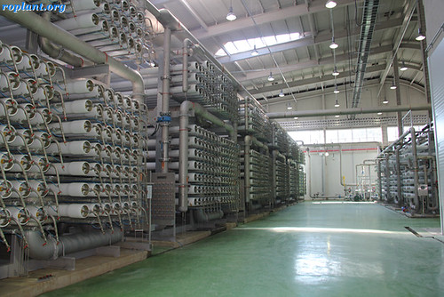
Records of the physical plant

Slide 26
Records of the physical plant
Records of the existing physical plant and all the
equipment included as part of the construction project
should be maintained.

Slide 27
Records of the physical plant
Records of the existing physical plant and all the
equipment included as part of the construction project
should be maintained.
This information is valuable to operating staff regarding
the day-to-day operation of the systems, management
personnel in scheduling services, and to regulatory
personnel in evaluating performance and compliance
with standards.
This info should be available to the operating personnel

Slide 28
at all times and kept up-to-date and in usable condition.
These records may include as-built drawings and
specifications of the water / waste water systems.

Slide 29
at all times and kept up-to-date and in usable condition.
These records may include as-built drawings and
specifications of the water / waste water systems.
The name and phone number of the plant design
engineer should be included in the records.

Slide 30

Records of operation

Slide 31
Records of operation
Records of operation are necessary to provide an
accurate description and ongoing account of the
system.

Slide 32
Records of operation
Records of operation are necessary to provide an
accurate description and ongoing account of the
system.
The systems operating records are comprised of the
results of water quality tests, measurements, readings,
and observations which have been made at various
Points of the system.

Slide 33
Records of operation
Records of operation are necessary to provide an
accurate description and ongoing account of the
system.
The systems operating records are comprised of the
results of water quality tests, measurements, readings,
and observations which have been made at various
Points of the system.
Again, the truth is in the numbers. so accuracy and
Honesty is key.

Slide 34
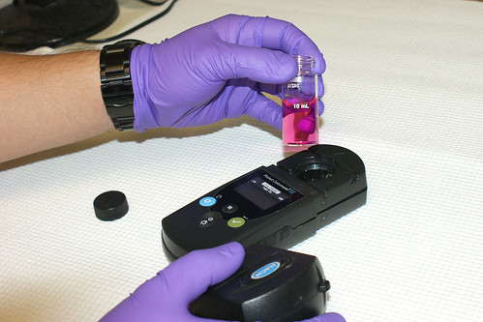
Records of water quality results

Slide 35
Records of water quality results
Water quality results should be recorded daily. These
could include the raw water and treated water results.

Slide 36
Records of water quality results
Water quality results should be recorded daily. These
could include the raw water and treated water results.
Depending on the type of treatment process these
records could consist of the time and date of sample,
Ph, free chlorine, total chlorine, turbidity, color,
alkalinity, iron and manganese.

Slide 37
Records of water quality results
Water quality results should be recorded daily. These
could include the raw water and treated water results.
Depending on the type of treatment process these
records could consist of the time and date of sample,
Ph, free chlorine, total chlorine, turbidity, color,
alkalinity, iron and manganese.
If any of these parameters are out of line, it could
Indicate that the operators will have to calibrate
Instruments.

Slide 38
Records kept will help determine the time and date of
a certain event.

Slide 39

Records for regulatory agencies

Slide 40
Records for regulatory agencies
Every First Nation has EHO’s (Environmental Health
Officer). Water quality records help indicate and assure
that there is safe and reliable drinking water for our
communities.

Slide 41
Records for regulatory agencies
Every First Nation has EHO’s (Environmental Health
Officer). Water quality records help indicate and assure
that there is safe and reliable drinking water for our
communities.
If there are certain parameters not compliant, these
historical records can assist in determining if an
advisory should be issued. (Cautionary Advisory, Boil
Water Advisory, and Do Not Drink Advisory).

Slide 42

Preventative Maintenance Records

Slide 43
Preventative Maintenance Records
Preventative maintenance records are needed to
provide accurate documentation of maintenance
work or repairs that have been done on water system
equipment.

Slide 44
Preventative Maintenance Records
Preventative maintenance records are needed to
provide accurate documentation of maintenance
work or repairs that have been done on water system
equipment.
These records are valuable to the system when
selecting equipment in the future and for preparing
maintenance budgets.

Slide 45
Preventative Maintenance Records
Preventative maintenance records are needed to
provide accurate documentation of maintenance
work or repairs that have been done on water system
equipment.
These records are valuable to the system when
selecting equipment in the future and for preparing
maintenance budgets.
These may include equipment records, records of repair
And maintenance work, maintenance repair costs

Slide 46
And store room inventory records.

Slide 47
And store room inventory records.
It is important to maintain accurate records of water
systems operating costs because these records may be
used to help plan operating budgets,

Slide 48
And store room inventory records.
It is important to maintain accurate records of water
systems operating costs because these records may be
used to help plan operating budgets, justify water rate
increase,

Slide 49
And store room inventory records.
It is important to maintain accurate records of water
systems operating costs because these records may be
used to help plan operating budgets, justify water rate
increase, evaluate water system expenditures, and
compare costs from one year to the next.

Slide 50

Personnel Records

Slide 51
Personnel Records
The water system personnel should have an up to date record of each of its employees.

Slide 52
Personnel Records
The water system personnel should have an up to date record of each of its employees.
The record should include:

Slide 53
Personnel Records
The water system personnel should have an up to date record of each of its employees.
The record should include:
The employees name
Job title
Address and phone number
Emergency contact numbers
Date of hire
Operator certification and education,

Slide 54
Personnel Records
The water system personnel should have an up to date record of each of its employees.
The record should include:
medical history
disciplinary actions
accidents
injury reports
awards received

Slide 55
Personnel Records
The water system personnel should have an up to date record of each of its employees.
The record should include:
medical history
disciplinary actions
accidents
injury reports
awards received.
The employees are a communities best asset.

Slide 56
Personnel Records
The employees are a communities best asset.

Slide 57

Emergency Condition Records

Slide 58
Emergency Condition Records
Documentation of emergency conditions, as well as the
Actions taken in response to the emergency, is highly
recommended.

Slide 59
Emergency Condition Records
Documentation of emergency conditions, as well as the
Actions taken in response to the emergency, is highly
recommended.
Such records will prove useful in updating and/or
modifying EMP’s (Emergency Response Plan) as well
as documenting problem areas for future construction
Projects.

Slide 60
Emergency Condition Records
Documentation of emergency conditions, as well as the
Actions taken in response to the emergency, is highly
recommended.
Such records will prove useful in updating and/or
modifying EMP’s (Emergency Response Plan) as well
as documenting problem areas for future construction
Projects.
An Emergency Conditions Report should be compiled
for each significant emergency and filed into the

Slide 61
Water system records.

Slide 62
Water system records.
For example, an Emergency Report for flooding of a
water treatment plant should include the following:

Slide 63
Water system records.
For example, an Emergency Report for flooding of a
water treatment plant should include the following:
Time of notification of impending flooding.

Slide 64
Water system records.
For example, an Emergency Report for flooding of a
water treatment plant should include the following:
Time of notification of impending flooding.
Actual time flood water entered treatment plant site.

Slide 65
Water system records.
For example, an Emergency Report for flooding of a
water treatment plant should include the following:
Time of notification of impending flooding.
Actual time flood water entered treatment plant site.
Measurement of highest water level in relation to the
physical structures at treatment plant.

Slide 66
Water system records.
For example, an Emergency Report for flooding of a
water treatment plant should include the following:
Time of notification of impending flooding.
Actual time flood water entered treatment plant site.
Measurement of highest water level in relation to the
physical structures at treatment plant.
Location of where water first entered plant.

Slide 67
Water system records.
For example, an Emergency Report for flooding of a
water treatment plant should include the following:
Time of notification of impending flooding.
Actual time flood water entered treatment plant site.
Measurement of highest water level in relation to the
physical structures at treatment plant.
Location of where water first entered plant.
Equipment and/or structure damaged by flood. Was
the equipment shut down? Record date and time.

Slide 68
Water system records.
For example, an Emergency Report for flooding of a
water treatment plant should include the following:
Time of notification of impending flooding.
Actual time flood water entered treatment plant site.
Measurement of highest water level in relation to the
physical structures at treatment plant.
Location of where water first entered plant.
Equipment and/or structure damaged by flood. Was
the equipment shut down? Record date and time.
Reports of maximum flood stage of the receiving
stream.

Slide 69
Protective actions taken by personnel.

Slide 70
Protective actions taken by personnel.
Other organizations or agencies contacted and
Actions taken.

Slide 71
Protective actions taken by personnel.
Other organizations or agencies contacted and
actions taken.
Length of time and degree to which water quality was
affected. Operators should report all complaints by date
And time, and the follow-up actions.

Slide 72
Protective actions taken by personnel.
Other organizations or agencies contacted and
actions taken.
Length of time and degree to which water quality was
affected. Operators should report all complaints by date
and time, and the follow-up actions.
Description of repairs and/or replacements required
to restore plant to original condition. Record date and
Time of restoration of each unit.

Slide 73
Protective actions taken by personnel.
Other organizations or agencies contacted and
actions taken.
Length of time and degree to which water quality was
affected. Operators should report all complaints by date
and time, and the follow-up actions.
Description of repairs and/or replacements required
to restore plant to original condition. Record date and
time of restoration of each unit.
Contractor, repair service, or equipment vendor
involved in repairs.

Slide 74
Protective actions taken by personnel.
Other organizations or agencies contacted and
actions taken.
Length of time and degree to which water quality was
affected. Operators should report all complaints by date
and time, and the follow-up actions.
Description of repairs and/or replacements required
to restore plant to original condition. Record date and
time of restoration of each unit.
Contractor, repair service, or equipment vendor
involved in repairs.
Cost of repairs/replacements.

Slide 75
Actions taken to prevent reoccurrence of emergency
conditions. Recommendations for revision to
emergency response plan and capital improvements.
This information could be necessary if insurance claims
would arise as a result of a particular emergency
conditions.

Slide 76

Preservation of records

Slide 77
Preservation of records
In order to prevent the destruction of records through
loss of flood, fire, or other disasters, it is recommended
that a program for the preservation of records be
initiated into the O&M plan.

Slide 78
Preservation of records
In order to prevent the destruction of records through
loss of flood, fire, or other disasters, it is recommended
that a program for the preservation of records be
initiated into the O&M plan.
The program should outline where copies of records
are to be maintained.

Slide 79
Preservation of records
In order to prevent the destruction of records through
loss of flood, fire, or other disasters, it is recommended
that a program for the preservation of records be
initiated into the O&M plan.
The program should outline where copies of records
are to be maintained.
Some locations where the record copies may be
maintained are with the systems consulting engineer,
in the water plant, band office, public works shop, etc.

Slide 80
Electronic storage data devices are a good idea and
backing up these devices should be a regular routine.

Slide 81
Electronic storage data devices are a good idea and
backing up these devices should be a regular routine.
If the hardware used to access the electronic data is not
easily replaced, measurements should be taken identify
Equipment/software is needed.

Slide 82

Electronic storage data devices are a good idea and
backing up these devices should be a regular routine.
If the hardware used to access the electronic data is not
easily replaced, measurements should be taken identify
Equipment/software is needed.

Slide 83
Conclusion

Slide 84
Conclusion
Regular records and reporting of the operation of a
communities water/waste water system can prove to be
very important and helpful to those directly responsible
for the system, band officials, consulting engineers and federal agencies.
.

Slide 85
Conclusion
Regular records and reporting of the operation of a
communities water/waste water system can prove to be
very important and helpful to those directly responsible
for the system, band officials, consulting engineers and federal agencies.
They can be used to regulate, adjust, and modify the
facilities and its operation. Finally, that is why it is very
important to keep these records in a honest and
accurate way.

Slide 86

Questions or comments?

