Slide 1

Operation and Maintenance of Biofiltration and RO Systems
Dr. Babak Roshani, Ph.D., P.Eng.
&
Dillon Petrucha, P.Eng.
Service@dropwater.ca

Slide 2
Definition
Biological filtration is defined by AWWA Committee as:
“The operational practice of managing, maintaining,
and promoting biological activity on granular media in a filter to enhance the removal of organic and inorganic constituents before treated water is introduced into the distribution system” (Brown et al.2016).
In the presence of :
No oxidant residuals,
Indigenous organisms attach on the filter media surface and form a biofilm.

Slide 3
Biofilm
Once established, the quantity of biomass maintained within the biofilm matrix tends to remain consistent over time,
and the biomass is resilient to varying temperatures, backwashing, substrate loading rates, and in some cases, low concentrations (e.g.,<0.1 mg/L free chlorine) of filter influent oxidant residuals (Evans et al. 2013a, Hooper et al. 2019, Lauderdale et al. 2018, Pharand et al. 2014).

Slide 4
Removal Mechanisms
Physical separation (i.e., particle removal by Sand)
Adsorption (DOC removal by GAC)
Biodegradation/biotransformation (Fe, Mn, NH3)

Slide 5
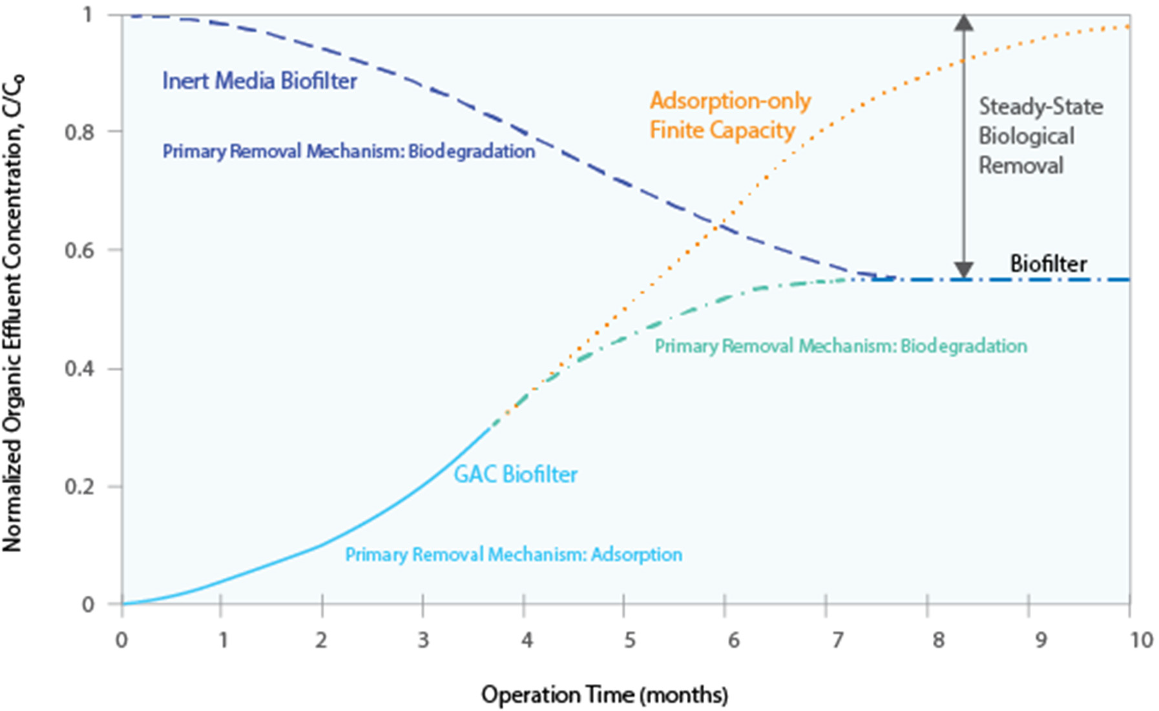
Effluent Concentration as a Function of Time Comparing Removal Trends Using an Inert Filter Media (e.g., Sand, Anthracite) and Fresh Adsorptive Media (e.g., GAC) from Start‐Up. Adapted from Brown et al. 2018.

Slide 6
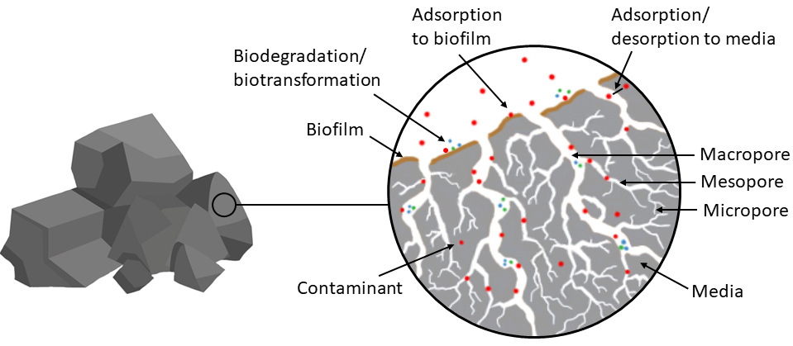
Illustration of Contaminant Removal Mechanisms by Biological Filtration with a Porous Media.

Slide 7
Iron and Manganese
  Soluble
  Insoluble

Slide 8
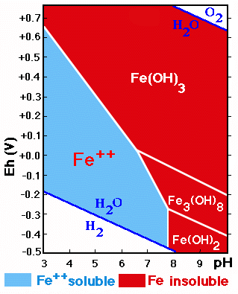
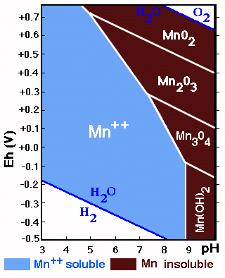
Pourbaix Diagrams for Fe & Mn
Iron
Manganese
Source: http://edafologia.ugr.es

Slide 9
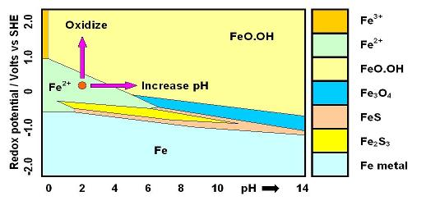
Pourbaix Diagram (Electrode potential/ PH diagram)
Source: http://edafologia.ugr.es

Slide 10
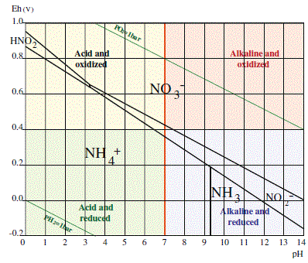
Pourbaix Diagram of Nitrogen
Source: http://edafologia.ugr.es

Slide 11


Iron and Manganese Removal
Chemical Oxidation of Manganese
Mn(II)
Mn(IV)
Chemical Oxidation of Iron
Ferrous
Ferric
The stoichiometric dosing rates

Slide 12
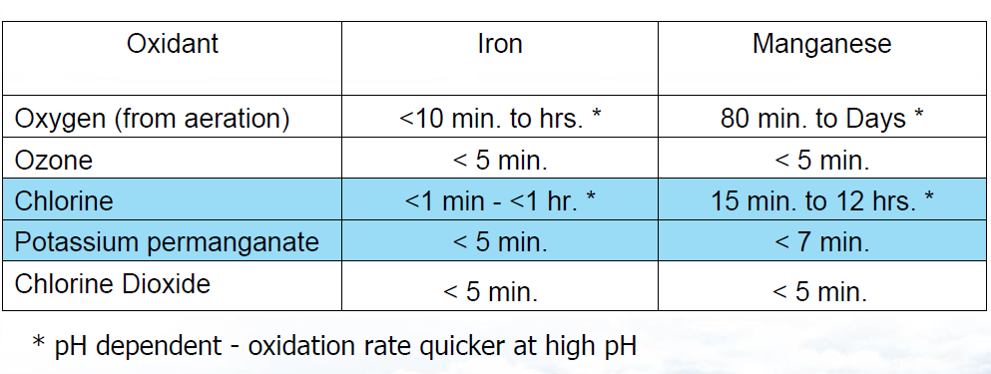
Conventional Iron and Manganese Removal
How long does it take?

Slide 13
Conventional Iron and Manganese Removal
Intense aeration just for Iron removal
Special media
    Manganese Greensand
    Greensand Plus
    Pyrolusite
Chemical oxidation (Cl₂, KMnO₄, O₃)
    Chemical injection
Adsorption (Resin)

Slide 14
Conventional Iron and Manganese Removal
Limitations
Expense of chemical consumption
Frequent need for backwash : 18-24 hours
Storage and handling of strong oxidant
Limited filtration rates: Approximately 2.6USGPM/ft². of media
Time-consuming operation and maintenance

Slide 15
Conventional Iron and Manganese Removal
Limitations
Chemical feed pump maintenance, KMnO₄ make down
Oxidant carry over
  Resulting in ‘pink water’ to reservoir
  Possible damage to Membrane elements downstream
Loss of media bed due to frequent backwashing
No Ammonia or DOC removal

Slide 16
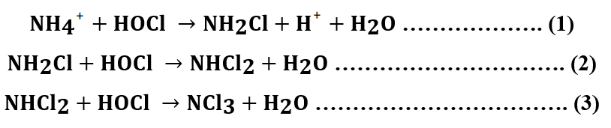
Conventional Ammonia Removal
Break-point chlorination in Distribution Systems
Chlorine to NH₃-N ratio is 10:1
Toxic disinfection by-Products

Slide 17
Conventional Ammonia Removal
Limitations
Chlorine : NH₃-N ratio is 10:1
Toxic disinfection by-Products
Deterioration of valves and fittings in distribution systems

Slide 18
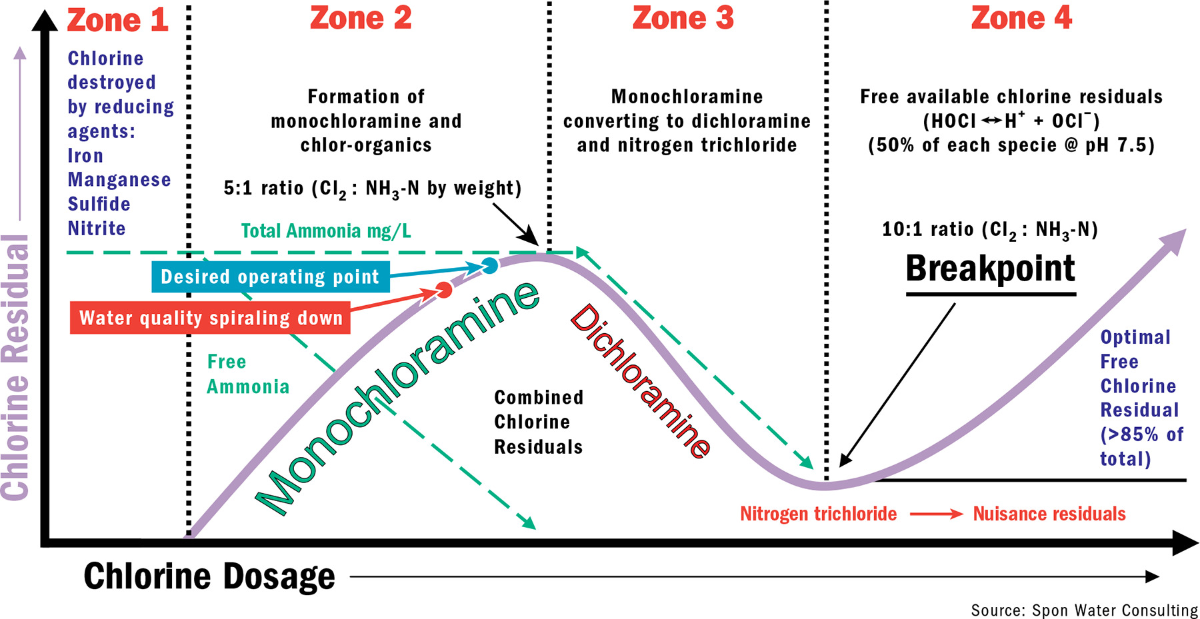
Breakpoint Chlorination Curve

Slide 19
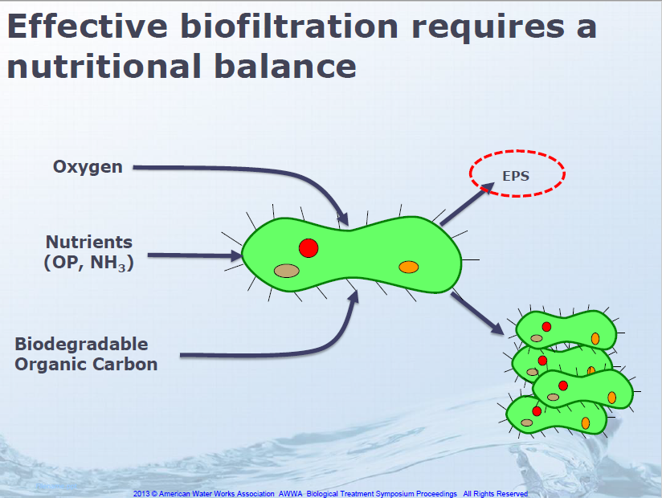
Nutritional Balance

Slide 20
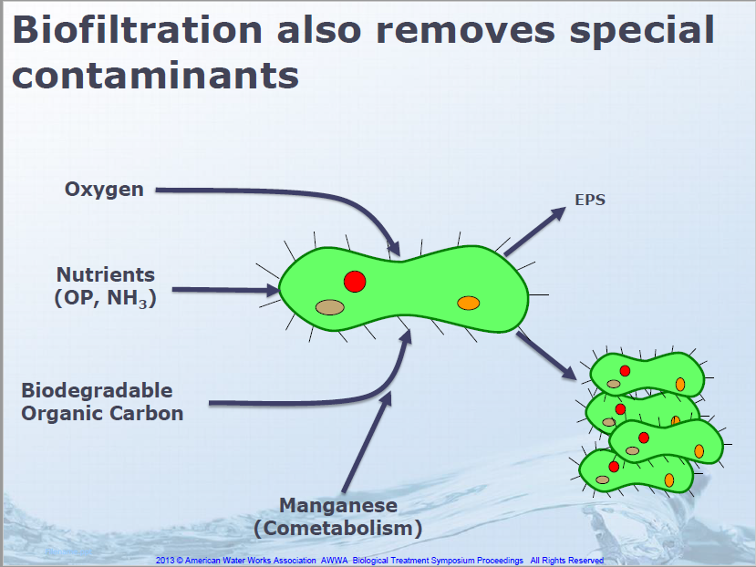
Nutritional Balance

Slide 21
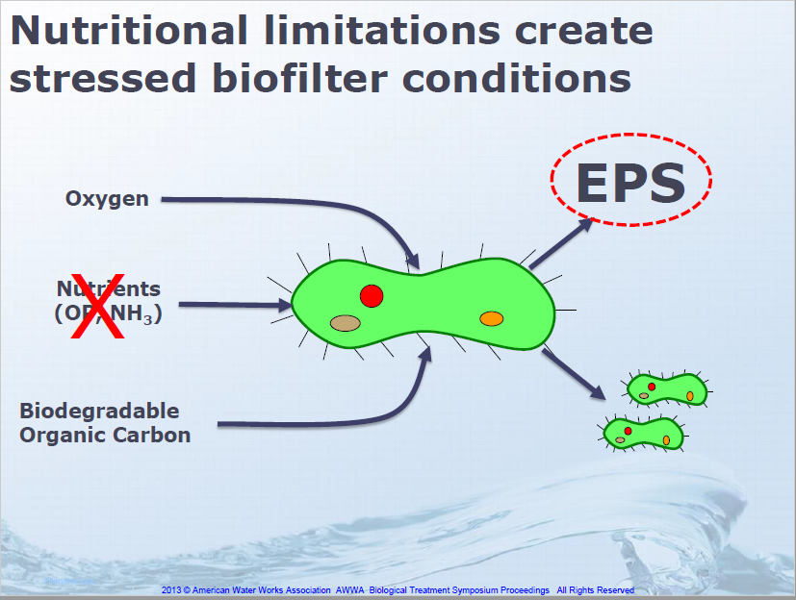
Nutritional Balance

Slide 22
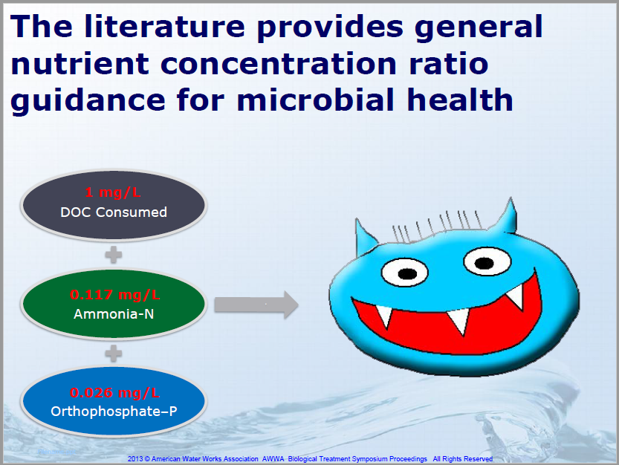
Nutritional Balance

Slide 23
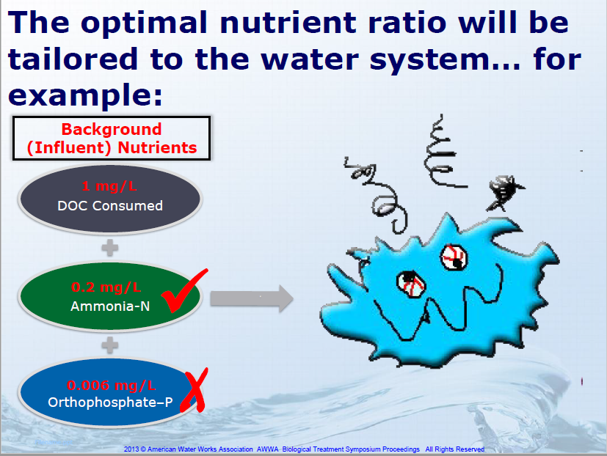

Slide 24
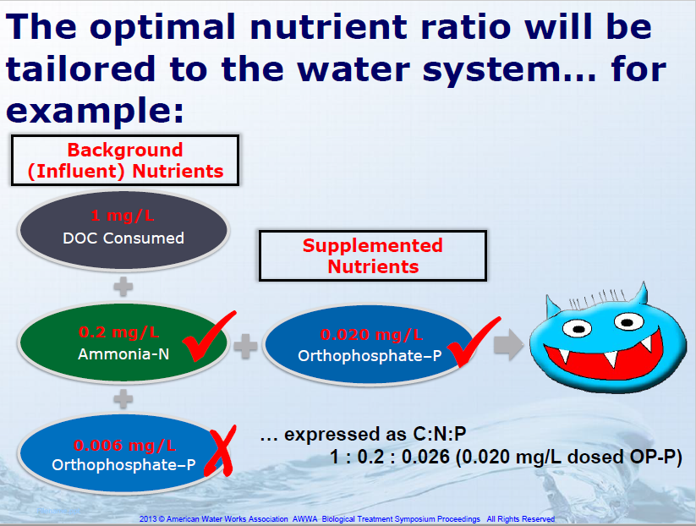

Slide 25
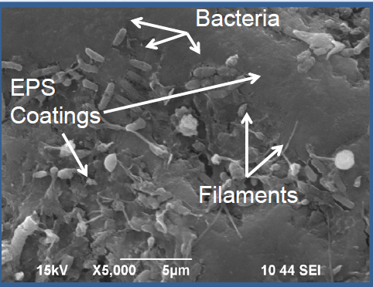
Biofilm is Predominately Extracellular Polymeric Substances (EPS)
EPS Benefits bacteria
Adhesion
Protection
Storage
Excess EPS impairs filter performance
Head loss
Clogging

Slide 26
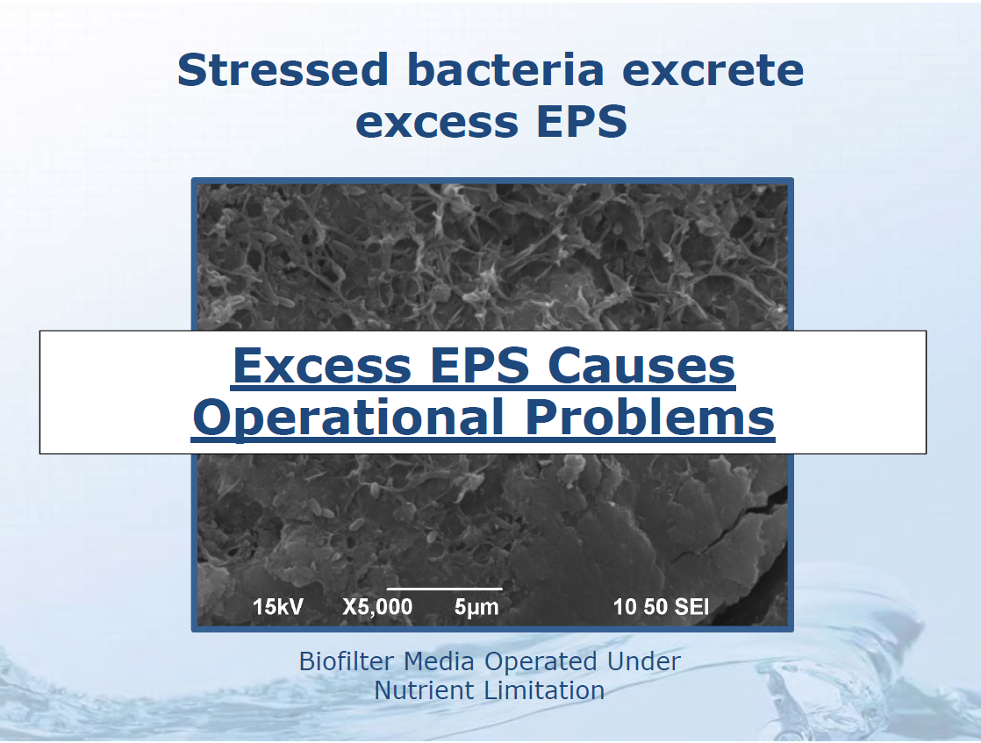

Slide 27
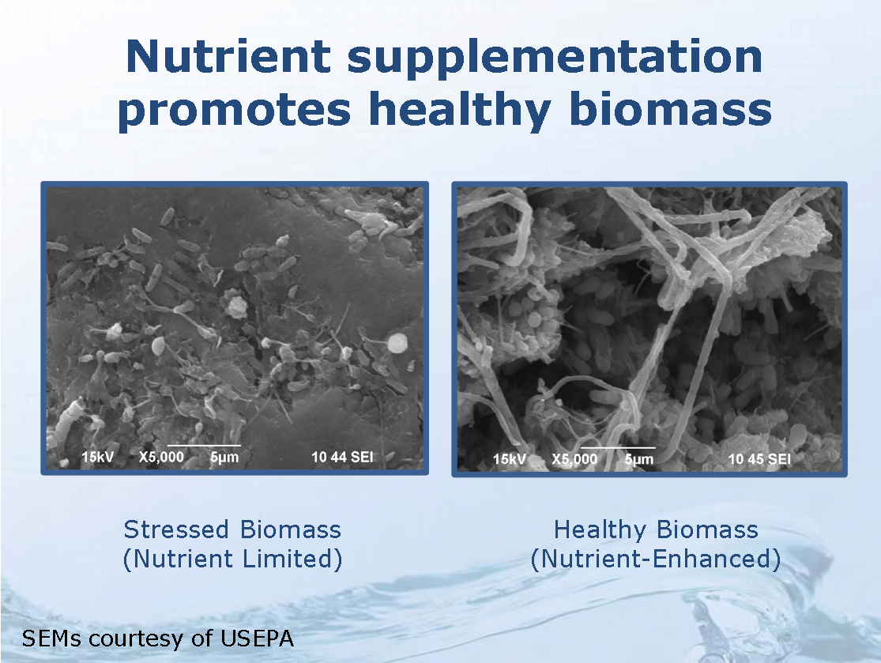

Slide 28
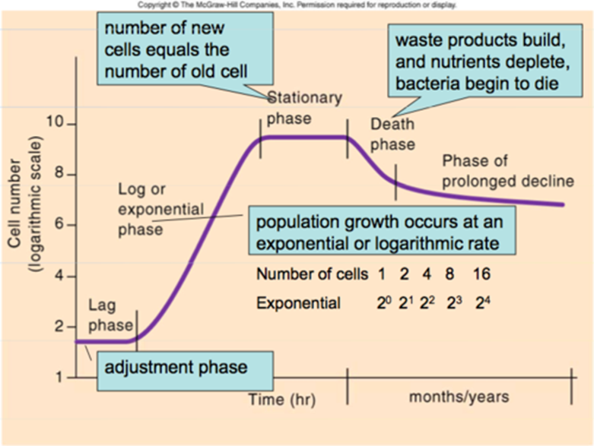
Bacterial Growth

Slide 29
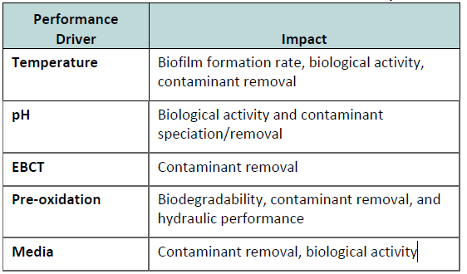
Biofilter Performance Drivers and Their Impact

Slide 30
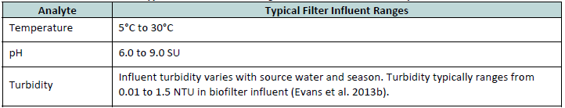
Water Quality Monitoring
Temperature
pH
Turbidity
Iron
Manganese
Ammonia

Slide 31
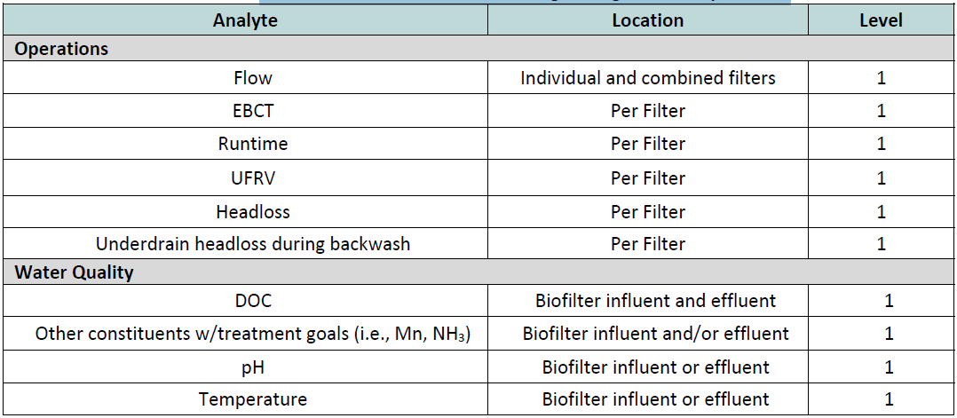
Recommended Biofilter Monitoring During Routine Operations

Slide 32
Optimization Strategies
Biofiltration optimization leverages design and operational strategies to enhance contaminant biodegradation kinetics, particle removal, and/or filter hydraulics. Biofilter optimization strategies that have been explored in drinking water treatment and will be discussed in this section include:
Media selection
Backwash protocol
Nutrient augmentation
pH adjustment

Slide 33
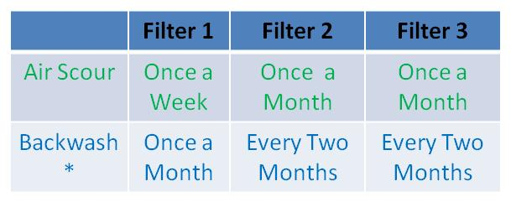
Backwashing and Air Scour Frequency
Week
*Backwashing depends on differential pressure for each filter

Slide 34
Operation and Maintenance
  Monitoring
  Start‐Up and Acclimation
  Steady‐State Operation
  Shutdown, Idling, and Restart

Slide 35
Operation and Maintenance of Reverse Osmosis System

Slide 36
Reverse Osmosis
Topics for Reverse Osmosis Systems:
  Fundamentals
  Operation
  Maintenance

Slide 37
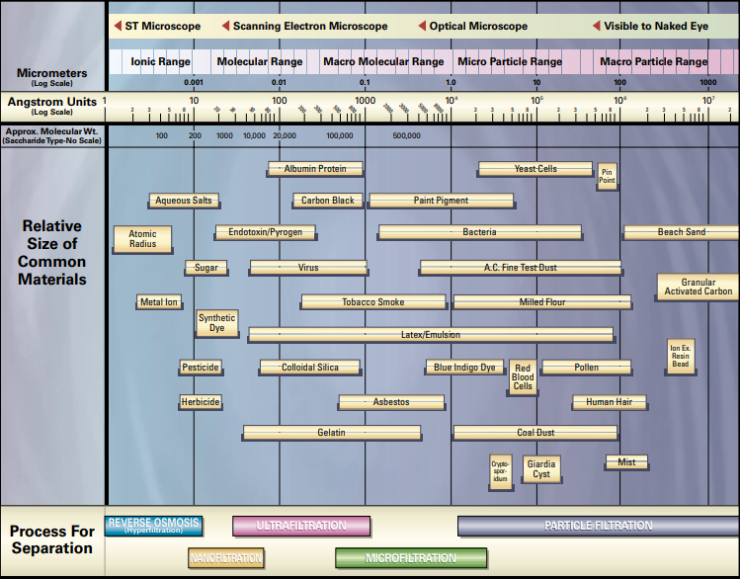
Filtration Spectrum

Slide 38
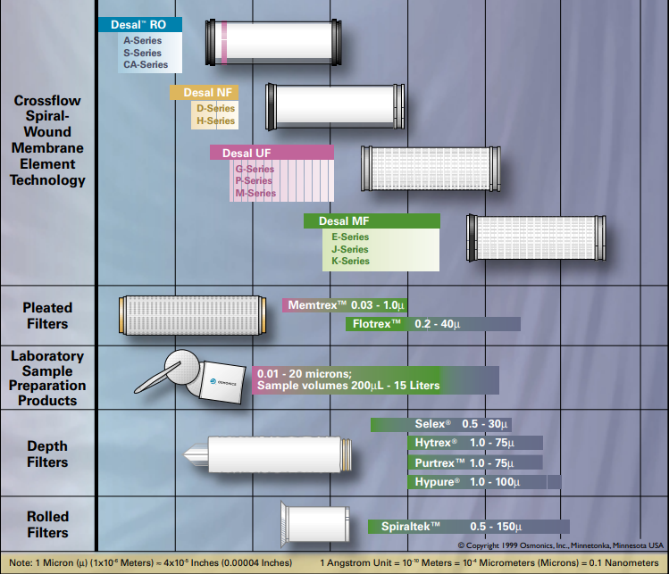
Filtration Spectrum Types

Slide 39
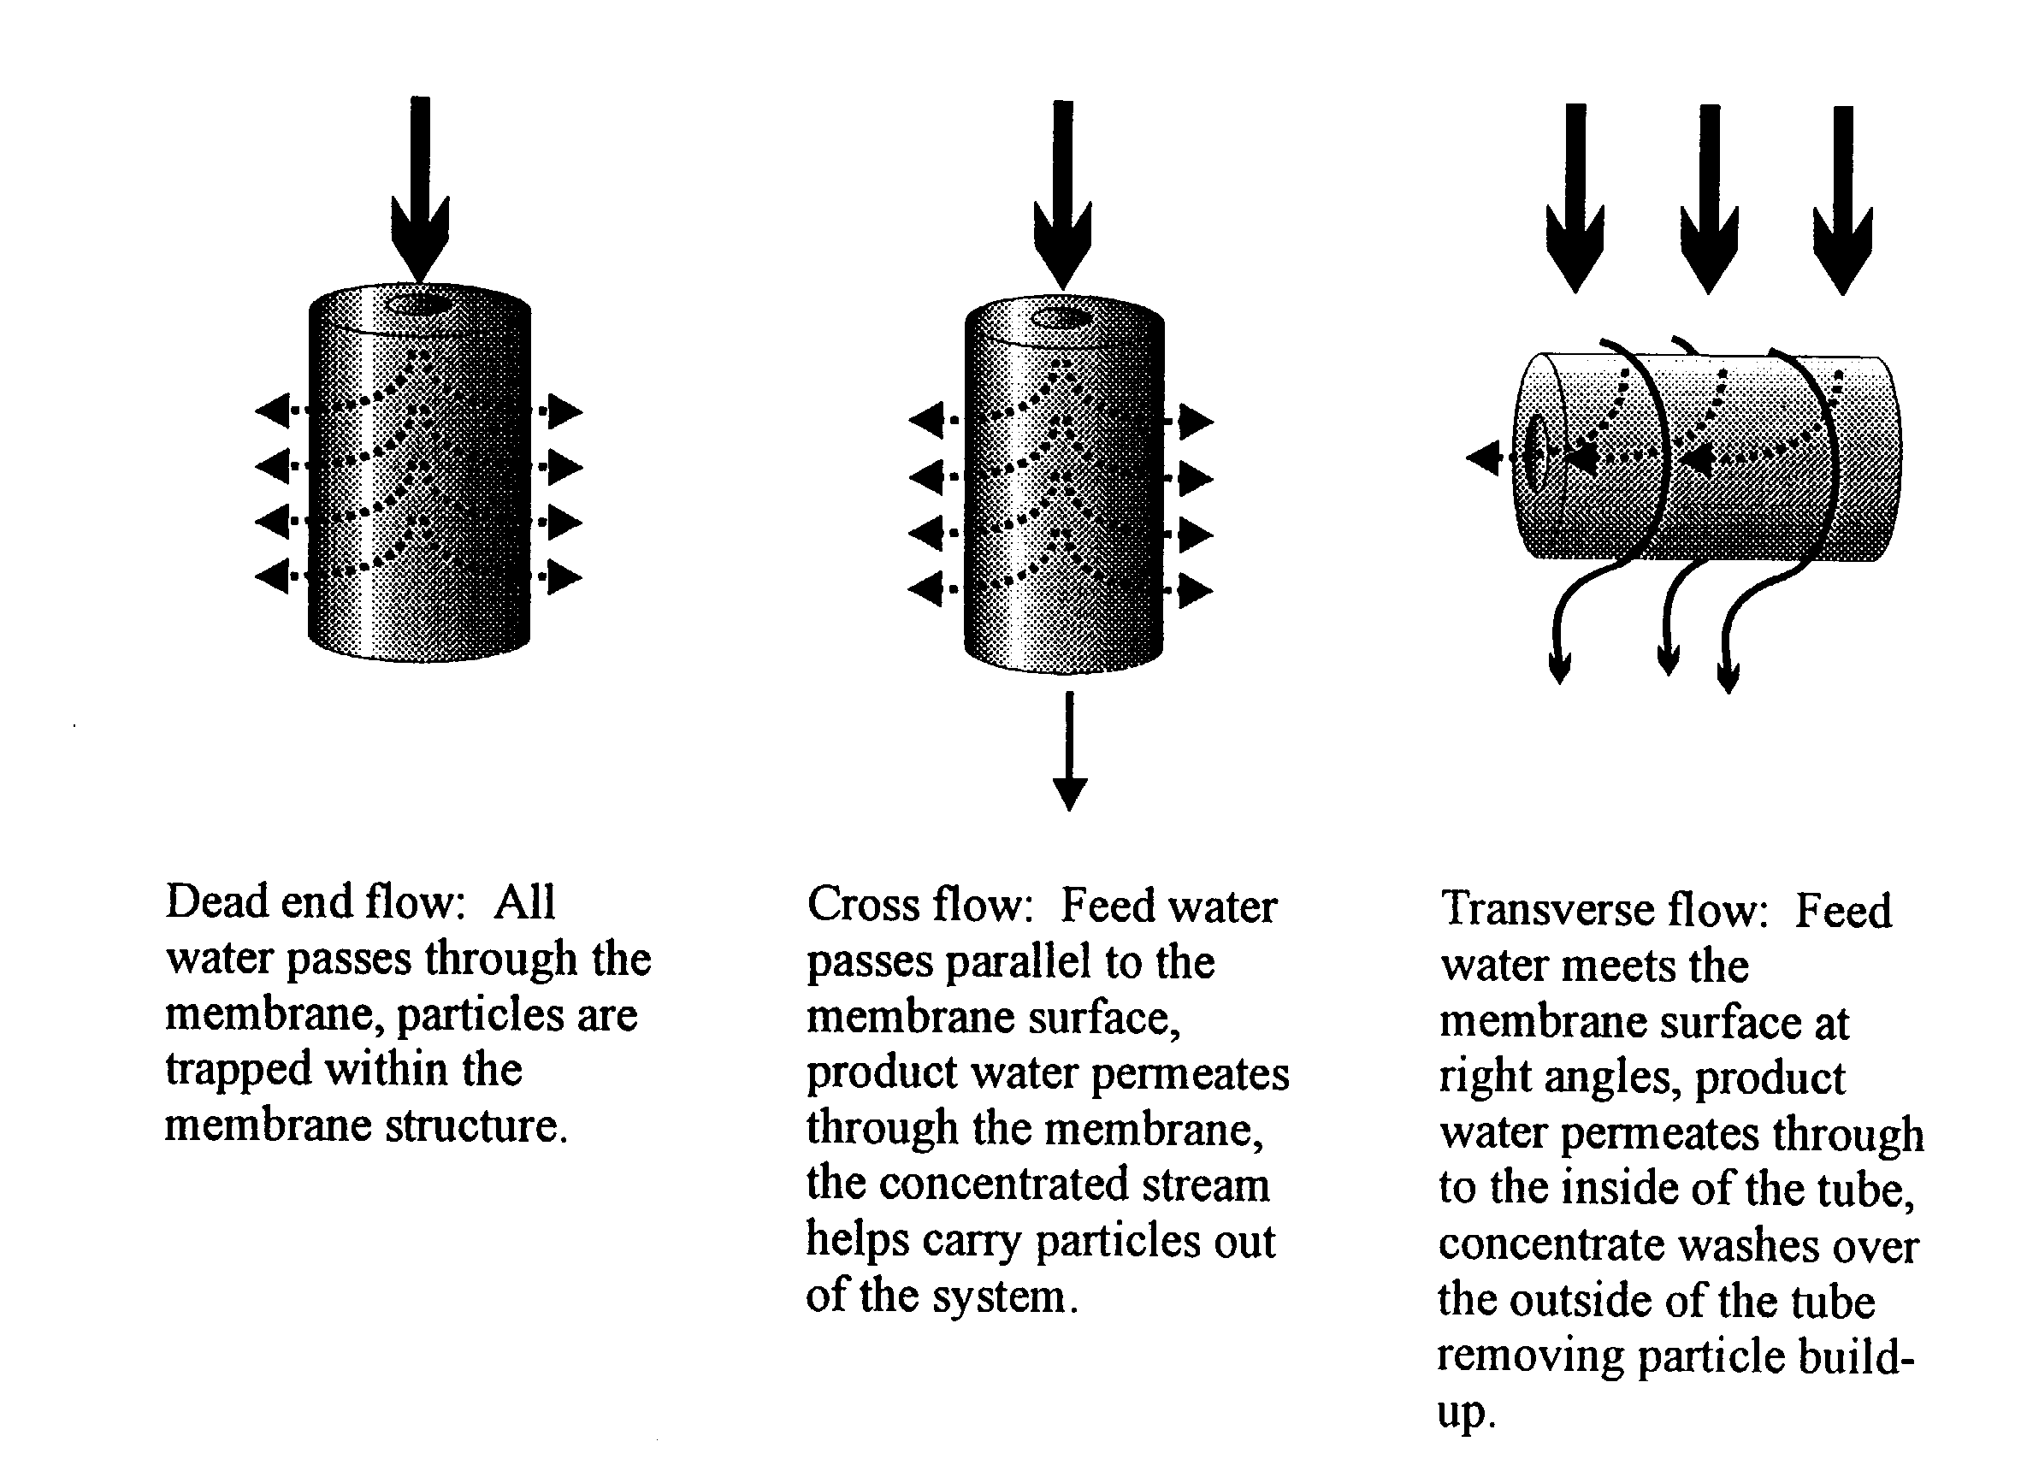
Typical Flow Types

Slide 40
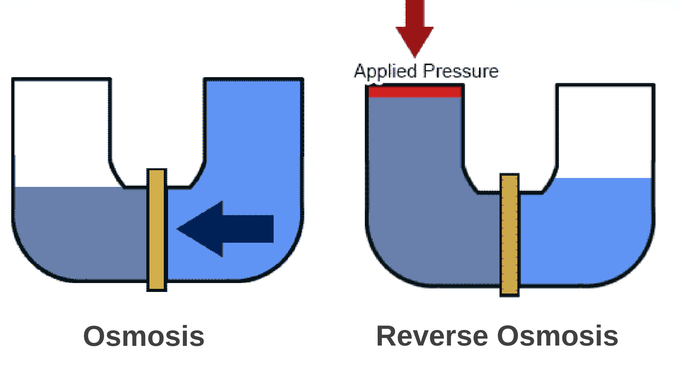
Basic Reverse Osmosis Principle

Slide 41
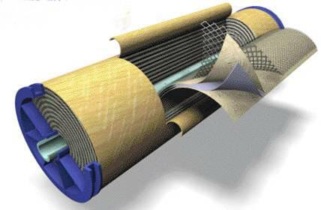
The Spiral Wound Membrane
Concentrate Outlet
Permeate Outlet
Fiberglass Outerwrap
Spacer
Permeate Carrier
Feedwater Inlet
Membrane
Permeate Outlet

Slide 42
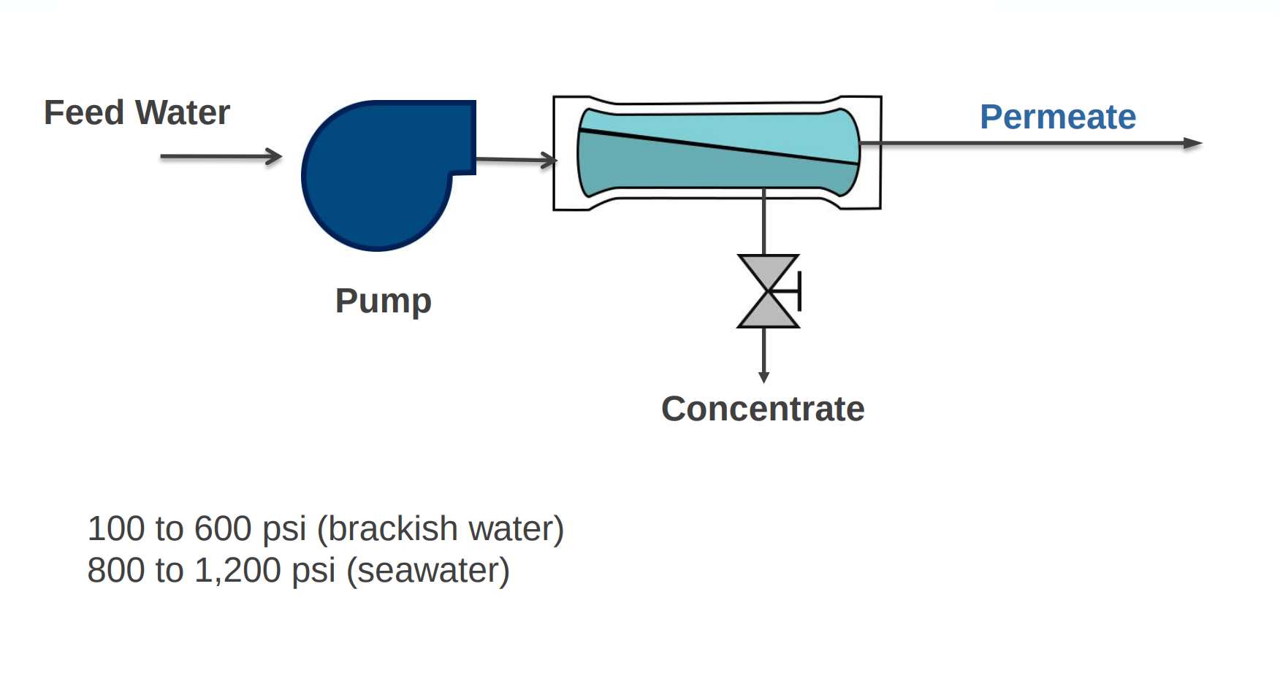
Typical Reverse Osmosis Equipment

Slide 43
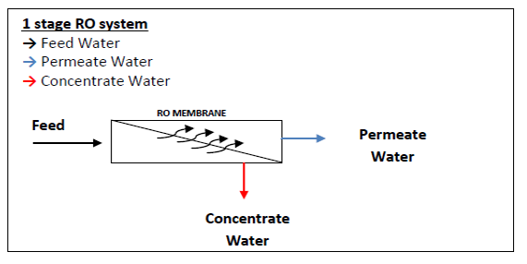
One Stage RO System

Slide 44
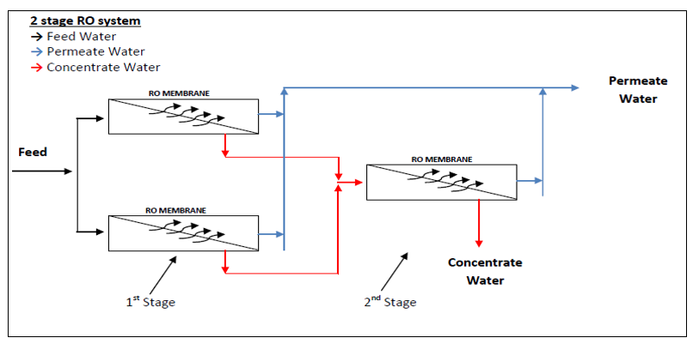
2 Stages RO system

Slide 45
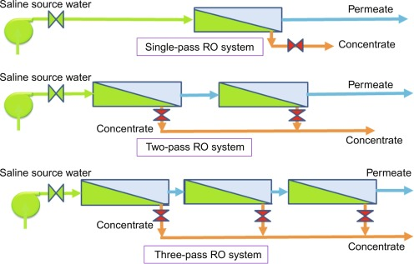
RO System for Saline Water

Slide 46
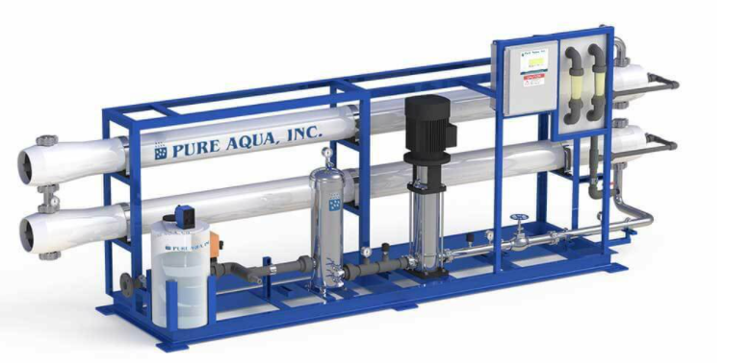
RO Skid with Antiscalant

Slide 47
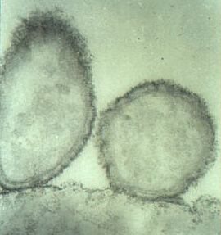
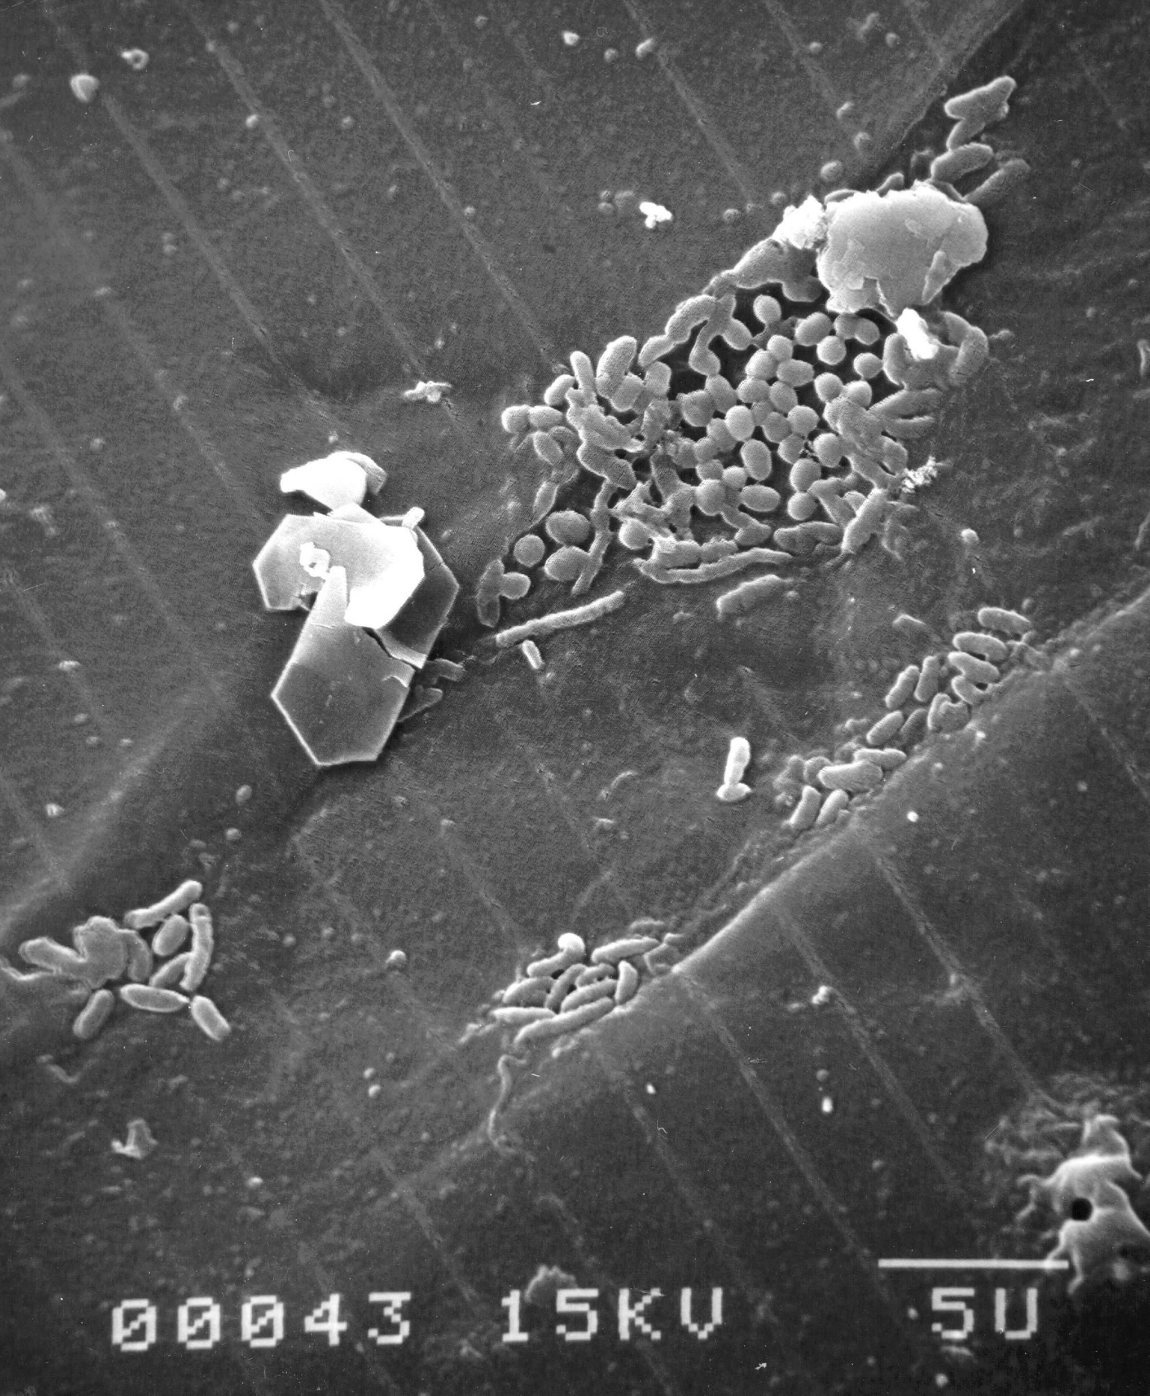
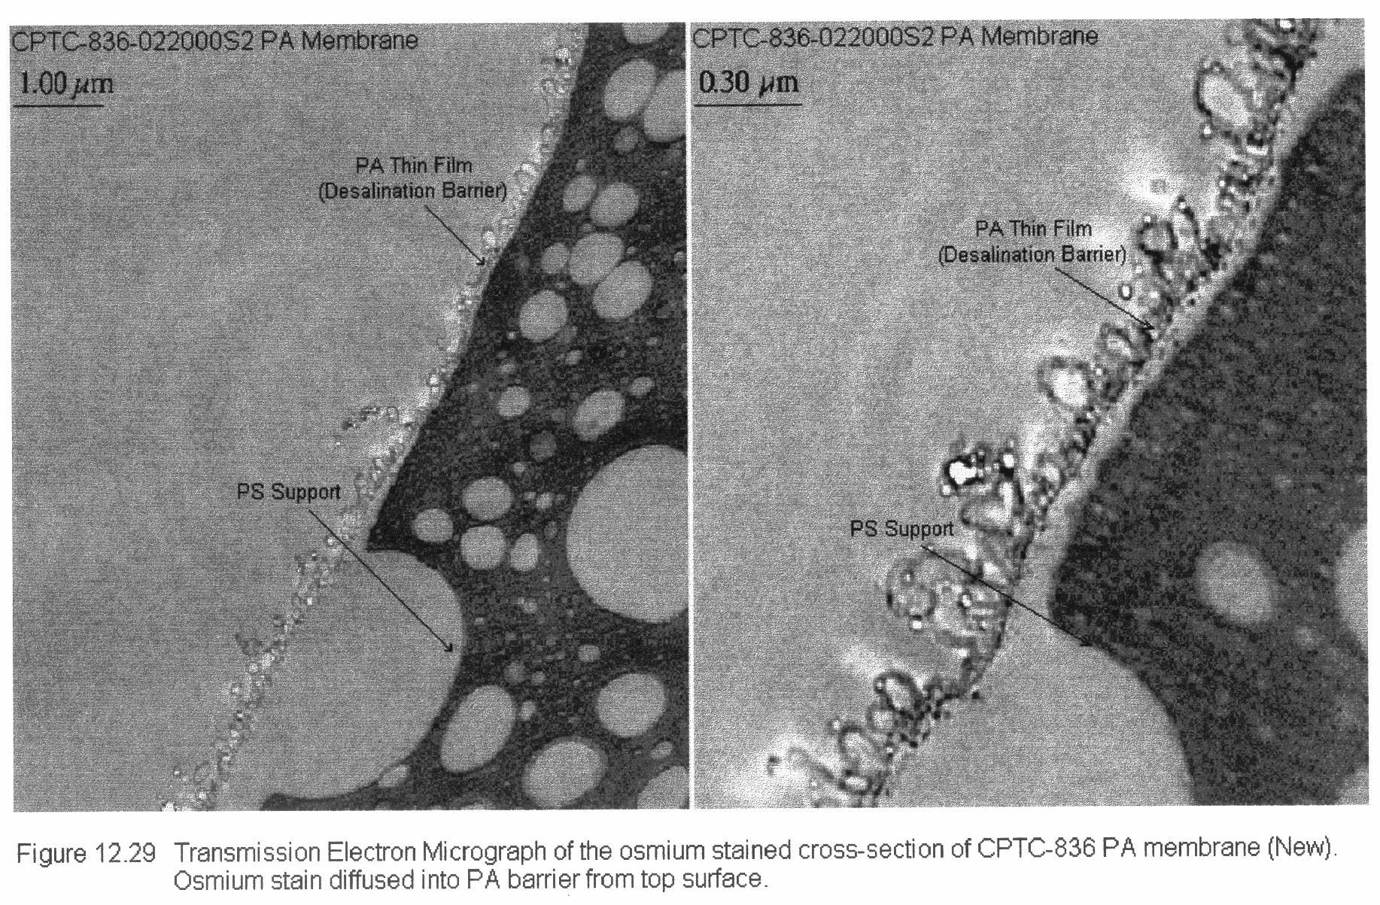
The Issues...
Flux loss
Solute passage
1. Bio-organic Fouling
Molecular Adsorption
De-lamination
2. Physico-Chemical Integrity
PA
PS

Slide 48
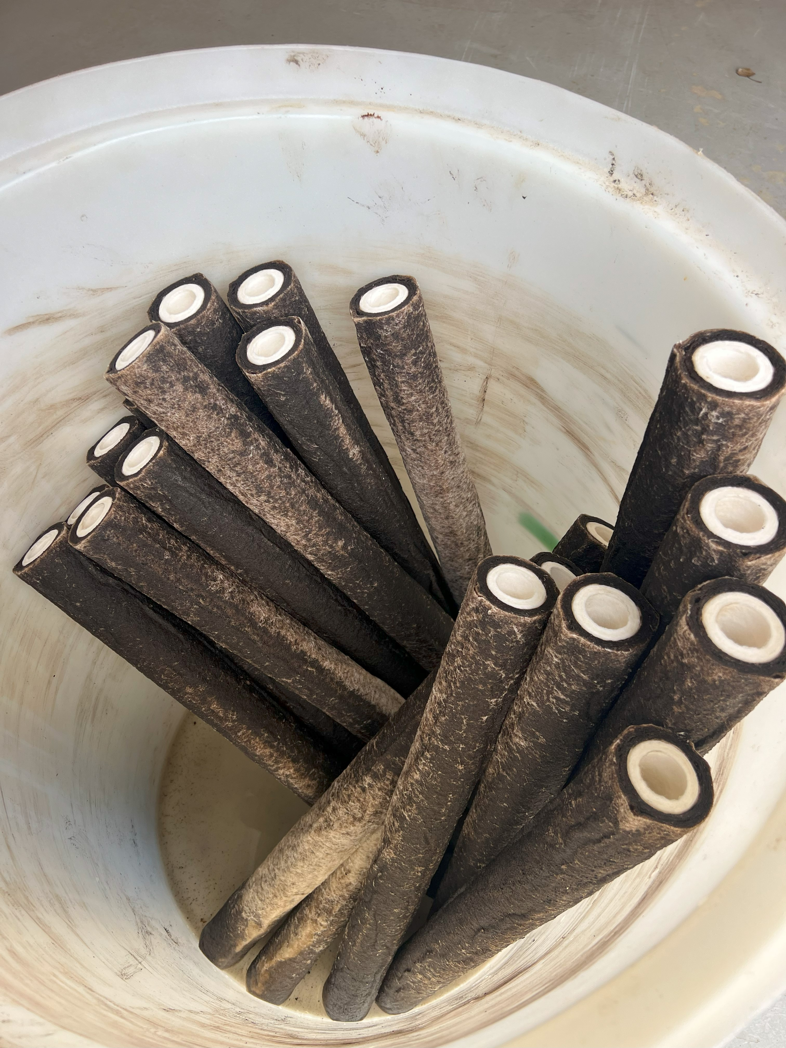
Cartridge Filter

Slide 49
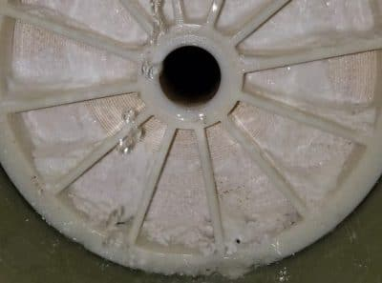
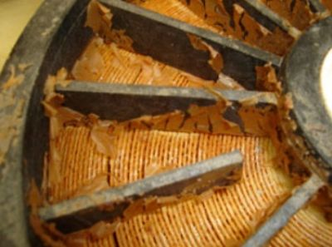
Membrane Scaling

Slide 50
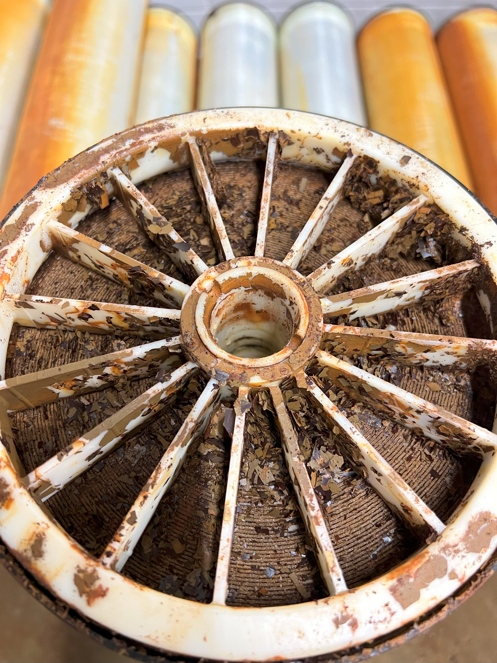
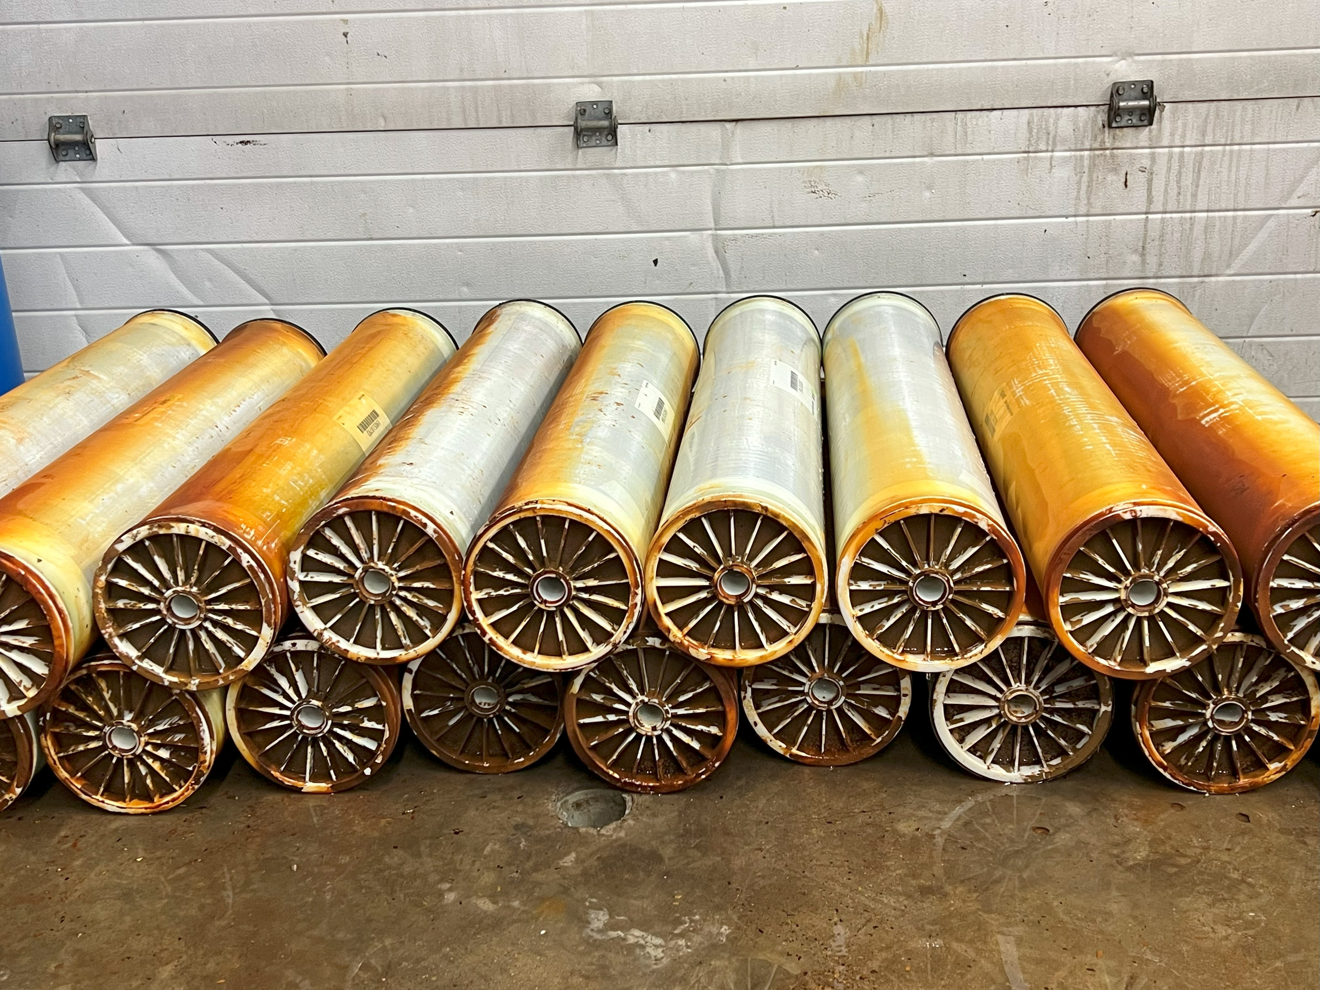
RO Direct Feed without Pre-treatment

Slide 51
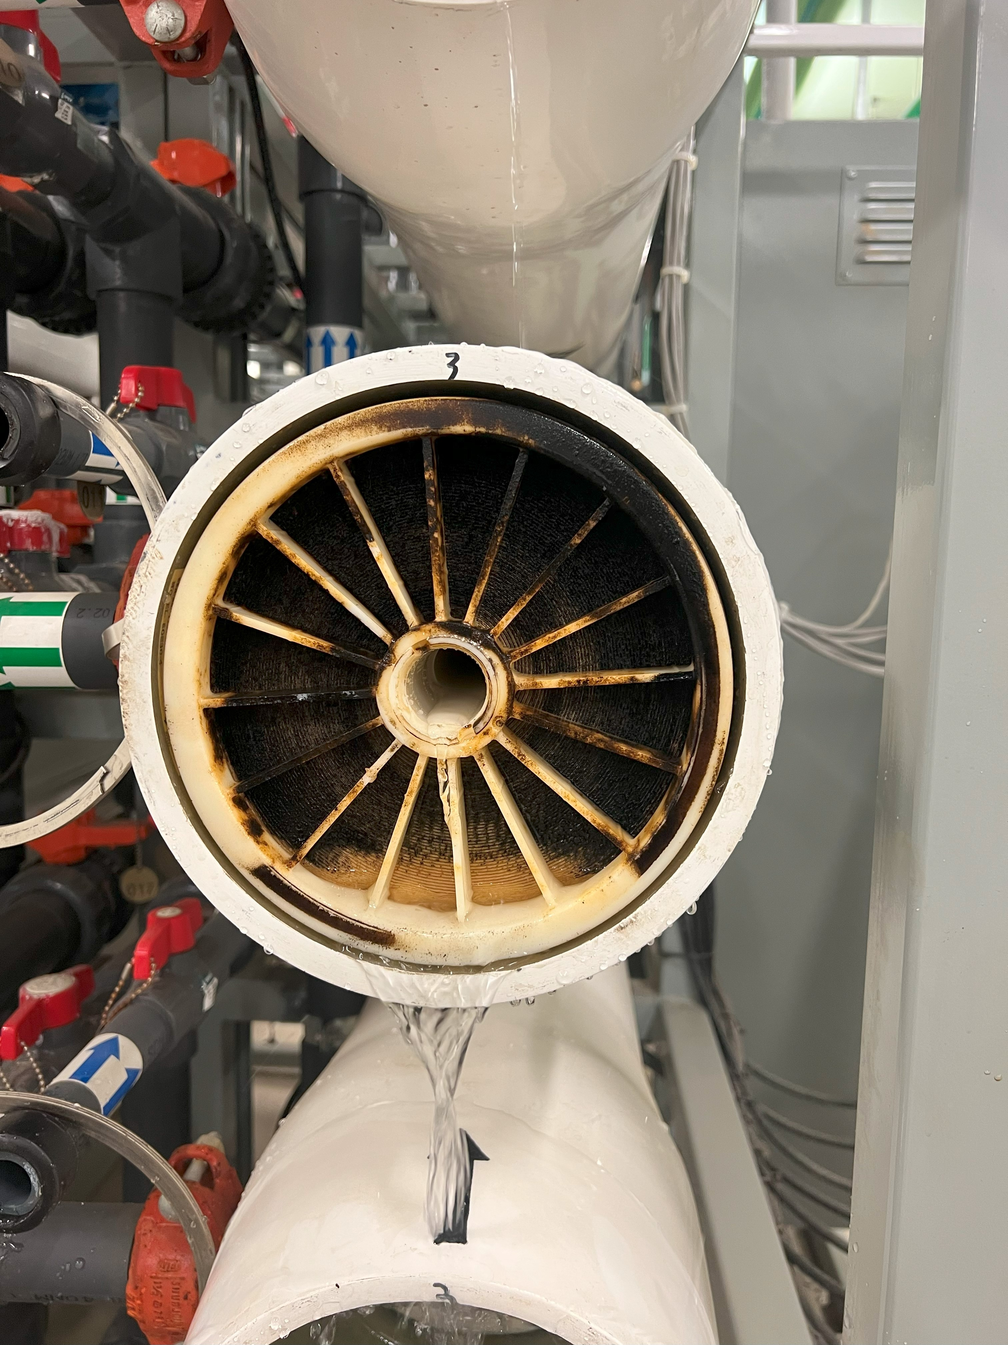
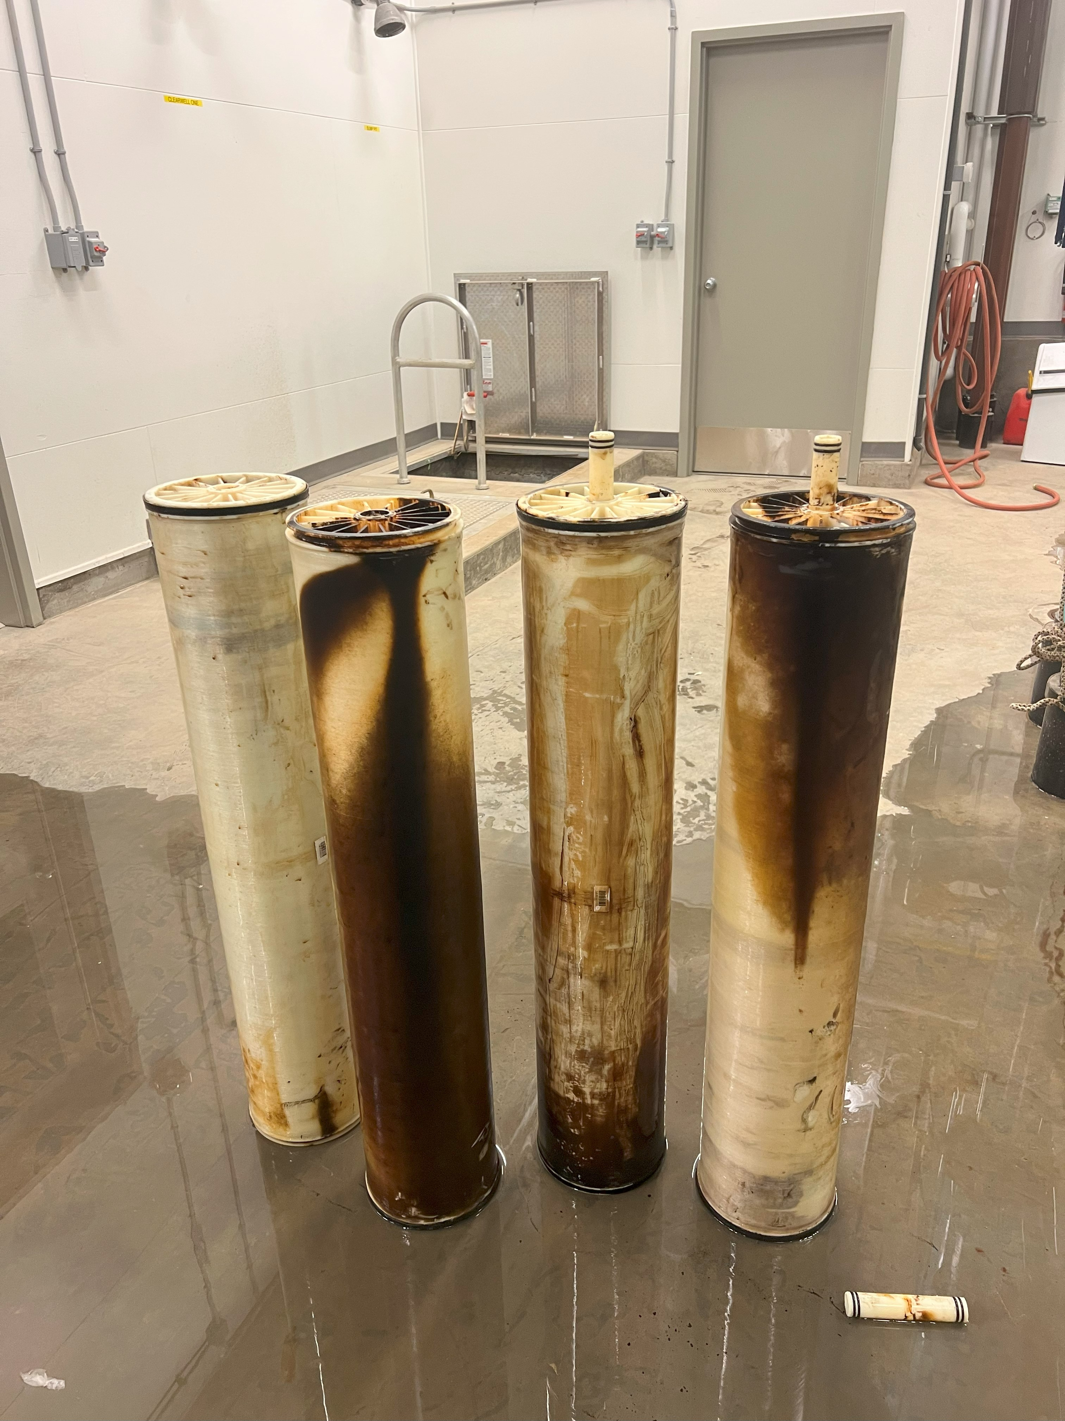
RO Direct Feed without Pre-treatment

Slide 52
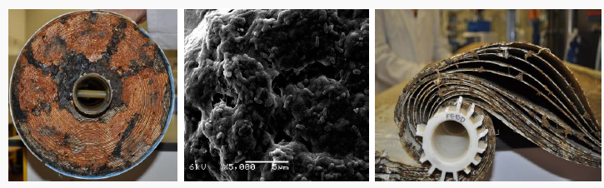
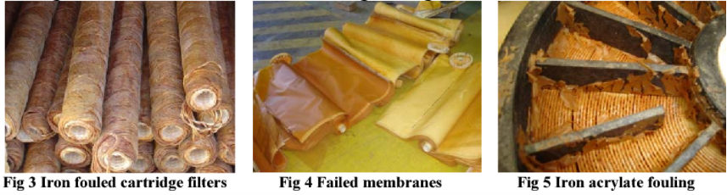
Membrane Fouling

Slide 53
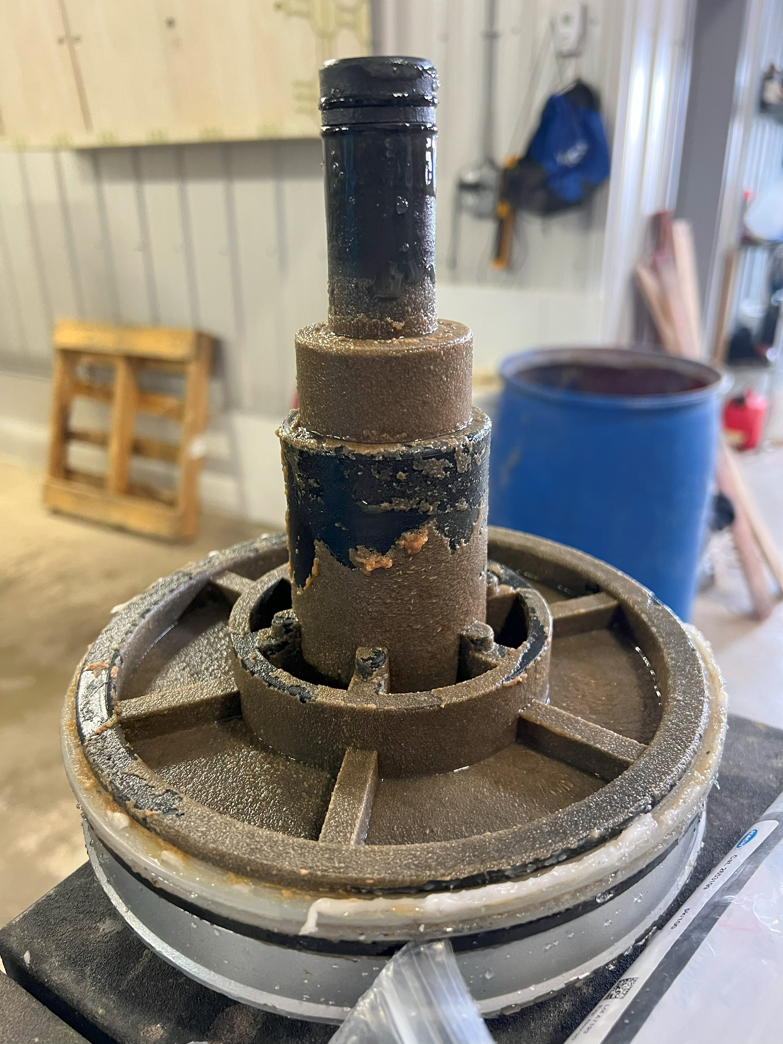
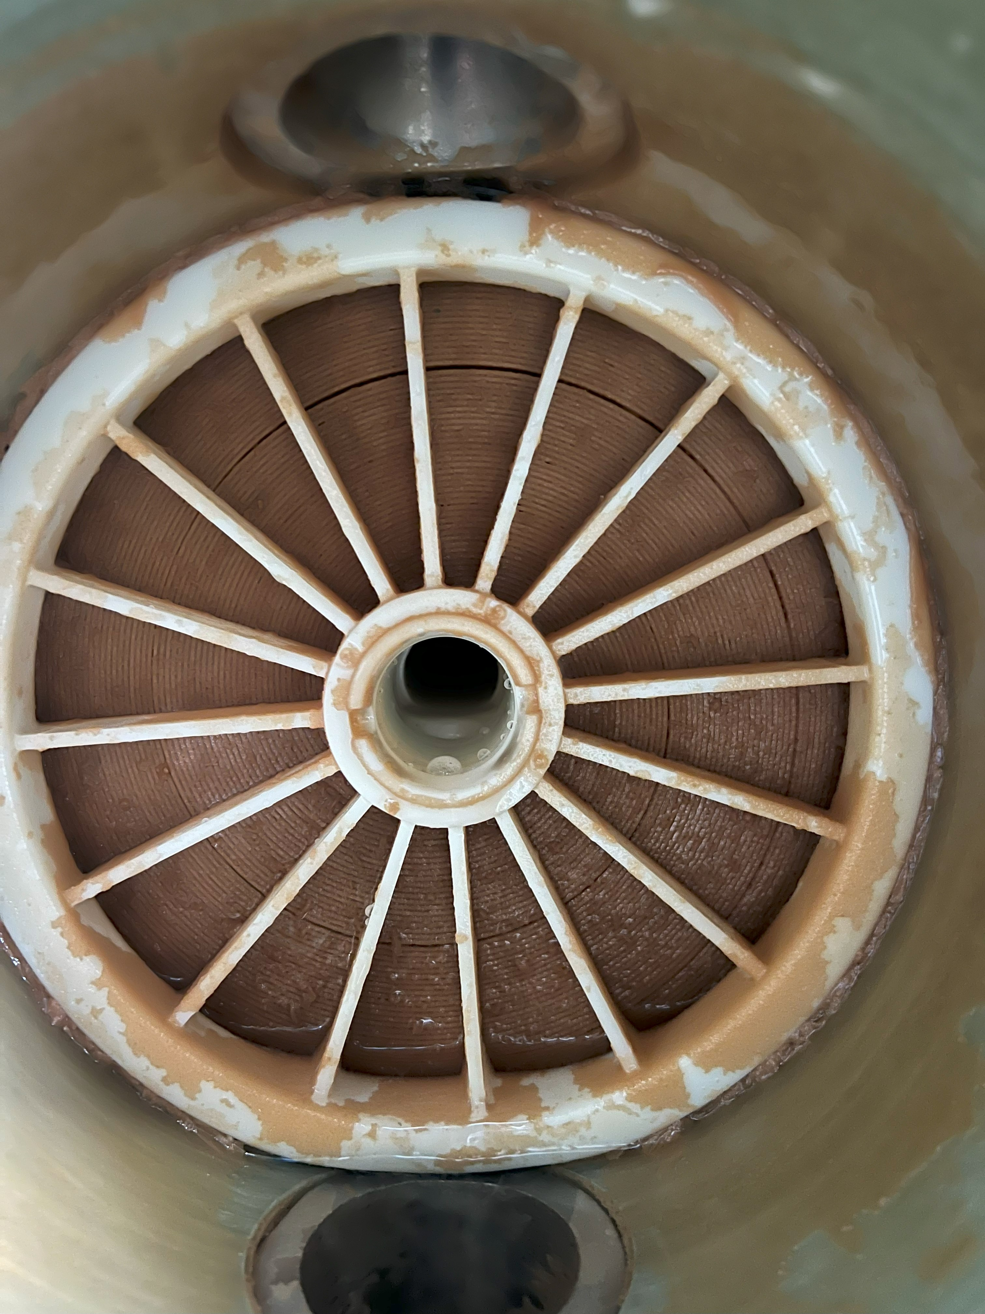
Membrane Biofouling

Slide 54
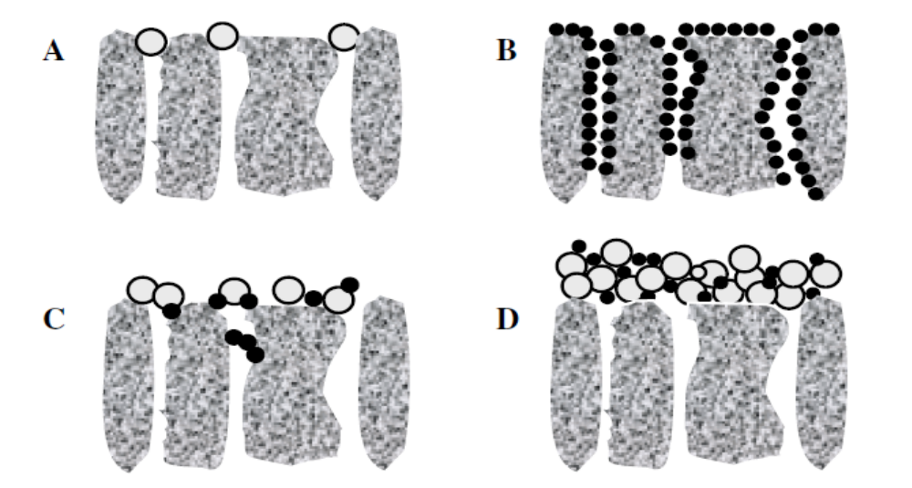
Membrane Fouling
Membrane fouling is referred to as the deposition or adsorption of the particles
contained in the feed stream on the membrane surface or in the membrane pores
This gel layer forms a secondary barrier to flow through the membrane
↓ flux
↓ membrane life
↑ energy use
Schematics of membrane fouling mechanisms: (A) pore blockage, (B) pore
constriction, (C) intermediate blockage and (D) cake filtration.
Membrane fouling has a negative impact on filtration performance as it decreases the permeate flux

Slide 55
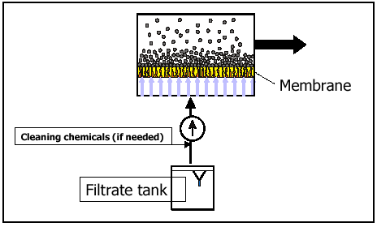
Cleaning in Backwash Mode
Membrane
Cleaning chemicals (if needed)
Filtrate Tank

Slide 56
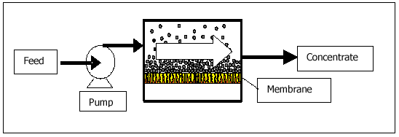
Cleaning in Forward Flush Mode
Feed
Concentrate
Membrane
Pump

Slide 57
Operation Overview
  Check correct setting of all valves
  Purge feed water
  Purge system at low pressure
  Partially close feed pressure control valve
  Ramp up or start high pressure pump
  Slowly open feed control valve or adjust pump speed
  Slowly close concentrate control valve to adjust to design recovery
  Check all chemical dosages rates
  Let system stabilize (1 hour)
  Record all operating parameters
  Check permeate conductivity
  Take water samples and analyze
  Compare performance to prediction
  Record operating data daily (recommended)
  Flush with permeate to shut down

Slide 58
Monitoring Reverse Osmosis Numbers
Main parameters affecting operation:
  Temperature
  Recovery
  Pressure
  Flow
  Salt Rejection (Conductivity)
  and sometimes pH

Slide 59
How to Monitor Reverse Osmosis Performance
Parameters affecting operation
  Normalized Parameters
    Permeate Flow
    Differential Pressure
    Salt Rejection
  Overall vs per Stage Performance

Slide 60
Normalized Parameters
Why?
  Fluctuation in operating conditions cause permeate flow and salt passage changes
  Detecting performance changes from membrane properties
  Eliminating effects of fluctuating operating conditions gives a better perspective of membrane health

Slide 61
Reverse Osmosis Maintenance
What determines membrane health?
  Normalized flow declines by 10%
  Pressure drop increases by 10-15%
  Normalized salt passage increases by 5-10%
    Depending on system design

Slide 62

Normalized Permeate Flow
The main parameter of importance
  Cleaning after 10-15% decline maximizes performance
  Waiting too long reduces performance and lifespan

Slide 63


Normalized Permeate Flow

Slide 64
Membrane Health Degradation
Scale
  Effects the backend of the system
  Mineral build up
  Lower permeate flow, higher pressure, higher salt passage
Fouling
  Effects the frontend of the system
  Organic material build up
  higher pressure, lower permeate flow, lower salt passage
Oxidation
  Effects the whole system but starts at frontend
  lower pressure, lower permeate flow, higher salt passage

Slide 65
General Membrane Cleaning Guidelines
    Determine location of fouling or scaling
    Obtain detailed feed water source analysis
    Identify pH and temperature limits of membrane element
    Permeate flush between cleanings
    Permeate for cleaning chemical solution preparation
    Inspect CIP tank prior to each cleaning
    Measure pH during cleaning: adjust pH when needed
    Typical cleaning pH limits 3.5 – 10
    Harsh cleaning pH limits 2 - 12
    Chemical solution preparation
    Alkaline cleanings at elevated temperatures: 35°C (95°F)
    Acid cleanings can be carried out at minimum 25°C (77°F)
    When using commercial cleaners
    Never use household cleaners

Slide 66

Membrane Clean-in-Place System

Slide 67
Membrane Cleaning Types
Scale
  Dissolve mineral build up with low pH
  Minerals can solidify the membrane material
    Can prevent membrane from producing permeate
    Results in need for membrane replacement
Fouling
  Break down organic material with high pH
  Organics can break down membrane
    Can behave similarly to oxidation
    repeated organic breakdown results in the need for membrane replacement
Oxidation
  This cannot be cleaned
  Severe oxidation results in membrane replacement

Slide 68
Membrane Cleaning Types
High or Low pH Cleaning?
  BOTH
    Typically, high pH then low pH
  Monitor the membrane degradation to determine what type of cleaning is needed
    Membrane autopsies are helpful
    Feed water analysis is helpful
    Trial and error can be helpful

Slide 69

Membrane Cleaning

Slide 70

Membrane Autopsy

Slide 71
Thank You
&
Questions?
Service@dropwater.ca
Systems@dropwater.ca

