Slide 1
TSAG Water Week
June 13 - 15, 2023
ALBERTA REGIONAL OPERATIONS
WATER AND WASTEWATER PROGRAM

Slide 2
Overview
Who We Are
Organizational Structure
What We Do
  Infrastructure Project Planning and Delivery
  Annual Performance Inspections (API’s)
  Operations and Maintenance
  Drinking Water Advisory Group
Past Projects
Contact Information
Questions?

Slide 3
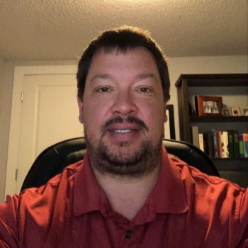
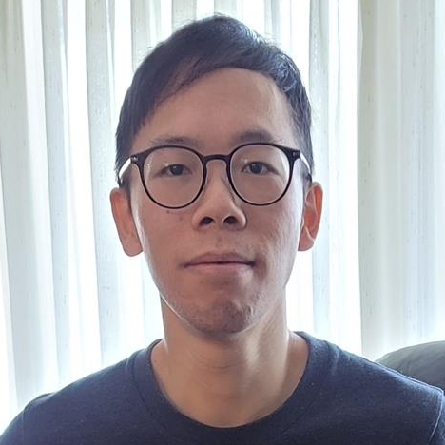


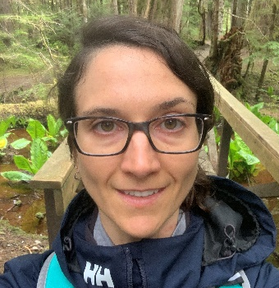
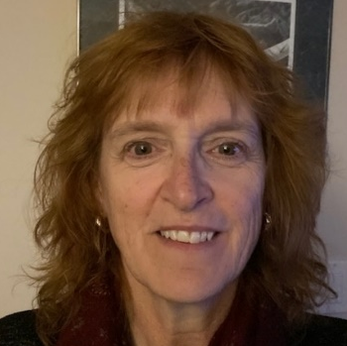
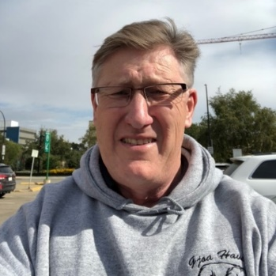
Who We Are
The water strategy team works in partnership with First Nations in Alberta to deliver water and wastewater projects funded through the First Nations Water and Wastewater Enhanced Program (FNWWEP).
Mervin Clarke
Water Strategy Manager
Adam Kuehnbaum
Engineering Manager
Felix Chan
Senior Engineer
Madison Van Tassell
Capital Planning Officer
Christa Bergeron
Project Officer
Diane Gramlich
Project Officer
Carlyle Goetzie
Project Officer
Notes:
Photos of the team.

Slide 4
Organizational Structure
Jamie Brown
Regional Director General
Alberta
Dayna Jongejan
Associate Regional Director General
Alberta
Andrew Wujcik
Director
Community Infrastructure and FNR Treaty 7
Adam Kuehnbaum
Engineering Manager
Water and Wastewater Infrastructure
Mervin Clarke
Manager
Water Strategy
Felix Chan
Senior Engineer
Madison VanTassell
Capital Planning Officer
Carlyle Goetzie
Project Officer
Diane Gramlich
Project Officer
Christa Bergeron
Project Officer

Slide 5
What We Do
Infrastructure Project Planning and Delivery
First Nation Infrastructure Investment Plan (FNIIP)
What is it?
  It helps to identify the infrastructure needs and priorities and to strategically plan infrastructure investments in First Nation communities.
The National FNIIP is developed each year.
  It is based on infrastructure investment plans at the community and regional level.
  A First Nation will submit a community-level plan to a regional office in order to be considered in the National FNIIP.
  Submission for the community-level plan is due September 30 but it can be updated throughout the year.
Capital projects are identified on FNIIP. They are divided into two categories:
  Major Capital Projects
  Minor Capital Projects
Our team is available to discuss FNIIP with Nations and assist them with infrastructure planning.

Slide 6
What We Do
Infrastructure Project Planning and Delivery
Major Capital Projects (Total Estimated Cost >$1.5M)
Feasibility Study
Look at current conditions of water infrastructure and develop options to meet objectives.
Options analysis must include a life cycle cost estimate (LCC) for each option.
  LCC estimate must consider both the capital cost and the long-term operations and maintenance costs.
Project Approval Request (PAR) Development.
  Projects <$15M require review and approval within the AB Region.
  Projects >$15M require review and approval at headquarters.
Design
Once the PAR has been approved and funding secured, an engineering consultant is typically procured to design the recommended solution.
Process typically takes one year.
Construction
A project can go out to tender to procure a contractor for construction.
Construction of new water and wastewater system typically takes two years.

Slide 7
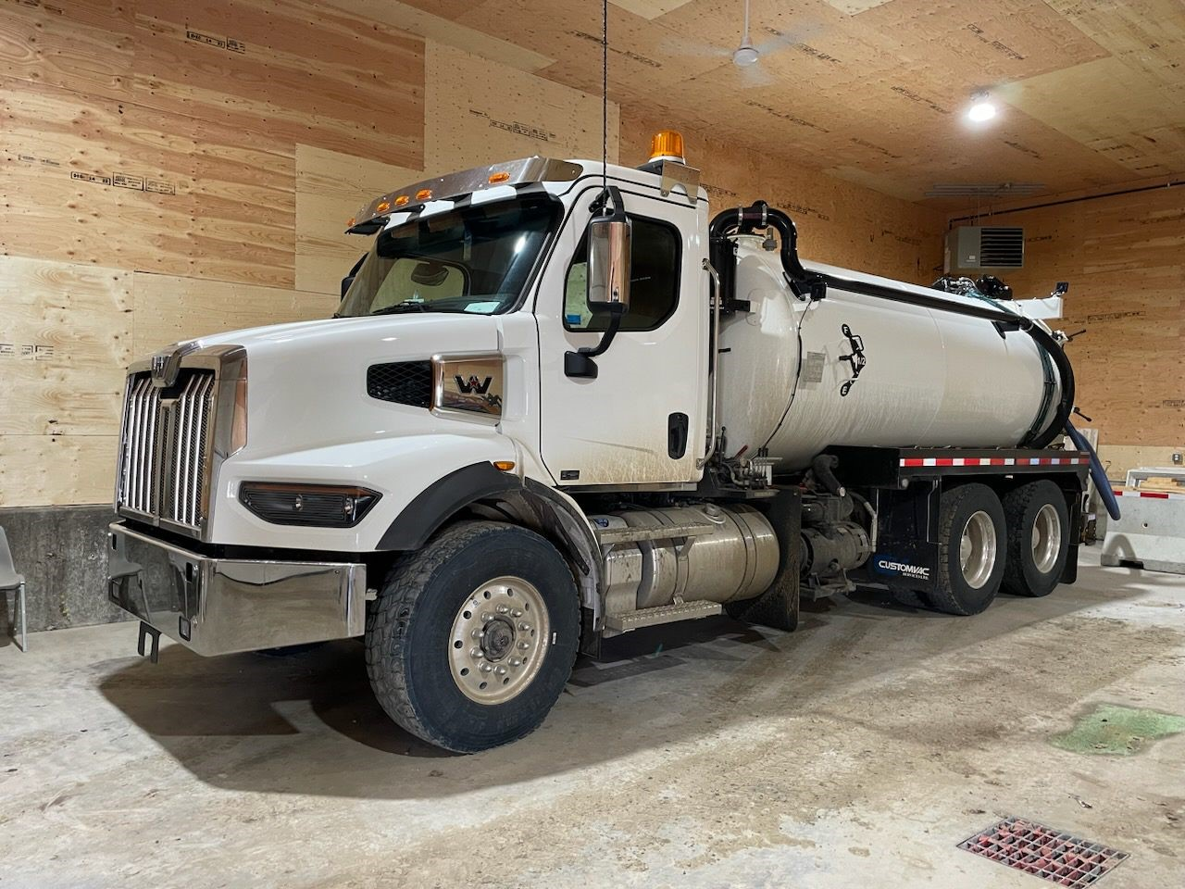
What We Do
Infrastructure Project Planning and Delivery
Minor Capital Projects (Total Estimate Cost <$1.5M)
Nations work with our Senior Engineer or Project Officer on options to secure funding.

Slide 8

What We Do
Annual Performance Inspections (API’s)
Neegan Burnside Report
An Initial National Assessment was completed by Neegan Burnside in 2009/10 and 2010/11.
A report was sent out to each First Nation.
Annual Performance Inspections
Completed on an annual basis.
  Have been completed by FNTSAG since 2011/12.
API’s identify risks associated with water and wastewater systems.
  Risks are categorized under five different headings.
  The weighted risk for each category is combined to calculate an overall risk for each system.
  Each system is identified as a high, medium, or low risk system.
  WATER
  Source Water – 10%
  Design – 30%
  Operations – 30%
  Reporting – 10%
  Operators – 20%
  WASTEWATER
  Effluent Receiver – 20%
  Design – 25%
  Operations – 25%
  Reporting – 10%
  Operators – 20%

Slide 9
What We Do
Annual Performance Inspections (API’s)
2022/23 API Results
Water Systems:
  2 High Risk System
  16 Medium Risk Systems
  47 Low Risk Systems
Wastewater Systems:
  8 High Risk Systems
  35 Medium Risk Systems
  17 Low Risk Systems

Slide 10
What We Do
Operations and Maintenance (O&M) Funding
Operations and Maintenance (O&M)
O&M funding is a subsidy to assist with operations and maintenance costs for eligible assets.
Funding is based on a national asset formula which takes into account factors such as the geographical location and proximity to city centers.
Last year, a review of the full formula was completed by headquarters and resulted in significant increases in the O&M funding provided.
Water and wastewater assets are now funded at 100% of the amount calculated by the formula.
  It was previously funded at 80% of the calculated amount.
Tracey Travis (Regional Program Development Advisor) leads the O&M program for Alberta Region.

Slide 11
What We Do
Drinking Water Advisory (DWA) Group
Regional Drinking Water Advisory (DWA) Group
An Initial National Assessment was initiated in 2010/11.
Collaborative approach in rectifying DWA issues.
Participants include:
  ISC
  ISC FNIHB
  TSAG - CRTP
Meetings are held weekly to review the ISC FNIHB report.
Discuss common issues to resolve past, current, and outstanding drinking water advisories.
Work collaboratively to develop DWA Work Plans with the goal to mitigate ALL DWA’s.

Slide 12
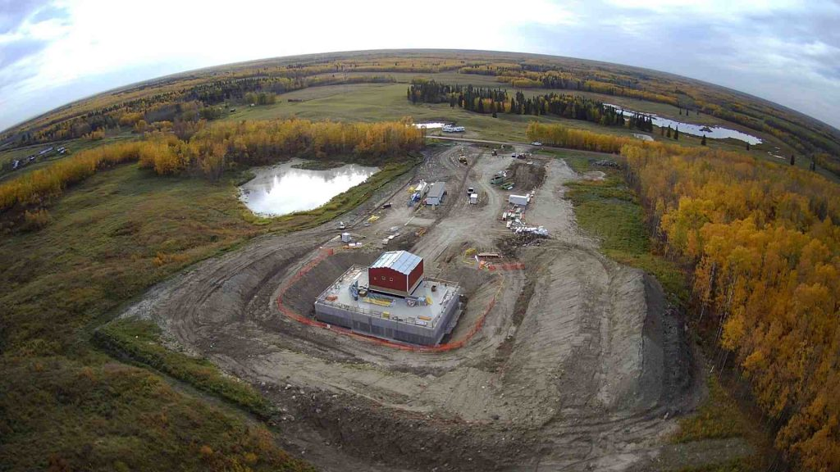
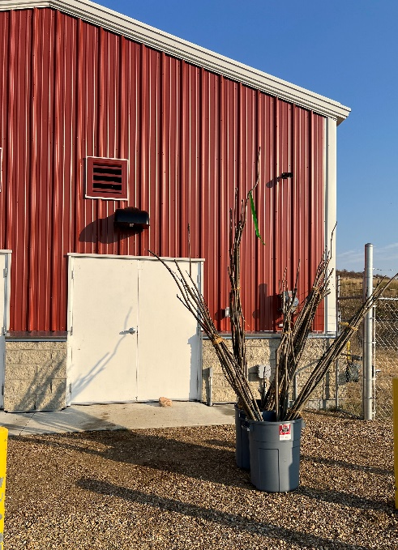
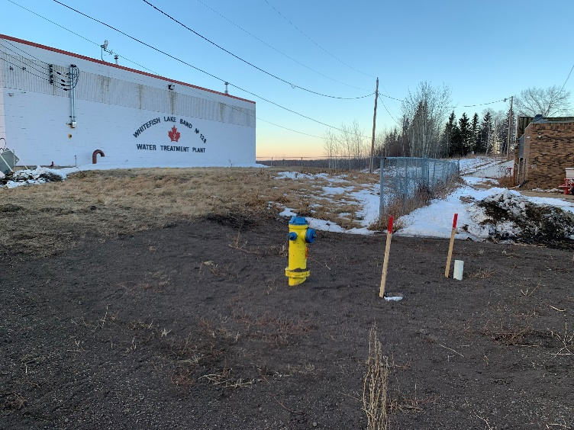
Past Projects
Whitefish Lake #128 – Regional Water System

Slide 13
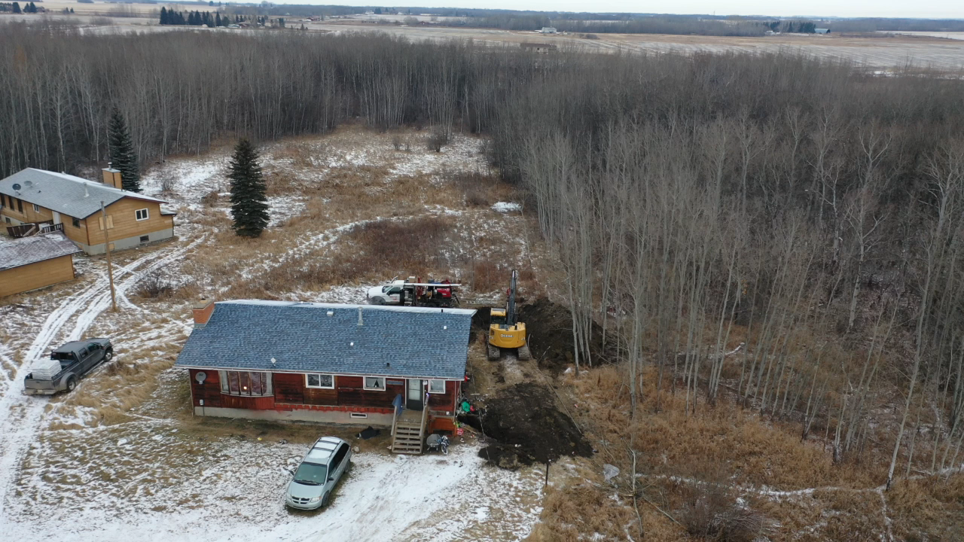
Past Projects
Samson Cree Nation – Rural Drinking Water

Slide 14
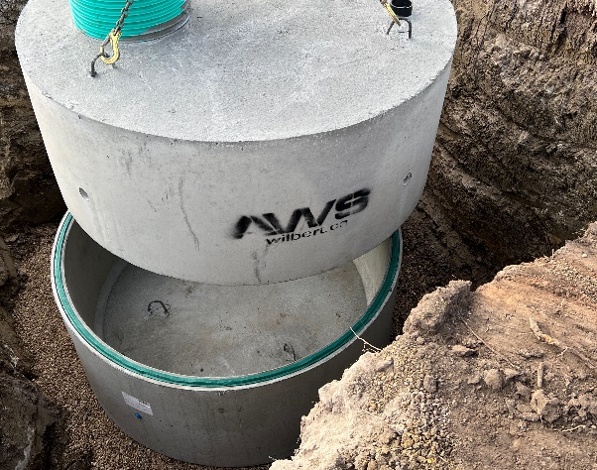
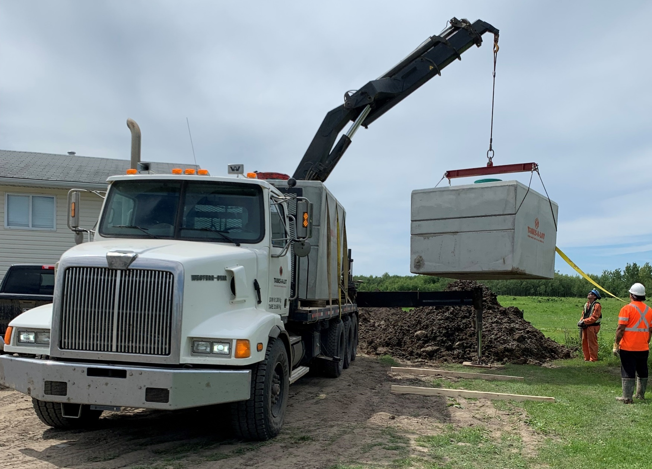
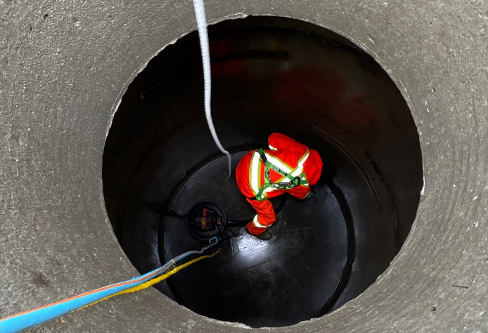
Past Projects
Water Cistern Inspections and Replacements

Slide 15
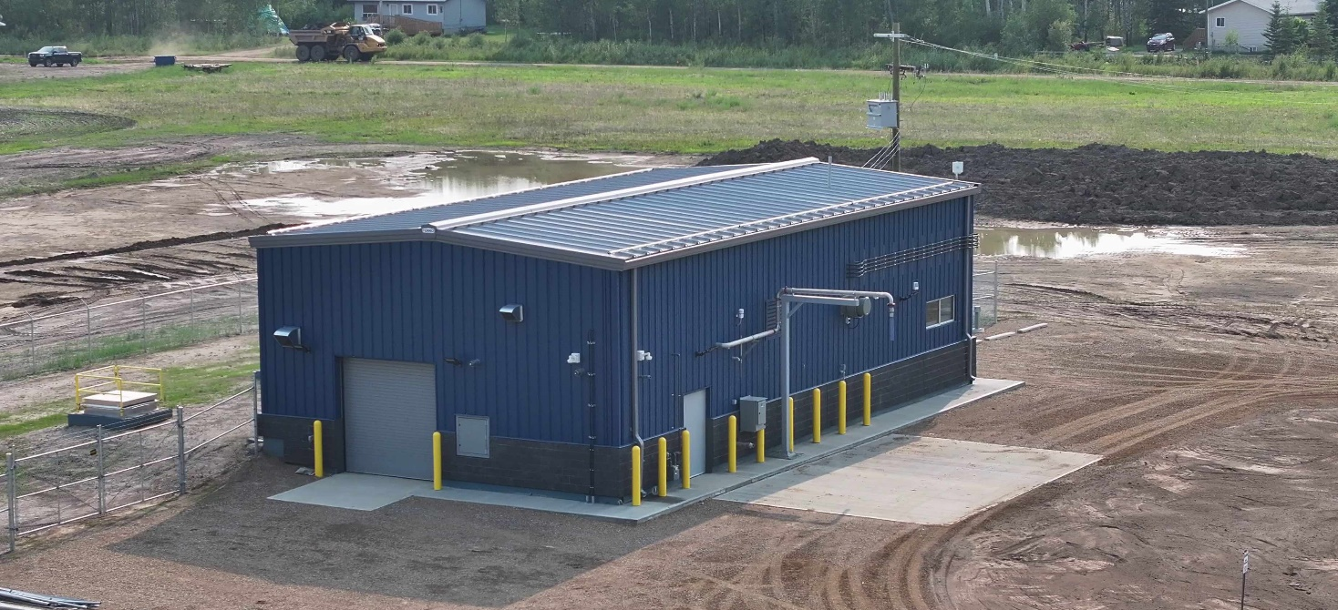
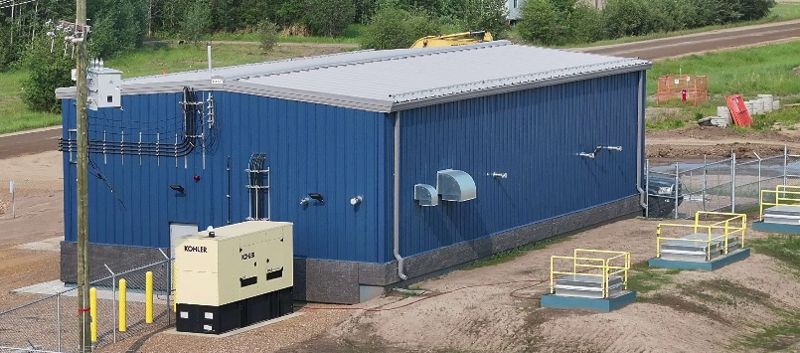
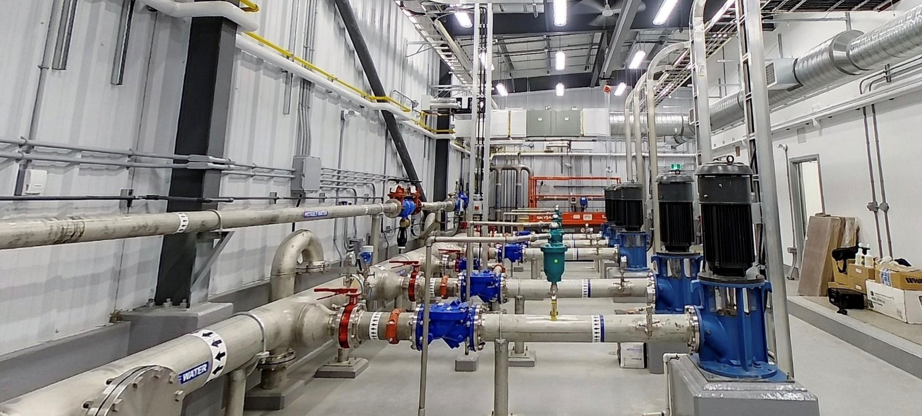
Past Projects
Bushe River Water Treatment Plant

Slide 16
Contact Information
Andrew Wujcik Director, Community Infrastructure and FNRT7
andrew.wujcik@sac-isc.gc.ca
Mervin Clarke Manager, Water Strategy
mervin.clarke@sac-isc.gc.ca
Adam Kuehnbaum Engineering Manager, Water & Wastewater Infrastructure
adam.kuehnbaum@sac-isc.gc.ca
Tracey Travis Regional Program Development Advisor (O&M)
tracey.travis@sac-isc.gc.ca

Slide 17
Questions?

