Slide 1





v
Fire Safety Course: Sun, Sun Summertime Grades 4-6
First Nations
Technical Services
Advisory Group Inc.
Fire Prevention is Everyone’s Responsibility
Notes:
Added

Slide 2


Fire Ravages City of Fort McMurray, Alberta
ABC News. (2016, May 4). Fire Ravages City of Fort McMurray, Alberta [Video]. YouTube. https://www.youtube.com/watch?v=sLz8qJhi054
tsag.net
Notes:
On May 1, 2016, a wildfire began southwest of Fort McMurray, Alberta, Canada. On May 3, it swept through the community, forcing the largest wildfire evacuation in Alberta's history, with upwards of 88,000 people forced from their homes
Cost: $9.9 billion (direct and indirect costs)
Burned area: 589,552 ha (1,456,810 acres)
Buildings destroyed: 3,244
It is suspected to have been caused by humans in a remote area 15 km (9.3 mi) from Fort McMurray, but no official cause has been determined to date.
What is the first thing that comes to your mind when you see this video?
Wikimedia Foundation. (2022, August 10). 2016 Fort McMurray wildfire. Wikipedia. Retrieved September 27, 2022, from https://en.wikipedia.org/wiki/2016_Fort_McMurray_wildfire

Slide 3
Wildfires
Caitlyn Bledsoe. (2019, March 8). Wildfires [Video]. YouTube. https://www.youtube.com/watch?v=6o9mEygSWV0
tsag.net

Slide 4
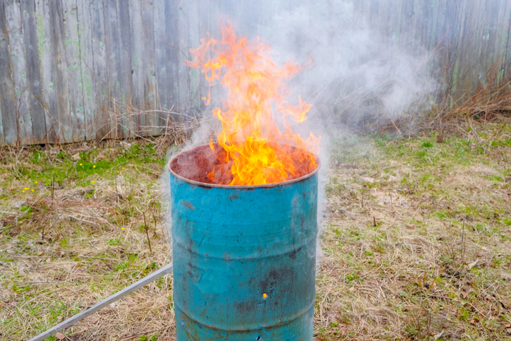
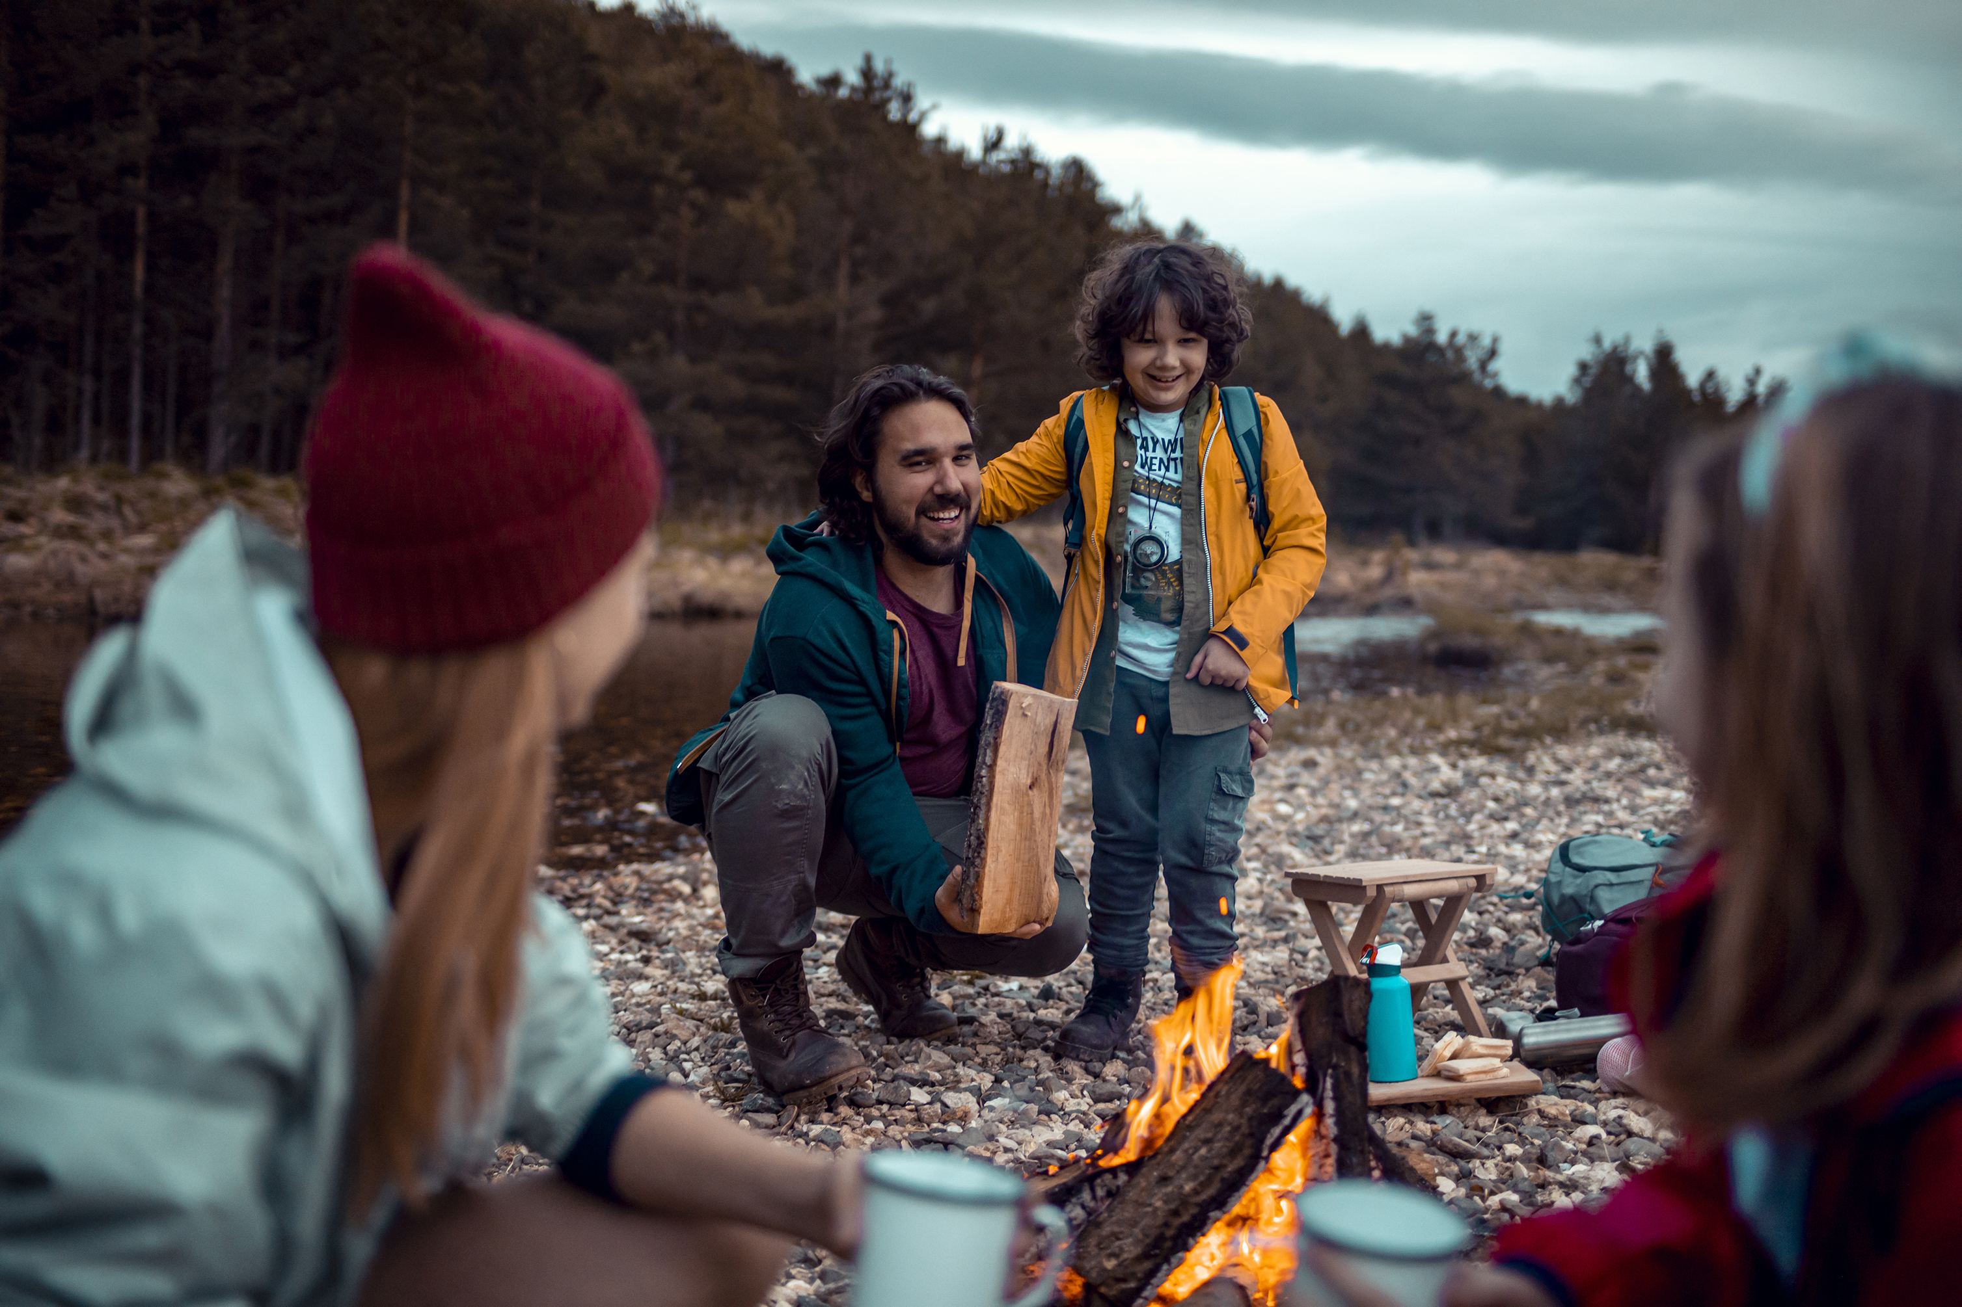
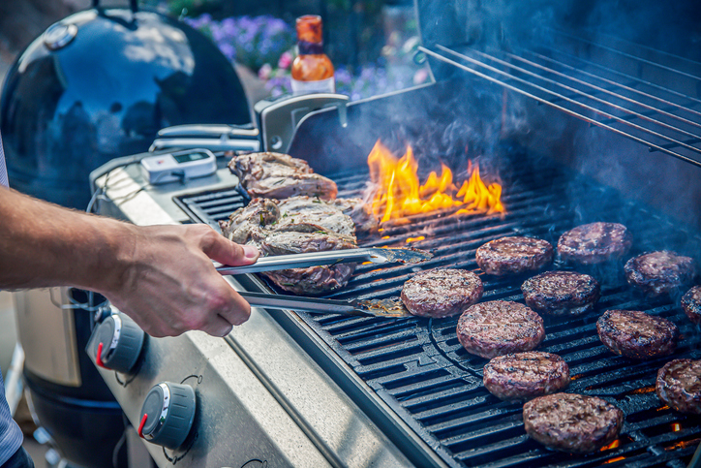

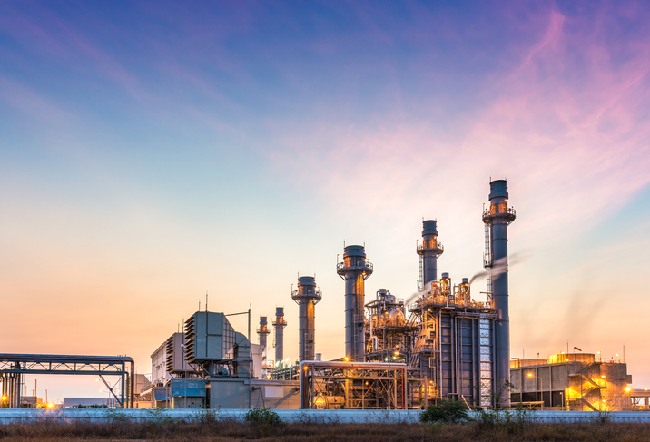

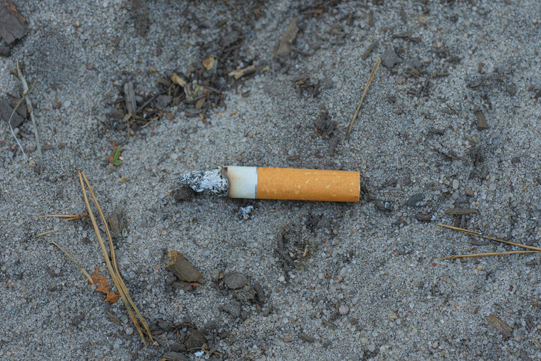
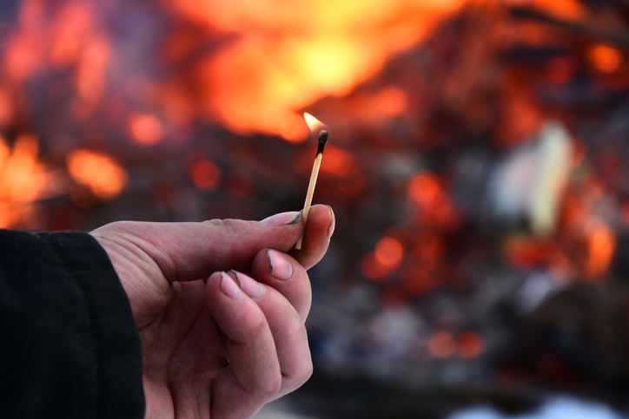
Causes of Wildfires
tsag.net
Notes:
Most common sources of human caused wildfires
Open burning
Vehicle and engine use
Industrial activity
Fireworks, sky-lanterns, outdoor flame lighting
Discarding burning items (cigarettes)
Arson
Human Activity causes approximately 40% of all wildfires

Slide 5
Summer Safety Tips
U.S. Fire Administration. (2019, June 25). Summer Safety Tips [Video]. YouTube. https://www.youtube.com/watch?v=BnzC4h5MXpQ&t=22s
tsag.net

