Slide 1





v
Fire Safety Course:
Fire Protection K-1
First Nations
Technical Services
Advisory Group Inc.
Fire Prevention is Everyone’s Responsibility
Notes:
Added

Slide 2
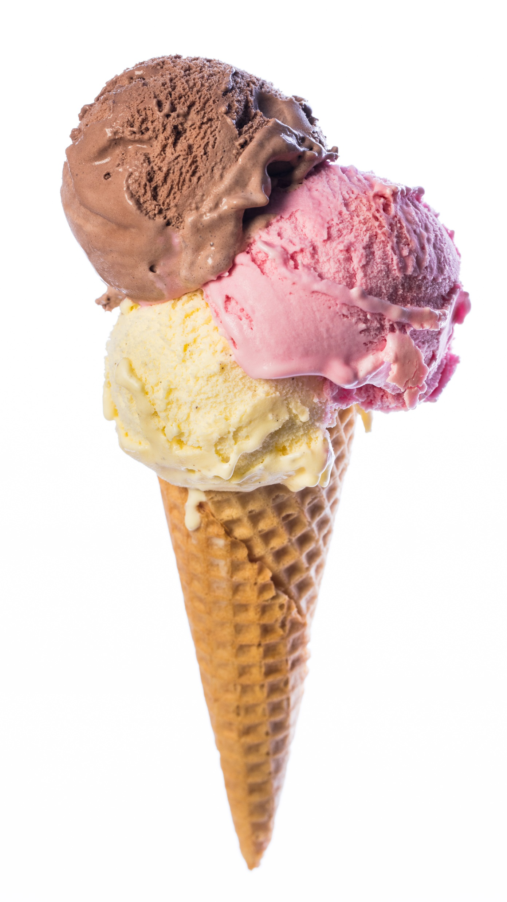


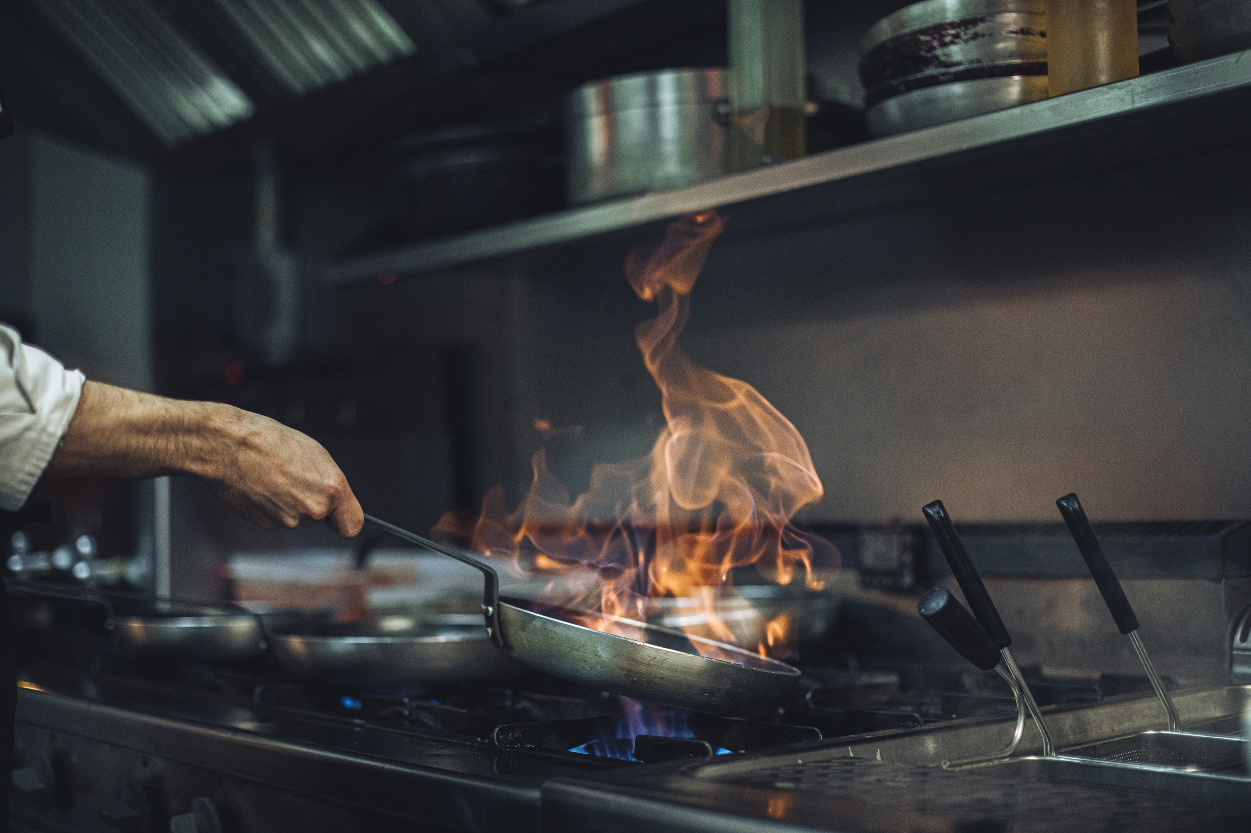


Which one can burn you?
tsag.net
Notes:
Added

Slide 3
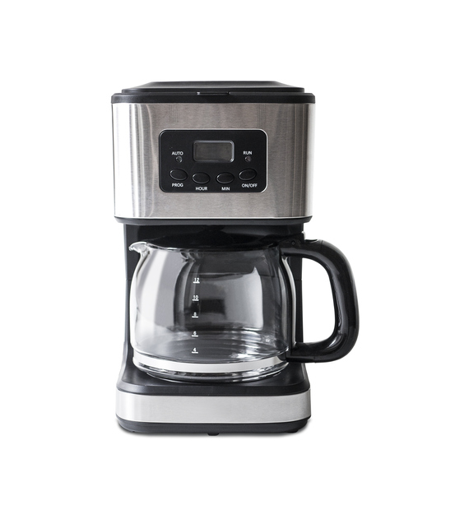
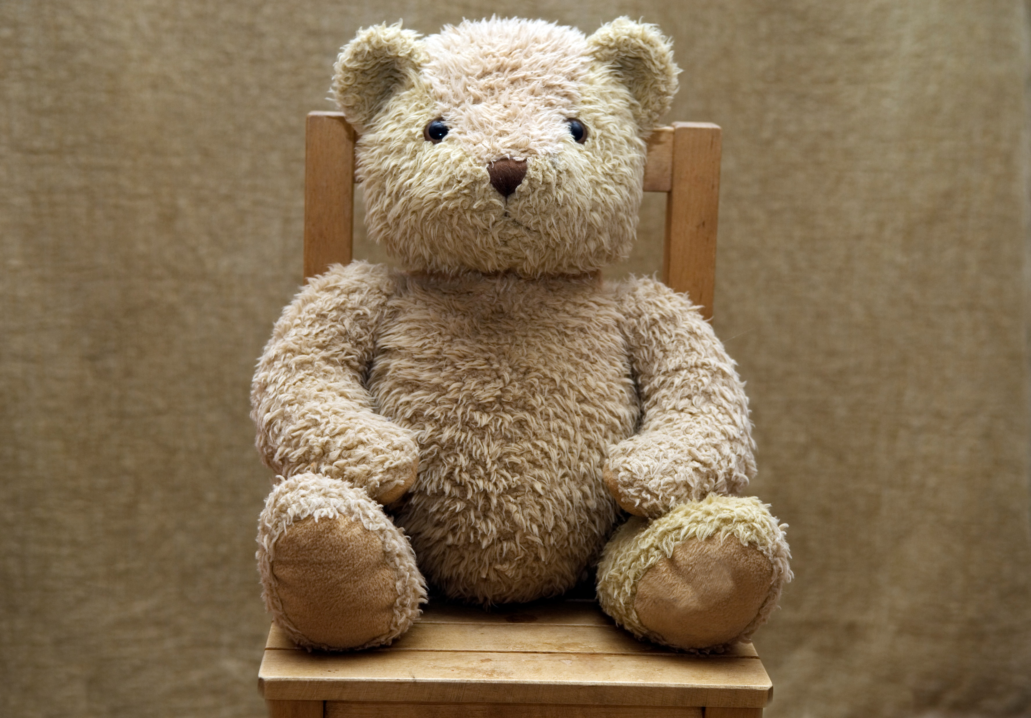
Which one can burn you?
tsag.net
Notes:
Added

Slide 4

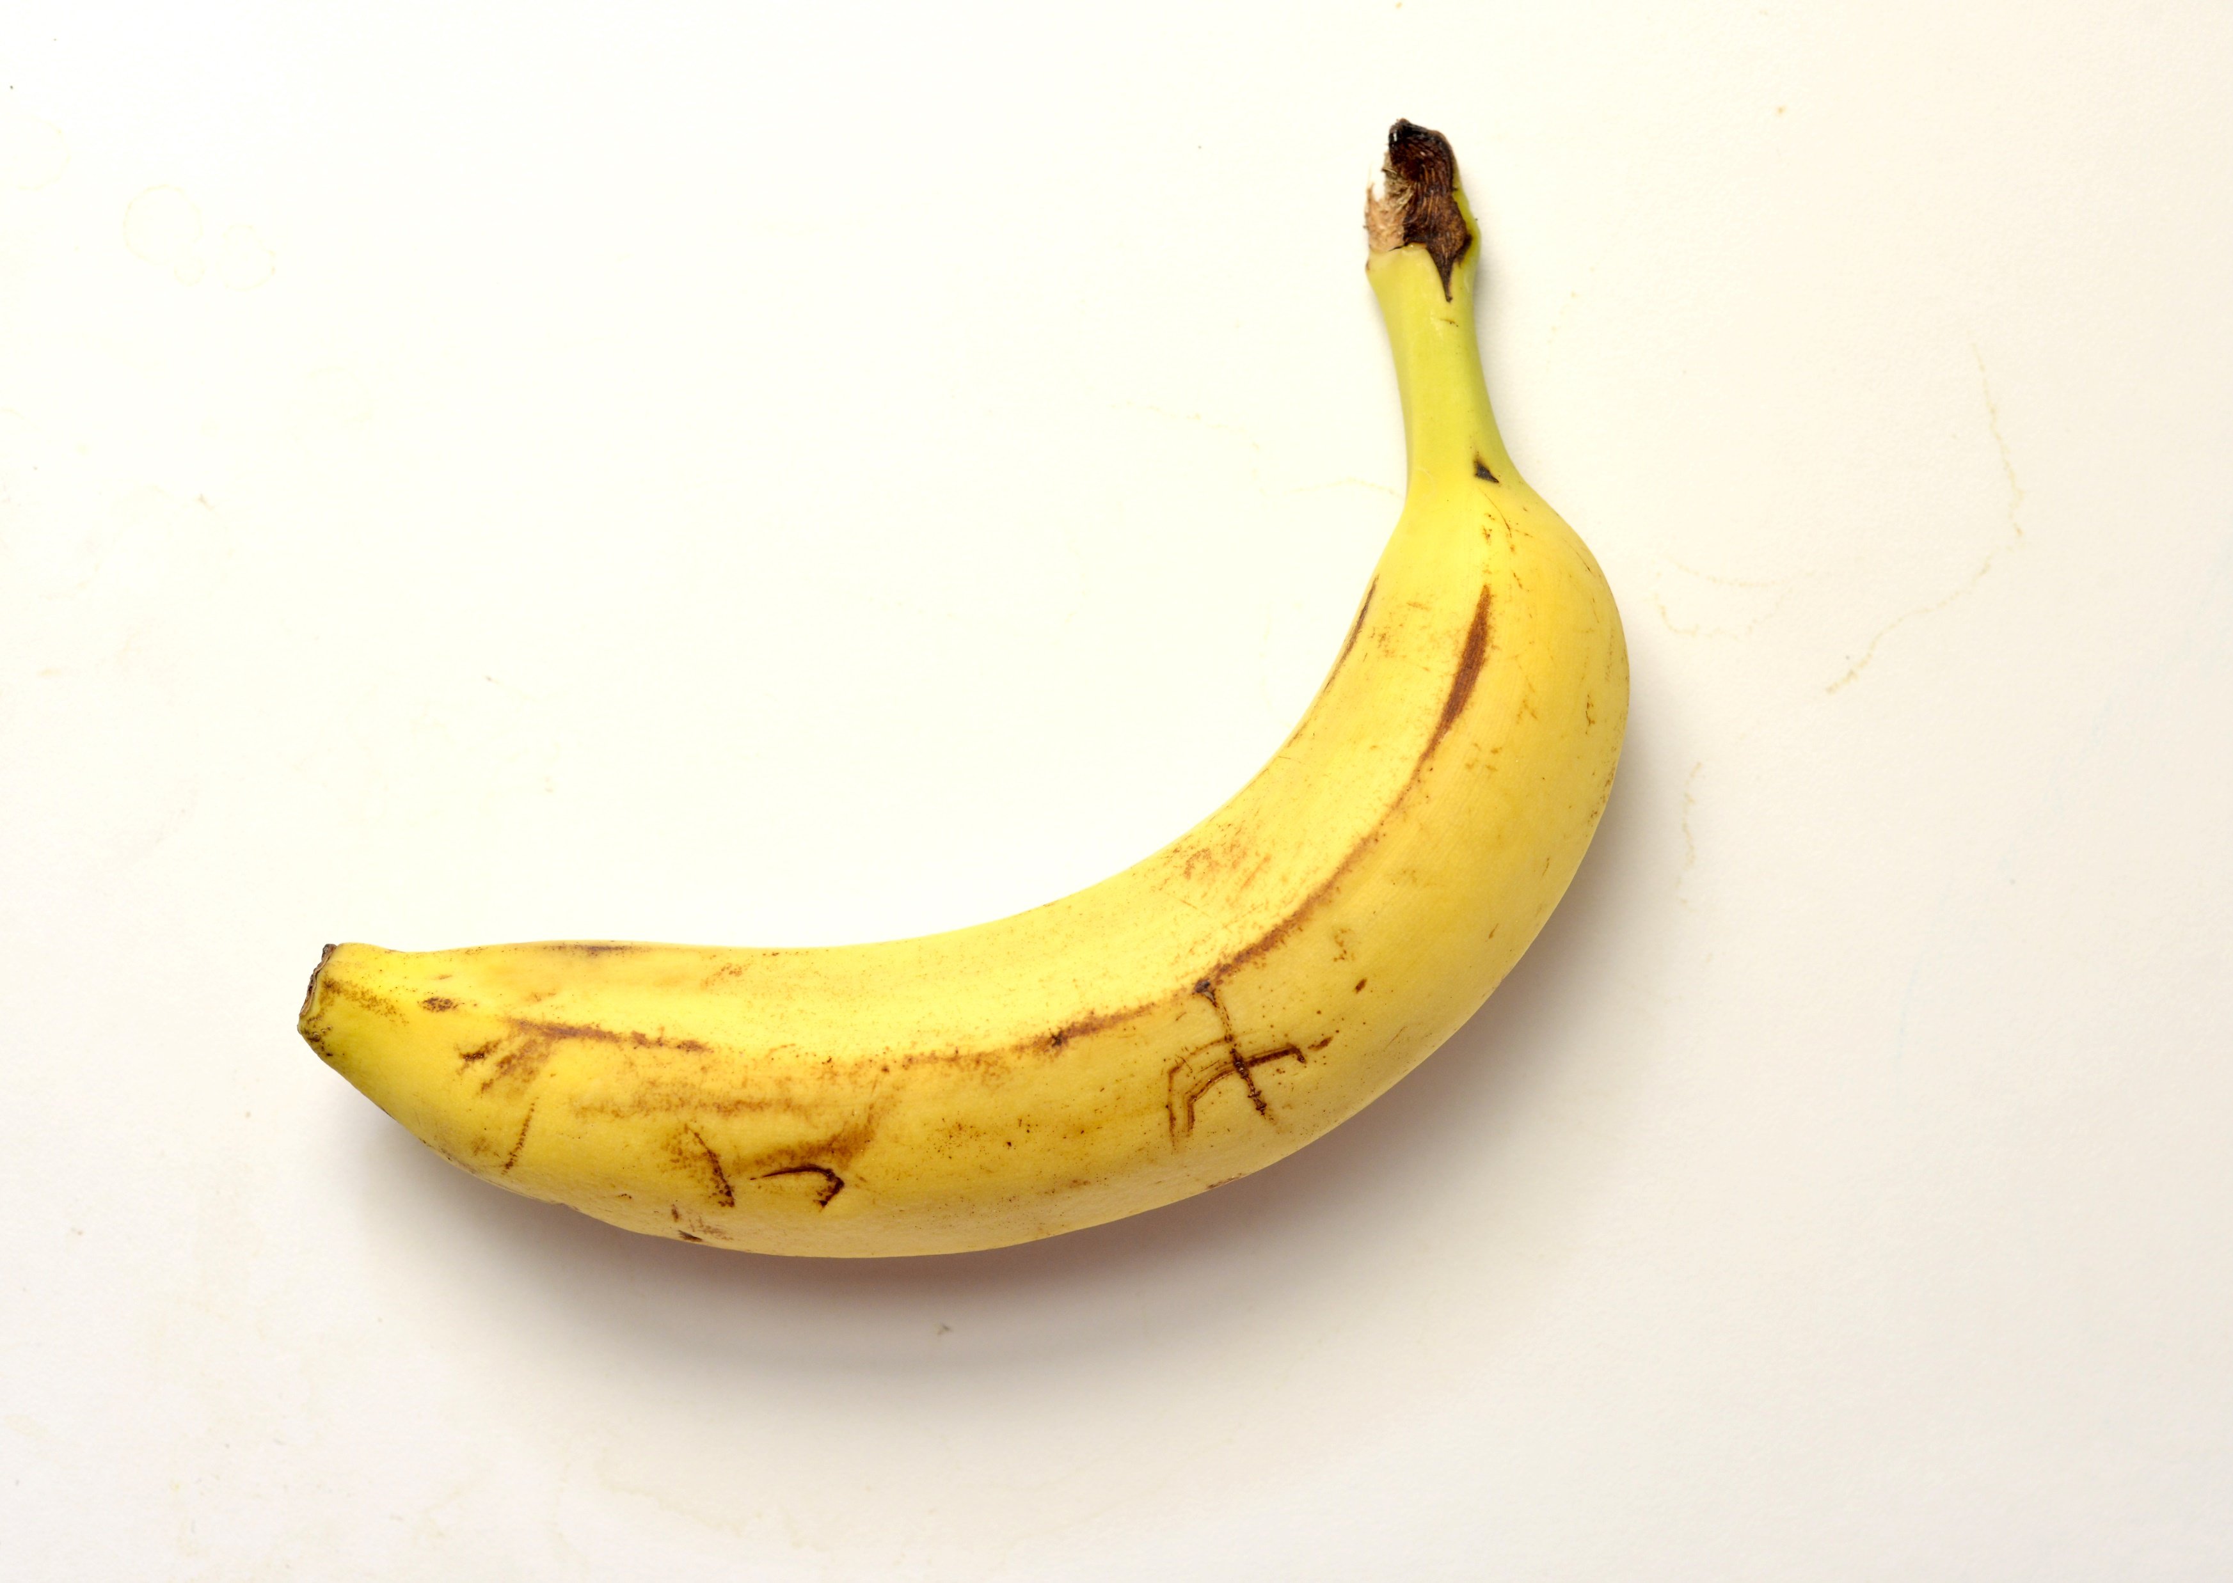
Which one can burn you?
tsag.net
Notes:
Added

Slide 5
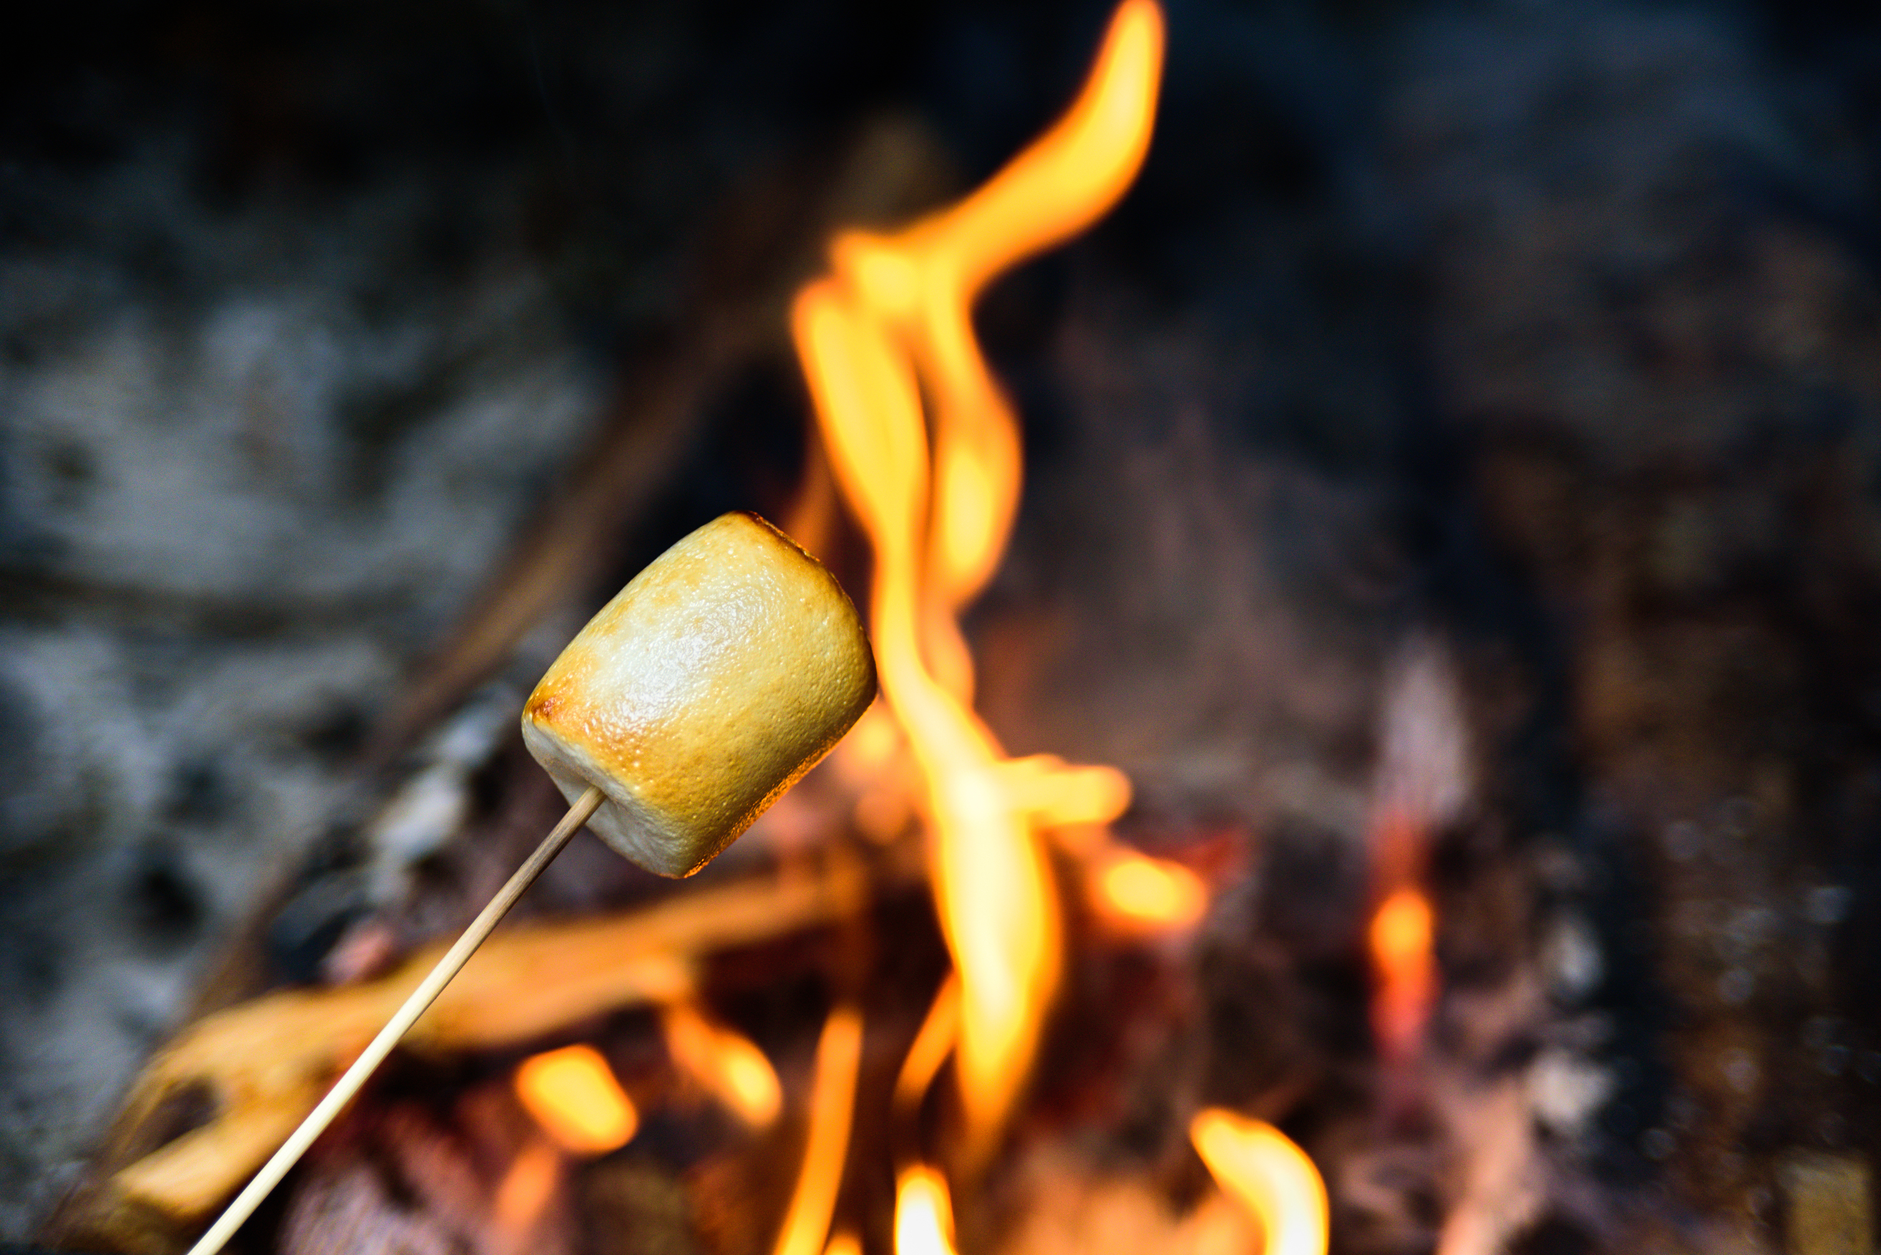

Which one can burn you?
tsag.net
Notes:
Added

Slide 6
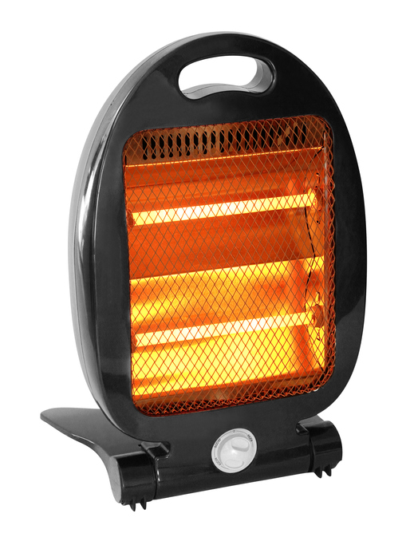
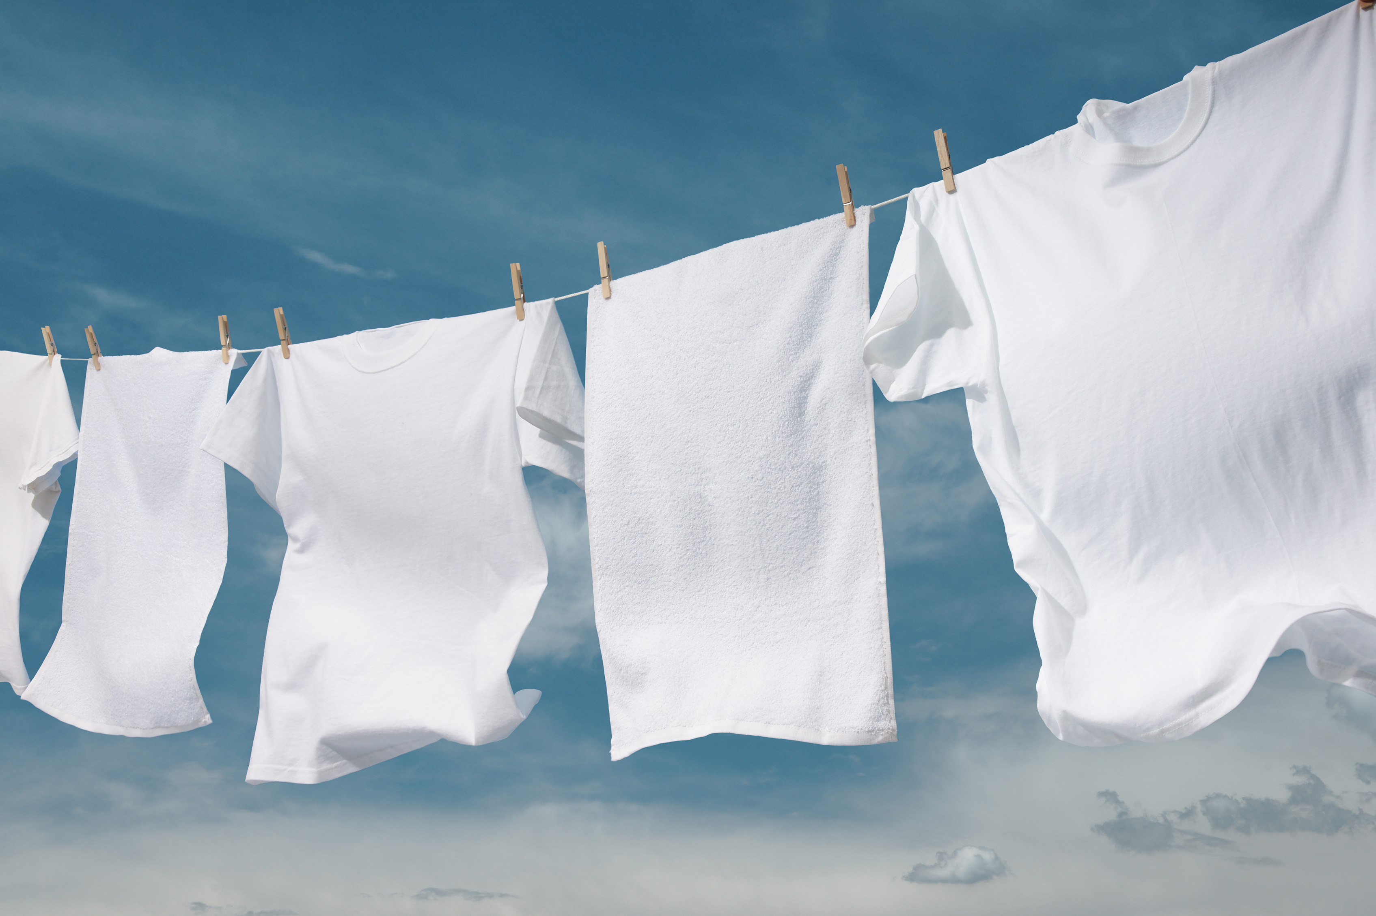
Which one can burn you?
tsag.net
Notes:
Added

Slide 7



What do you do if you get burned?
1. Always tell an Adult
2. Hold the burn under cool water for 15 minutes
3. Cover it with a bandage.
tsag.net
Notes:
Why do you always tell an adult? (they will know whether you should go to emergency)

