Slide 1




Fire Safety Course: Fire Protection Grades 4-6
First Nations
Technical Services
Advisory Group Inc.
Fire Prevention is Everyone’s Responsibility
Notes:
Added

Slide 2
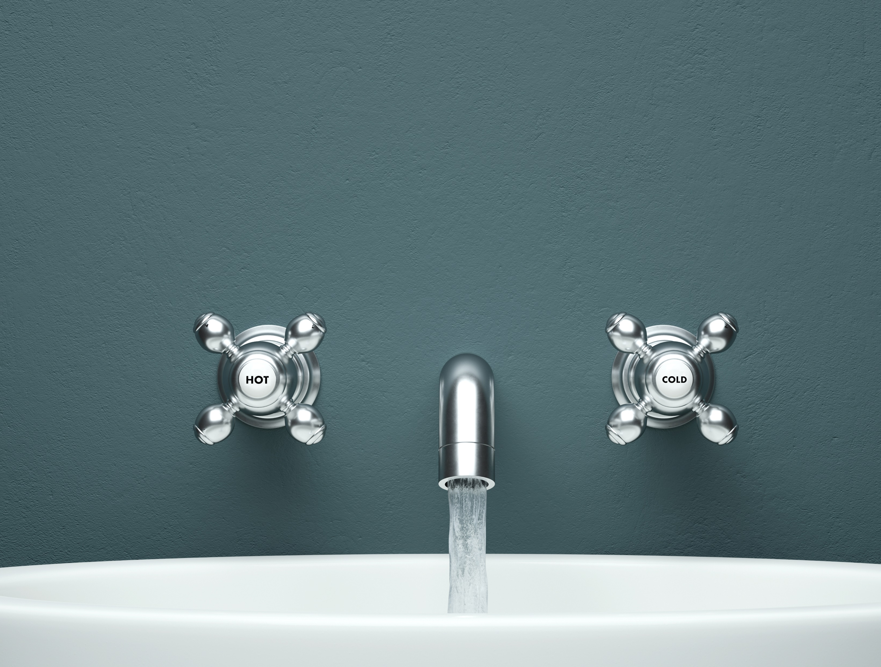
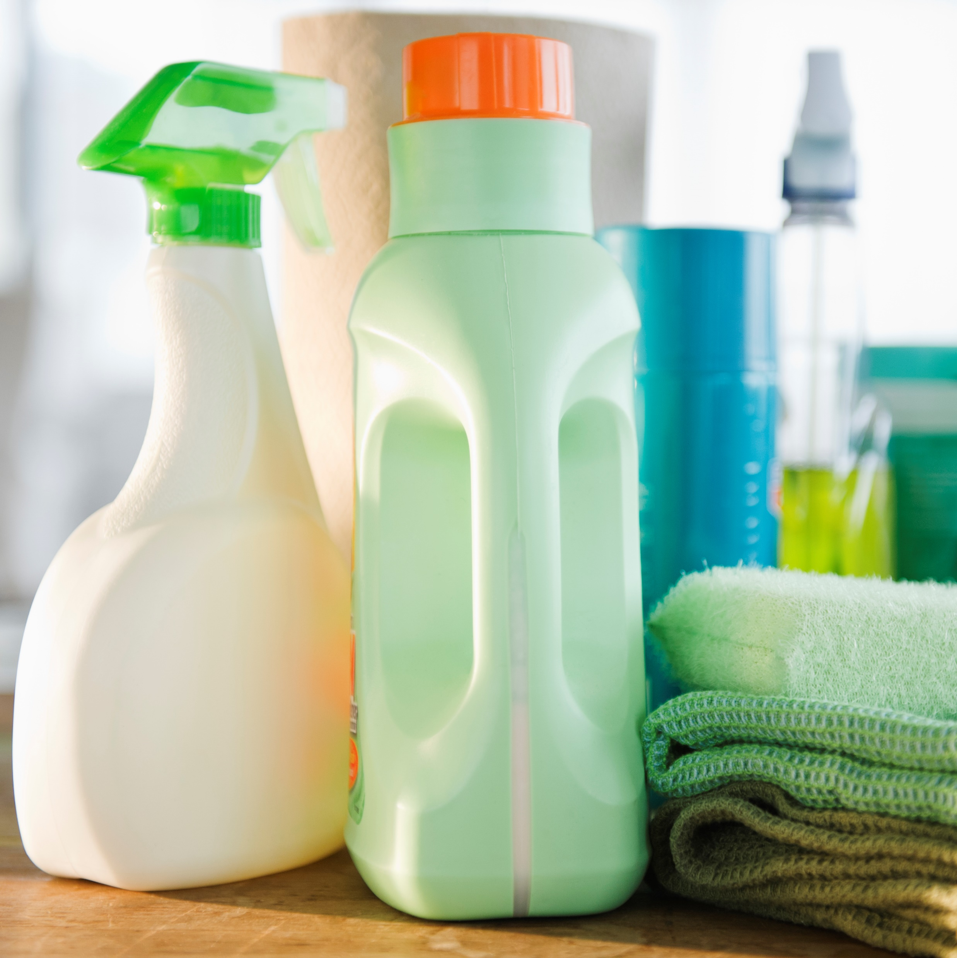
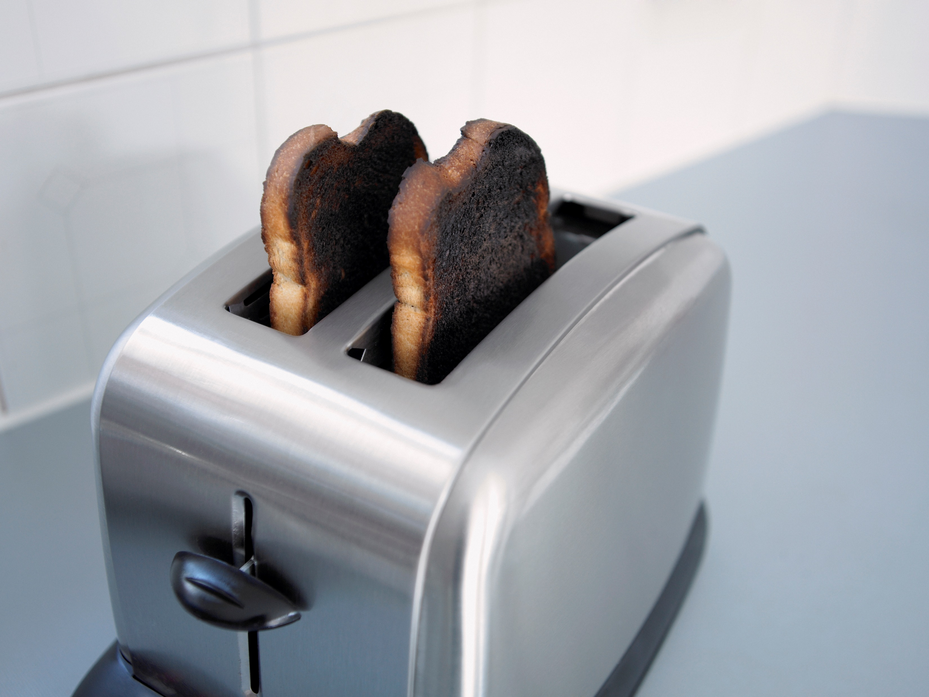


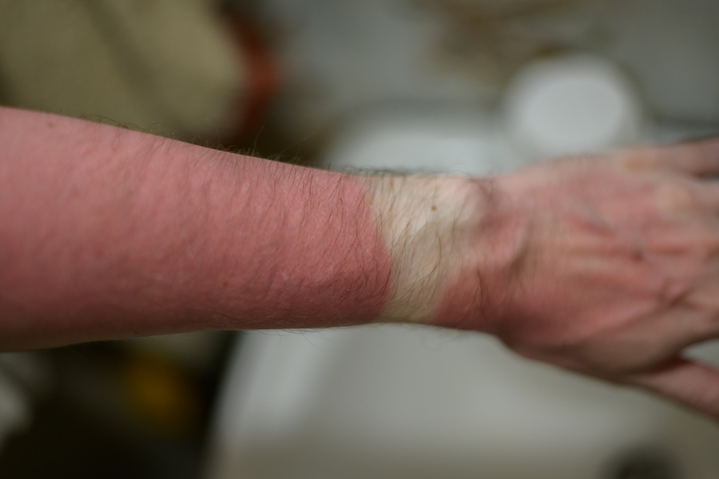



First-Degree Burns are caused by:
Hot Water
Symptoms: red coloring, slight swelling, painful.
Does not have blisters
tsag.net
Notes:
First degree burn only hurt the the top layer of skin. They can be caused by:
Hot water
Some Household cleaners
Stove burners, hot pans, ovens, or toaster ovens
Hair Straighteners and curling irons
Sun burn
Electrical cords or outlets
If an infant or elderly person experiences a burn of any degree, you should seek medical attention. See a doctor for burns that wrap all the way around a body part, such as the leg) and burns to the face, neck, hands, or feet.
Treatment. (n.d.). Canadian Skin Patient Alliance. Retrieved September 27, 2022, from https://canadianskin.ca/burns/45-treatment-1

Slide 3


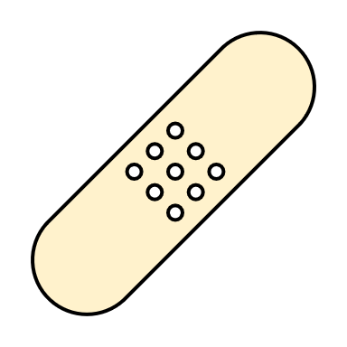
If you get a first degree burn:
1. Remove any clothing or jewelry from the burn area.
3. Cover it with a bandage.
2. Hold the burn under cool water for at least 15 minutes.
tsag.net
Notes:
Added

Slide 4
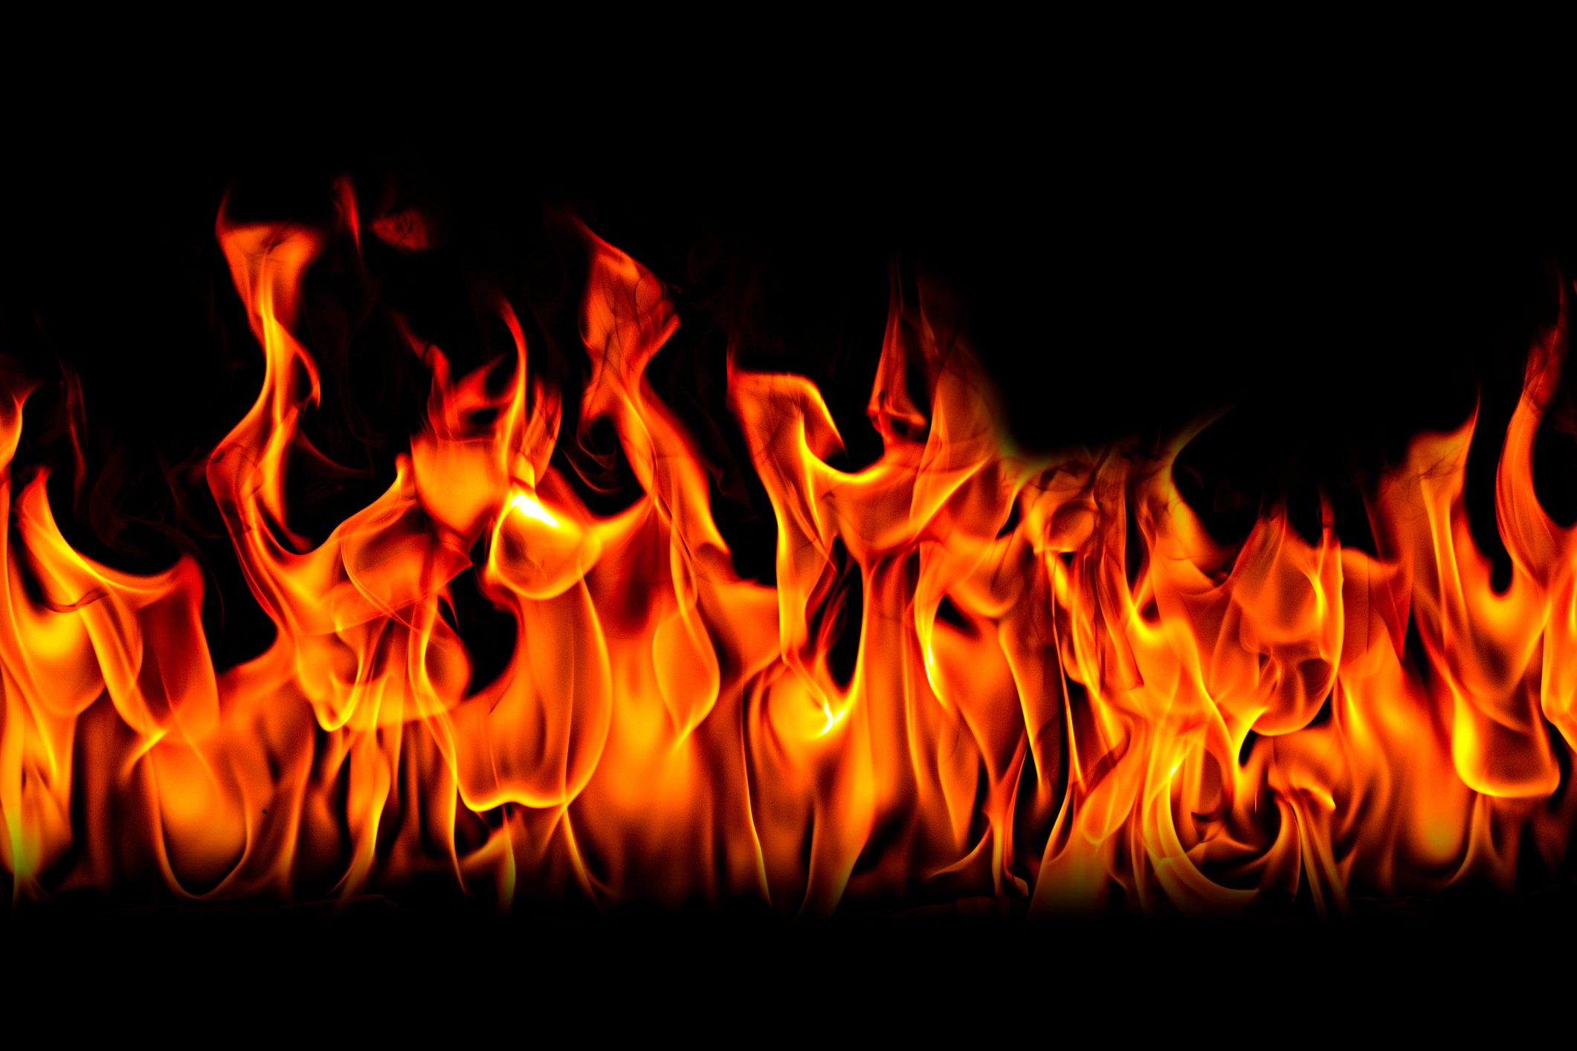
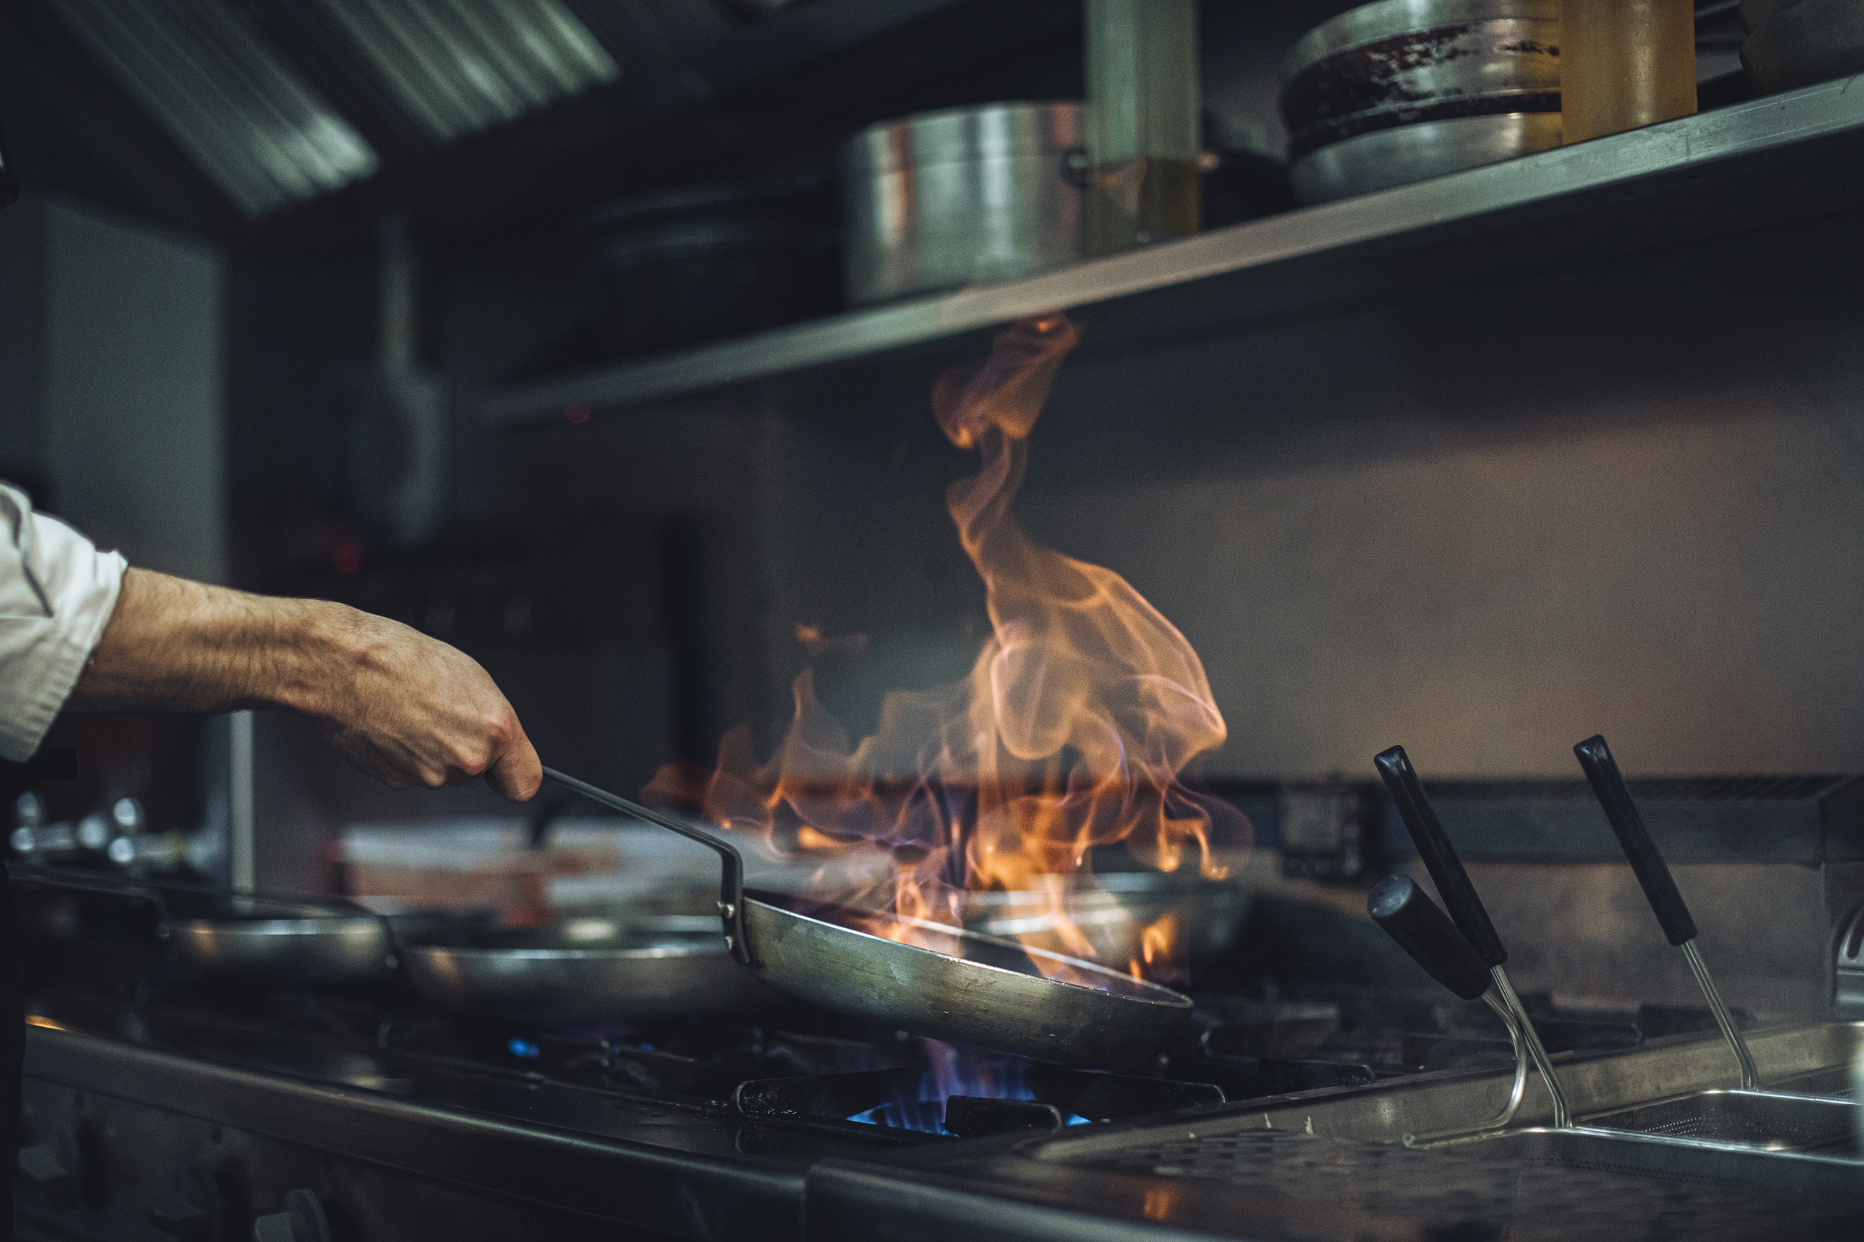
Second-Degree Burns are Caused by:
Hot Water
Symptoms: Can look red and shiny, blisters form, lasting pain.
tsag.net
Notes:
There are two types of second-degree burns. The more mild penetrate the surface layer of skin and into the next layer of skin, the dermis. The more severe second-degree burns go well into the dermis. They cause blistering or open sores on the skin, are more painful, and take longer to heal
Some common causes of second-degree burns include:
severe sunburn,
accidents with ovens and stoves
exposure to fire
contact with boiling water
If an infant or elderly person experiences a burn of any degree, you should seek medical attention. Seek medical attention if the burn area is bigger than 2-3 cm, for burns that wrap all the way around a body part, such as the leg) and burns to the face, neck, hands, or feet.
Treatment. (n.d.). Canadian Skin Patient Alliance. Retrieved September 27, 2022, from https://canadianskin.ca/burns/45-treatment-1

Slide 5

If you get a second degree burn:
4. If it is a mild second- degree burn, cover the burn with antibiotic ointment to keep the burn moist for several days. Seek medical advice is the burn is bigger than 3 inches wide or is on the face, feet hands or across a joint or caused by chemicals or electricity
1. Remove any clothing or jewelry from the burn area.
2. Hold the burn under cool water for at least 15 minutes.
3. Cover it with a bandage.
tsag.net
Notes:
Added

Slide 6
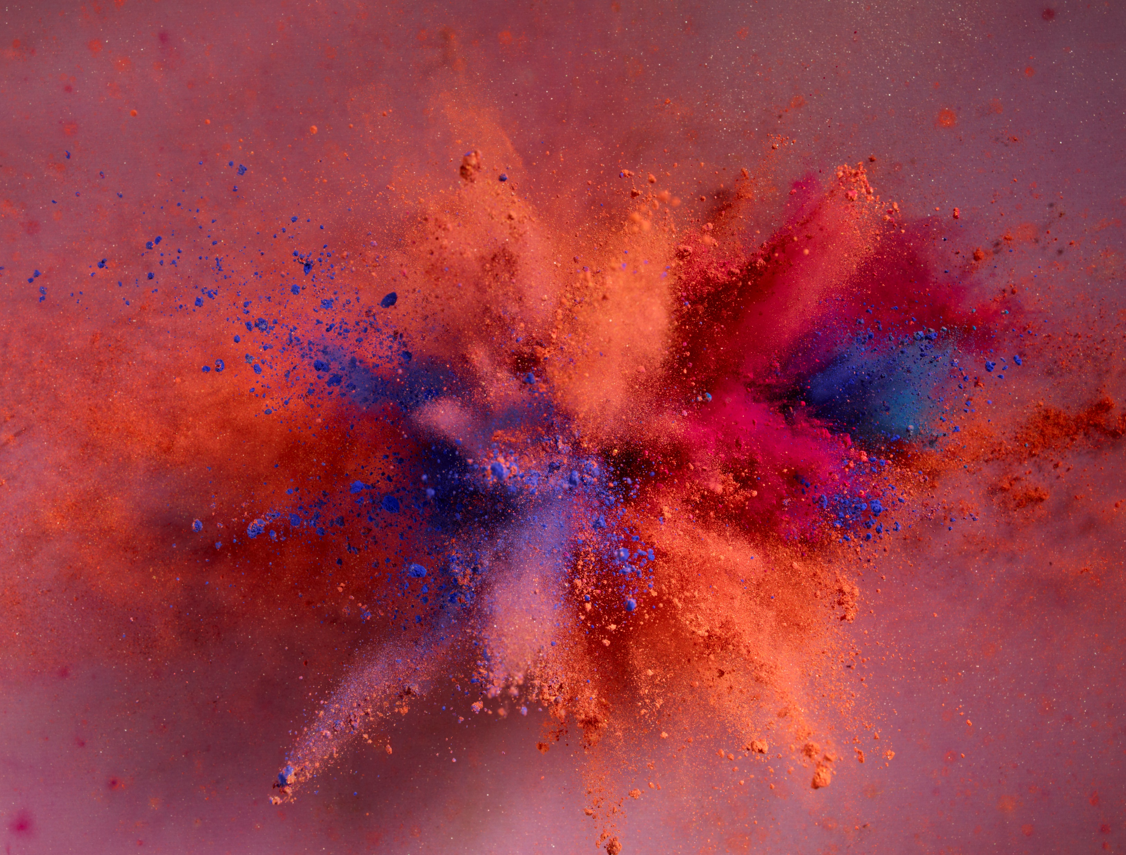
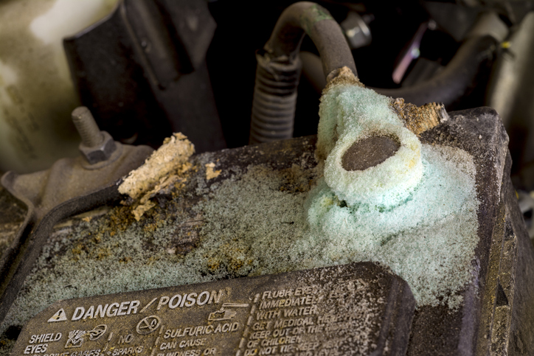
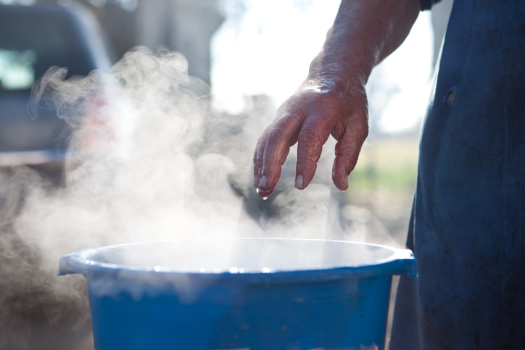
Third and Fourth Degree Burns are Caused by:
Symptoms: Burns may not hurt, may be white, grey, black, brown, yellow, charred, waxy, dry, or leathery. These types of burns require medical attention immediately!
tsag.net
Notes:
Third degree burns are a type of burn go through all layers of skin. The skin dies and turns white. People with third degree burns over large parts of their bodies can go into shock and die.
Fourth degree burns go through the skin, and into the muscle and bones. People can die from these burns they may not hurt because they go so deep that they cause damage to the nerve endings.
These types of burns can be caused by:
flames
flash from an explosion
chemicals such as acids
electricity
scalding liquids
contact with an extremely hot object for an extended period
Always call emergency services for these tpyes of burns
Treatment. (n.d.). Canadian Skin Patient Alliance. Retrieved September 27, 2022, from https://canadianskin.ca/burns/45-treatment-1
Morales-Brown, L. (2021, February 15). What to know about third degree burns. Medical News Today. Retrieved September 27, 2022, from https://www.medicalnewstoday.com/articles/third-degree-burns#causes

Slide 7
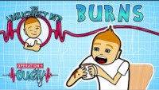
Science for Kids| Bad Burns
Operation Ouch. (2018, January 26). Science for kids – Bad burns | Experiments for kids | Operation Ouch [Video]. YouTube. https://www.youtube.com/watch?v=CRfvCCKFsHk
tsag.net
Notes:
Added

