Slide 1




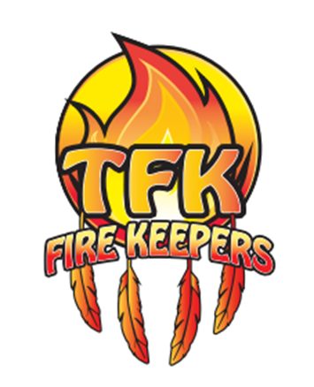
v
Fire Safety Course:
Fire Heroes Grades 7-9
First Nations
Technical Services
Advisory Group Inc.
Fire Prevention is Everyone’s Responsibility
Notes:
Added

Slide 2


Occupational Video- Firefighter
alisWebsite. (2022, April 13). Occupational Video – Firefighter [Video]. YouTube. https://www.youtube.com/watch?v=RFI4-4z5hnE
tsag.net

Slide 3
Meet the Firefighters Who Fight Alberta’s Wildfires
Alberta Environment. (2014, August 1). Meet the firefighters who fight Alberta’s summer wildfires [Video]. YouTube. https://www.youtube.com/watch?v=Qzh2372-QGE
tsag.net
Notes:
Wildland fire fighting involves responding to forest and wildland fires. The hiring qualifications are similar to those of a career fire fighter. As wildland fire fighting tends to be seasonal, many wildland fire fighters are hired on a contract basis.

Slide 4
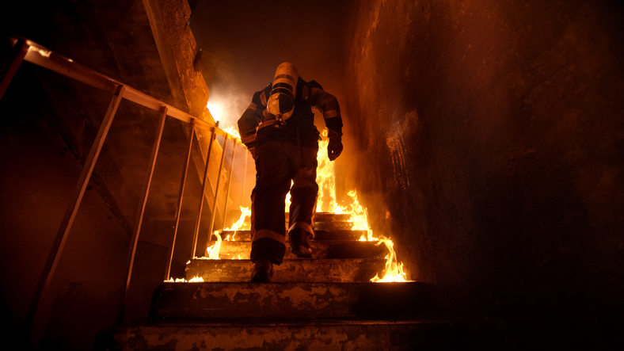
Structural Firefighting
tsag.net
Notes:
“Structural fire fighting involves responding to structural components of various types of residential, commercial or industrial buildings. Residential buildings range from single-family detached homes and townhouses to apartments and tower blocks, or various commercial buildings ranging from offices to shopping malls.” The hiring qualifications are that of a career fire fighter. Depending on the composite fire department the specific requirements for hire may vary from region to region. Firefighters protect the public from the dangers of fire and other hazards by controlling and extinguishing fires, providing pre-hospital care after rescuing people, responding to dangerous goods incidents, maintaining equipment, practicing fire prevention, and assisting emergency services at medical scenes.”
Wikimedia Foundation. (n.d.). Structure fire. Wikipedia. Retrieved November 15, 2022, from https://en.wikipedia.org/wiki/Structure_fire

Slide 5
Industrial Fire Brigade Live Fire Training
OSU Fire Service Training. (2021, January 6). Industrial Fire Brigade Live Fire Training [Video]. YouTube. https://www.youtube.com/watch?v=AvXuHnFexV0
tsag.net
Notes:
Wildland fire fighting involves responding to forest and wildland fires. The hiring qualifications are similar to those of a career fire fighter. As wildland fire fighting tends to be seasonal, many wildland fire fighters are hired on a contract basis.

Slide 6
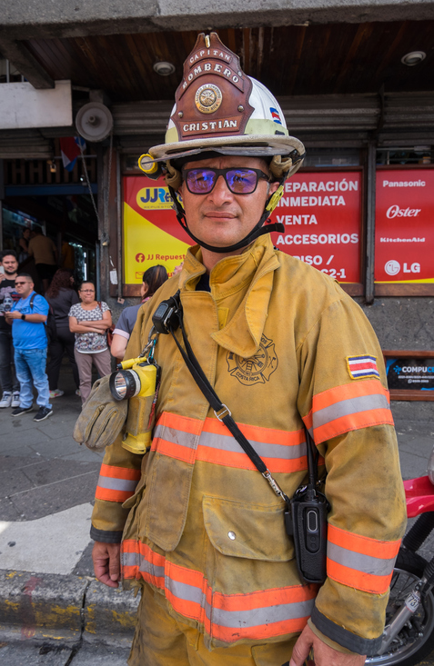
Fire Chief/Senior Fire Fighting Officer
tsag.net
Notes:
Assess the potential fire hazards, anticipate emergency risks, protect lives and the property of citizens, organize fire prevention, and ensuring a firefighting team is capable of carrying out the necessary tasks within a geographic makeup and budget limitations. The Fire Chief is tasked with identifying future staff requirements and equipment needs, assessing the labour/management environment, identifying trends in the fire protection industry, and providing regular reports to administration and council. Progress is reviewed by analyzing community risks, fire loss statistics, and through reports of fire prevention and firefighting activities.

Slide 7
Aboriginal Firefighters Association of Canada - 25 years of fire safety and friendly competition
GCIndigenous. (2014, October 14). Aboriginal Firefighters Association of Canada – 25 years of fire safety and friendly competition [Video]. YouTube. https://www.youtube.com/watch?v=fT8eEuhzd08
tsag.net

Slide 8
Junior Forest Rangers Association
Alberta JFR. (2019, January 31). Junior Forest Rangers [Video]. YouTube. https://www.youtube.com/watch?v=6pC2wwx3Dxw
tsag.net
Notes:
A great way to get started in a firefighting career is Junior Forest Rangers

Slide 9
Junior Forest Rangers Association
https://alis.alberta.ca/junior-forest-rangers/
tsag.net
Notes:
A great way to get started in a firefighting career is Junior Forest Rangers

