Slide 1





v
Fire Safety Course: Family and Community K-1
First Nations
Technical Services
Advisory Group Inc.
Fire Prevention is Everyone’s Responsibility
Notes:
Added

Slide 2

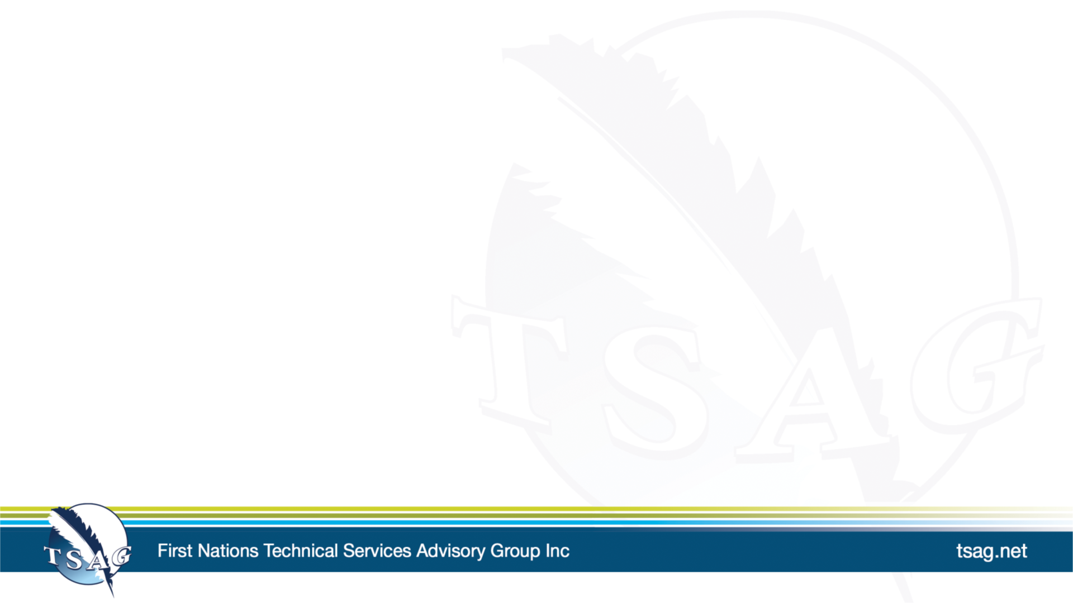
Walk Away or Stay and Play
National Fire Protection Association Kids. (n.d.-j). Walk Away Stay and Play [Video]. https://www.sparky.org/videos?playlistVideoId=6237281914001
tsag.net
Notes:
Added

Slide 3
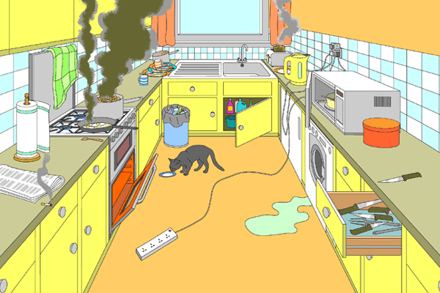
tsag.net
Notes:
What dangers do you see? (Cooking and fire)
Keeping oven and stoves clean is critical. Food scraps left in, near or on microwave, stoves and ovens can start fires.

