Slide 1





v
Fire Safety Course: Fire Facts Grades 7-9
First Nations
Technical Services
Advisory Group Inc.
Fire Prevention is Everyone’s Responsibility
Notes:
Added

Slide 2


The Fire Triangle
Fuel
Air
Heat
tsag.net
Notes:
Fire needs fuel, oxygen, and heat to start.
Fires can move more or less quickly depending on the fuel that they have.
Things that burn easily are plastics, grass, clothing, paper alcohol, nylon, flammable liquids, petroleum products
Things that do no burn as easily are metals, bricks, concrete, rocks, and materials that have been treated with a chemical flame retardant.
What are some examples of fuel?
What makes flammable liquids and gases more dangerous? (they ignite faster and can do more damage)
What are some examples of heat (electric appliance such as heaters, curling irons, stove burners… and flames)
You can put out a fire by taking away one of these three elements. This is called inhibiting a chemical reaction.
You can remove the air by covering up the fire ( like putting a lid on a pot, or rolling on the ground)
You can remove the heat (put water on the fire, or use a fire extinguisher)
You can remove the fuel (take it away from the heat source)

Slide 3
How different Fabrics and Materials Burn
Matthew Rusch. (2013, June 1). How different Fabrics and Materials Burn Cotton, Leather ect [Video]. YouTube. https://www.youtube.com/watch?v=Vio4kleGxhM&t=121s
tsag.net
Notes:
What do you thing the best fabrics are to wear?
Nylon and polyester burn quickly

Slide 4
10 Household Items That Are Highly Flammable
SCIENCE and TECHNOLOGY. (2018, March 5). 10 Household Items That Are Highly Flammable [Video]. YouTube. https://www.youtube.com/watch?v=O1er6VFbp48
tsag.net
Notes:
What does this video tell you about where and how to store certain household items?

Slide 5
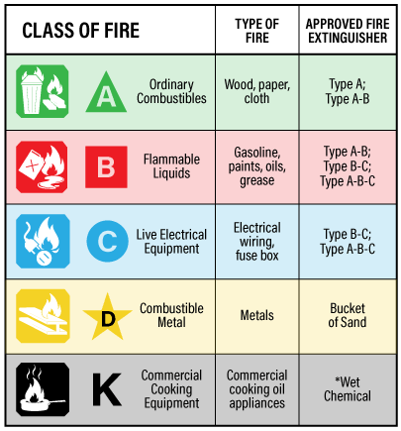
Canadian Centre for Occupational Health and Safety. (2021, March 29). OSH Answers Fact Sheets. Retrieved October 9, 2022, from https://www.ccohs.ca/oshanswers/safety_haz/fire_extinguishers.html
tsag.net
Notes:
There are 5 classes of fires but only 3 really are related to house fires.
CLASS A : In this class, all the materials which are solid in nature and can become ash when burnt. Examples are wood, paper, textiles, rubber, plastic, coal etc. When Solids burn, usually the smoke is White in Colour.
(https://ertseshadri.com/2019/12/19/classification-of-fuel-fire/)
What do you think this means in terms of where and how we store these items? (not near flames or sources of heat)
CLASS B : This class is all about the flammable liquids like paints, oils, grease, gasoline , kerosene, and diesel.
What do you think this means in terms of where and how we store these items?
CLASS C : Electrical Equipment
What are some good tips on how to safely use these items?
There are 3 main types of fire extinguishers: Water, Carbon Dioxide, and dry chemical
Water extinguishers are not as common because they can only put out Type A fires.
Dry Chemical fire extinguishers are the most common type of fire extinguisher separates fire from oxygen and interrupts the chemical process. They contain chemicals that can smother flames and coat fuel with a thin layer of dust.
Type D and K fire extinguishers are not typically used in home fires.

Slide 6
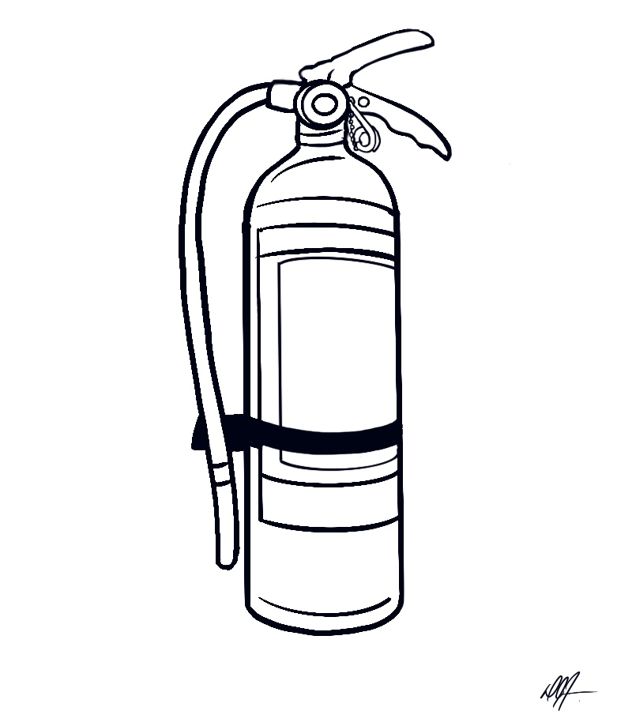
Parts of an ABC Fire Extinguisher
Release Lever
Handle
Pull Pin
Hose
Extinguishing Agent (inside)
Tank
tsag.net
Notes:
The most common type of home extinguisher is an ABC extinguisher because it will put out Type A,B and C types of fires. It is a dry chemical extinguisher.

Slide 7
How to Use a Fire Extinguisher
(fire extinguisher training)
Disaster Survival Skills. (2016, May 23). How To Use A Fire Extinguisher (fire extinguisher training) [Video]. YouTube. https://www.youtube.com/watch?v=Jz_m46qN35c
tsag.net
Notes:
What are some things you shouldn’t do when using a fire extinguisher?

Slide 8
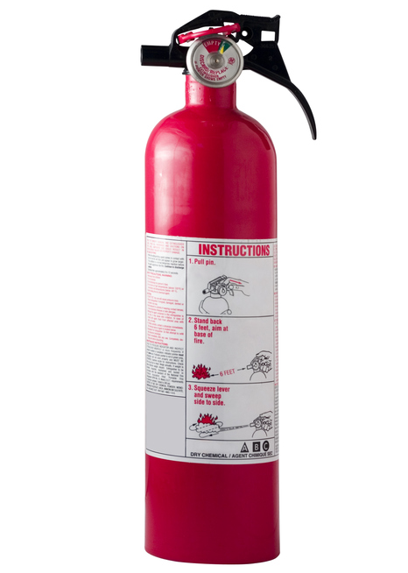
Remember the word PASS.
Pull the pin out of the top of the fire extinguisher. Turn the extinguisher away from your body and press the handle to make sure it works.
Stand a safe distance away from the fire and Aim the nozzle at the base of the fire.
Squeeze the handle to release extinguisher contents.
Move the nozzle from side to side in a Sweeping motion towards the base of the fire.
tsag.net

