Slide 1





v
Fire Safety Course: Grades 7-9 It’s a New Year, Are You Ready?
First Nations
Technical Services
Advisory Group Inc.
Fire Prevention is Everyone’s Responsibility
Notes:
Added

Slide 2


What's So Dangerous About Smoke?
Fire Safety Research Institute. (2022, October 7). What’s So Dangerous About Smoke? [Video]. YouTube. https://www.youtube.com/watch?v=ACjtIa5MU5M
tsag.net
Notes:
Some of the toxic chemicals smoke contains are
Carbon Dioxide-(A colorless, odorless gas that is formed when carbon containing fuel is burned. It can give you headaches, make you dizzy, cause breathing problems, cause vomiting, lose consciousness, increase your heart rate)
Hydrogen cyanide ( this is formed when fibers found in insulation, flooring, furniture and even clothing are not completely burned in a fire). It keeps your lungs from using oxygen).
Soot: made from tiny particles of charred wood, oil coal, metals, soil, and dust- causes breathing issues, heart disease and cancer.
Carbon Monoxide ( a colorless and odorless gas). When you breathe it in, it keeps your blood from carrying oxygen). Symptoms of poisoning include: fatigue, chest pain, impaired vision, headaches, dizziness, confusion, nausea, flu like symptoms (https://molekule.com/blog/where-does-carbon-monoxide-come-from-in-a-home
What can happen when you are exposed to smoke from a house fire? Smoke inhalation, confusion, poor or lack of visibility

Slide 3
How Smoke Detectors Work
engineerguy. (2011, March 6). How smoke detectors work [Video]. YouTube. https://www.youtube.com/watch?v=oFUUQcpGR3k
tsag.net
Notes:
Added

Slide 4
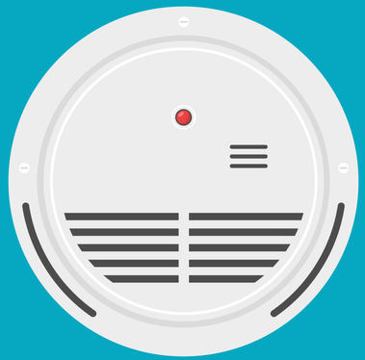
Smoke Detector Checklist
Replace smoke detectors every 10 years (check the manufacturing date on the back).
Change the batteries when you hear the smoke alarm chirp.
Test smoke alarms once a month.
Install smoke alarm on every floor.
Install smoke alarms outside each sleeping area.
Install a smoke alarm inside every bedroom.
Install smoke alarms at least 10 feet away from cooking appliances.
Change the batteries in the smoke detector once a year.
tsag.net
Notes:
Added

Slide 5
Carbon Monoxide Poisoning: Everything You Need to Know
Medical Centric. (2022, May 7). Carbon Monoxide Poisoning: Everything You Need to Know [Video]. YouTube. https://www.youtube.com/watch?v=PqiAtelp-Qc
tsag.net
Notes:
Added

Slide 6
In a Fire
1. Get low and go to the nearest exit.
2. If the door is closed-use the back of your hand to check to make sure it is not hot.
3. If the door is cool, open it slowly to see if there is smoke or fire along your escape route.
4. Go to your family meeting place.
tsag.net
Notes:
Added

Slide 7



If Your Clothing Catches Fire!
tsag.net
Notes:
What does it do when you stop? It stops fanning the flames and avoids having them further scatter on the body. It can also help bystanders put out the fire. When you run or wave your arms the movement fans the flames and can cause the burns to be more severe.
Why should you drop? If there is no one around to help it is best to drop on the ground quickly and cover your face with your hands to prevent burns. Lay flat with your legs out straight so as much of your body as possible is in contact with the ground to smother any flames.
What does it do when you roll?: Rolling over and over smothers the flames and takes the oxygen away from the flames which feeds the fire.

Slide 8
Fire Statistics
1. There are approximately 220 fire-related deaths in
Canada each year.
2. More home fires occur in January to March than other months of the year.
3. At least 1 in 7 fire related deaths occurred in residences without working smoke alarms.
4. At least 1 in 5 residential fire related deaths were caused by cigarettes or other smoking materials.
https://www150.statcan.gc.ca/n1/daily-quotidien/220616/dq220616b-eng.htm
tsag.net
Notes:
What does fact number one tell you?
What does fact number two tell you?
What does fact number three tell you?
What does fact number four tell you?
What can you do in your home? (plan for prevention: ensure there are working smoke alarms, tell your family about fire safety, have an escape plan)

Slide 9
Every Second Counts in a Home Fire
National Fire Protection Association. (2020, March 17). Every Second Counts in a Home Fire – Practice Your Escape Plan [Video]. YouTube. https://www.youtube.com/watch?v=Vc-AkbpdSYk
tsag.net
Notes:
Why do you need a home fire escape plan?

Slide 10
Making a Fire Escape Plan
commerceohio. (2021, October 1). Making a Fire Escape Plan [Video]. YouTube. https://www.youtube.com/watch?v=7qDX3PvmLyE&t=6s
tsag.net
Notes:
What are steps to making your home fire escape plan?
Draw a map of all the rooms in your house.
Mark 2 exits from every room (usually a window and a door)
Mark a path from each exit to the outside.
Choose a meeting place in front of your home where everyone can meet
Put the local emergency number on your plan

Slide 11
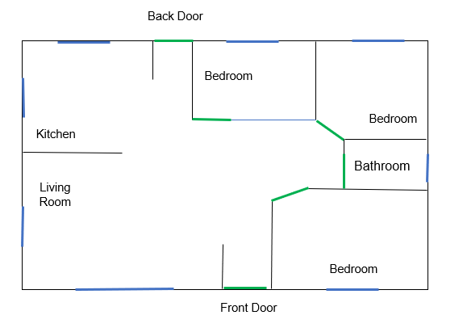
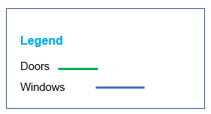

Smoke Alarm
tsag.net

Slide 12
Creating a Fire Escape Plan
Draw a map of all the rooms in your house.
Mark 2 exits from every room (usually a window and a door). You should have a Primary and secondary exit. The primary exit is the easiest one to use and the secondary exit is the back up plan.
Draw the larger pieces of furniture that can help or hinder escape.
Mark a path from each exit to the outside.
Choose a meeting place in front of your home where everyone can meet
Put the local emergency number on your plan.
tsag.net
Notes:
Added

Slide 13
1. Type of Emergency
911
2. Your Name
3. Your Address or GPS Coordinates
4. A Phone Number
tsag.net
Notes:
Added

