Slide 1





v
Fire Safety Course: Grades 2-3 It’s a New Year, Are You Ready?
First Nations
Technical Services
Advisory Group Inc.
Fire Prevention is Everyone’s Responsibility
Notes:
Added

Slide 2
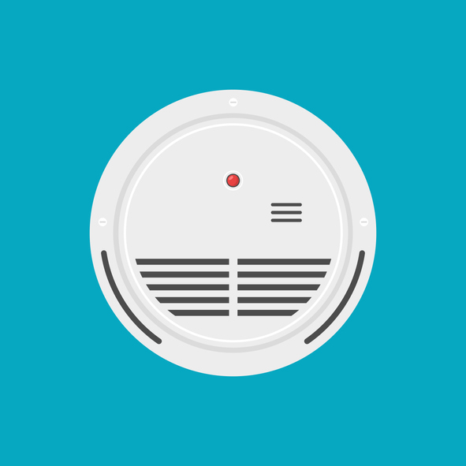


How Do We Know if There is a Fire or Smoke?
Beep!
Beep!
Beep!
tsag.net
Notes:
There are different types of smoke detectors. Some beep and others talk to you. Even though they may sound different they all have the same parts and all have test buttons.
Smoke detectors are loud because it needs to warn everyone in the house-no matter where they are or what they are doing, even sleeping.
Every house should have a smoke detector/one on each floor, outside each sleeping area and in each bedroom.
Smoke alarms should be tested every month by pushing the test button (show the button). They also need new batteries every year.

Slide 3
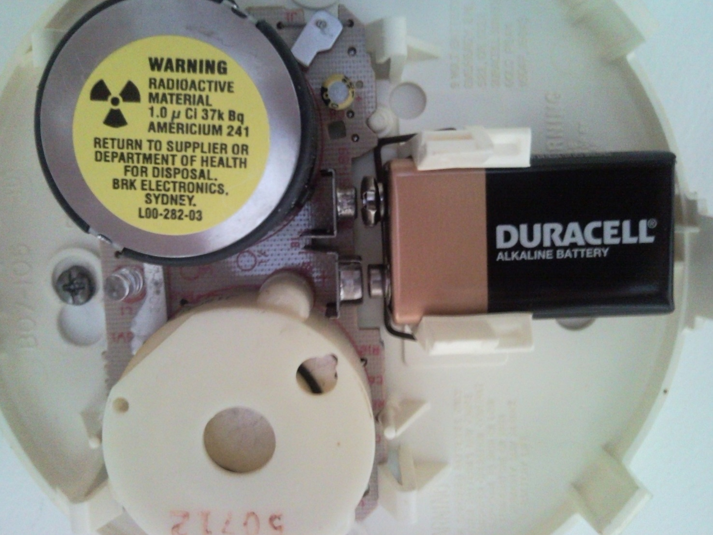
Smoke Detector Parts
Beeper
Battery
Nose
tsag.net
Notes:
Smoke Detectors work by detecting fires by sensing small particles in the air. When there is a high count of those smoke particles this signals the alarm.

Slide 4
Learn the Sounds of Fire Safety
National Fire Protection Association Kids. (n.d.-g). NFPA - Learn the Sounds of Fire Safety [Video]. https://www.sparky.org/videos?playlistVideoId=6272543525001
tsag.net
Notes:
What should you do if you hear a smoke alarm?
Where should there be smoke detectors in every house?
What about if you smell smoke but don’t hear an alarm?
What do you think you should do if you smell smoke or see a fire starting on the stove or in another area of your house? (Yell fire and get an adult)

Slide 5

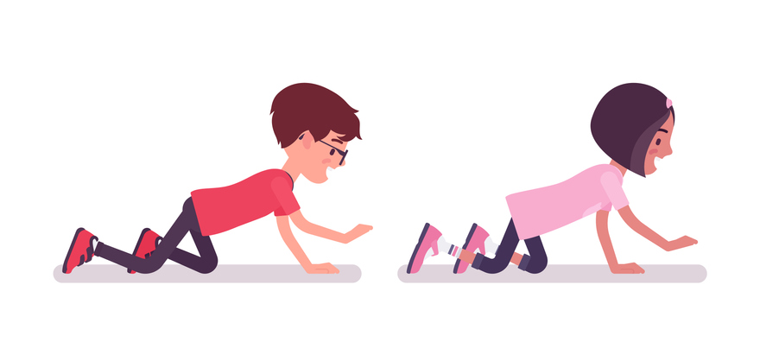
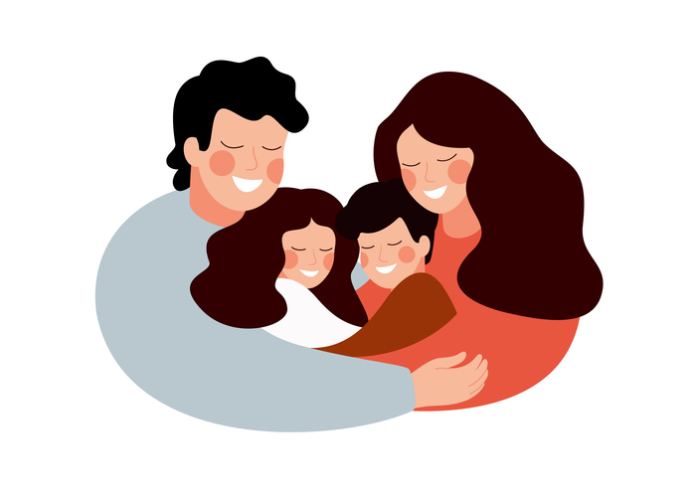
What To Do If You Hear The Fire Alarm!
Beep!
Beep!
Beep!
1. Hear the fire alarm
2. Get low and get out
3. Meet up with your family
tsag.net
Notes:
Added

Slide 6


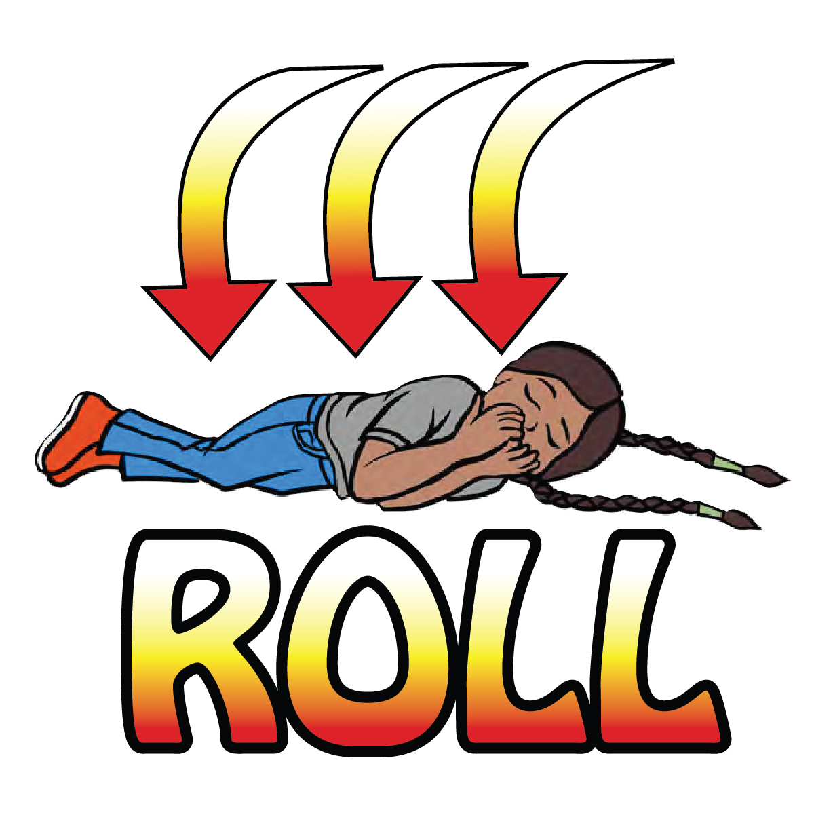
If Your Clothing Catches Fire!
tsag.net
Notes:
WHEN WE ROLL IT SQUISHES THE FLAMES AND TAKES THE OXYGEN AWAY FROM THE FLAMES WHICH FEEDS THE FIRE

Slide 7
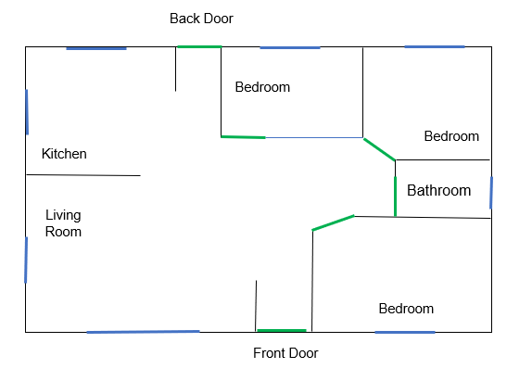
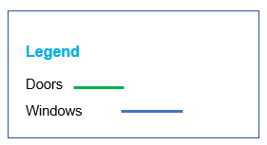
tsag.net
Notes:
Added

Slide 8
1. Type of Emergency
911
2. Your Name
3. Your Address
4. A Phone Number
tsag.net
Notes:
Added

