Slide 1





v
Fire Safety Course: Grades 10-12 It’s a New Year, Are You Ready?
First Nations
Technical Services
Advisory Group Inc.
Fire Prevention is Everyone’s Responsibility
Notes:
Added

Slide 2


Smoke inhalation most common cause of death in house fires
NewsNation. (2022, January 11). Smoke inhalation most common cause of death in house fires | Morning in America [Video]. YouTube. https://www.youtube.com/watch?v=Sp1gfos8CdQ
tsag.net

Slide 3
Smoke and Carbon Monoxide Detectors
AMRE Supply. (2018, March 12). Smoke & Carbon Monoxide Detectors | Spec. Sense [Video]. YouTube. https://www.youtube.com/watch?v=JNnnxe6ze78
tsag.net
Notes:
Smoke detectors play a vital role in preventing tragedies. In fact, smoke detectors cut the risk of dying in a fire by 55%. (http://albertachoralfederation.ca/household-smoke-detectors-what-kind-do-you-need/)
Where should smoke detectors be placed?
Why should they be place high on a wall or ceiling? (warm air rises and so as soon as the smoke rises we are alerted of its presence)

Slide 4
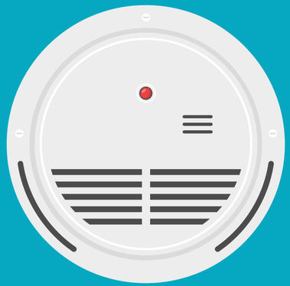
Smoke Alarm Checklist
Replace smoke detectors every 10 years (check the manufacturing date on the back).
Change the batteries when you hear the smoke alarm chirp.
Test smoke alarms once a month.
Install smoke alarm on every floor.
Install smoke alarms outside each sleeping area.
Install a smoke alarm inside every bedroom.
Install smoke alarms at least 10 feet away from cooking appliances.
Change the batteries in the smoke detector once a year.
tsag.net
Notes:
Added

Slide 5
In a Fire
1. Get low and go to the nearest exit.
2. If the door is closed-use the back of your hand to check to make sure it is not hot.
3. If the door is cool, open it slowly to see if there is smoke or fire along your escape route.
4. Go to your family meeting place.
tsag.net
Notes:
Added

Slide 6



If Your Clothing Catches Fire!
tsag.net
Notes:
If your clothing should ever catch fire you need to stop, drop and roll.
What does it do when you stop? It stops fanning the flames and avoids having them further scatter on the body. It can also help bystanders put out the fire. When you run or wave your arms the movement fans the flames and can cause the burns to be more severe.
Why should you drop? If there is no one around to help it is best to drop on the ground quickly and cover your face with your hands to prevent burns. Lay flat with your legs out straight so as much of your body as possible is in contact with the ground to smother any flames.
What does it do when you roll?: Rolling over and over smothers the flames and takes the oxygen away from the flames which feeds the fire.

Slide 7
Fire Statistics
1. Fire incidence rates for First Nations are 2.4 times higher than for the rest of Canada.
2. First Nations residents are also 10 times more likely to die in a house fire.
3. Between 2010 and 2016, at least 173 First Nations People in Canada lost their lives in house fires.
4. At least 25 of the 173 people were children.
https://www150.statcan.gc.ca/n1/daily-quotidien/220616/dq220616b-eng.htm
tsag.net
Notes:
What does fact number one tell you?
What does fact number two tell you?
What does fact number three tell you?
What does fact number four tell you?
What can you do in your home? (plan for prevention: ensure there are working smoke alarms, tell your family about fire safety, have an escape plan)

Slide 8
Bedroom Fire Test
LancashireFire. (2013, March 7). Bedroom Fire Test [Video]. YouTube. https://www.youtube.com/watch?v=ezJ6SorlpJo
tsag.net
Notes:
You may have as little as 2 minutes to get out of the house after the smoke alarm sounds. This is because the smoke has to be thick enough to activate the alarm. By the time you hear it, the fire is already very large.
What does this tell you about getting out alive? ( you need an escape plan)

Slide 9
Making a Fire Escape Plan
commerceohio. (2021, October 1). Making a Fire Escape Plan [Video]. YouTube. https://www.youtube.com/watch?v=7qDX3PvmLyE&t=6s
tsag.net
Notes:
What are steps to making your home fire escape plan? See next slide

Slide 10
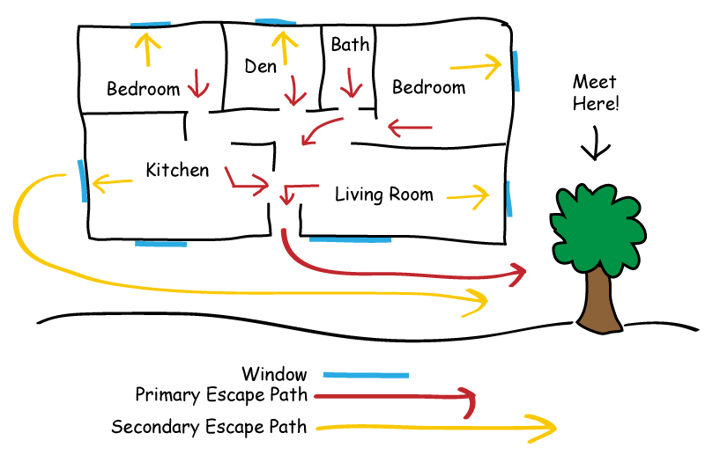
tsag.net

Slide 11
Creating a Fire Escape Plan
Draw a map of all the rooms in your house.
Mark 2 exits from every room (usually a window and a door). You should have a Primary and secondary exit. The primary exit is the easiest one to use and the secondary exit is the back up plan.
Draw the larger pieces of furniture that can help or hinder escape.
Mark a path from each exit to the outside.
Choose a meeting place in front of your home where everyone can meet
Put the local emergency number on your plan.
tsag.net
Notes:
Added

Slide 12
Fire Escape Plan Checklist
We have a plan of 2 ways to get out of every room in the house.
We all know 2 ways out of every room.
We know who will take care of Elders, babies, and pets.
All windows and door are easy to get to (nothing in the way).
All windows and doors open easily.
We have decided on a safe meeting place in front of our house.
Everyone knows the emergency number to call.
Everyone knows about the emergency plan.
tsag.net
Notes:
Added

Slide 13
Fire Escape Plan Checklist
We practice our fire drill twice each year.
We know not to go back into a burning building.
We know to always shut doors behind you.
There are smoke alarms in every room.
Everyone knows not to open doors that are hot to the touch.
We can get out of the house in under 2 minutes.
We all know to crawl or get low to stay under smoke.
We have a paper copy of the emergency plan posted in the house.
tsag.net
Notes:
Added

Slide 14
1. Type of Emergency
911
2. Your Name
3. Your Address or GPS Coordinates
4. A Phone Number
tsag.net
Notes:
Added

