Slide 1





v
Fire Safety Course: 2-3
Holiday Safety
First Nations
Technical Services
Advisory Group Inc.
Fire Prevention is Everyone’s Responsibility
Notes:
Added

Slide 2



tsag.net
Notes:
If it is real- water it every day
Keep it away from fireplaces, candles or heaters

Slide 3
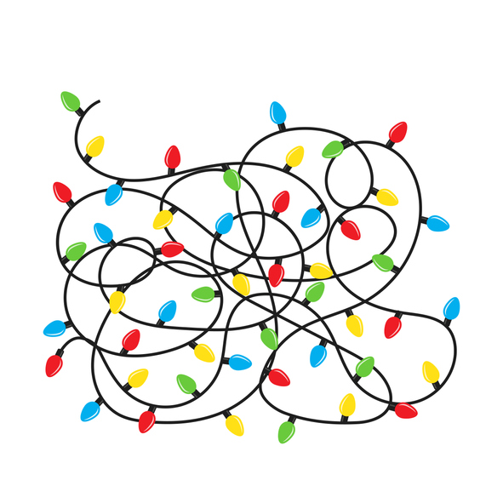
tsag.net
Notes:
Check each set of lights, for broken or cracked sockets, frayed or bare wires, or loose connections, and throw out damaged sets.
Use no more than three sets of lights in one extension cord.
Turn off all lights when you go to bed or leave the house.

Slide 4
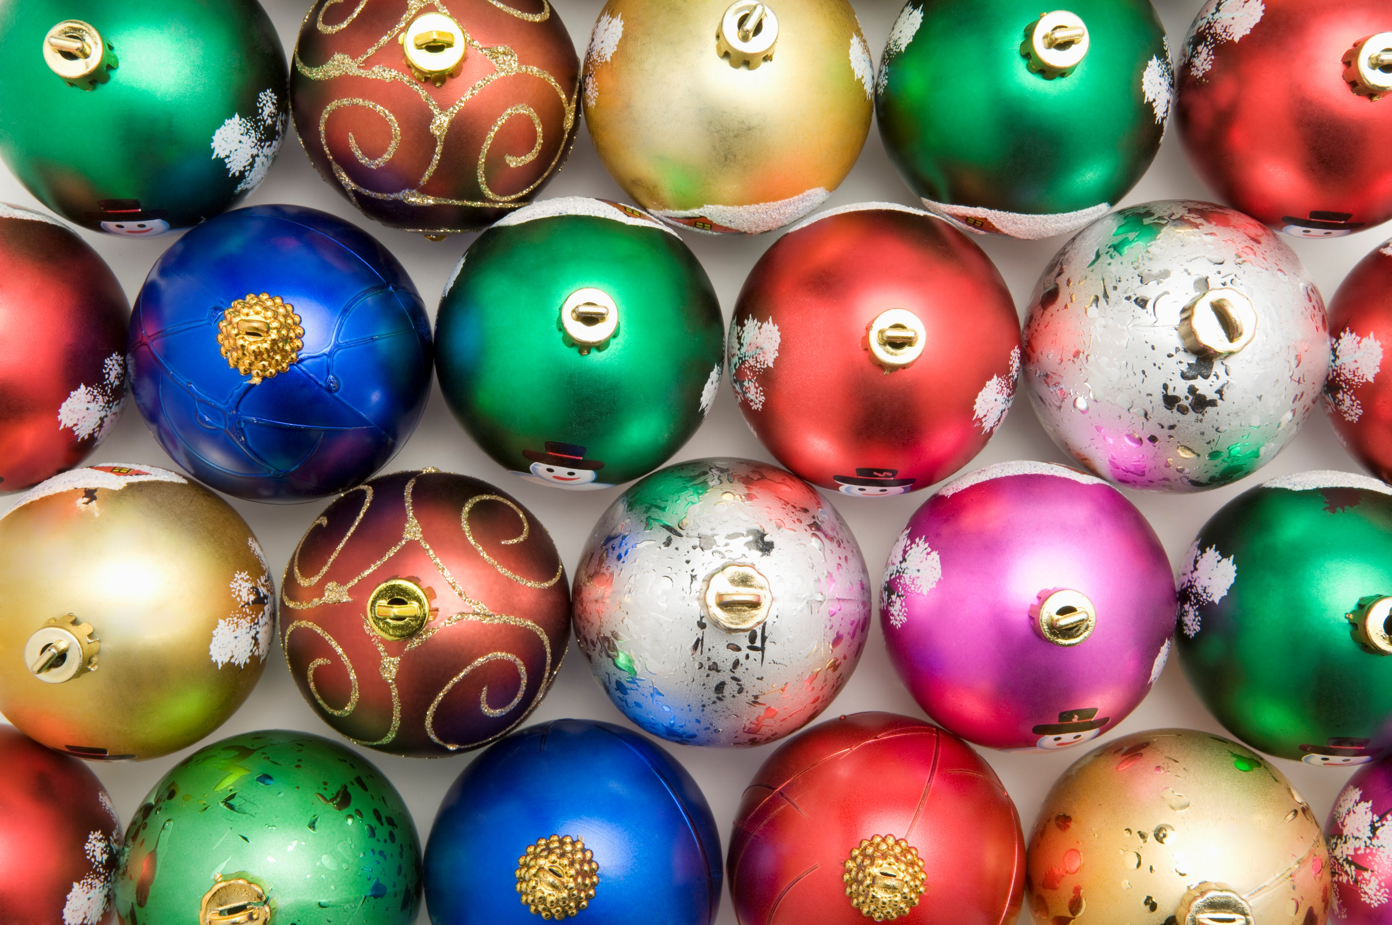
tsag.net
Notes:
Only use decorations that are nonflammable

Slide 5
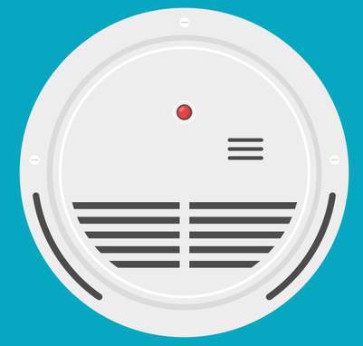
tsag.net
Notes:
Test your smoke alarms to make sure they are working.
Make sure there is one outside all sleeping areas

Slide 6
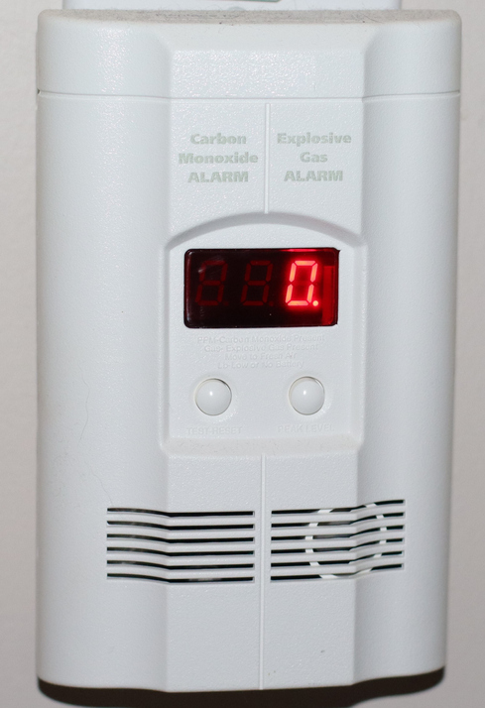
tsag.net
Notes:
Carbon monoxide can come from wood burning stoves, gas stoves engines and kerosene heaters
Make sure you have one in your home

Slide 7
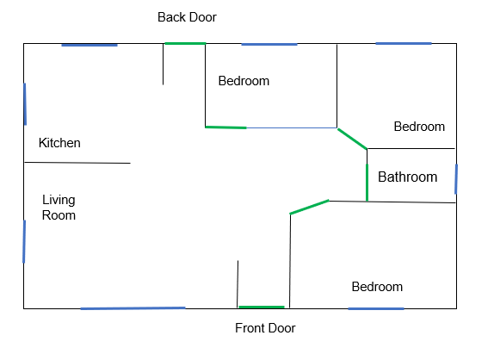
tsag.net
Notes:
Make sure you have a fire escape plan and everyone knows where to meet

Slide 8
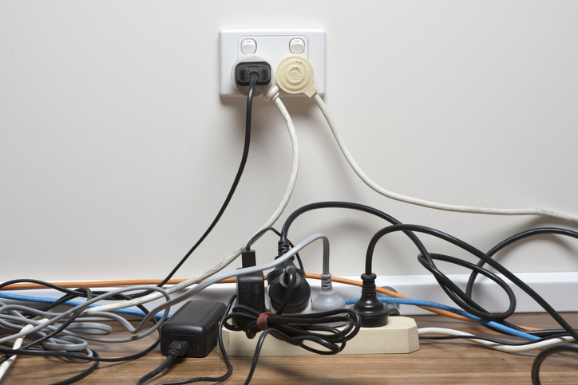
tsag.net
Notes:
Make sure you don’t have too many items plugged into the same extension cord
Never put them under rugs

Slide 9
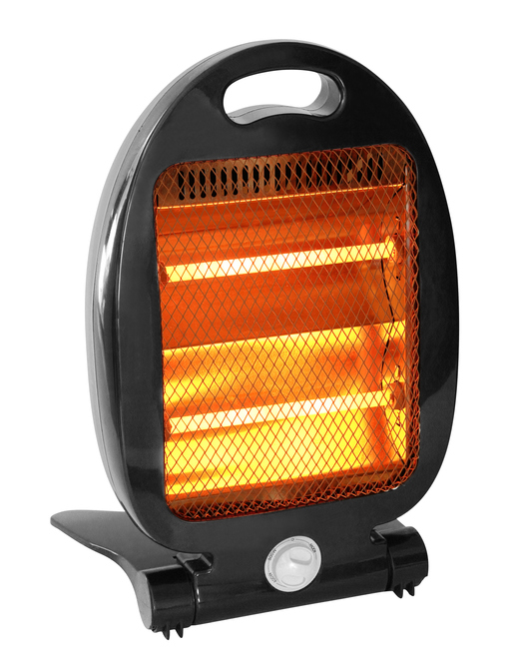
tsag.net
Notes:
Keep space heaters at least one meter from anything that can burn (curtains, decorations, furniture)

Slide 10
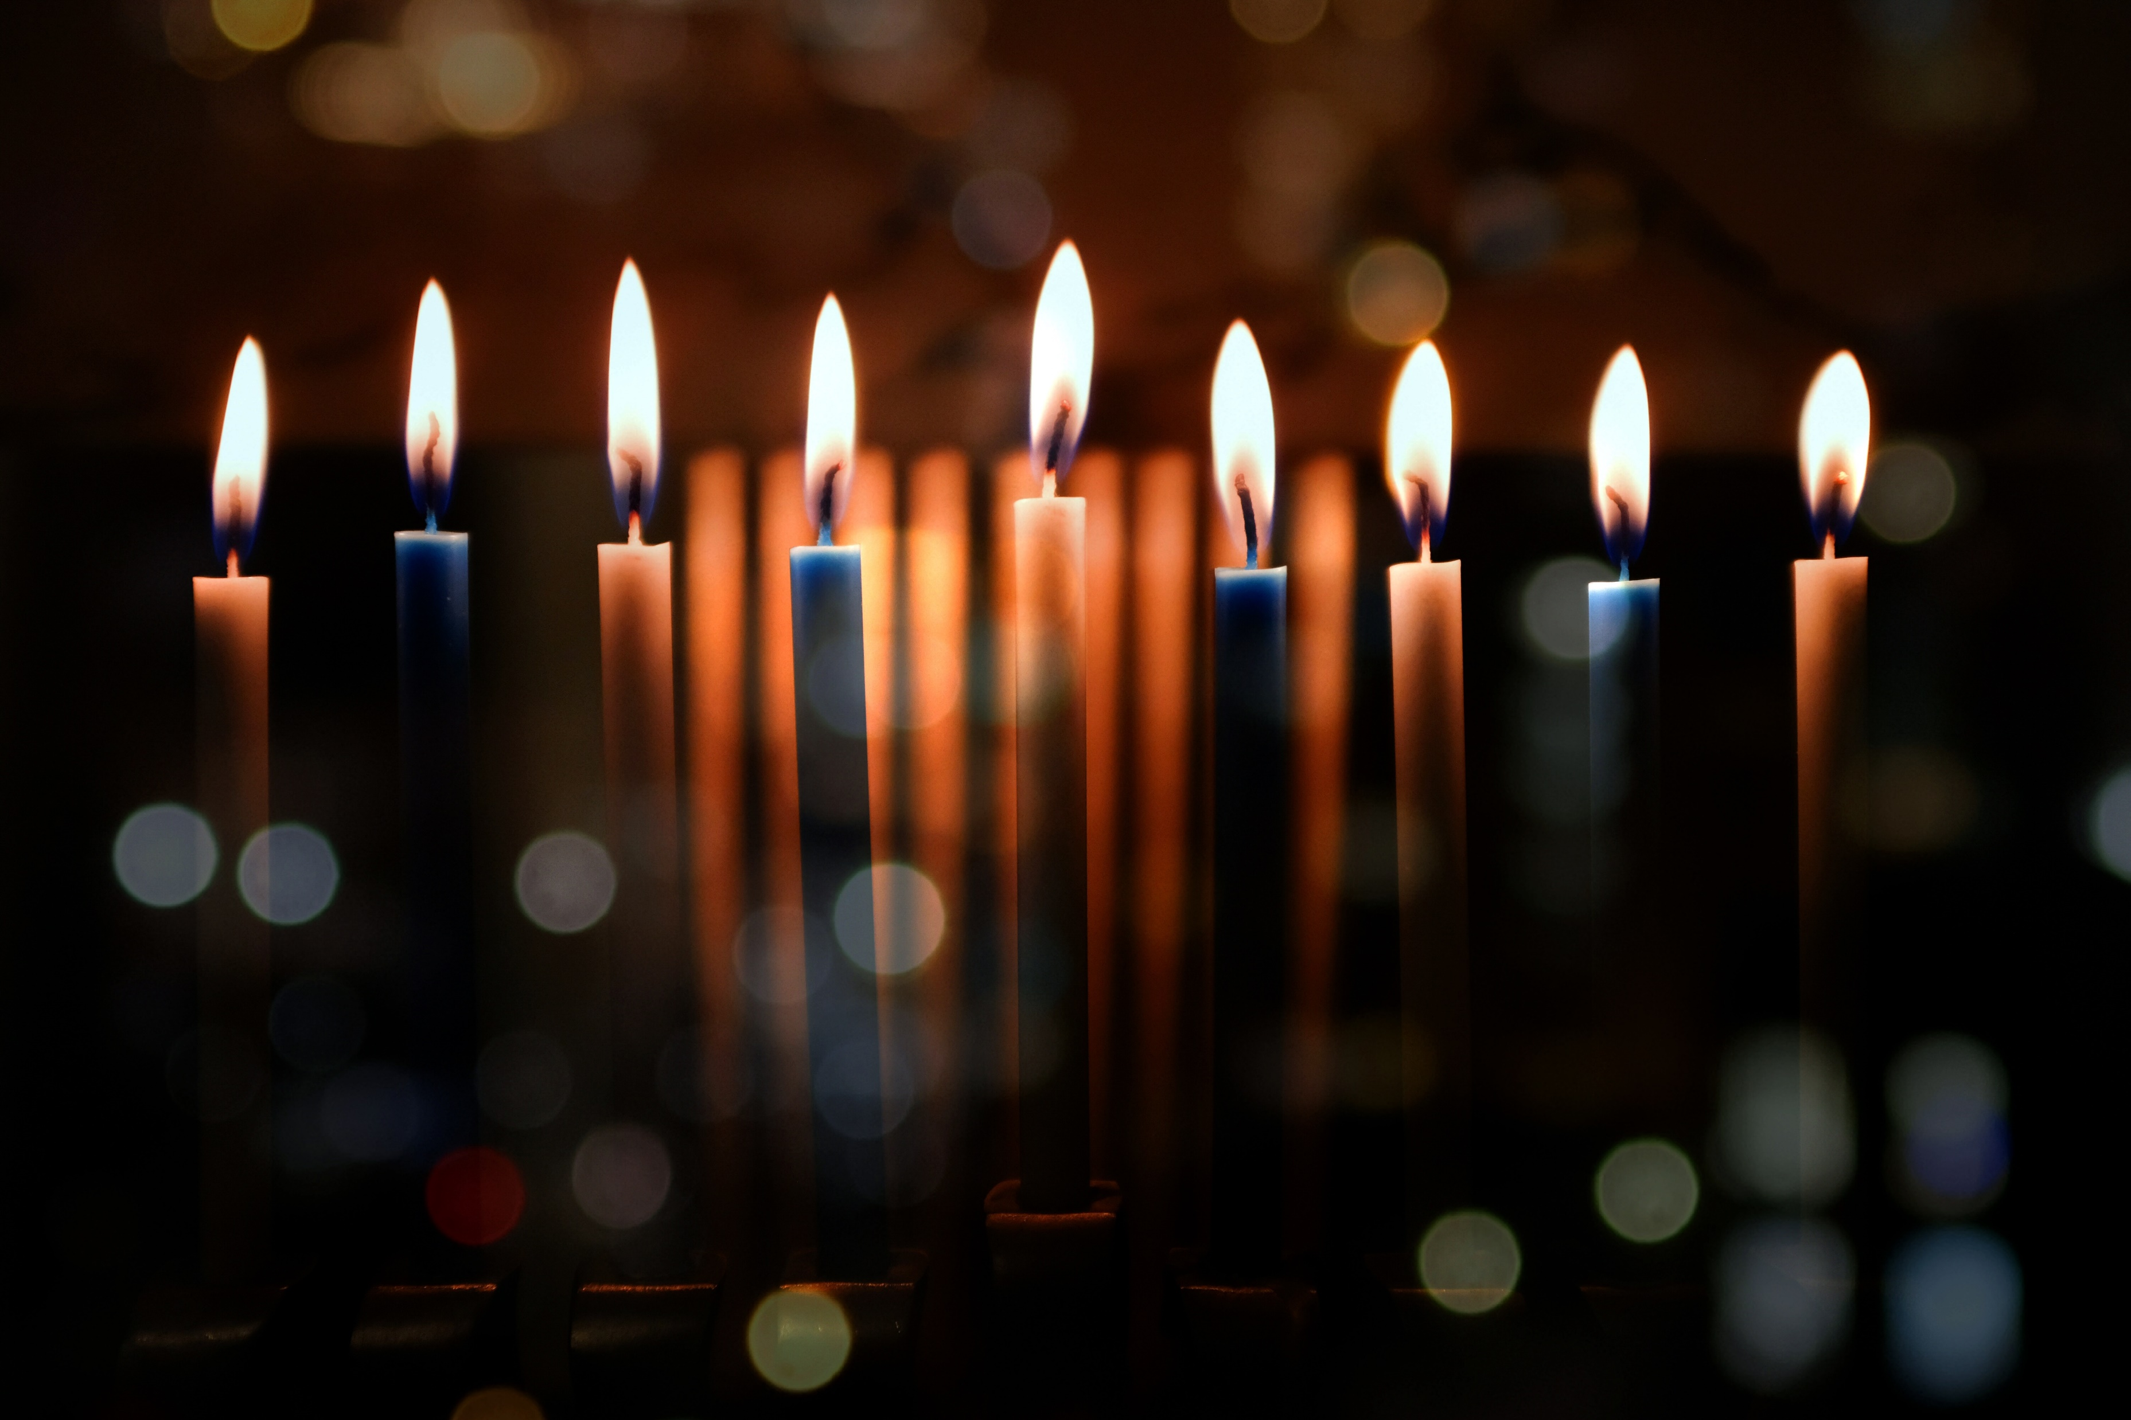
tsag.net
Notes:
Always make sure someone puts them out before bed, or when they leave the room or house
Keep them away from children and pets
Keep them away from anything that can burn (curtains, furniture, clothing, decorations)
Never let candles burn out completely. Extinguish them when they get to within two inches of the holder or decorative material.

Slide 11
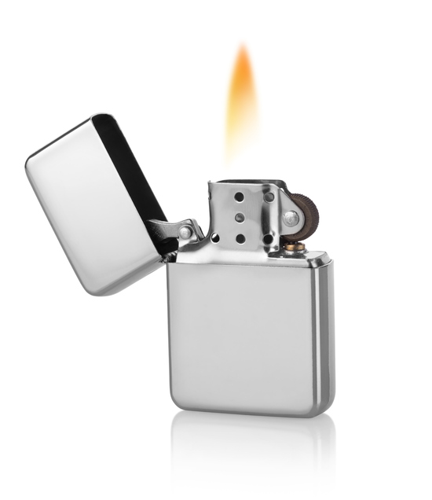
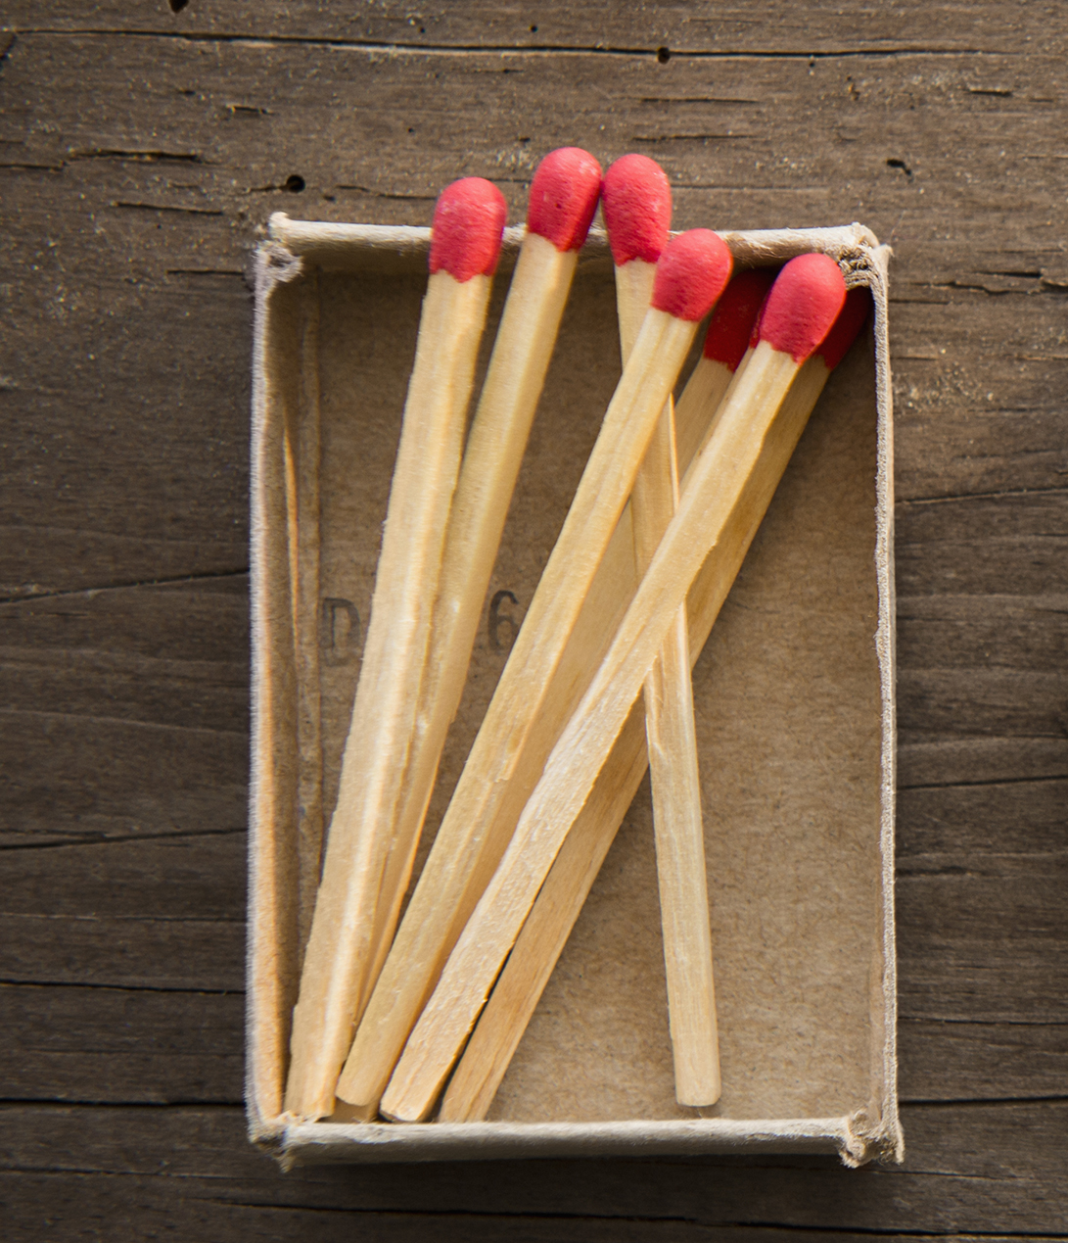
tsag.net
Notes:
Keep lighters and matches safety out of sight and reach of children

Slide 12
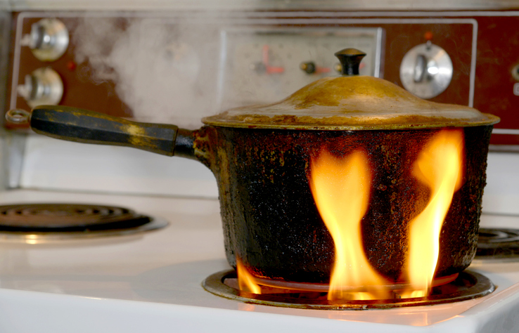
tsag.net
Notes:
Keep pot handles out of reach of children
Watch food when you are cooking
Don’t play near a stove or oven

Slide 13

tsag.net
Notes:
Do not touch burning cigarettes
Ask people to smoke outside
Make sure they put out their cigarettes completely

Slide 14
Holiday Fire Safety
U.S. Fire Administration. (2019, December 2). Holiday Fire Safety [Video]. YouTube. https://www.youtube.com/watch?v=ixPiiw81nOY
tsag.net
Notes:
Added

