Slide 1





v
Fire Safety Course: K-1
Holiday Safety
First Nations
Technical Services
Advisory Group Inc.
Fire Prevention is Everyone’s Responsibility
Notes:
Added

Slide 2
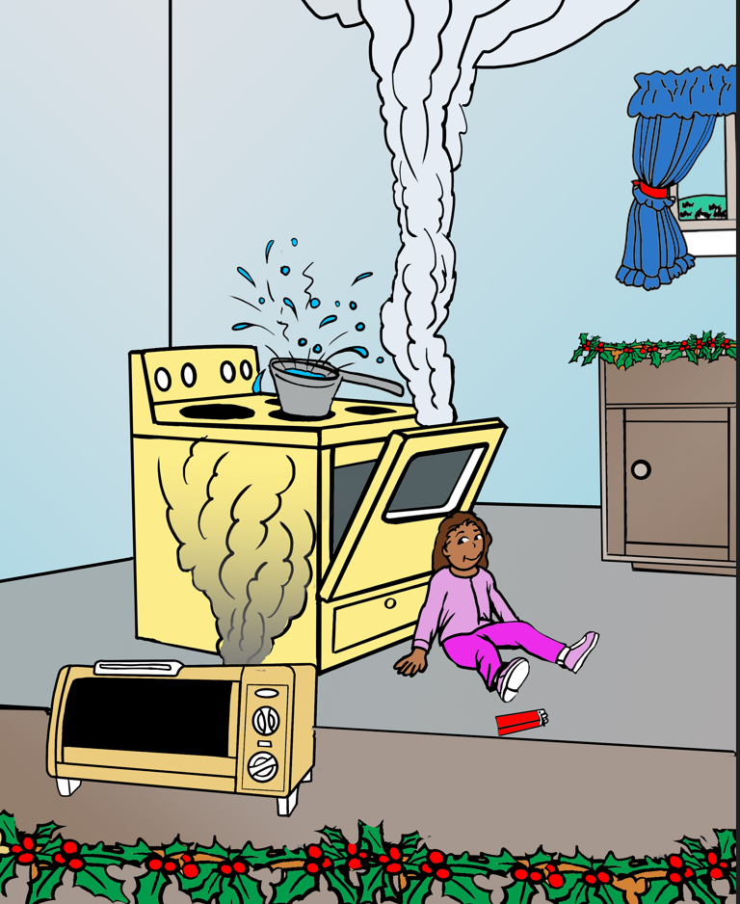
Spot The Fire Dangers
Notes:
Does any one know how far away from a stove you should stand? (1 meter)
Should you ever touch pot handles, kettles, or anything that just came off the stove or out of the oven?

Slide 3
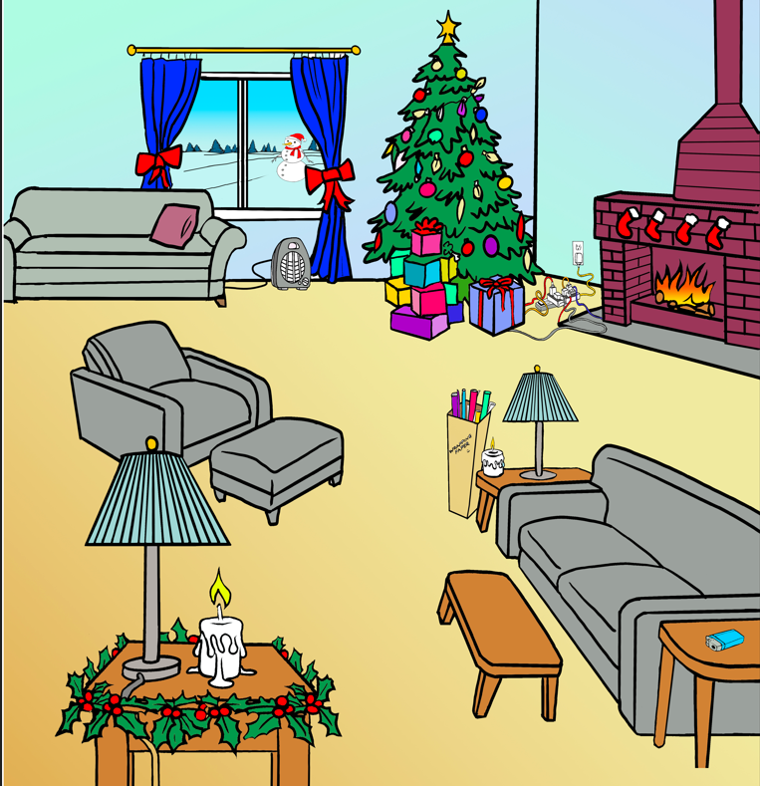
Spot The Fire Dangers
Notes:
Why should tree lights be unplugged when you leave the house and at night?
Why shouldn’t you plug too many things into one electrical outlet or extension cord?
Should you play with candles?

Slide 4

P.I. Plug's Holiday Safety Video
Electrical Safety Foundation International (ESFI). (2011, September 19). P.I. Plug’s Holiday
Safety Video [Video]. YouTube. https://www.youtube.com/watch?v=plgjUCqXSGI
tsag.net
Notes:
What are some of the holiday safety rules that you noticed in this video?

