Slide 1





v
Fire Safety Course: 4-6
Holiday Safety
First Nations
Technical Services
Advisory Group Inc.
Fire Prevention is Everyone’s Responsibility
Notes:
Added

Slide 2


Kitchen Fire Safety
Ontario First Nations Technical Services Corporation. (2021, October 3). Kitchen Fire Safety | English Version [Video]. YouTube. https://www.youtube.com/watch?v=oAvTuvTNMB4
tsag.net
Notes:
What are some kitchen safety tips you learned from the video?
What do you do if something in a pot caught fire?
What do you do if something in the oven caught fire?
What other kinds of things might come into contact with a hot burner and start a fire? (shirt sleeves, potholders, oven mitts, tea towels, wooden spoons, grease, plastics)
Keeping oven and stoves clean is critical. Food scraps left in, near or on microwave, stoves and ovens can start fires.

Slide 3
Microwave Safety
MDFR Kids. (2020, October 7). Fire Prevention Week 2020: Microwave Safety [Video]. YouTube. https://www.youtube.com/watch?v=GkHEia0-2qM
tsag.net
Notes:
What are some of the things that should not go in the microwave?
Should you leave cooking unattended?
Can you think about any other microwave safety ideas (what about watching cooking times- don’t over cook?

Slide 4
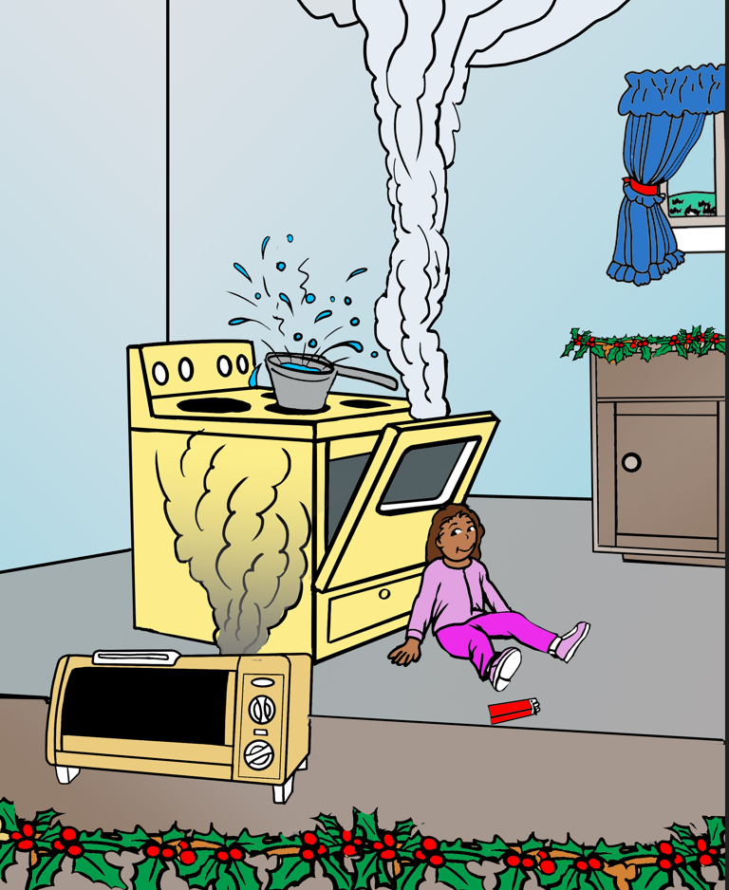
What Fire Hazards Do You See?
Notes:
Can you think of any other fire or burn hazards that might be found in the kitchen?

Slide 5
Christmas Fire Safety Tips for Families & Kids
Educational Videos for Students (Cartoons on Bullying, Leadership & More). (2016, December 13). Christmas Fire Safety Tips for Families & Kids (Educational Videos or Students) [Video]. YouTube. https://www.youtube.com/watch?v=ukiS4zfg1VY
tsag.net

