Slide 1




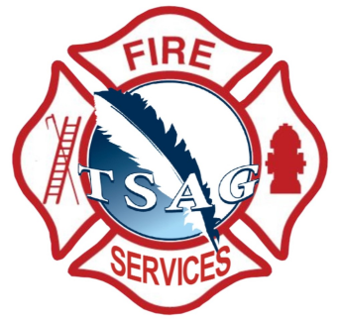
v
Fire Safety Course: K-1 Fire Facts
First Nations
Technical Services
Advisory Group Inc.
Fire Prevention is Everyone’s Responsibility
Notes:
Added

Slide 2

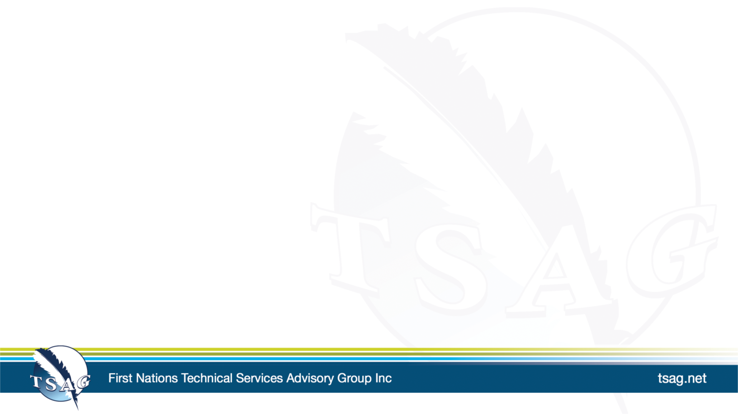
Hot, Not Hot or Sometimes Hot
National Fire Protection Association Kids. (n.d.-c). Hot, Not Hot, or Sometimes Hot [Video]. https://www.sparky.org/videos?playlistVideoId=6237281189001
tsag.net
Notes:
Added

Slide 3
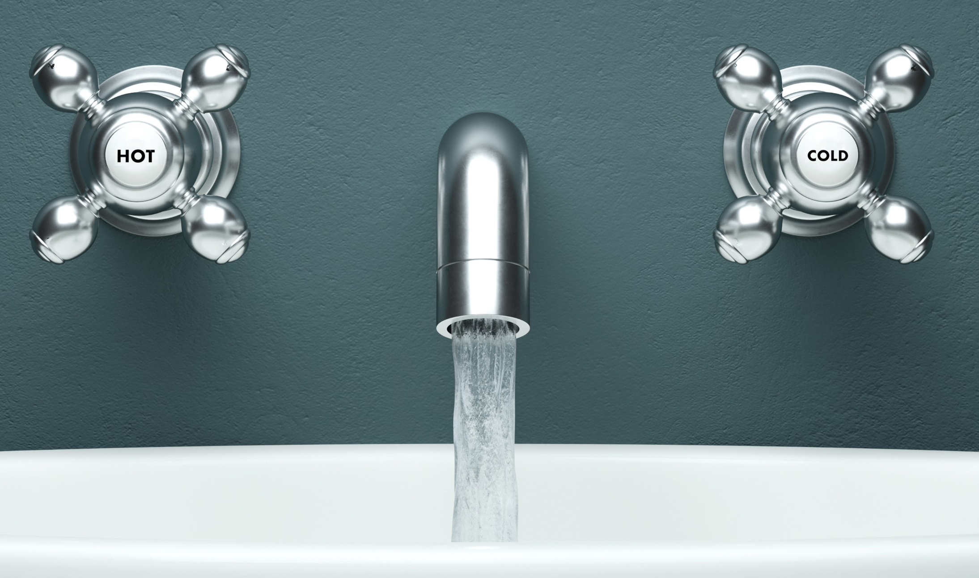
Hot and Cold
H
C
tsag.net
Notes:
Sometimes taps have red for hot and blue for cold or H for hot and C for cold on them.

Slide 4
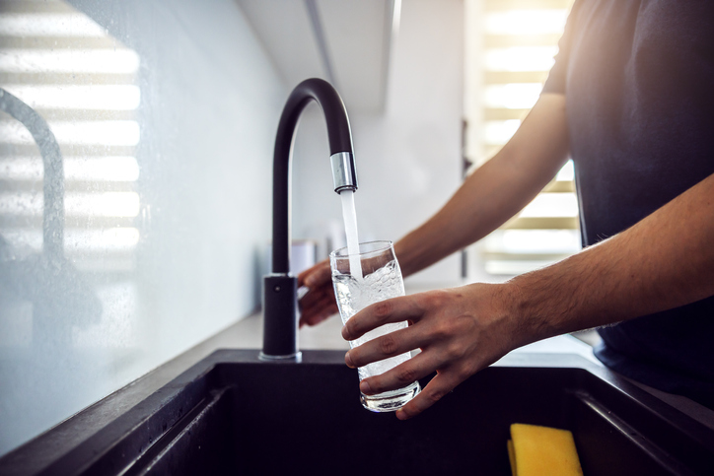
Hot or Cold?
tsag.net
Notes:
Sometimes they don’t have labels and you have to guess.
You should always have an adult run your bath or turn on the taps for you.

Slide 5
The Fire Triangle
Air
Fuel
Heat
tsag.net
Notes:
Fire is like this triangle. It needs 3 things to be a fire: oxygen, fuel, and heat.
What is heat? (what are some of the things we learned earlier that make heat?
What is oxygen (air)
What is fuel? (something that burns)
What kinds of things burn?

