Slide 1





v
Fire Safety Course: Fire Facts Grades 2-3
First Nations
Technical Services
Advisory Group Inc.
Fire Prevention is Everyone’s Responsibility
Notes:
Added

Slide 2


The Fire Triangle
Fuel
Air
Heat
tsag.net
Notes:
A fire needs 3 things to start and grow: air, fuel and heat
Ask: What are some examples of heat ( hot stove, candles, fire)
Click on the word fuel.
If you take away one of the sides of the triangle (or elements of a fire) is it still a triangle?
Can still be a fire if it doesn’t have all the elements? (if you remove one of the components the fire goes out)
What does this tell you about how to put out a fire? (remove one of the elements)
What does this tell you about preventing fires (make sure all three elements are not in the same area)
You can remove the air by covering up the fire ( like putting a lid on a pot, or rolling on the ground)
You can remove the heat (put water on the fire, or use a fire extinguisher
You can remove the fuel (take it away from the heat source)

Slide 3


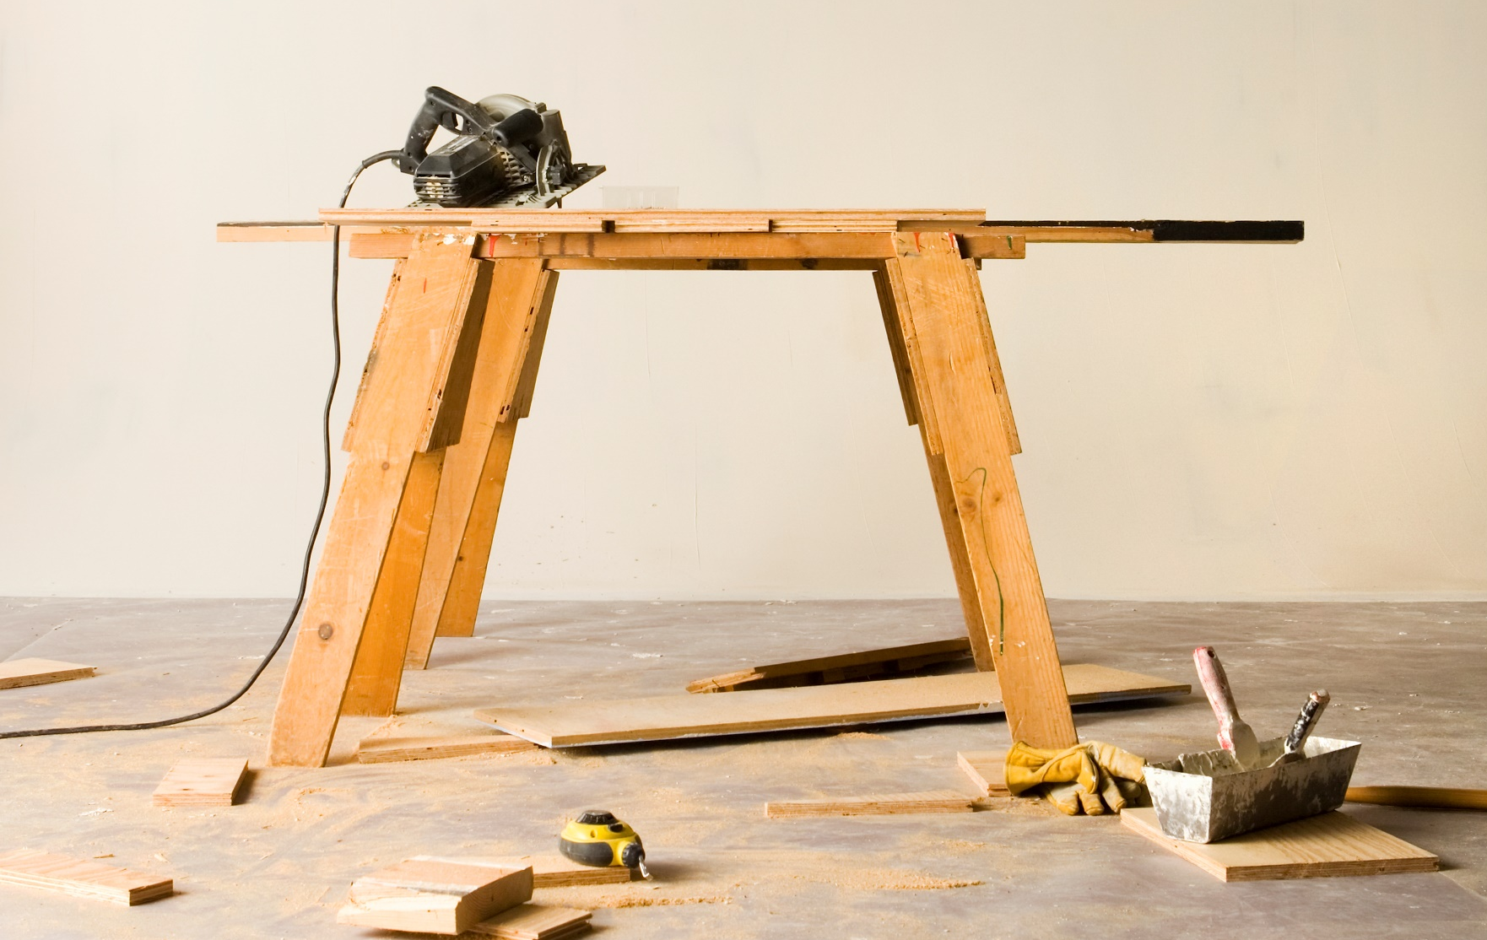
Combustible
Something that is combustible catches fire with some effort.
tsag.net
Notes:
When something burns it is called combustible.

Slide 4

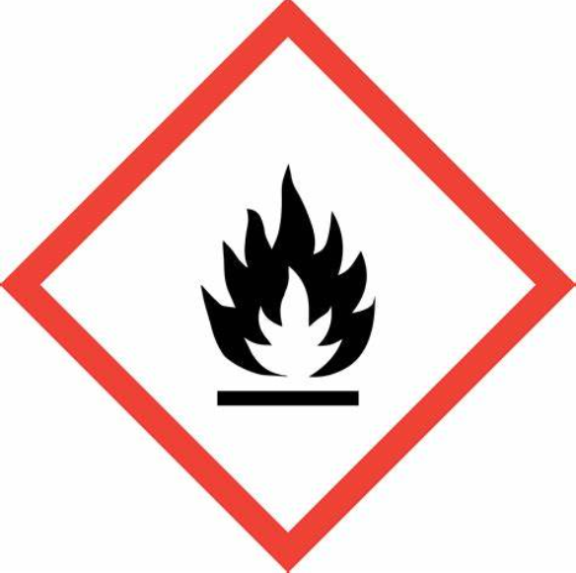
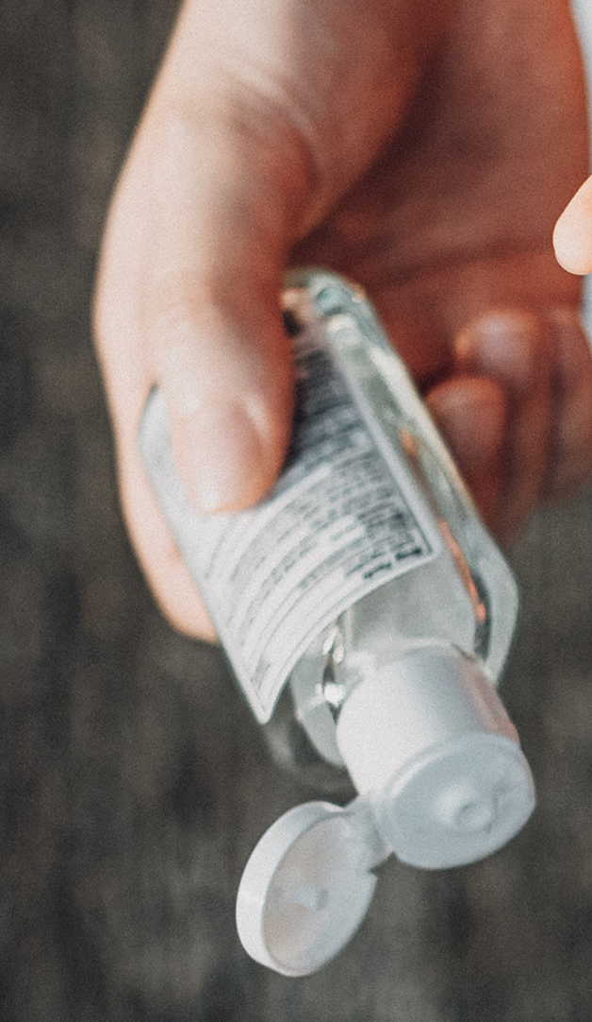

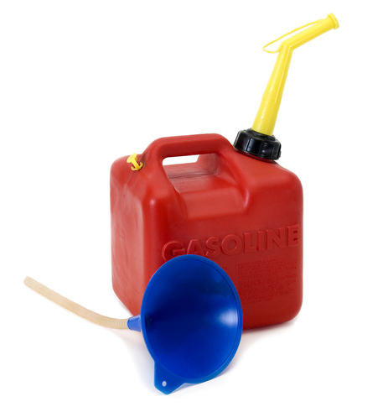

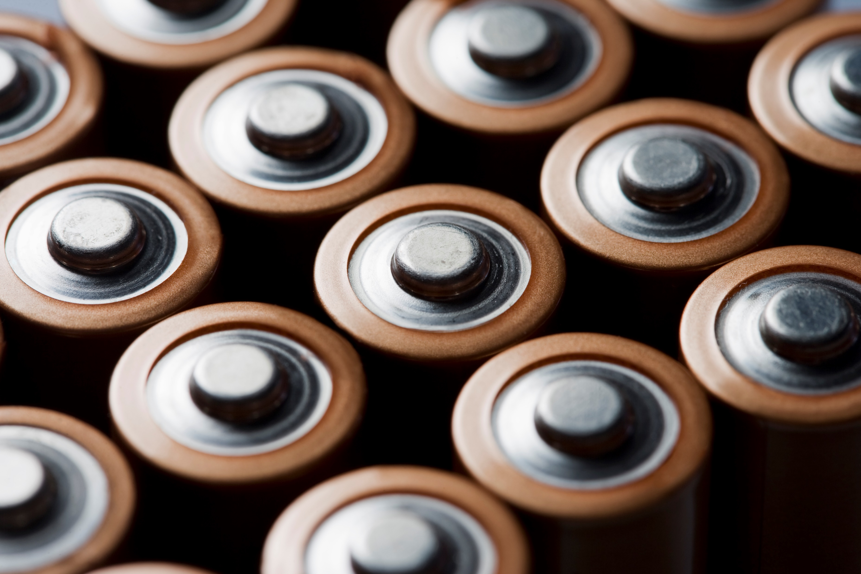
Flammable
Something that is flammable catches fire easily.
tsag.net
Notes:
Flammable materials are combustible materials that ignite easily.
Combustible materials start on fire at a certain temperature but flammable materials start on fire as soon as they are exposed to fire.
Examples of flammable liquids are rubbing alcohol, paint thinner, gasoline and even some cleaners.
You should never touch a container of flammable liquid.
Ask
Which of these things shouldn’t be in your house? Where could your parents store them?
Where are some places that your could store these items away from heat?

Slide 5
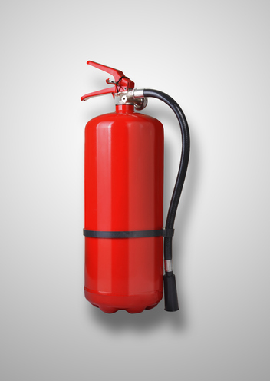

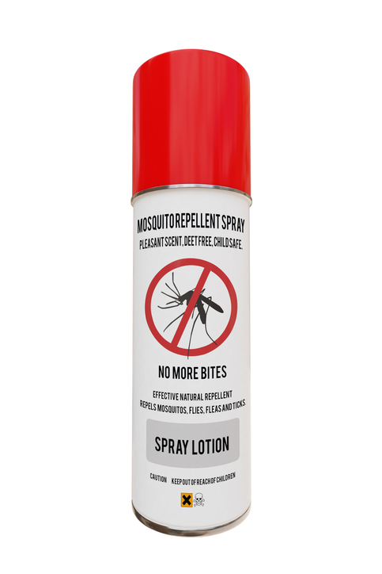
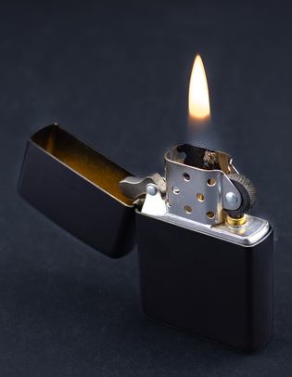
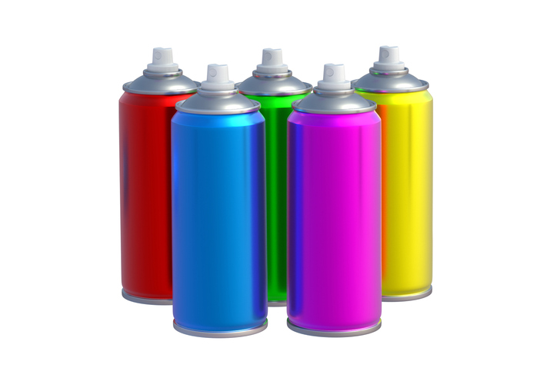
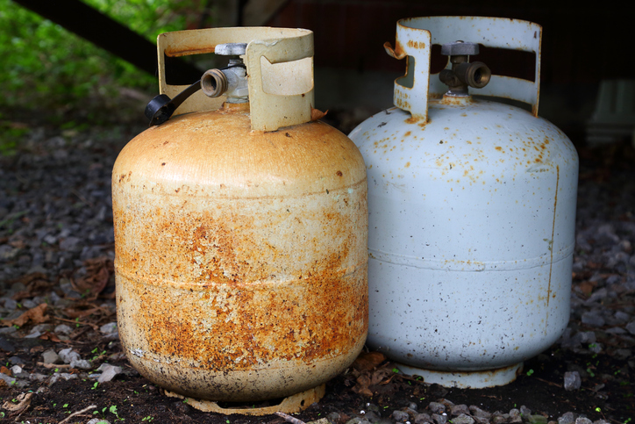
Compressed Gases
Compressed gas are a flammable hazard. They are sensitive to heat.
tsag.net
Notes:
Compressed gases should be kept away from heat.
Ask
Which of these things should not be in your house?
Which should be stored in a safe place?
Where are some places you could store these things?

Slide 6
Where There is Smoke There is Science
https://www.sparky.org/videos?playlistVideoId=6237280044001
National Fire Protection Association Kids. (n.d.-k). When There’s Smoke, There’s Science - Full [Video]. https://www.sparky.org/videos?playlistVideoId=6237280044001
tsag.net
Notes:
When something burns it creates gases and smoke that are really dangerous. These gases always rise which is why we must stay low if there is smoke in a room. If you inhale these gases, they can prevent you from thinking clearly.
This is why it is so important to stay low when getting away from fire (so you can see better, and so you don’t breathe in the smoke)

